Slide 1




BARTELS LAB · UC RIVERSIDE
Interface Engineering in 2D Semiconductors
Growing and probing atomically thin TMD layers on GaN
Nicolas Meneses
Dr. Ludwig Bartels Group · 4th Year Materials Science & Engineering
UNIVERSITY OF CALIFORNIA, RIVERSIDE
Notes:
Hi everyone, I'm Nick, a PhD student in Ludwig Bartels's lab in Materials Science & Engineering. In the next five minutes I'll give you the big picture of what our lab does: we grow atomically thin semiconductors called TMDs, stack them on gallium nitride, and use photoelectron spectroscopy to understand how the interface controls their electronic behavior.

Slide 2
Background: what are TMDs?
2 / 6
Moore's law is reaching its physical limit
The number of transistors on a circuit will double every two years with minimal rise in cost, now only a few nm across. At that size silicon leaks current and wastes power.
Transition metal dichalcogenide: MX₂
M = transition metal (Mo, W)
X = chalcogen (S, Se, Te) e.g. MoS₂, WS₂, NbS₂
Properties set by the environment
Monolayer TMDs have unique electronic and optical properties that are highly sensitive to thickness, stacking, substrate and interface chemistry.
covalent X–M–X layer, ≈ 0.65 nm thick
Why heterostructures?
Interfaces control band alignment and charge transfer without changing composition. Relevant for transistors, photodetectors, flexible electronics and sensors.
van der Waals gap: no bonds between layers
Strong covalent bonds across the layers, weak van der Waals forces between layers, so the material can be grown one layer at a time and be stacked.
The substrate
MoS₂/WS₂ and WS₂/MoS₂ should be equivalent (AB = BA). A real substrate like GaN can break that symmetry.
Notes:
First, some background. TMDs have the formula MX2: a layer of transition metal atoms, like molybdenum or tungsten, covalently bonded between two layers of chalcogen atoms like sulfur. Within a layer the bonds are strong; between layers there are only weak van der Waals forces, so we can make these materials a single layer, about 0.65 nanometers, thick. Why does that matter? Moore's law: the number of transistors on a chip doubles roughly every two years because we keep shrinking each transistor. Today the smallest features are only a few nanometers across, and at that size silicon runs into trouble: current leaks, the gate can't fully switch the channel off, and chips waste energy as heat. Atomically thin semiconductors like TMDs let the gate keep control. Monolayer TMDs have unique electronic and optical properties, but those properties are very sensitive to thickness, stacking, the substrate and the interface chemistry. That's exactly what makes heterostructures interesting: by stacking different TMDs we create interfaces that control band alignment and charge transfer, so we can tune properties without changing the materials themselves. In a free-standing stack, MoS2 on WS2 and WS2 on MoS2 should be equivalent. But real devices need a substrate, and the substrate can break that symmetry. That's the question we ask on gallium nitride.

Slide 3
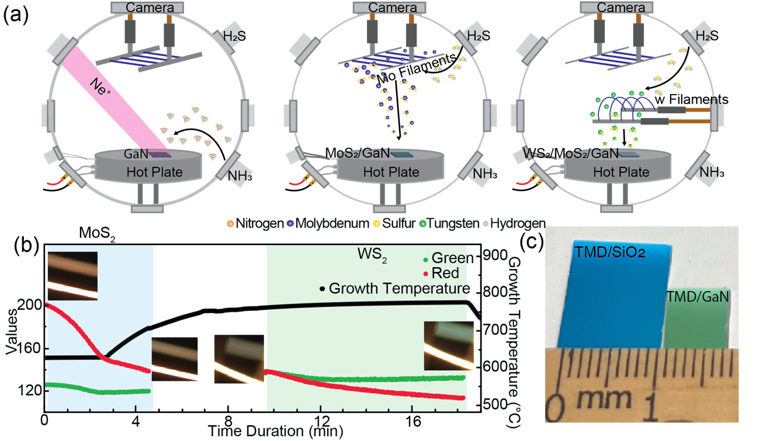
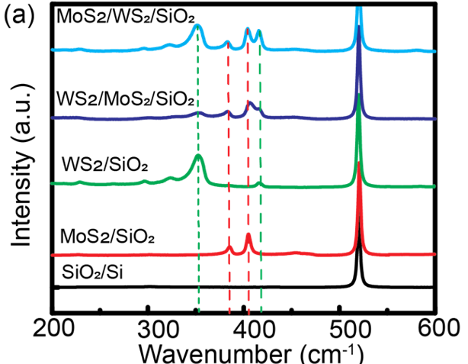
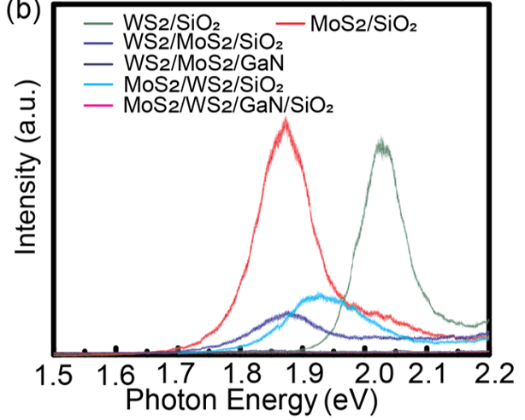
Growing the stacks: same materials, opposite order
3 / 6
Growth Hot-filament CVD + Real-time reflection monitoring
Raman
Both MoS₂ and WS₂ present in each stack
No intermixing of layers
Photoluminescence (PL)
Bandgap of TMDs
Emission quenched on GaN, a sign of charge transfer to the substrate
Ne⁺ cleaning of GaN, then heated Mo and W filaments with H₂S deposit MoS₂ and WS₂ in either order, tracked in real time.
WS₂
MoS₂
MoS₂
vs
WS₂
GaN
GaN
Yuying Ning (Oral Exam 2024)
Notes:
We grow these layers ourselves in a hot-filament reactor. We clean the GaN surface with a neon ion beam, then heated molybdenum and tungsten filaments with hydrogen sulfide gas grow MoS2 and WS2 one layer at a time, and a camera tracks the reflectance so we can see each layer form. Because we control the order, we can make the same two materials stacked both ways. Raman spectroscopy, top right, confirms both materials are in each stack. Photoluminescence, bottom right, shows the light emission is strongly quenched on GaN, which tells us charge is moving between the layers and into the substrate.

Slide 4
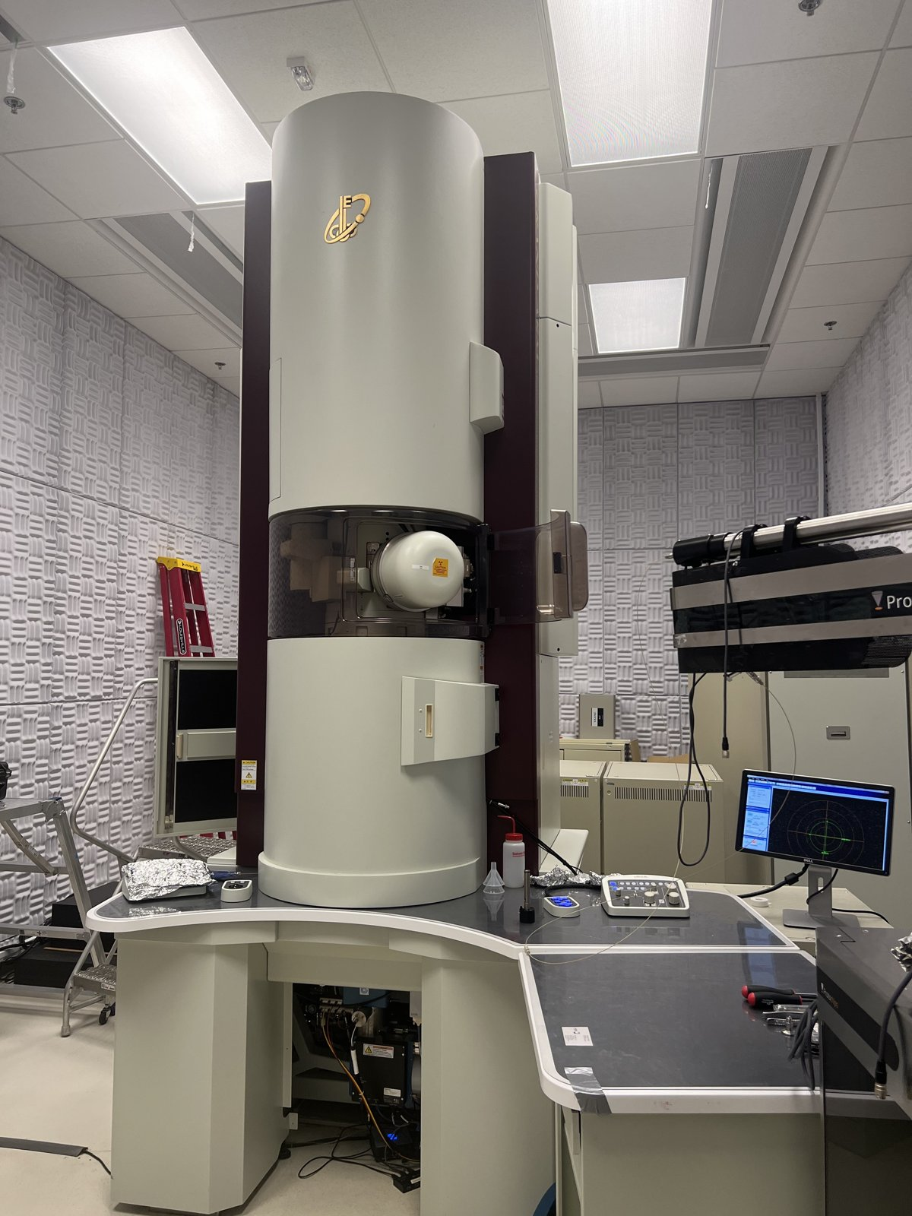
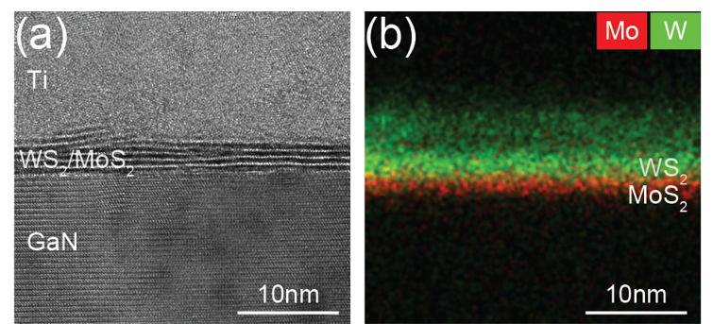
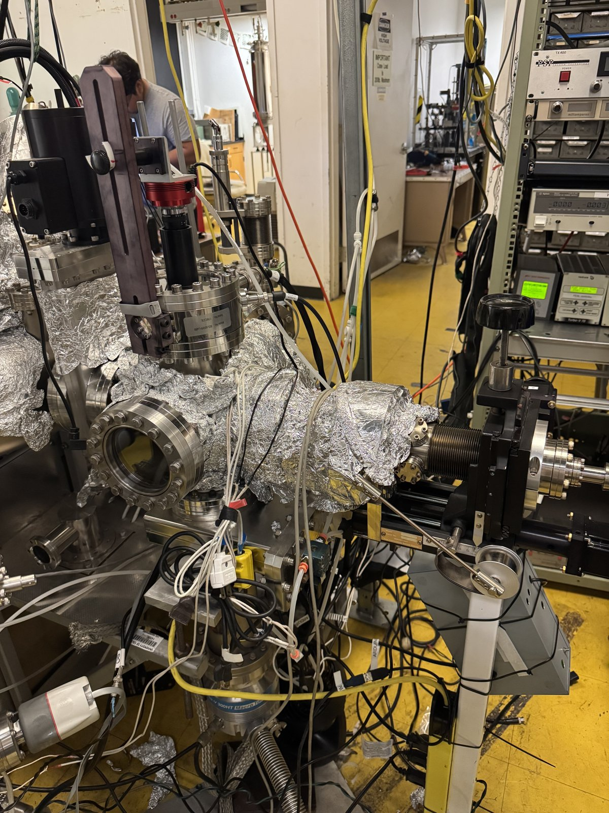
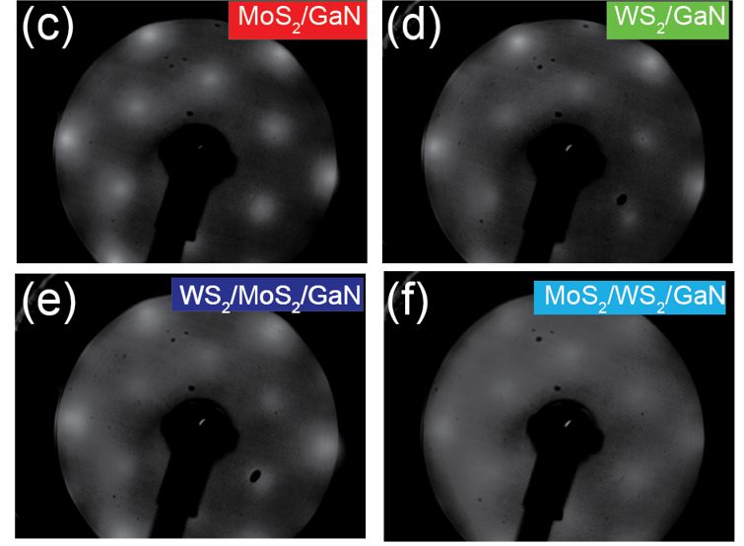
Structure: sharp, well-ordered interfaces
4 / 6
Transmission Electron Microscopy (TEM / EDS)
UC Irvine · cross-section
• Atomically sharp layers on GaN
• No Mo/W intermixing
Low Energy Electron Diffraction (LEED)
Surface diffraction · patterns (c–f)
• Sharp spots: epitaxial growth on GaN
• MoS₂ at GaN: 2×2 → strong coupling
• WS₂ at GaN: 1×1 → weak, vdW-like
• Mismatch: MoS₂ 0.8% vs WS₂ 1%
Notes:
Next, the structure. On top is the TEM at UC Irvine and our cross-section: the TMD layers sit right on GaN with a sharp boundary, and the elemental map shows molybdenum and tungsten stay in separate layers. On the bottom is our LEED system and the diffraction patterns. Sharp spots on every sample mean the layers grow epitaxially on GaN. When MoS2 touches GaN we see a 2-by-2 pattern, a sign of strong coupling to the substrate. When WS2 touches GaN we see a simple 1-by-1, a weaker, van der Waals-like contact. That fits the lattice match: MoS2 is only 0.8 percent mismatched to GaN versus 1 percent for WS2. So the layer touching GaN already changes the interface, and next we'll see how that shows up in the electronics.

Slide 5
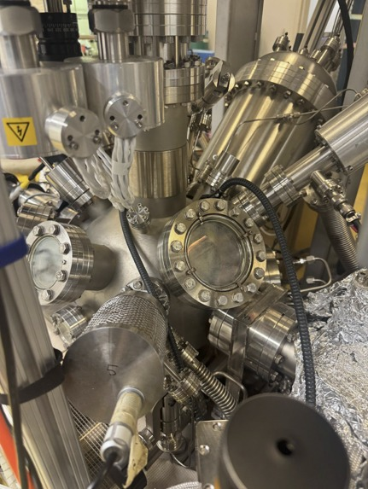
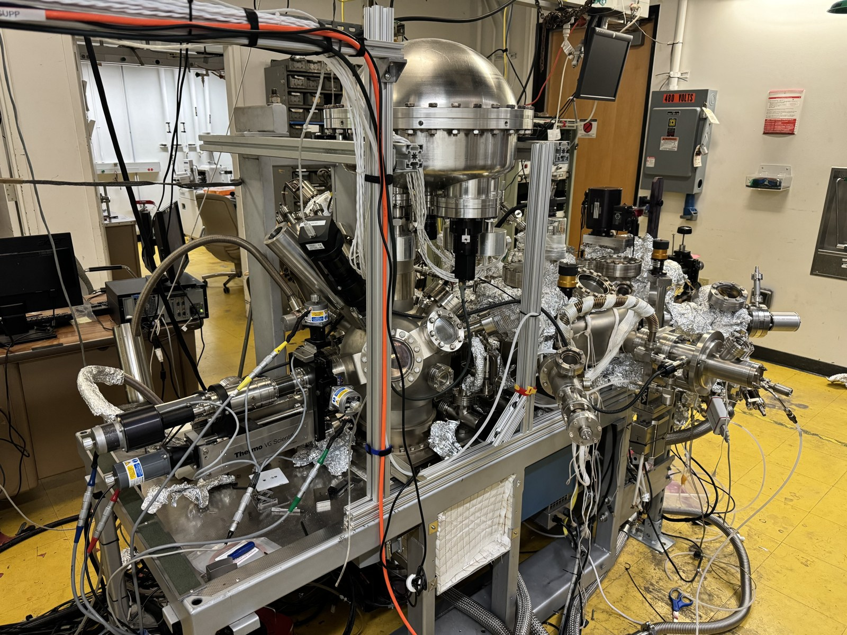
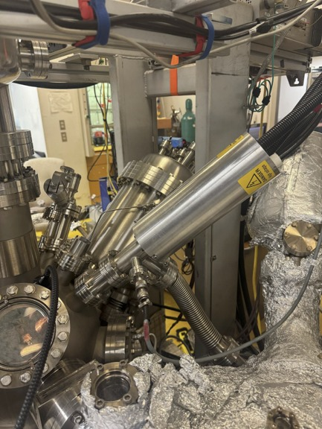
Probing the electronics: XPS & UPS
5 / 6
UV lamp for UPS
Full UHV characterization system
X-ray source for XPS
UPS: He II light, hν = 40.81 eV
Ejects valence electrons: band edge and work function.
Ultra-high vacuum
Electrons reach the analyzer unscattered, and the surface stays clean.
XPS: Al Kα X-rays, hν = 1486 eV
Ejects core electrons: elements, chemical state and core-level shifts.
Notes:
To measure the electronics we use photoemission spectroscopy in this ultra-high vacuum chamber. We shine light on the sample and measure the energy of the electrons that come out. On the left is the helium lamp for UPS: its He II line at about 41 eV knocks out the outermost valence electrons, which tells us where the band edge and work function sit. On the right is the aluminum K-alpha X-ray source for XPS, at 1486 eV, which knocks out tightly bound core electrons and tells us which elements are there and their chemical environment. The middle photo shows the whole system: the analysis chamber, the electron energy analyzer on top, and the sample transfer and preparation lines. Everything happens under ultra-high vacuum so electrons reach the analyzer without scattering and the surface stays clean.

Slide 6
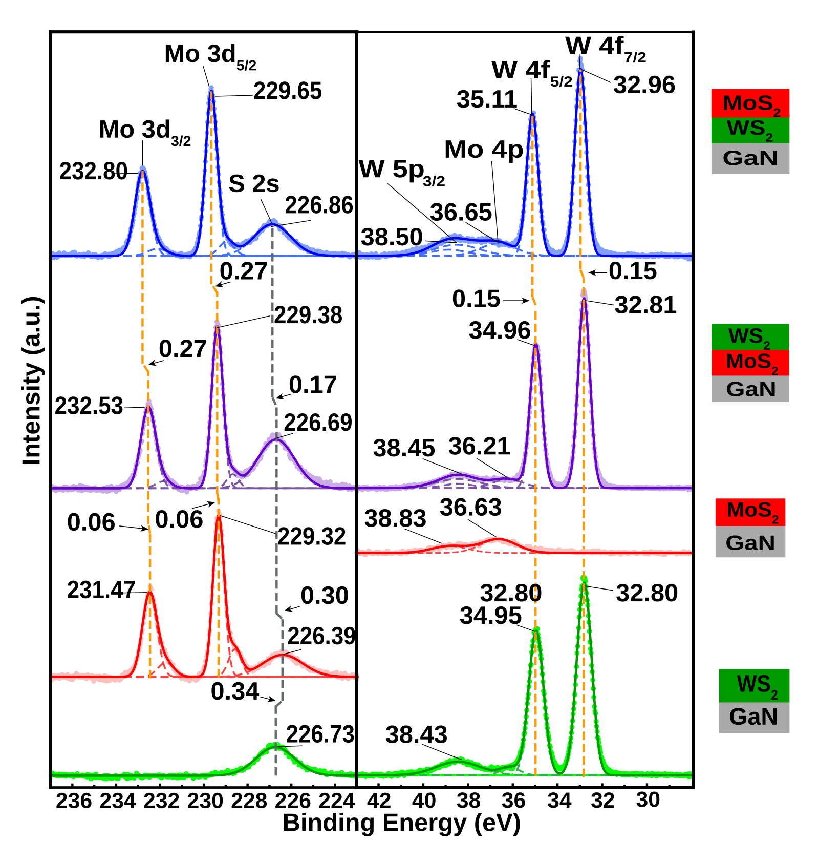
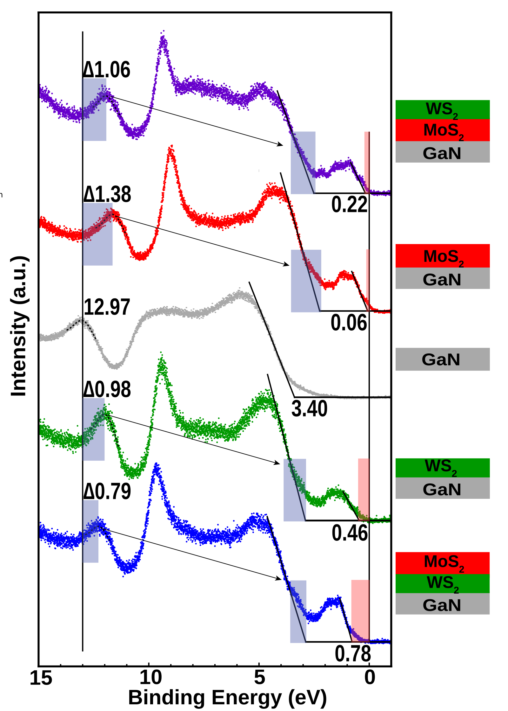
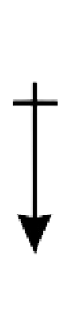
Electronics: stacking order matters
6 / 6
XPS (Sandia NL) Mo 3d and W 4f core levels
UPS valence band edge
Interface picture
WS₂
MoS₂
−
−
−
−
−
−
GaN
Si
MoS₂ on GaN: electrons pile up at the interface → interface dipole
MoS₂
WS₂
GaN
Si
WS₂ on GaN: weaker coupling, no charge accumulation
XPS: Mo 3d and W 4f core levels shift up to ~0.27 eV when the stack flips.
UPS: MoS₂ at GaN puts the VBM 0.56 eV closer to E_{F} in heterostructures (more p-type).
Takeaway: the layer touching GaN sets charge transfer and band alignment.
Notes:
Finally, the electronics, which is where my work comes in. On the left is X-ray photoelectron spectroscopy, which measures how tightly core electrons are bound. In the XPS, when we flip the stack, the molybdenum and tungsten peaks shift by up to about 0.3 eV, so the same layer is in a different electronic environment depending on whether it touches GaN. In the middle is ultraviolet photoemission, which finds the top of the valence band. With MoS2 touching GaN, the band edge sits at 0.22 eV; flip the stack so WS2 touches GaN and it moves to 0.78 eV. That 0.56 eV shift means the stack with MoS2 at the interface is more p-type, a big change just from swapping two layers. The drawing on the right shows what we think is happening. When MoS2 sits directly on GaN, charge transfers across the interface and electrons accumulate right at the MoS2/GaN boundary. That sheet of charge creates an interface dipole, a step in the electrostatic potential, which shifts the core levels and pulls the band edge toward the Fermi level. When WS2 is grown first, that strong coupling is screened, and the Mo components shift back to higher binding energy. The takeaway: the layer touching GaN controls charge transfer and band alignment, so stacking order is something we can design with. Thanks to Dr. Bartels, NSF and MSIPP, and our collaborators at Sandia and UC Irvine. Happy to take questions.

Slide 7
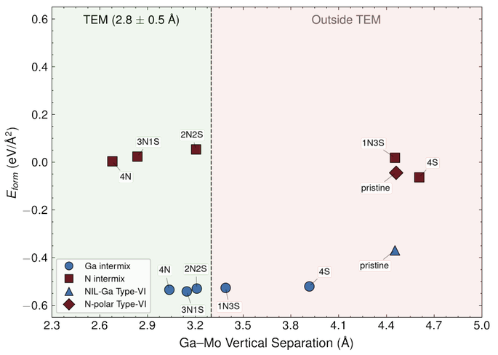
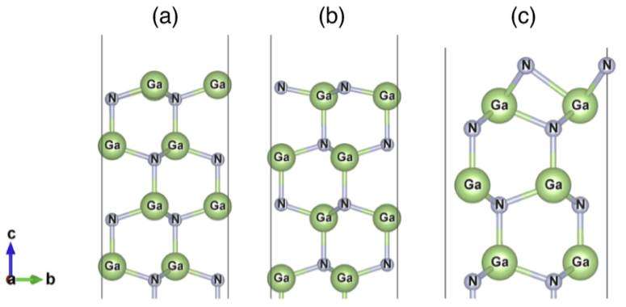
Conclusion: what is really at the MoS₂/GaN interface?
7 / 7
TEM shows a Ga–Mo gap of only 2.8 ± 0.5 Å, too short for a clean van der Waals interface (~4.5 Å in DFT).
DFT screened Ga-polar, N-polar and N-interlayer GaN surfaces for the lowest-energy MoS₂/GaN interface consistent with TEM.
Most likely interface: 3N1S on N-terminated GaN
In the first MoS₂ layer, 3 of the 4 bottom S atoms are replaced by N, bonding Mo to Ga through N; Mo and a full S layer sit on top. Lowest formation energy, matches the TEM gap, and gives rise to new peaks in our XPS.
GaN starting surfaces: (a) Ga-polar, (b) N-polar, (c) N interlayer (NH₃ growth). DFT: Hector Gomez (UCR)
Next: synchrotron beamtime to confirm it directly
Probes: ARPES · XAS/NEXAFS (S L, N K edges) · surface XRD + truncation rods · HAXPES + X-ray standing waves
Notes:
To wrap up, here's where this is heading. TEM shows the gap between the GaN surface and the molybdenum layer is only about 2.8 angstroms, and that's too short for a clean van der Waals interface, which in the calculations sits around 4.5 angstroms. So something chemical is happening at the interface. Our collaborator Hector Gomez here at UCR ran DFT calculations on three kinds of GaN starting surfaces: Ga-polar, N-polar, and a nitrogen interlayer that represents our ammonia treatment before growth. He then looked for the lowest-energy MoS2/GaN interface that also matches the TEM spacing. The winner, circled on the plot, is what we call 3N1S on N-terminated GaN: in the very first MoS2 layer, three of the four sulfur atoms on the bottom side are replaced by nitrogen, so molybdenum bonds to gallium through nitrogen, with the molybdenum and a full sulfur layer on top. It has the lowest formation energy of all the models and it matches the TEM spacing. That explains the new peaks we see in XPS. This is our motivation for synchrotron beamtime: we want to confirm that interface structure directly, using techniques like ARPES, X-ray absorption at the sulfur and nitrogen edges, surface X-ray diffraction, and hard X-ray photoemission with standing waves. Thank you, and I'm happy to take questions.

