Slide 1





MONITORING OF THE ELECTRODE-ELECTROLYTE INTERFACE AND REDOX ACTIVITY IN NA-ION BATTERIES WITH CONCENTRATED AQUEOUS ELECTROLYTES
THESIS SUPERVISORS :
Dr. Magali Gauthier (CEA – NIMBE, LEEL)
Dr. Antonella Iadecola (CNRS – PHENIX, SOLEIL SYNCHROTRON)
Dr. Jean-Blaise Brubach (SOLEIL SYNCHROTRON)
PRESENTED BY HARINI MOHANRAAJ – 24/09/2026
School on Synchrotron Radiation: Fundamentals, Methods and Applications

Slide 2
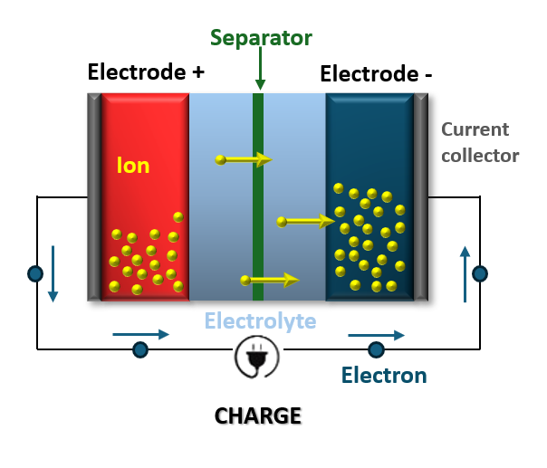

1. Na-ion Aqueous Batteries with « Water-In-Salt Electrolytes »
Li-ion batteries in all electrical devices
Na-ion Aqueous batteries
Lithium-based salt
Sodium-based salt (NaClO₄)
ELECTROLYTE
Sustainable and low-cost
Flammable organic solvent
Water H₂O
However, the electrochemical stability window (ESW) of water is narrow….

Slide 3
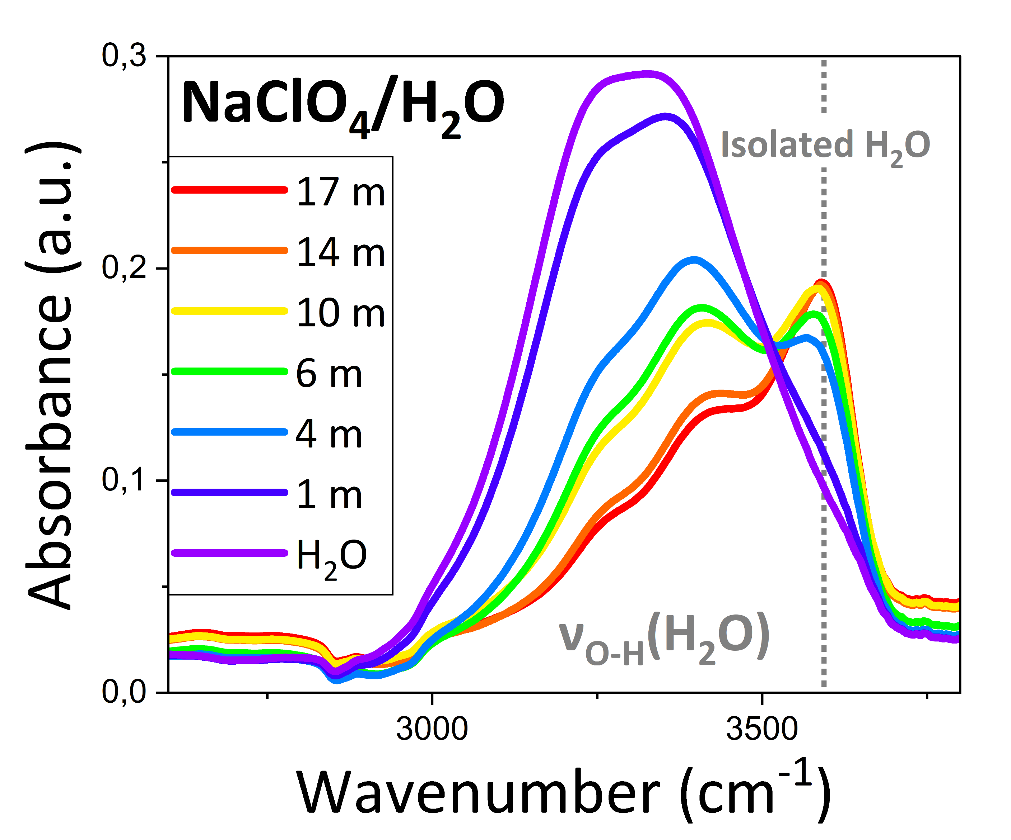
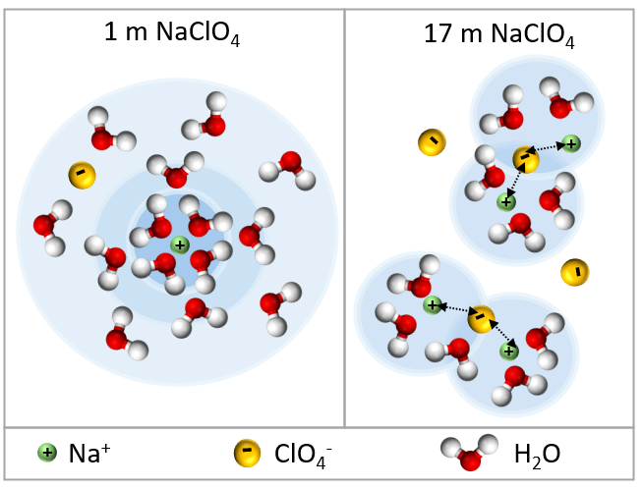
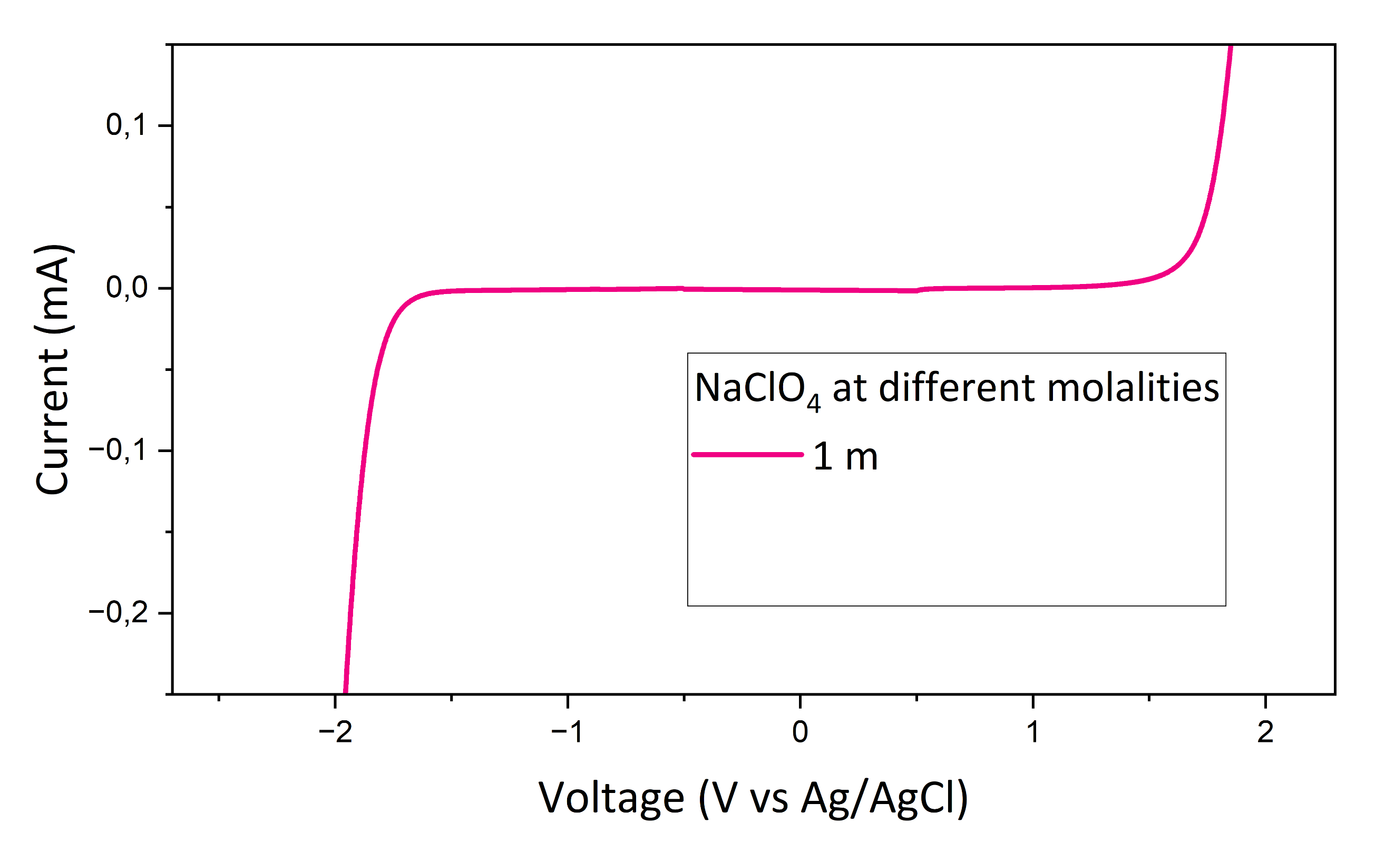
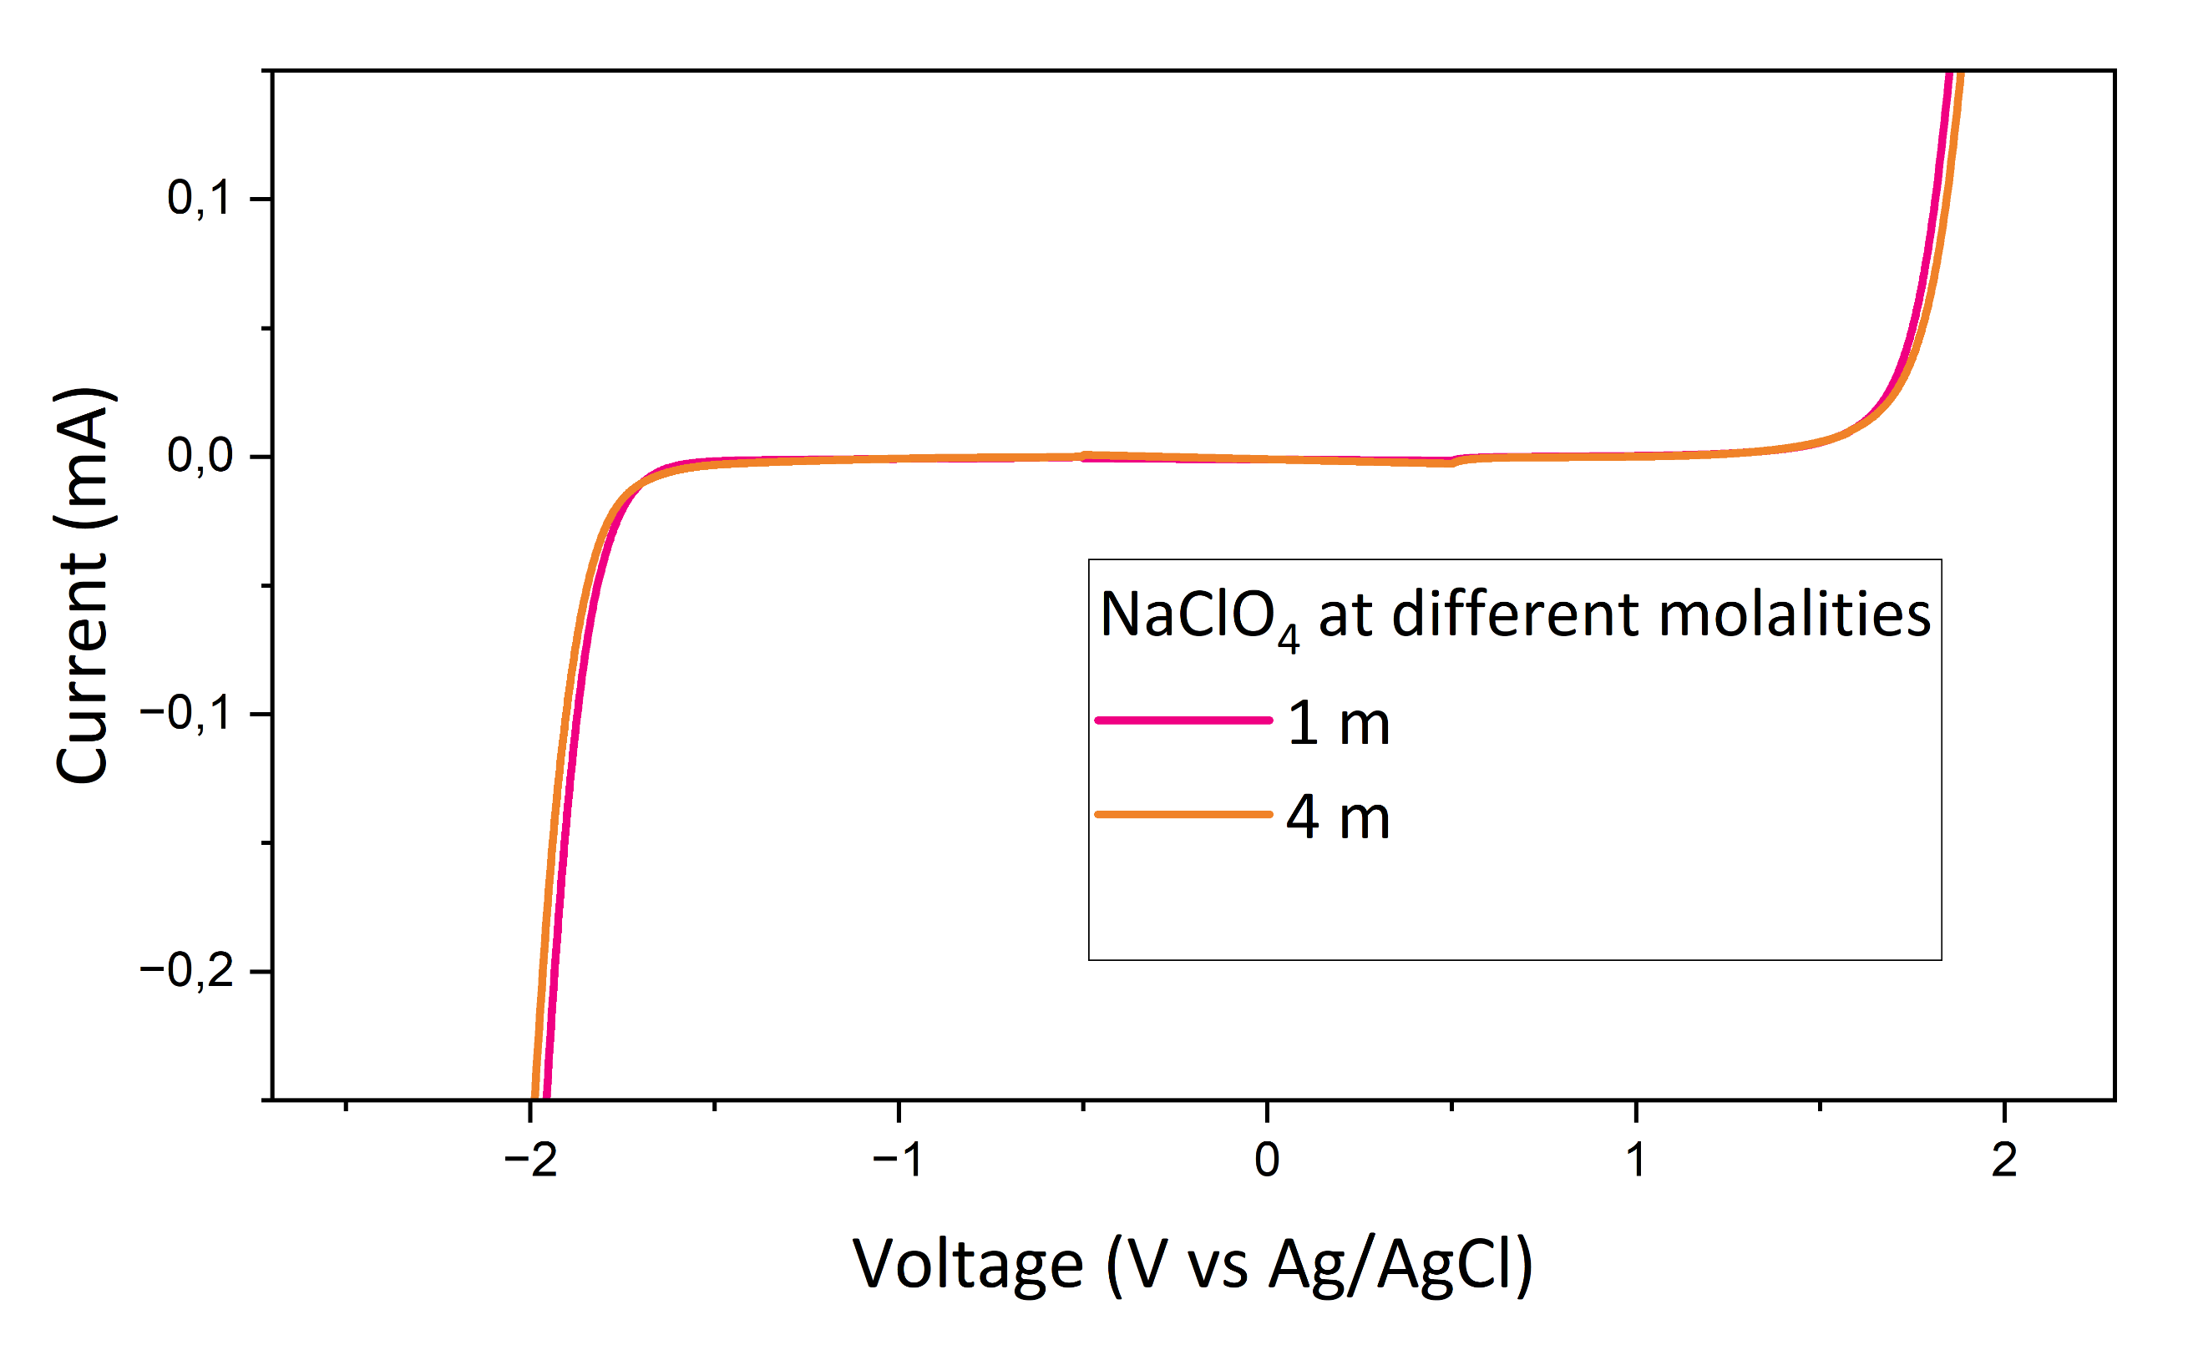
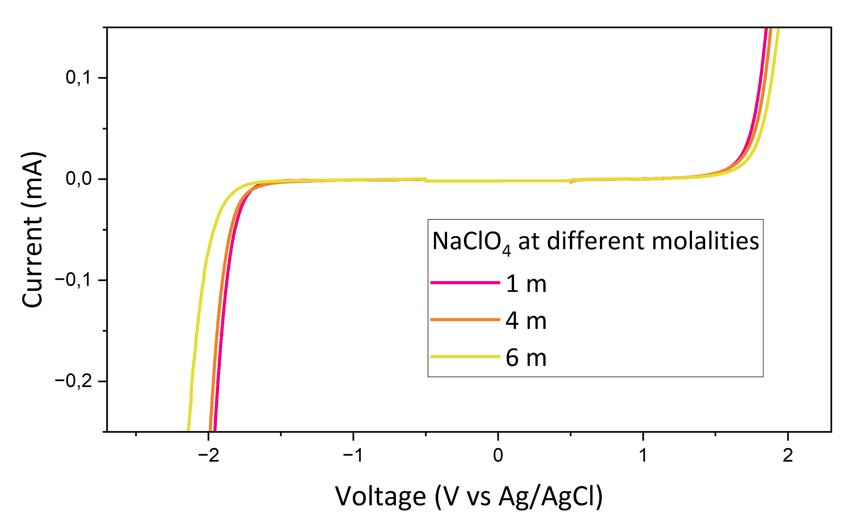
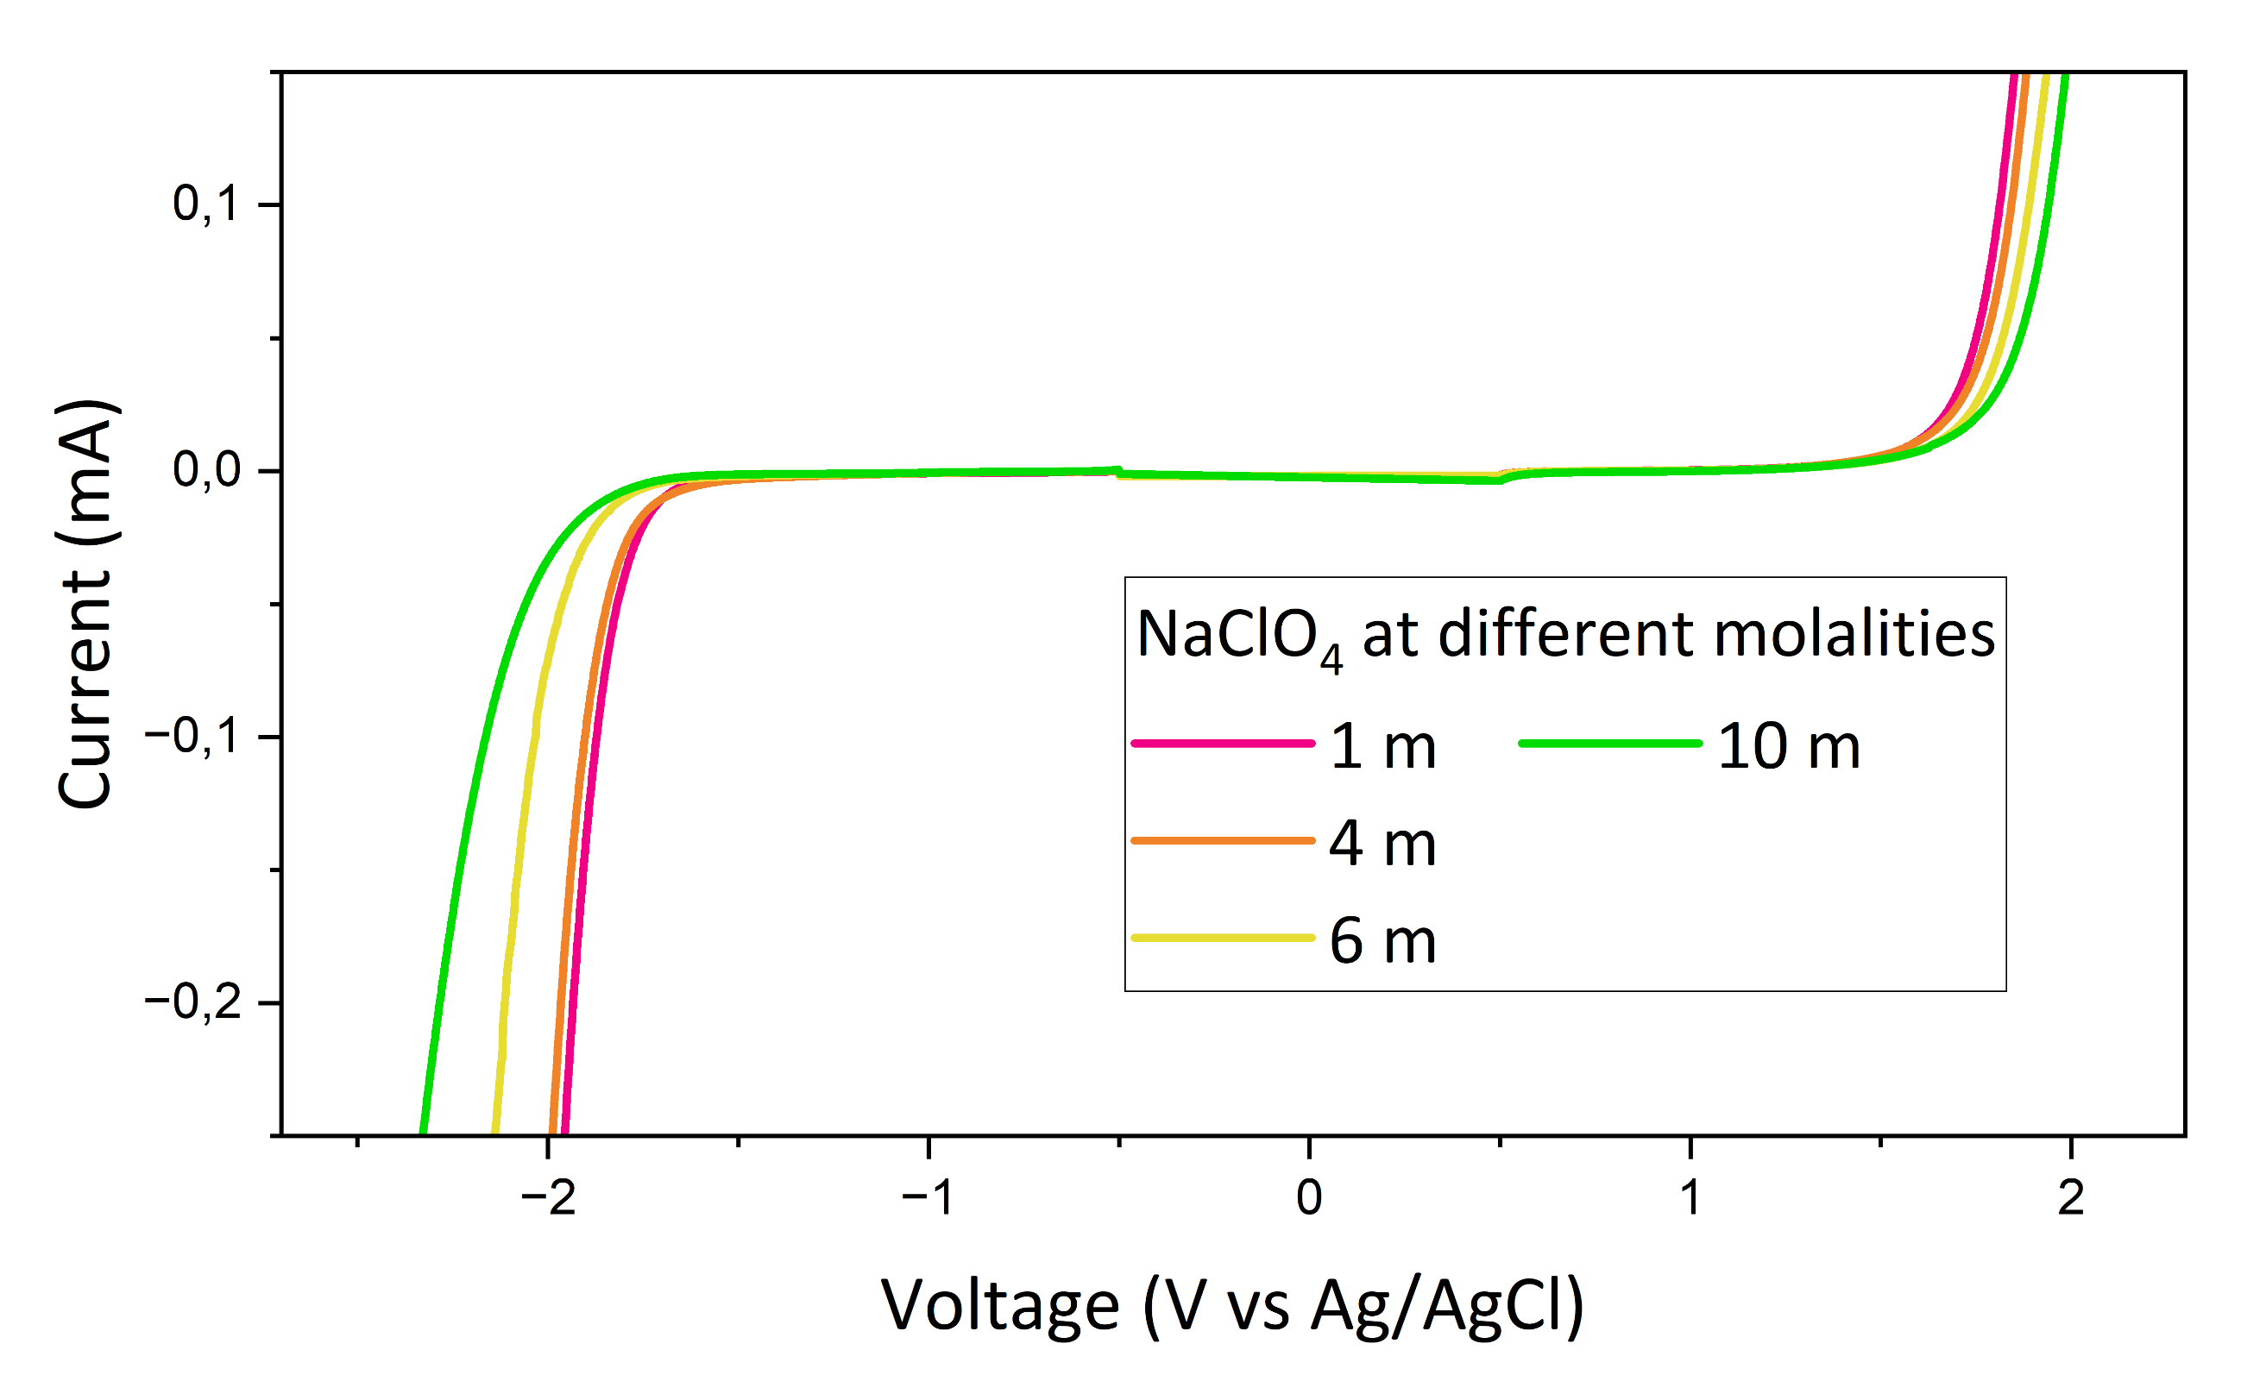
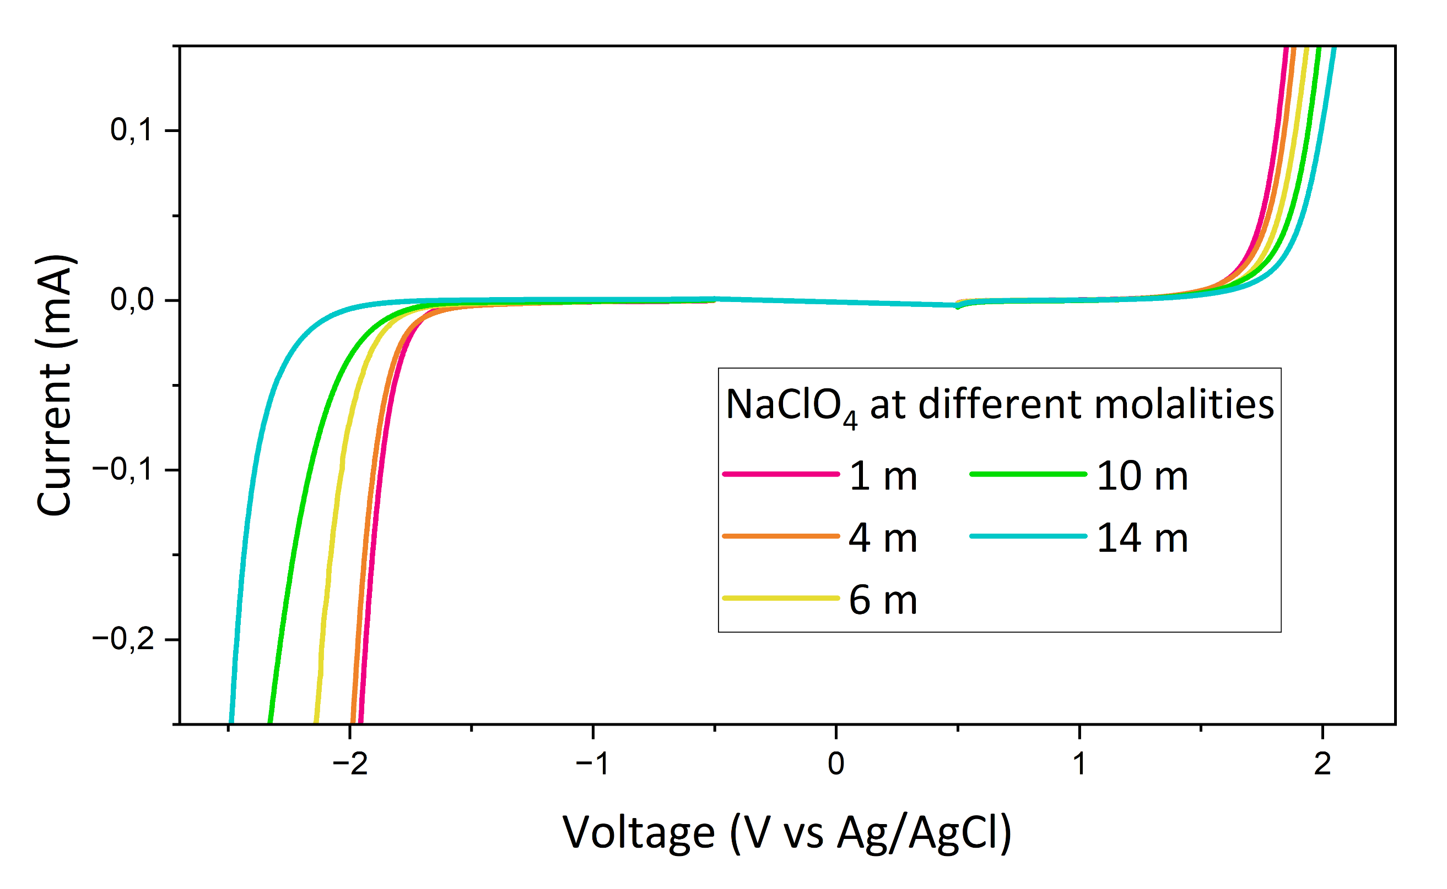
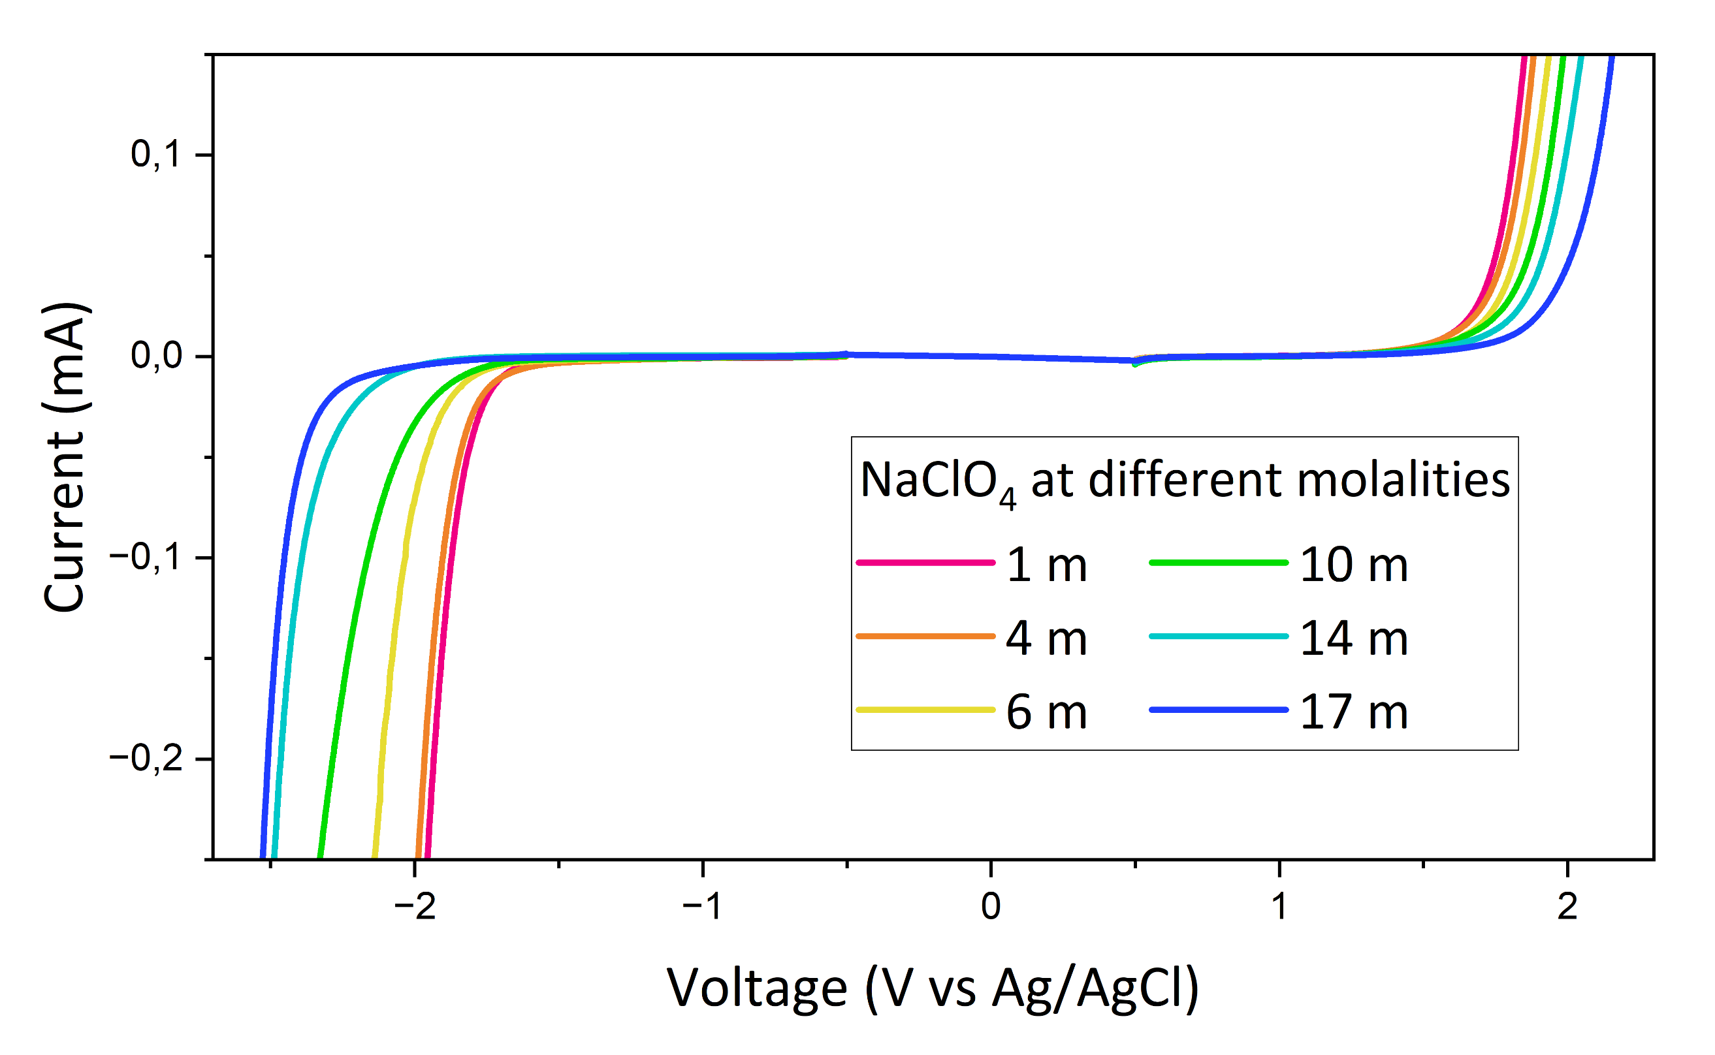
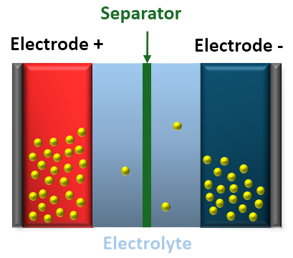
1. Na-ion Aqueous Batteries with « Water-In-Salt Electrolytes »
Highly concentrated electrolytes for widening the ESW (2015) [1]
m, molality : moles per kg of water
17 m = 68%w. of NaClO₄ + 32%w. of water
High concentration
Modification of the electrolyte structure with increasing salt concentration, associated with a reduction in free water molecules
SEI = Solid Electrolyte Interphase
Determines long-term stability and performance
OBJECTIVE : To better understand the formation and evolution of the SEI
in aqueous Na-ion batteries using operando infrared and X-ray spectroscopy
[1] L. Suo et al., Science, 2015, 350, 938-943.

Slide 4
2. Objectives and methods
OBJECTIVE : To better understand the formation and evolution of the SEI
in aqueous Na-ion batteries using operando infrared and X-ray spectroscopy
REDOX ACTIVITY AND STABILITY OF AQUEOUS CELLS
Aqueous vs. organic comparison
Study of various negative electrodes, various cycling parameters
FOURIER-TRANSFORM INFRARED SPECTROSCOPY (FT-IR)
AND X-RAY ABSORPTION (XAS)
FT-IR : evolution of water (solvation), interfacial layers
XAS : local structure and oxidation state at V et Ti K edge
Synchrotron for IR: water absorption and study of low-frequency vibrations (Na+, evolution due to changes in oxidation states)

Slide 5
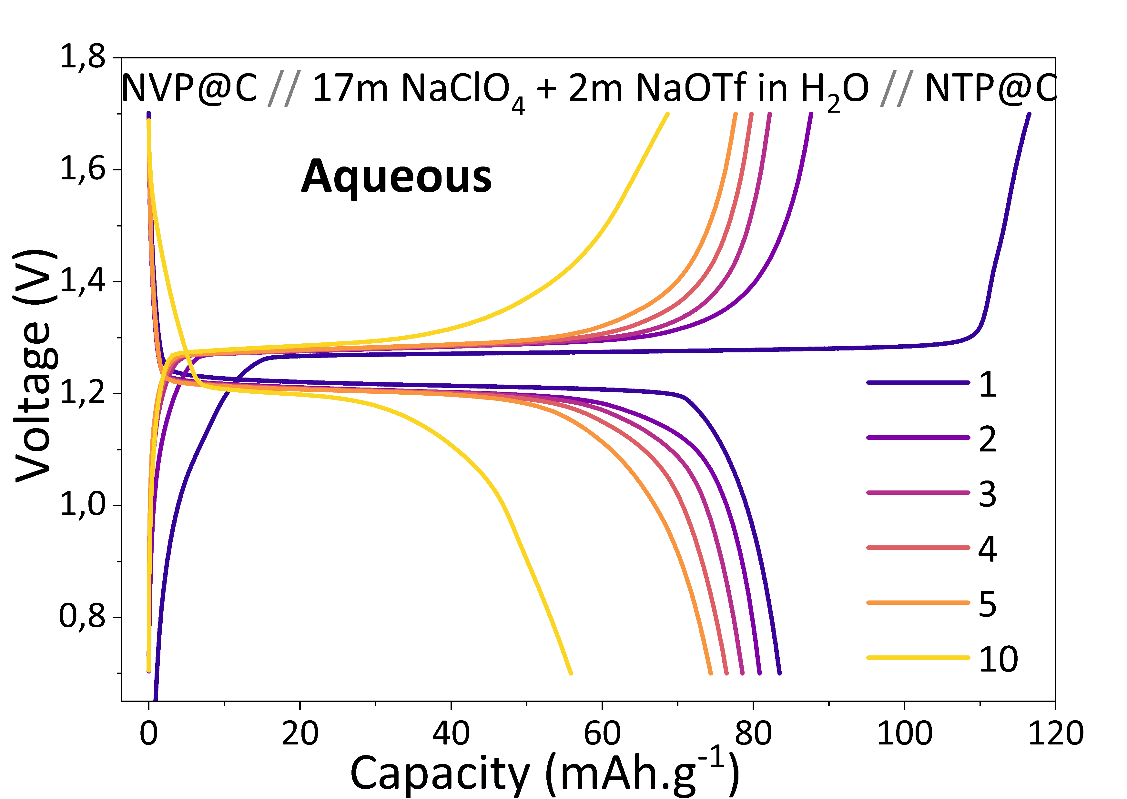
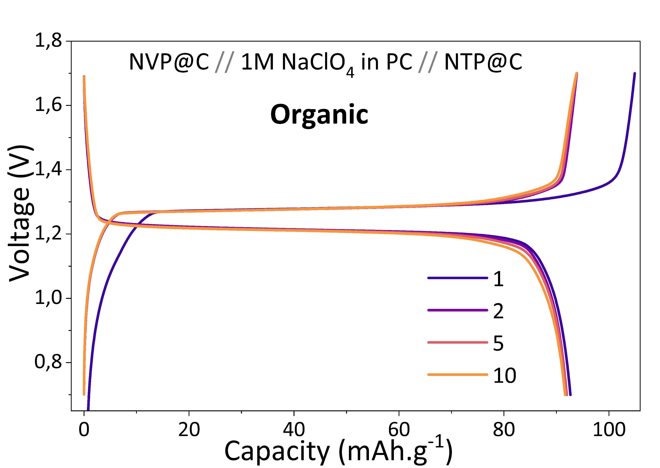
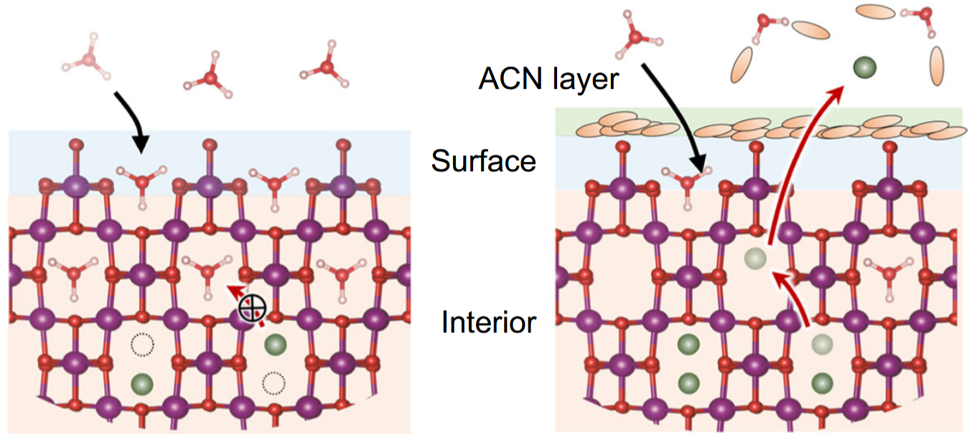
3. Redox activity and electrochemical performances
AQUEOUS
ORGANIC
 | Storage mechanism
NVP Na₃V₂(PO₄)₃ | Insertion/extraction of Na⁺ (V³⁺/V²⁺)
NTP NaTi₂(PO₄)₃ | Insertion/extraction of Na⁺ (Ti⁴⁺/Ti³⁺)
Hypotheses regarding the mechanisms responsible for the drop in capacity
Intercalation of H₃O⁺
No SEI formed → surface reactions
[2]
[2] Huang et al., Nat. Commun. (2024)

Slide 6
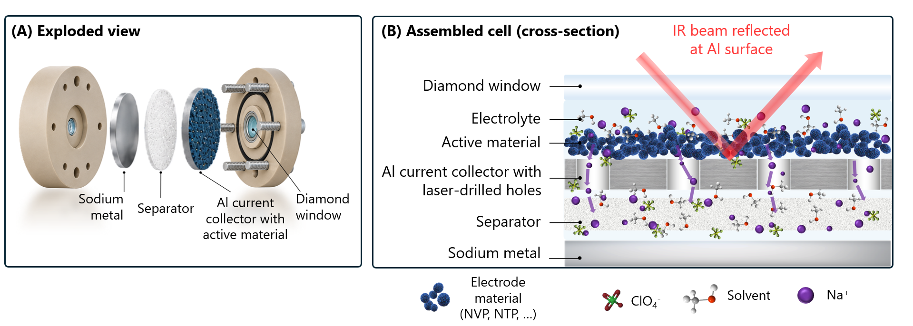
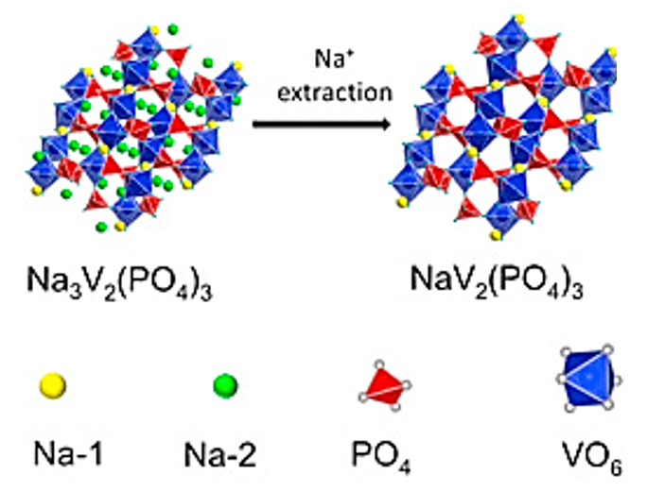
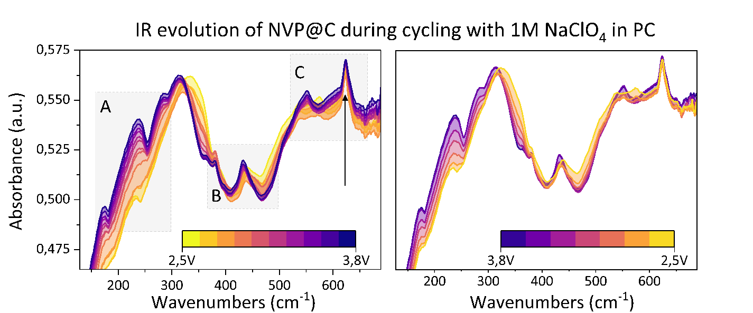
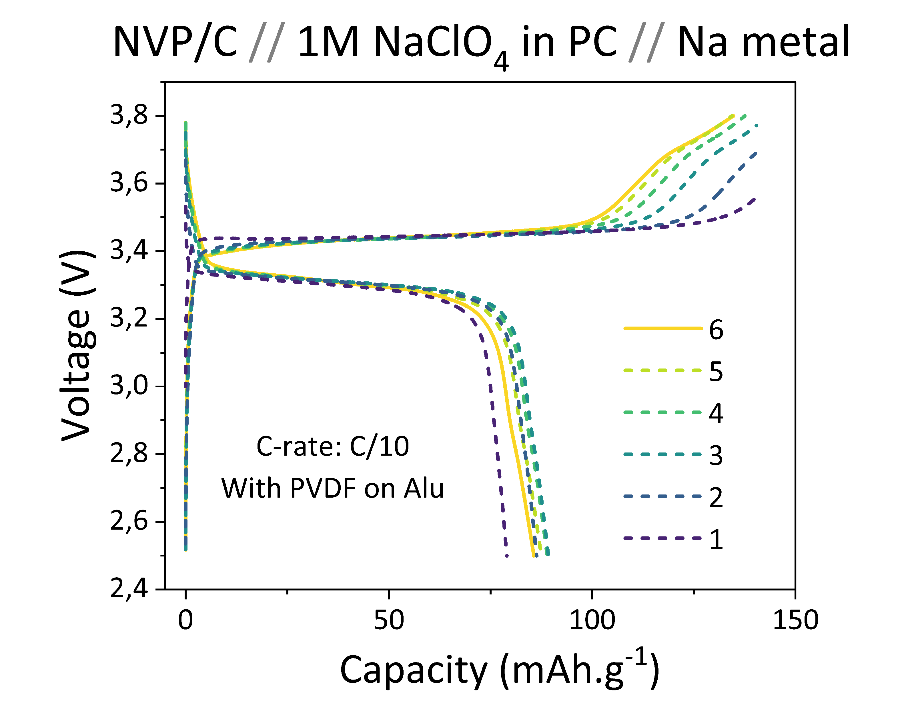
4. FTIR operando measurements
CHARGE
DISCHARGE
Region A: Rotation of PO₄ groups (T’(PO₄) and R'(PO₄))
Region B: V–O bonds
Region C: ν₄ deformation of PO₄ groups

Slide 7
Thank you for your attention!

