Slide 1



UV-VUV excited thermally-stimulated and delayed luminescence in Ce-doped scintillating crystals
Pietro Moiraghi, Francesca Cova, Vittoria Vigorito, Alessandra Ronchi, Alberto Paleari, Mauro Fasoli, Roberto Lorenzi
University of Milano-Bicocca
Department of Materials Science
“Gilberto Vlaic” XVIII School on Synchrotron Radiation: Fundamentals, Methods and Applications – Muggia, 24th September 2026

Slide 2
Charge trapping and release
Recombination (prompt luminescence)
10^{–10} – 10^{–7} s
Excitation
Free charge carriers
Charge trapping
Heat/time
Detrapping and recombination
10^{–2} – 10³ s
Conduction band
Detrapping
Electron trap
Excitation
Prompt luminescence
Luminescence centre
Thermally stimulated or delayed luminescence
Valence band

Slide 3




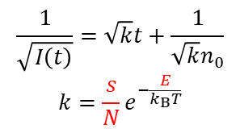






Kinetics and trap parameters
1st order kinetics
2nd order kinetics
Thermally stimulated luminescence (TSL)
Rate equation
$$−\frac{dn}{dt}=kn$$
$$−\frac{dn}{dt}=kn^{2}$$
Heat
Phosphorescence
$$I\left(t\right)=kn_{0}e^{−kt}$$
$$I\left(t\right)=\frac{kn_{0}^{2}}{{\left(1+kn_{0}t\right)}^{2}}$$
TSL equation with β (linear ramp)
$$I\left(T\right)=−\frac{dn}{dT}=n\frac{s}{β}e^{−\frac{E}{k_{B}T}}$$
$$I\left(T\right)=−\frac{dn}{dT}=n^{2}\frac{s}{βN}e^{−\frac{E}{k_{B}T}}$$
n
n₀
Number of trapped charges
Peak position
$$\frac{βE}{k_{B}T_{M}^{2}}=se^{−\frac{E}{k_{B}T_{M}}}$$
$$\frac{βE}{k_{B}T_{M}^{2}}=se^{−\frac{E}{k_{B}T_{M}}}\left[1+\frac{2k_{B}T_{M}}{E}\right]$$
0
I(t)
Variable heating rate (VHR) method
Arrhenius plot (from phosphorescence data)
TSL glow curve
0
$$\frac{1}{\sqrt{I\left(t\right)}}=\sqrt{k}t+\frac{1}{\sqrt{k}n_{0}}$$
$$k=\frac{s}{N}e^{−\frac{E}{k_{B}T}}$$
T
$$\ln{\frac{T_{M}^{2}}{β}}=\frac{E}{k_{B}T_{M}}+\ln{\frac{E}{sk_{B}}}$$
Heating ramp
T_{M}
Slope = β
Time
Estimation of trap parameters ($E$, $s$)
S. W. S. McKeever, Thermoluminescence of Solids (Cambridge University Press, Cambridge, 1985)

Slide 4
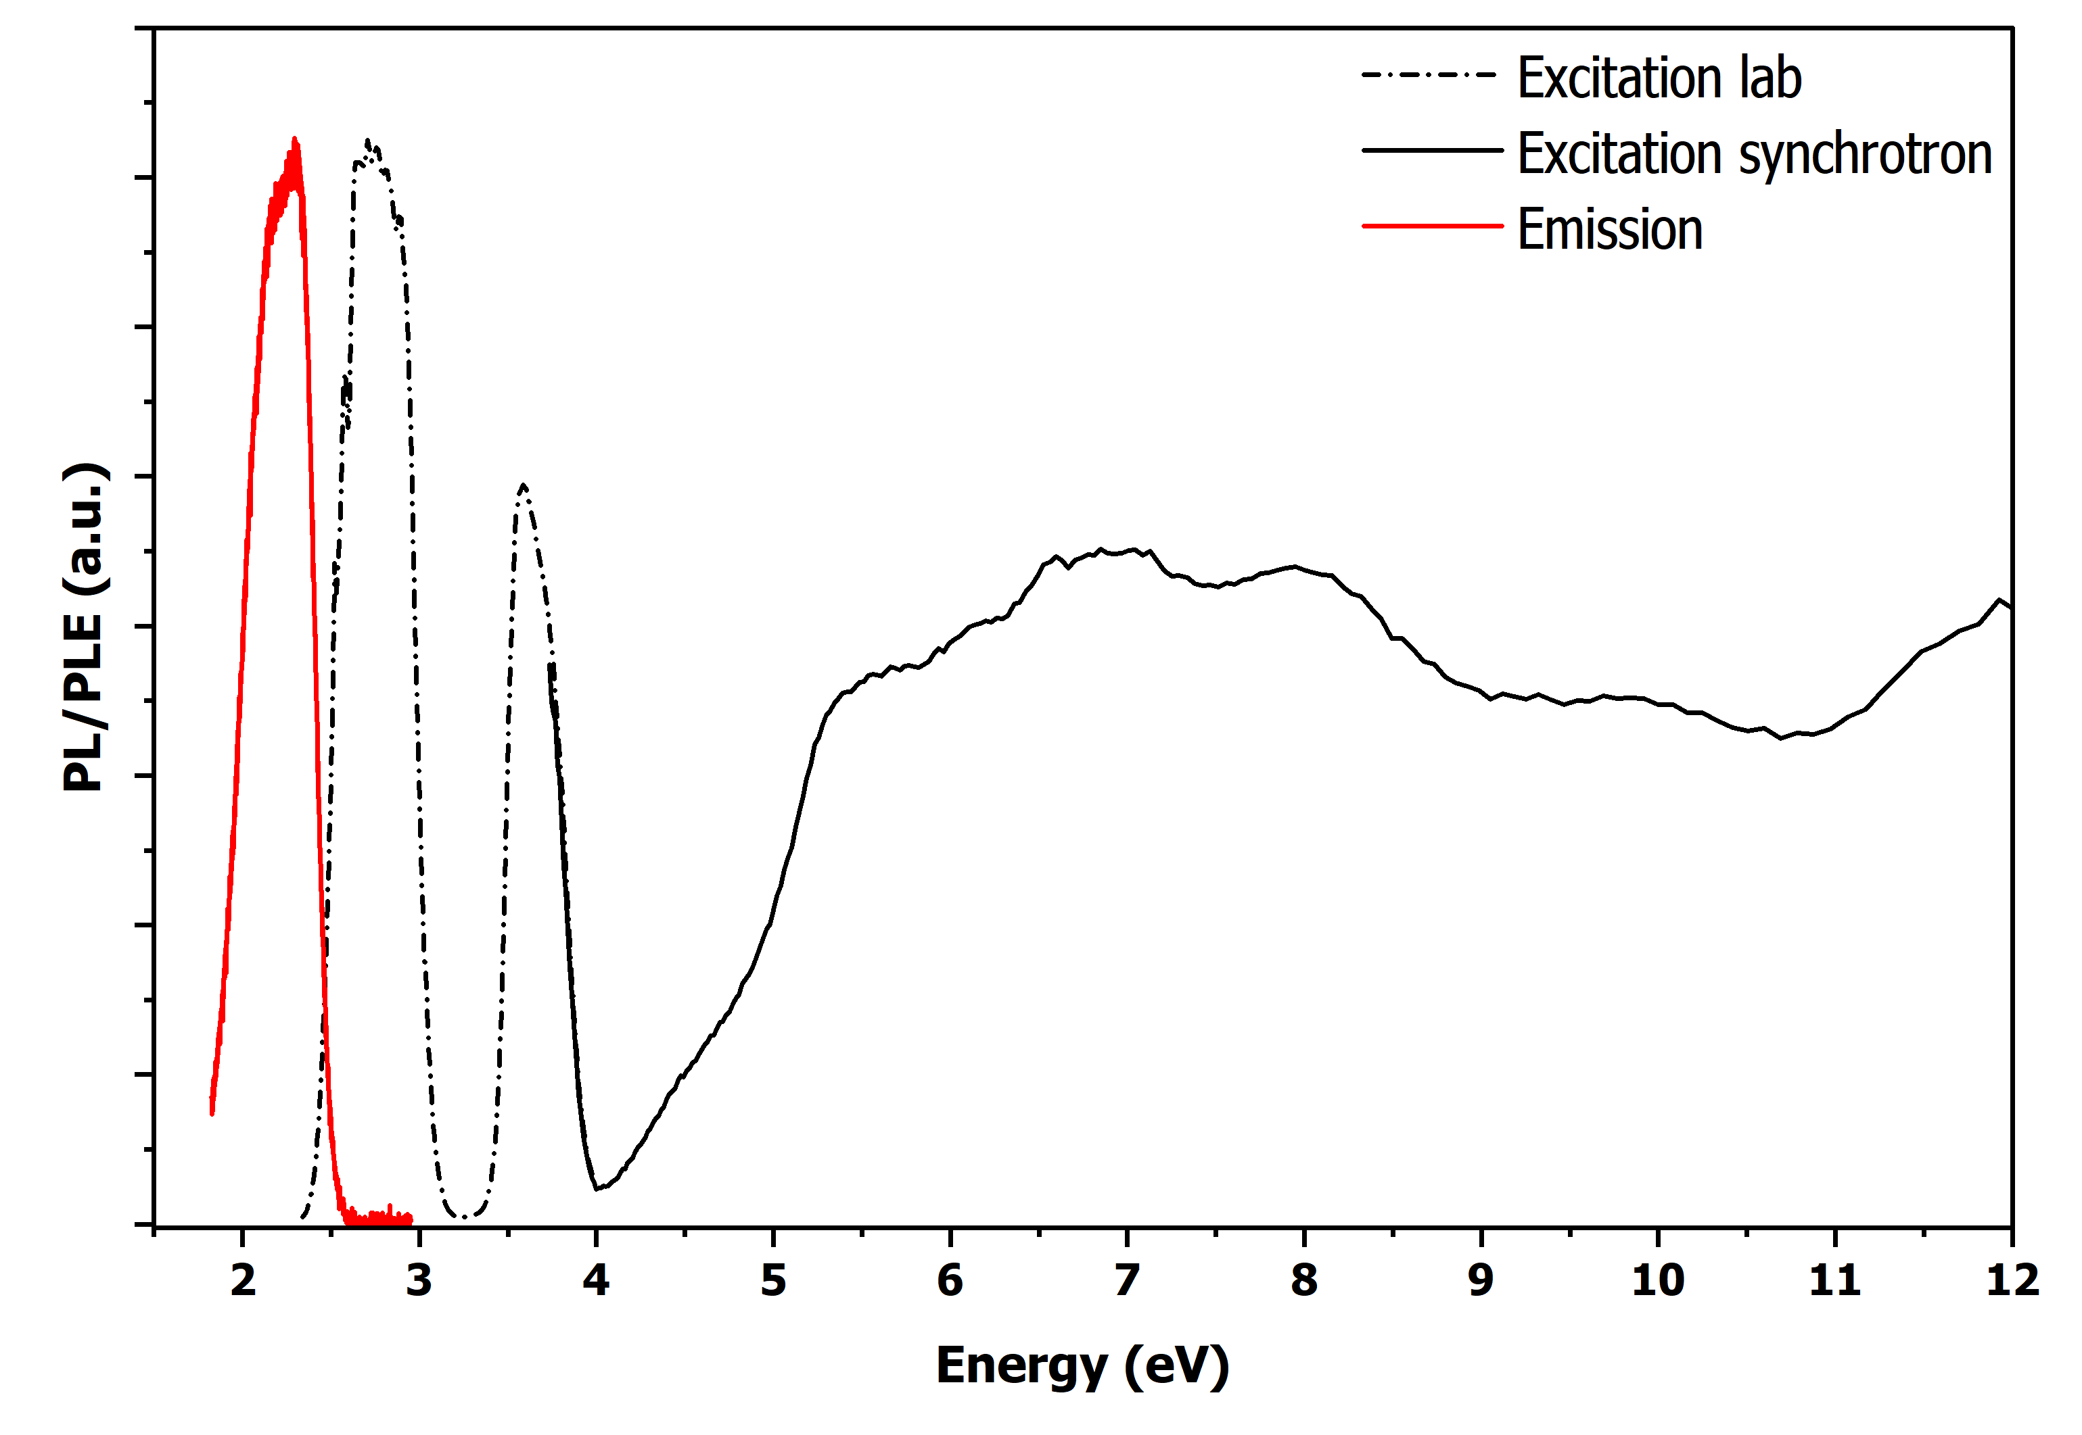
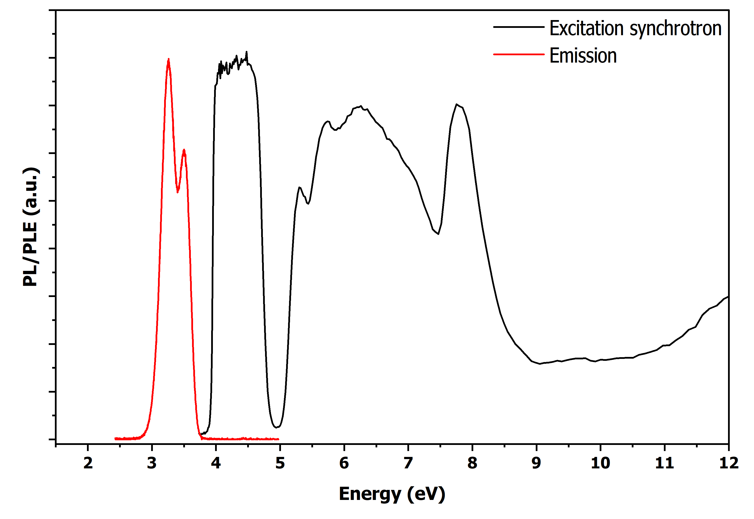
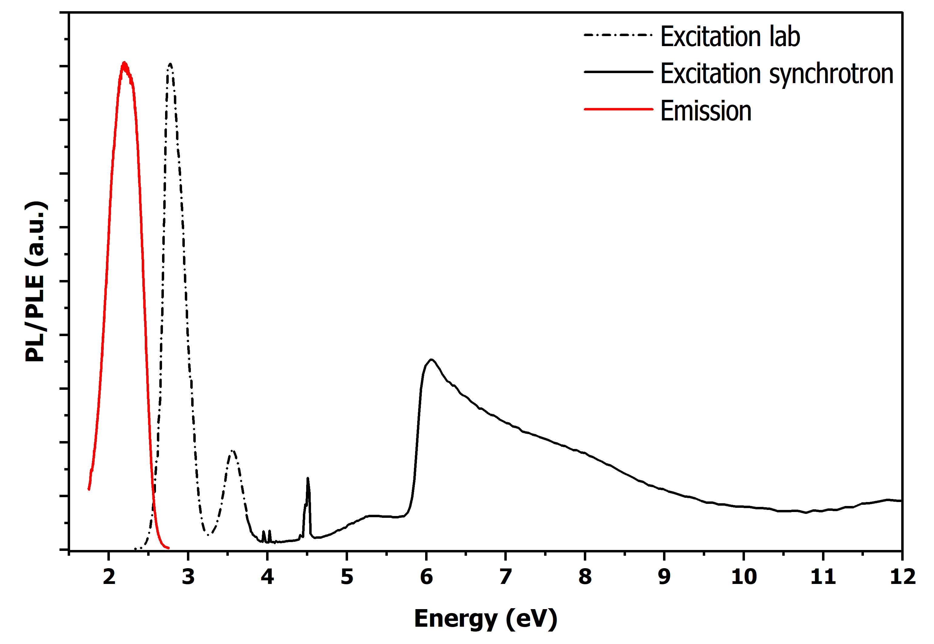
Materials
5d₁
5d₂
5d₅
Ce:YAG
Ce-doped scintillating crystals:
YAG (Y₃Al₅O₁₂) → garnet structure, Ce³⁺ substitutes Y³⁺ in the dodecahedral site
YAP (YAlO₃) → perovskite structure, Ce³⁺ substitutes Y³⁺ in the A site
GGAG (Gd₃(Ga,Al)₅O₁₂) → garnet structure, Ce³⁺ substitutes Gd³⁺ in the dodecahedral site
5d₃
5d₄
E_{g}
5d₁
5d₂
5d₅
Absolute energies and spacing of the 4f₁ and 5d levels
5d₄
Photoluminescence
5d₃
Ce:YAP
Location of the Ce levels in the energy gap of the host crystals
E_{g}
5d₅
5d₄
?
5d₃
5d₁
5d₂
Ce:GGAG
E_{g}
5d₁
5d₃
5d₄
4f₁ (split)
5d₂
Gd³⁺
5d₅
E_{g}
Ce:YAG
Ce:YAP
Ce:GGAG
Defect

Slide 5
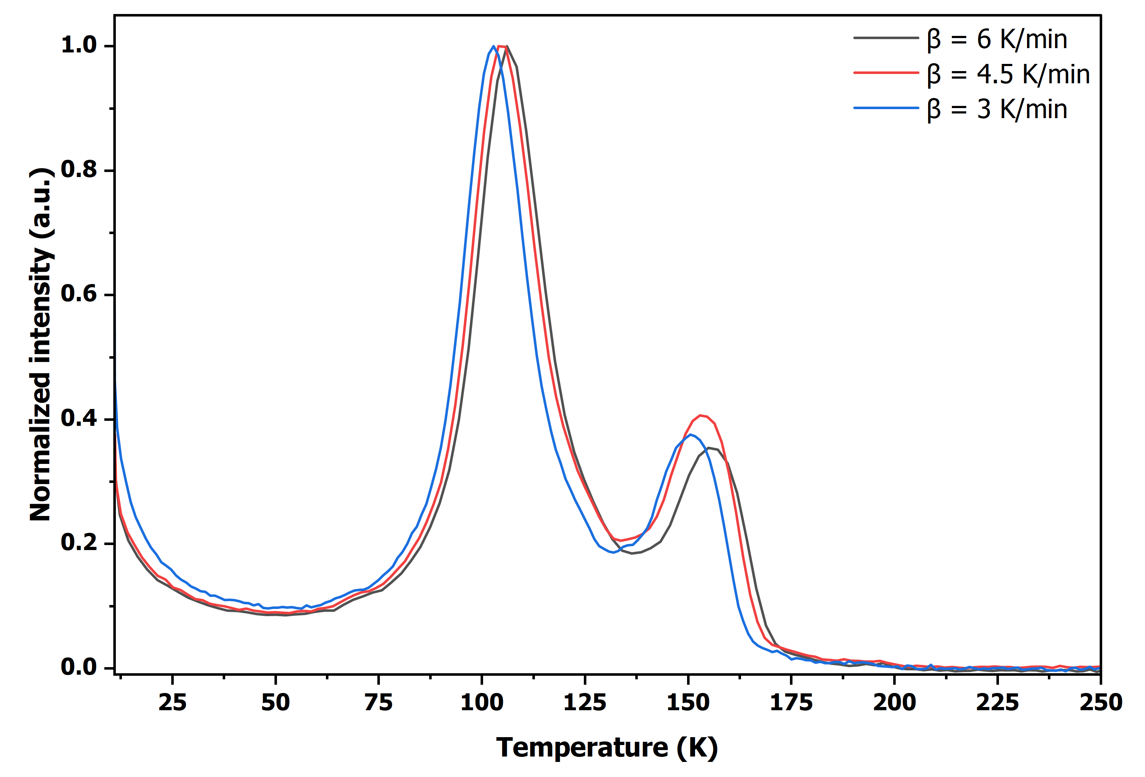
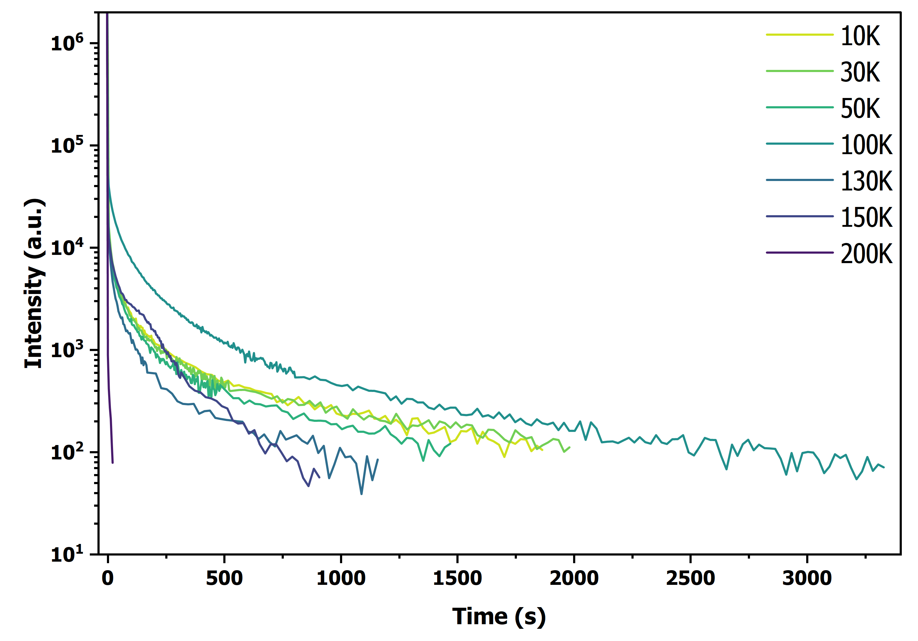
Results
Ce:YAP
Trap 1
TSL?
TSL?
✓
TSL?
✓
5d₅
✓
5d₄
VHR
✓
✓
5d₃
Trap 2
E₁ = 0.18 eV
E₂ = 0.30 eV
✓
×
✓
×
×
✓
×
✓
5d₂
×
×
5d₁
4f₁
(split)
7.8 eV
6.3 eV
Arrhenius plot
6.7 eV
Ce:YAG
Ce:YAP
Ce:GGAG
E₁ = 0.16 eV
E₂ = 0.11 eV

Slide 6

Thank you for your attention!
Synchrotron light (DESY, Hamburg): Dr. Aleksey Kotlov,
Dr. Yevheniia Smortsova
Campaign: Prof. Alberto Paleari, Prof. Roberto Lorenzi, Dr. Francesca Cova,
Dr. Alessandra Ronchi, Vittoria Vigorito, Pietro Moiraghi
Synchrotron radiation is a useful tuneable light source for thermoluminescence and phosphorescence measurements.
Changing excitation energy yielded information on energy levels within and above the gap and on the defects responsible for the peaks observed in the glow curves.
Synchrotron radiation allows the investigation of trapping and detrapping mechanisms for energy levels inside the conduction band, which would not be accessible with lab-scale UV-vis excitation.
DESY PETRA III beamline P66 Superlumi endstation proposal number I-20250130EC
Funding from the Italian Ministry of Research under the project Luminance of the PRIN2022 program (Grant Agreement 2022E42PMA), funded by the European Union – Next Generation EU
“Gilberto Vlaic” XVIII School on Synchrotron Radiation: Fundamentals, Methods and Applications – Muggia, 24th September 2026 Pietro Moiraghi

