Slide 1

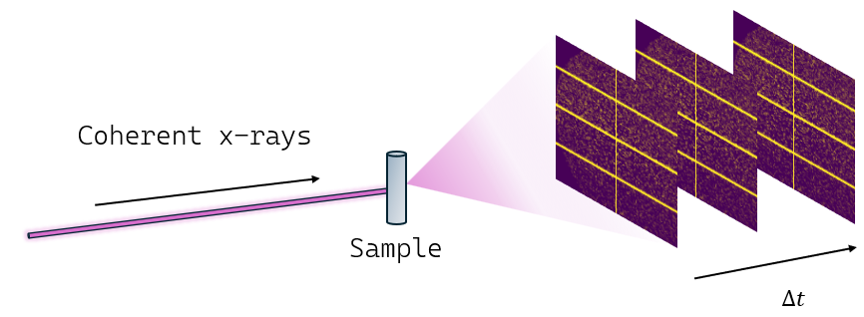
Metallic glasses and XPCS
Structural and dynamical aging in metallic glasses
Lourenço Tavares
1st Year PhD
Supervisor: Dr. Robert Maaß

Slide 2
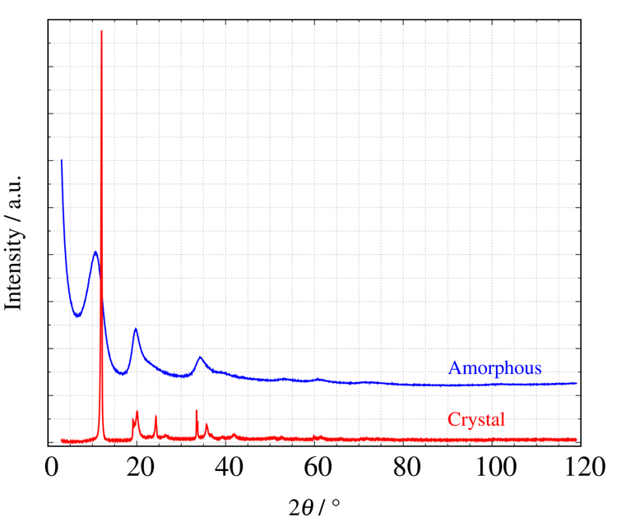
What are metallic glasses?
Metallic glasses are non-crystalline and do not exhibit long-range-order
VS
Crystal
Glass
Rapid cooling of a melt can bypass crystallization and form a glass
Volume
Super-cooled liquid
Liquid
Rapid cooling
Glass
Slow... cooling
Glass transition is still largely a mystery...
Crystal
Temperature

Slide 3
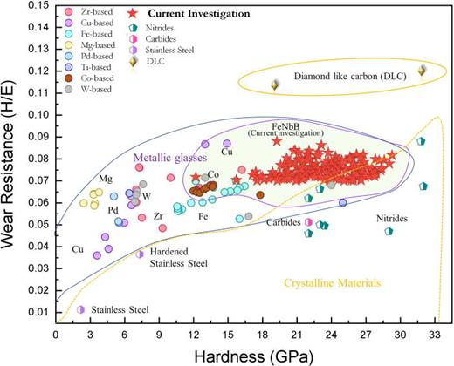

Why metallic glasses?
(1)
Metallic glasses are exceptionally materials due to their structure
However, not in equilibrium
Changes lead to loss in properties (“aging”)

Slide 4
X-ray Photon Correlation Spectroscopy (XPCS)
“Speckle patterns” represent structure at that moment
Diffraction patterns in metallic glasses are very sensitive and coherent beams are needed to capture detail
Analysing how “speckle patterns” change with time gives in-sight into how structure changes

Slide 5
Aims & methodology
What is the connection between structure and its dynamics (how it changes with time)?
Metallic glass: (Vit105) Zr_{52.5}Cu_{17.9}Ni_{14.6}Al₁₀Ti₅
Microstructural models
(Structure)
+
XPCS
(Dynamics)
How does compression affect these components?

Slide 6
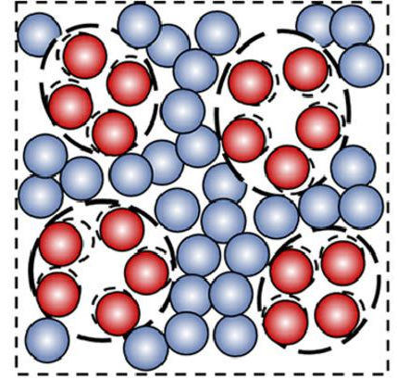
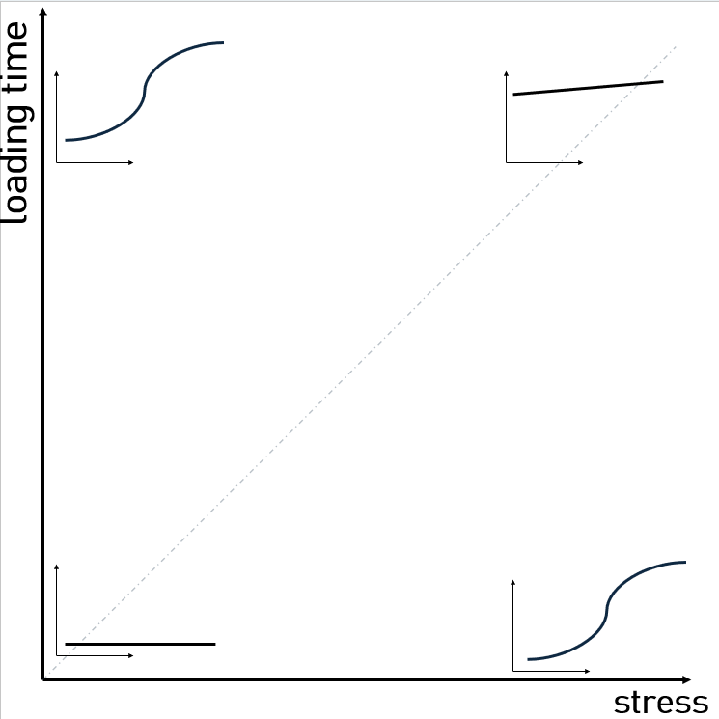
What we know and want to know
Structure
Dynamics
Elastic immobile network
(3)
1.Compression speeds-up atoms, even at very low stresses
2. Structure recovers slowly after decompression
Mobile “liquid-like” atoms
(2)
Current research: How dynamics change after decompression depending on previous stress and loading-time.

Slide 7
Takeaways and future steps
Metallic glasses have exceptional mechanical properties that worsen with time (“aging”)
Dynamics (XPCS) and structure (models) are deeply related
Aging can be minimised and materials improved
What does this behaviour mean? eg. structurally
Does it build upon the microstructural picture?
Future steps

Slide 8
References
Suchismita Sarker, Robert Tang-Kong, Rachel Schoeppner, Logan Ward, Naila Al Hasan, Douglas G. Van Campen, Ichiro Takeuchi, Jason Hattrick-Simpers, Andriy Zakutayev, Corinne E. Packard, Apurva Mehta; Discovering exceptionally hard and wear-resistant metallic glasses by combining machine-learning with high throughput experimentation. Appl. Phys. Rev. 1 March 2022; 9 (1): 011403. https://doi.org/10.1063/5.0068207
Zhang, L. T., Wang, Y. J., Pineda, E., Kato, H., Yang, Y., & Qiao, J. C. (2022). Sluggish dynamics of homogeneous flow in high-entropy metallic glasses. Scripta Materialia, 214, 114673. doi:10.1016/j.scriptamat.2022.114673
Riechers, B., Das, A., Rashidi, R., Dufresne, E., & Maaß, R. (2025). Metallic glasses: Elastically stiff yet flowing at any stress. Materials Today, 82, 92–98. doi:10.1016/j.mattod.2024.11.015

