Slide 1
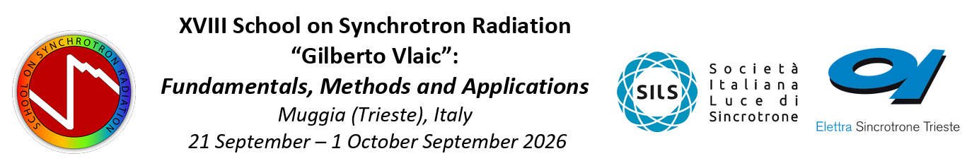

Research activities in UTV’s Metallurgy laboratories
Alessandra Palombi – alessandra.palombi@uniroma2.it

Slide 2
Investigation methods
Investigation of process–microstructure–properties relationships in metals and alloys:
Microstructure
Mechanical properties
Optical microscopy
Scanning Electron Microscopy + EDS + EBSD
X-ray Diffaction
Micro- and nano-indentation
Intrumented indentation
Tensile test
Wear test
Mechanical spectroscopy
Surface morphology and composition
Atomic Force Microscopy
Raman Spectroscopy
XPS
GDOES

Slide 3
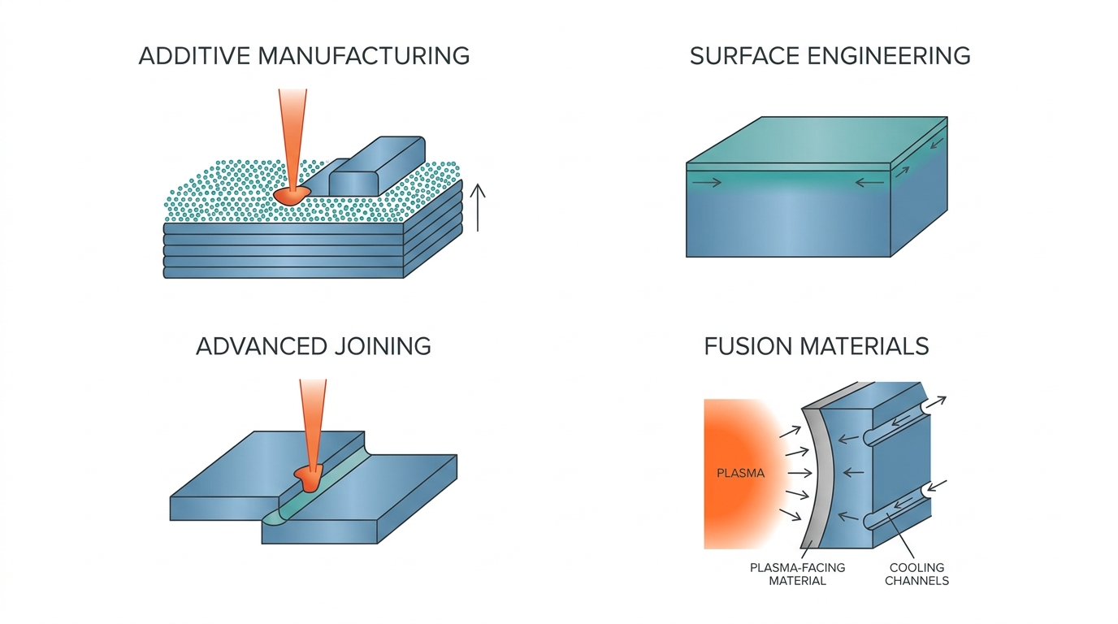
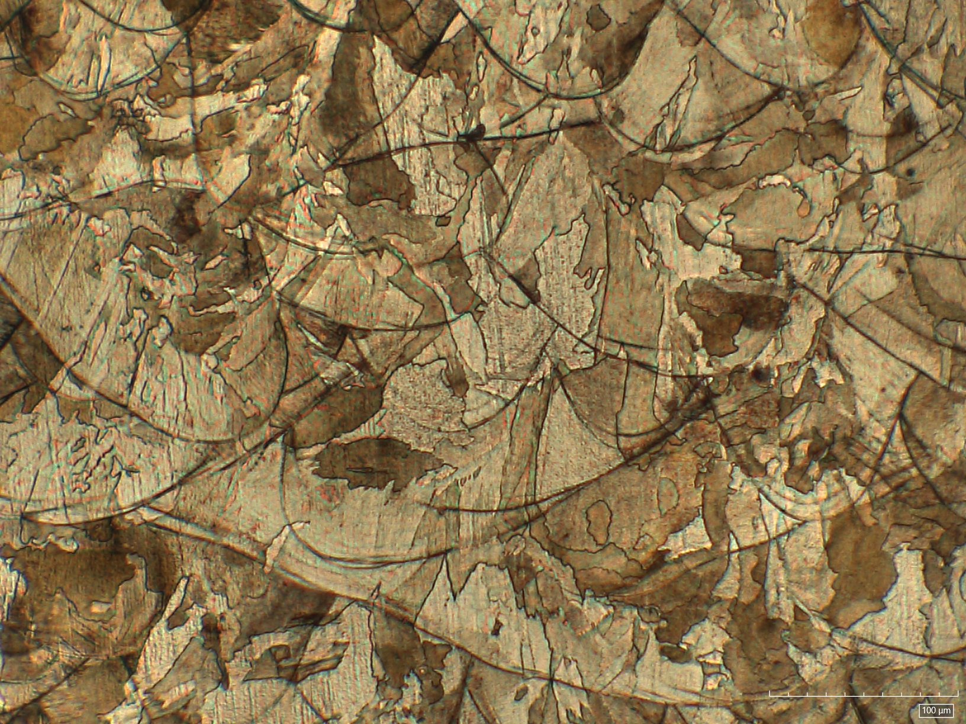
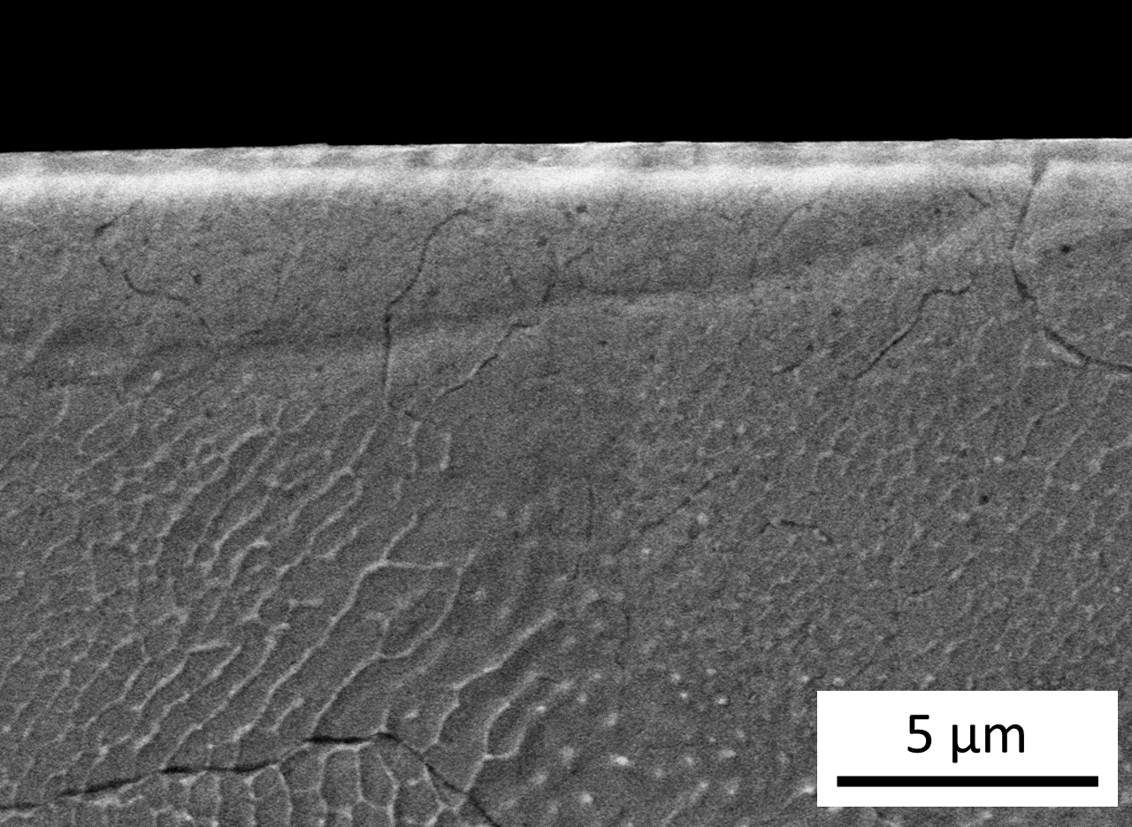
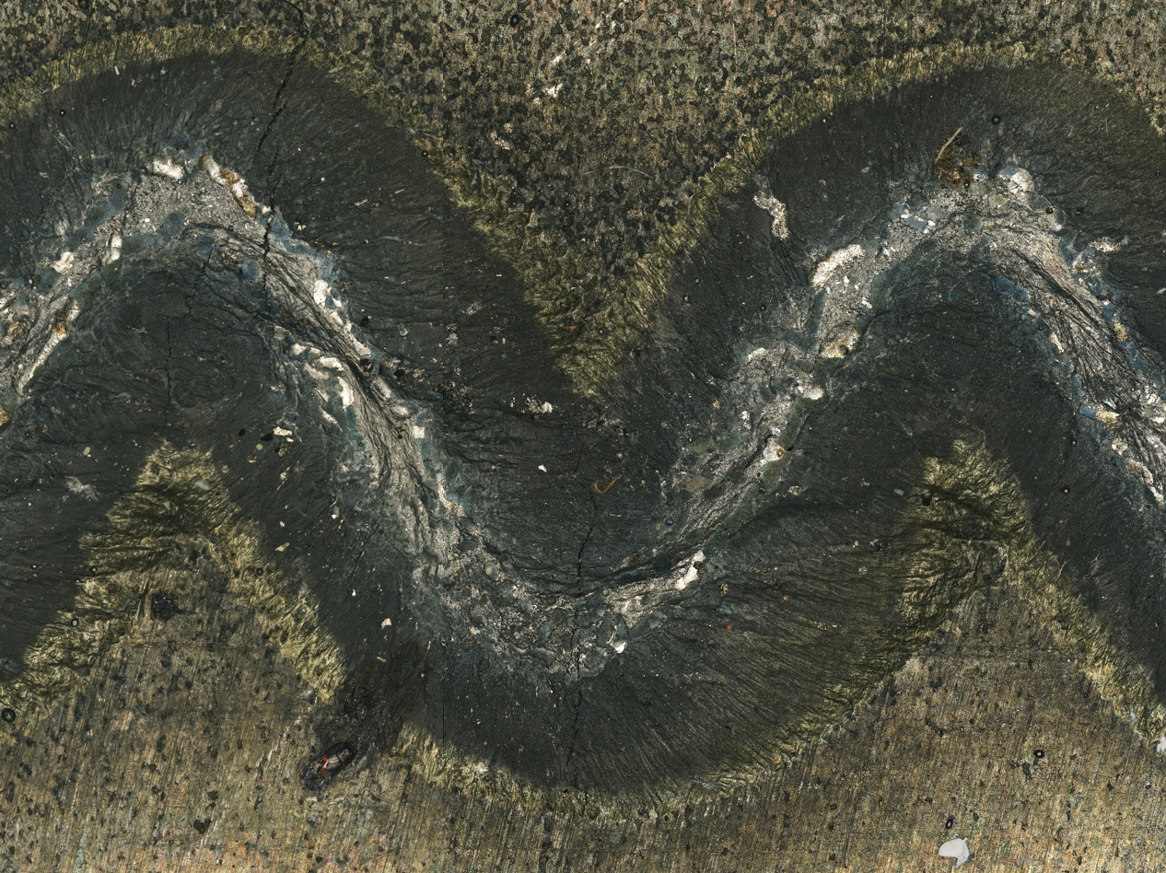
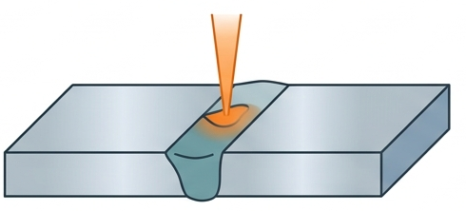
Research topics
Additive manufacturing of metals and alloys: Al, Ti, CoCr alloys and Steels…
Surface engineering:
  Low temperature plasma treatment on austenitic inox steels (AISI 316L)
  LDH growth on biocompatible and biodegradable metallic substrates
Advanced joinings
  Laser beam welding of Ni-based superalloys (IN792, IN625, IN718, Nimonic C26)
Materials for nuclear fusion reactors (W coatings, inox and martensitic steels, Ti6Al4V)

Slide 4
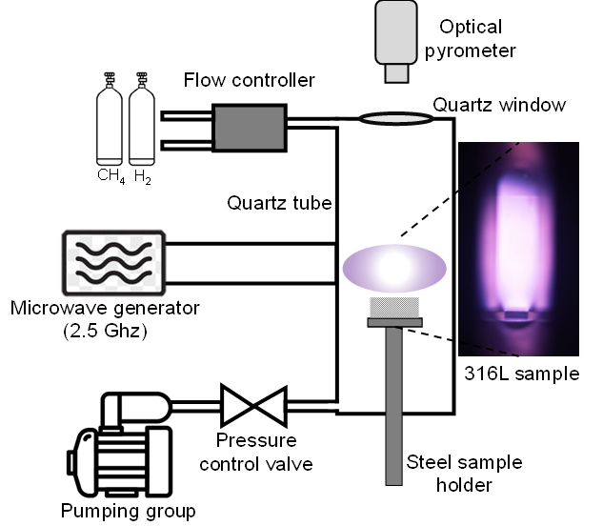
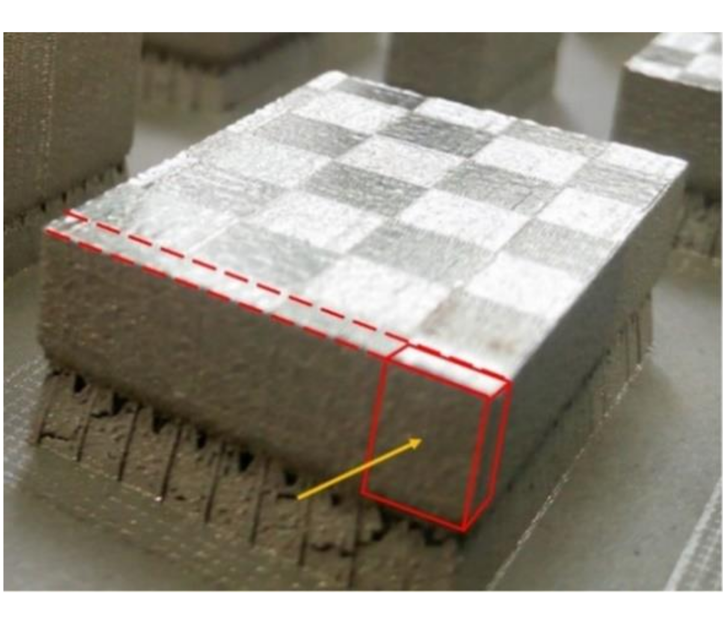
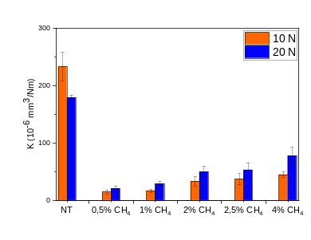
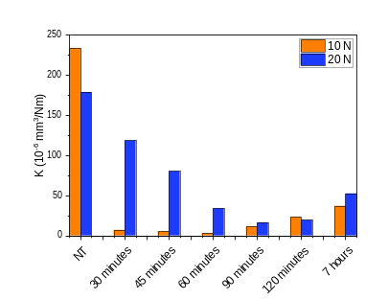
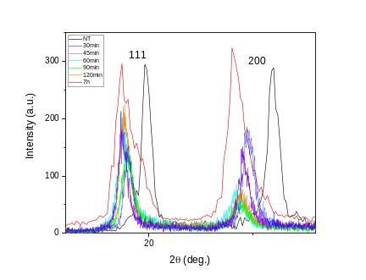
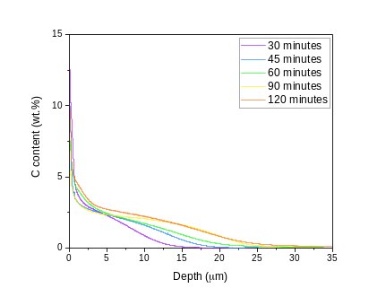
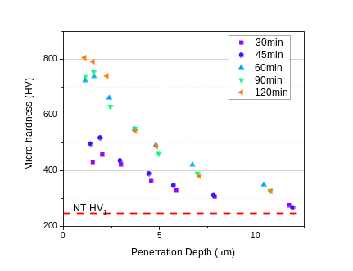
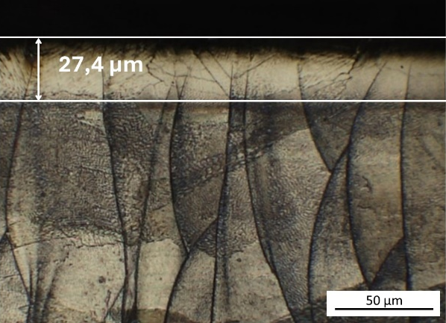
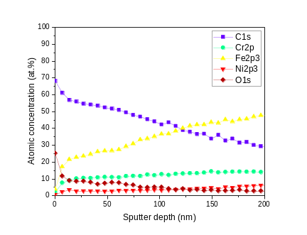
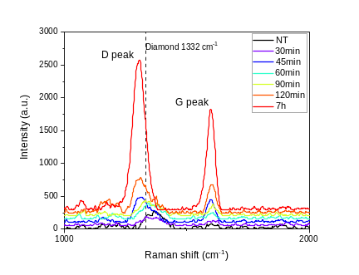
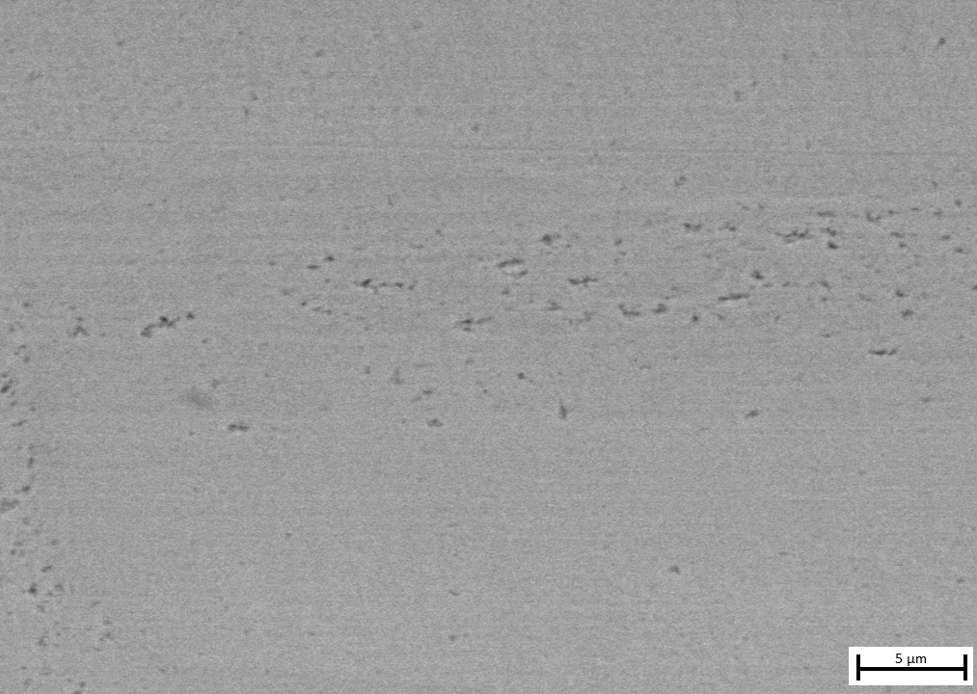
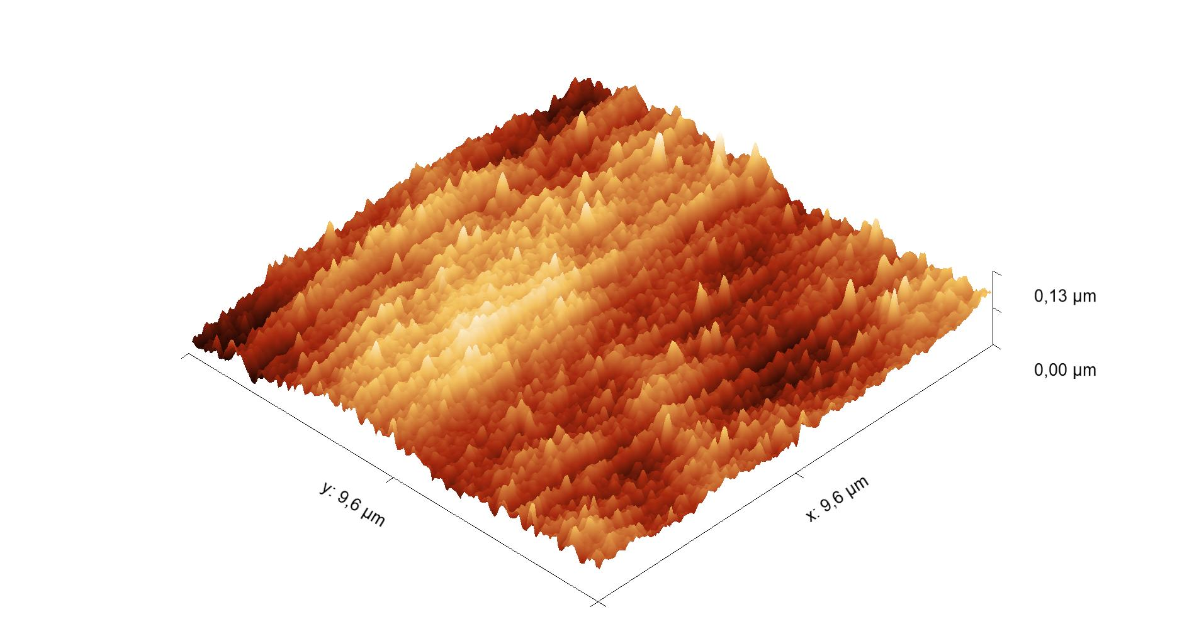
Main results
Low temperature plasma treatment on austenitic inox steels (AISI 316L)
  Surface hardness improvements with wear resistance up to 20 times higher than not treated material
    L-PBF 316L + Plasma treatments at 475 °C in different (CH₄ + H₂) atmospheres, increasing treatment time
475 °C + 2,5 % CH₄ + 90 minutes
K_{T} ~ 20 K_{NT}
Process parameter optimization
Next steps:
Residual stress evaluation in the cross section

Slide 5
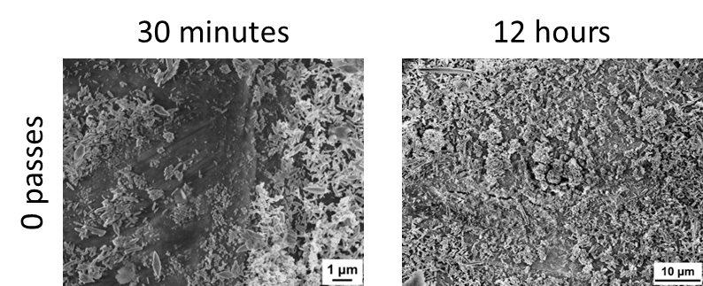
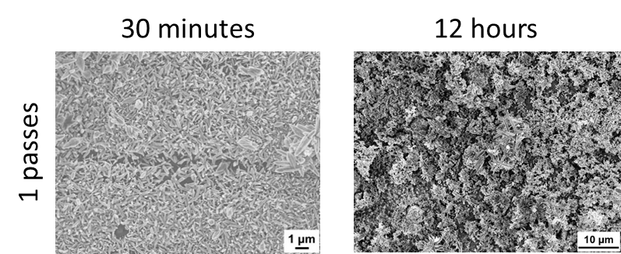
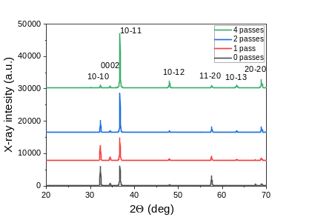
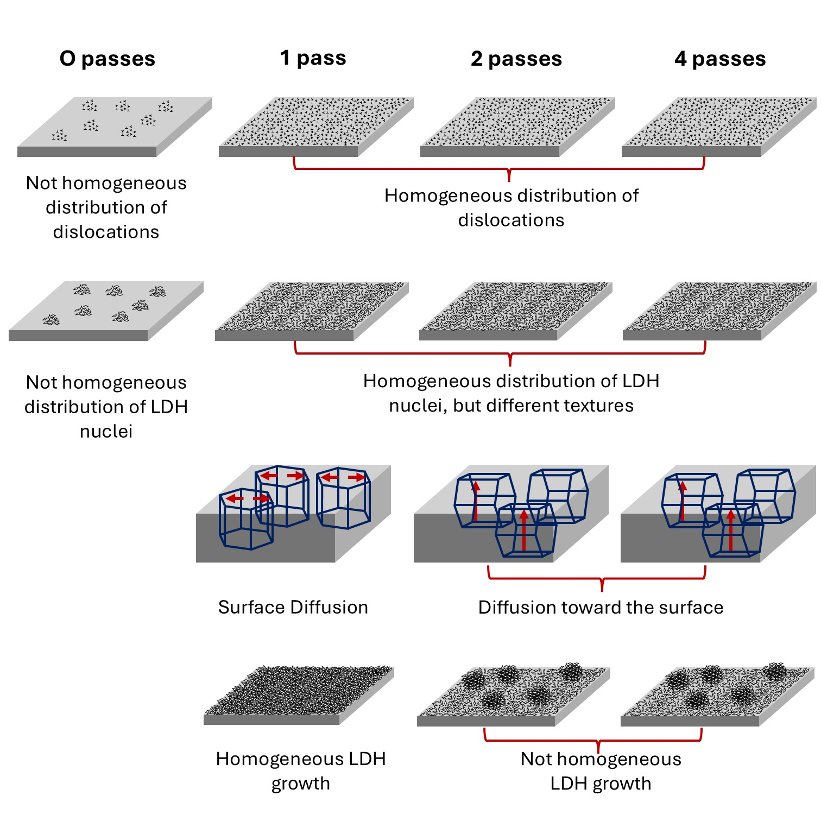
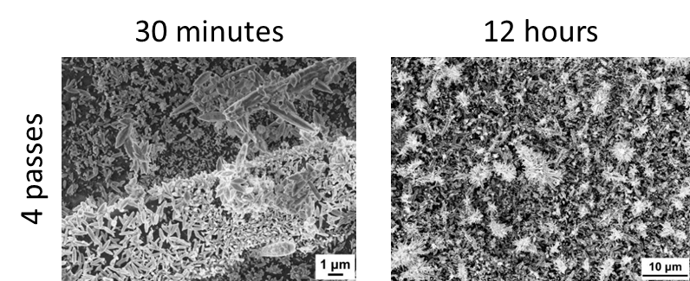
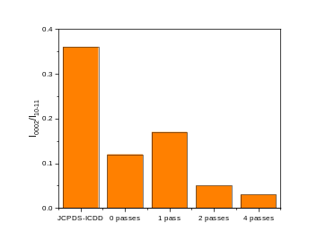
Main results
LDH growth on biocompatible and biodegradable metallic substrates
  Determination of the influence of crystallografic orientation of the substrate on LDH nucleation and growth
    AZ31 processed by ECAP in 4 different configurations
    LDH syntesis for 30 minutes and 12 hours on the 4 samples
Next steps:
In situ imaging and analysis during LDH growth

Slide 6
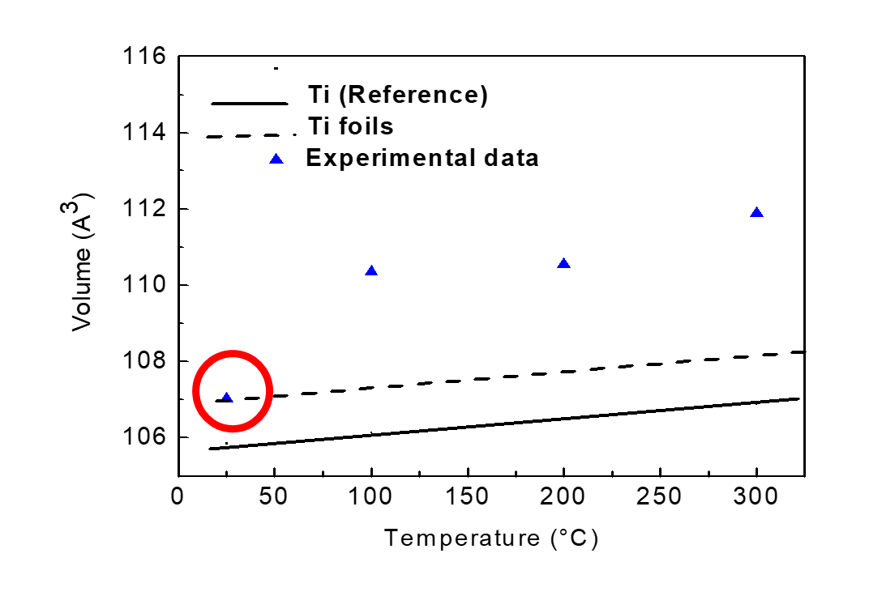
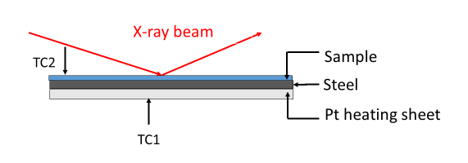
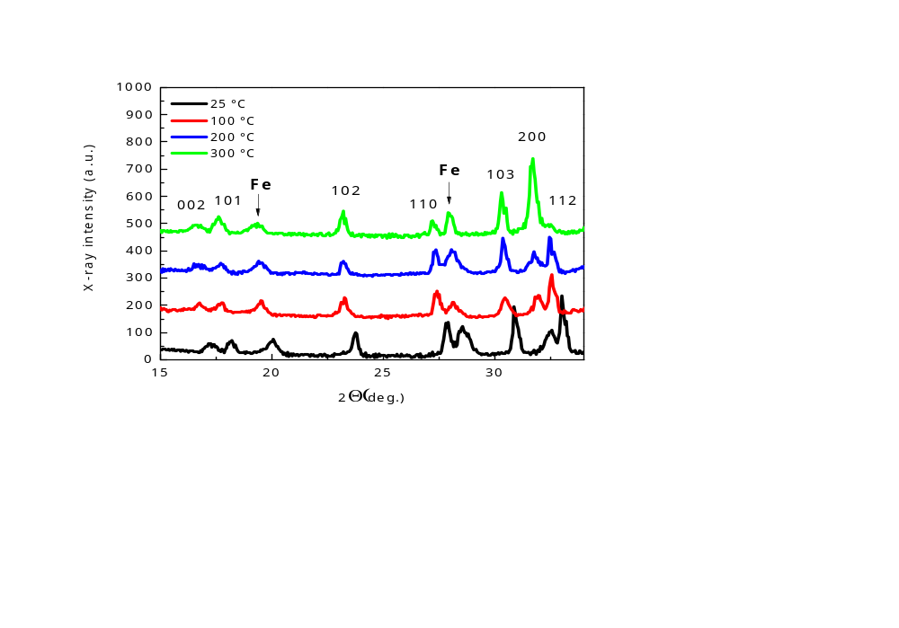
Main results
Microstructure and mechanical behaviour of Ti-CP thin foils (7 μm)
  Severe plastic deformation (texture) + Oxygen absorption
    Anomalous behaviour under low applied stress (ν < 0)
Next steps:
XPS depth profiles across the entire foil thickness & surface maps and punctual analysis

Slide 7
Alessandra Palombi - alessandra.palombi@uniroma2.it
Thank you for your attention

