Slide 1




Bridging UV and soft X-ray excitation in luminescent materials for scintillation
V. Vigorito¹, R. Lorenzi¹, A. Paleari¹, A. Ronchi¹, A. Erroi¹, F. Cova¹
¹Department of Materials Science, University of Milano-Bicocca, Milan, Italy
“Gilberto Vlaic” XVIII School on Synchrotron Radiation: Fundamentals, Methods and Applications
24 September 2026 - Muggia (Italy)

Slide 2
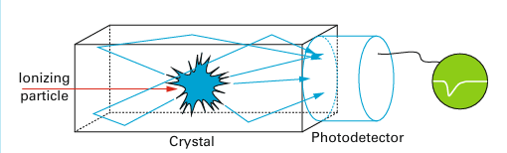
Scintillation
A scintillator is a material that absorbs high-energy radiation and re-emits part of that absorbed energy as light, typically in the visible or near-visible range
Hot electron
Conduction band
1
2
3
Ionizing radiation
Transfer
Energy
Luminescence
Valence band
Scintillating material
X-rays, γ-rays, neutrons, electrons and α particles
Deep hole
Core levels
Absorption and multiplication
Carrier migration
Relaxation and emission
Classes of scintillators
INORGANIC
ORGANIC
LIQUID
NANOCRYSTALS
Dujardin C. Tech. Ingénieur EE6347 (2018)

Slide 3
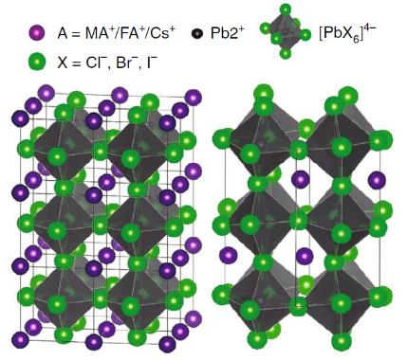
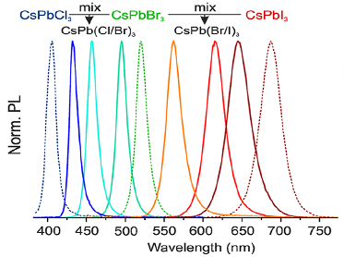
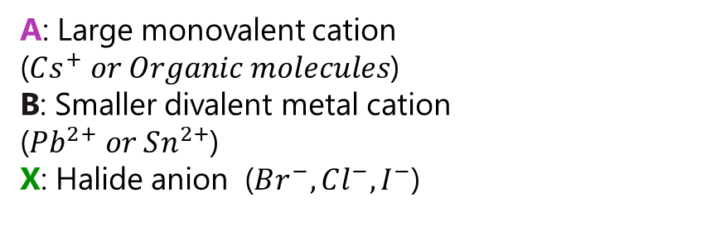
Material
LEAD HALIDE PEROVSKITES
General formula: ABX₃
A: Large monovalent cation ($Cs^{+} or Organic molecules$)
B: Smaller divalent metal cation
($Pb^{2+} or Sn^{2+}$)
X: Halide anion ($Br^{−},Cl^{−},I^{−}$)
Q. A. Akkerman et al. Nature Materials, 17, 394–405 (2018)
By varying the halide ratios in the colloidal nanocrystal solution, the PL can be tuned across the entire visible spectral range
G. Nedelcu et al. Nano Lett. 15,5635−5640 (2015)

Slide 4


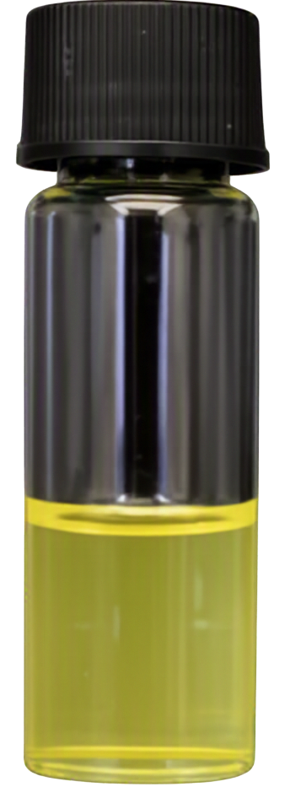



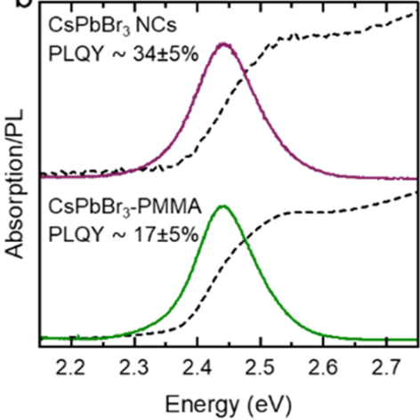
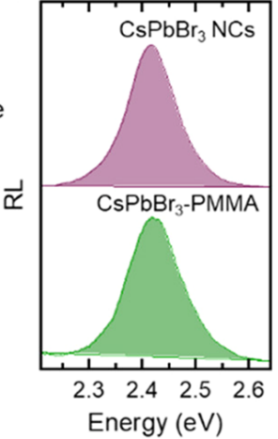
Material
LEAD HALIDE PEROVSKITES
CsPbBr₃
General formula: ABX₃
A: Large monovalent cation ($Cs^{+} or Organic molecules$)
B: Smaller divalent metal cation
($Pb^{2+} or Sn^{2+}$)
X: Halide anion ($Br^{−},Cl^{−},I^{−}$)
Hot‑injection synthesis rapidly mixes precursors into a hot solvent, inducing immediate nucleation of perovskite nanocrystals.
Q. A. Akkerman et al. Nature Materials, 17, 394–405 (2018)
By varying the halide ratios in the colloidal nanocrystal solution, the PL can be tuned across the entire visible spectral range
G. Nedelcu et al. Nano Lett. 15,5635−5640 (2015)
Cova F et al. Nano Lett 24, 905–913 (2024)

Slide 5
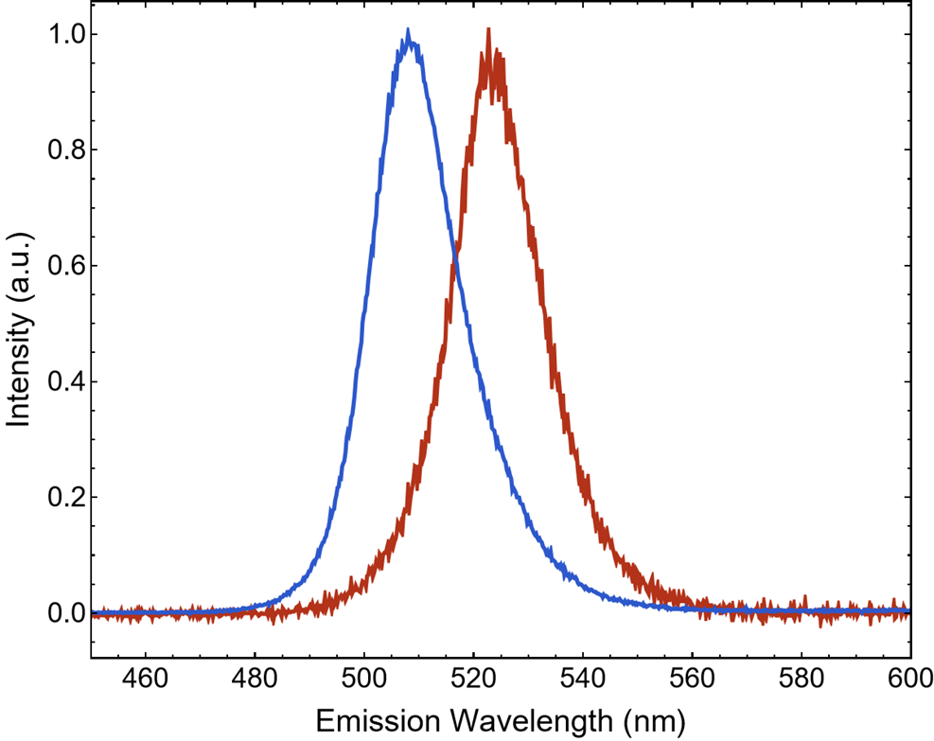

Bridging the excitation gap
PL
RL
Exc energy $3.8 eV$
Exc energy 20 keV
A difference in emission behavior when the material is excited optically versus when it's excited by ionizing radiation is observed

Slide 6
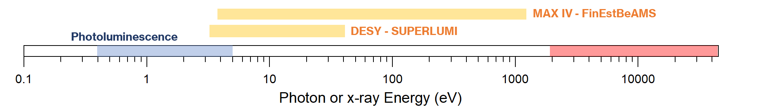
Bridging the excitation gap
PL
RL
Radioluminescence
Exc energy $3.8 eV$
Exc energy 20 keV
Synchrotron light can be used to bridge the gap in the excitation photon energies between UV/Vis lamps and x-ray tubes routinely used in labs
A difference in emission behavior when the material is excited optically versus when it's excited by ionizing radiation is observed

Slide 7
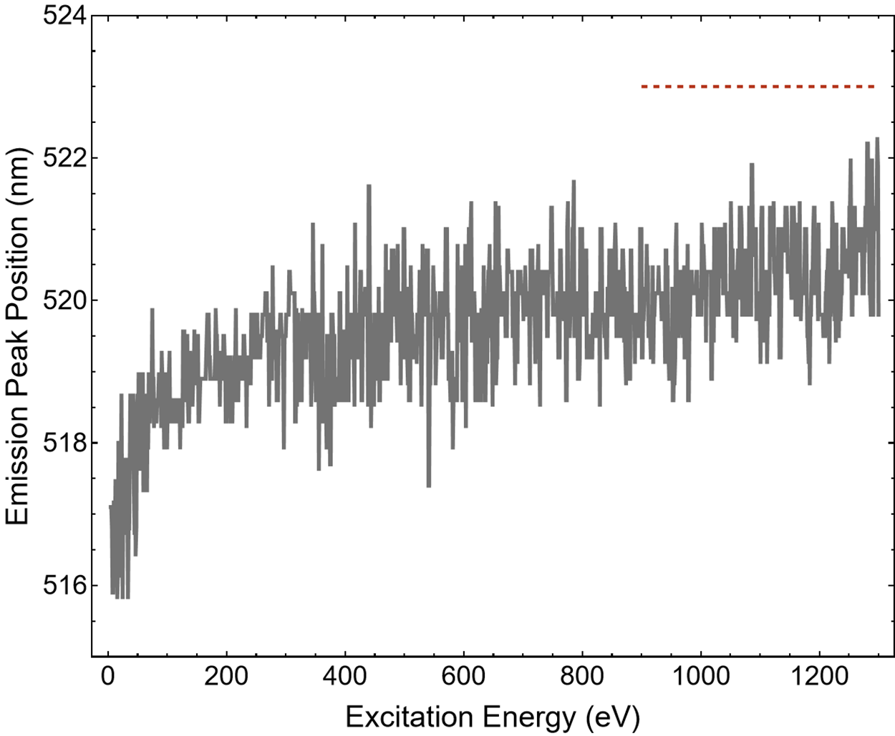
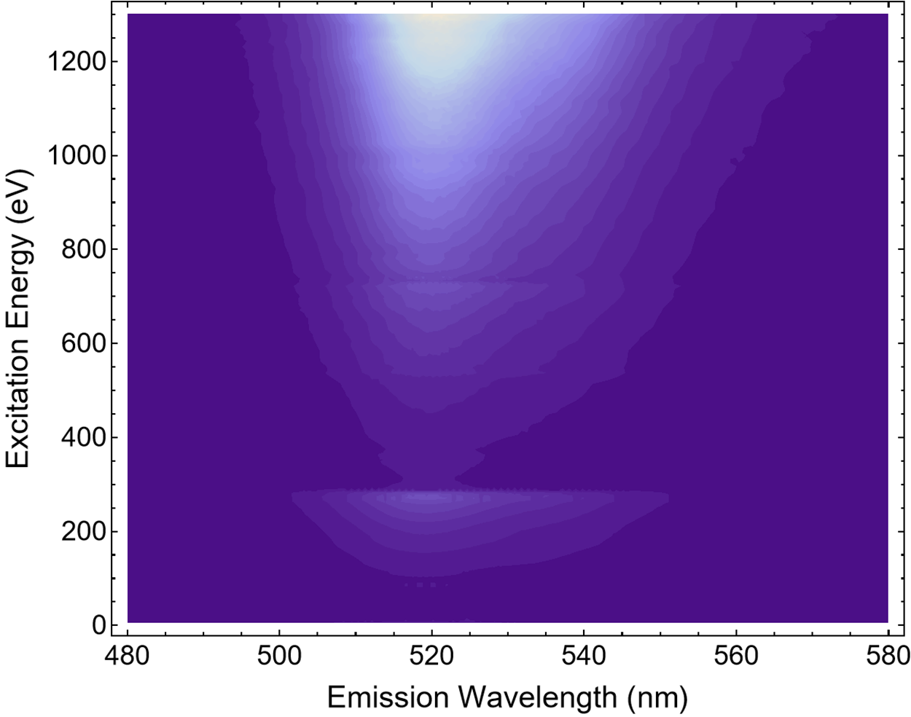
Bridging the excitation gap
PL
RL
Radioluminescence
Exc energy $3.8 eV$
Exc energy 20 keV
Synchrotron light can be used to bridge the gap in the excitation photon energies between UV/Vis lamps and x-ray tubes routinely used in labs
RL maximum (for reference)
A difference in emission behavior when the material is excited optically versus when it's excited by ionizing radiation is observed

Slide 8
Aknowledgments
Synchrotron campaigns: Dr. Francesca Cova, Prof. Roberto Lorenzi, Prof. Alberto Paleari, Prof. Franco Meinardi, Dr. Andrea Erroi, Pietro Moiraghi, Dr. Alessandra Ronchi
Synchrotron light from DESY, Hamburg, Germany: Dr. Aleksei Kotlov, Yevheniia Smortsova
Synchrotron light from MAXIV, Lund, Sweden: Dr. Antti Kivimäki, Dr. Kirill Chernenko
MAX IV FinEstBeAMS beamline, proposal umber 20241473
Thank you for your attention

