Slide 1
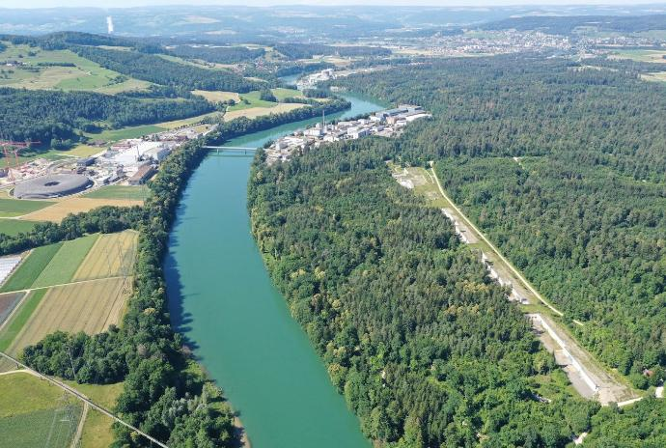
Simulation Study of 3-bunch Operation Methods for SwissFEL Upgrade
Zheqiao Geng, Sven Reiche
LLRF2026 Workshop
October 13-15 2026, Nova Gorica, Slovenia

Slide 2
Outline
Introduction
RF System Modeling
Simulation Software
3-bunch Setup and Feedback
Conclusion and Outlook
Notes:
Architecture design

Slide 3
Introduction

Slide 4
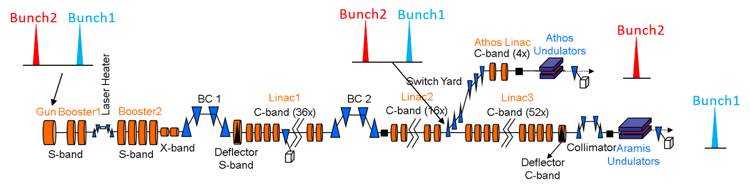
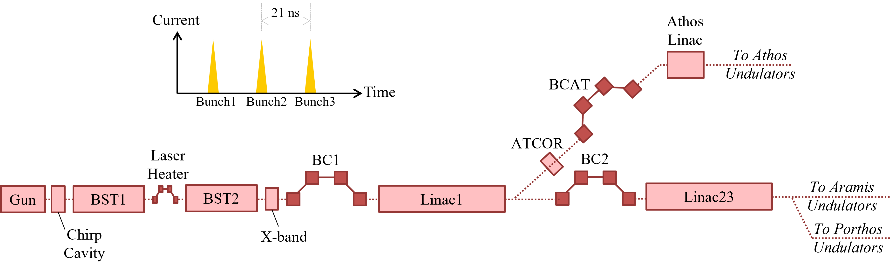
SwissFELplus and Porthos
Parameters of SwissFEL:
Aramis (hard X-ray): 1.8 – 12.4 keV
Athos (soft X-ray): 0.25 – 1.9 keV
e- energy Aramis: up to 6.2 GeV
e- energy Athos: up to 3.4 GeV
2-bunch operation with a space of 28 ns
Upgrade in two phases:
Phase I: SwissFELplus (project approved)
  Aramis (hard X-ray): up to 19 keV
  e- energy Aramis: up to 7 GeV
  Full coherence (self-seeding for Aramis and EEHG scheme for Athos)
  Improved temporal stability
  Remain with 2-bunch OP spaced by 28 ns
Phase 2: Porthos (future project)
  Porthos: a third hard X-ray beamline (2~10 keV)
  3-bunch operation spaced by 21 ns planned
  SwissFELplus allocates pre-conditions for Porthos. E.g., add dedicated bunch compressor (BCAT) and a correction C-band RF station (ATCOR) in the Athos branch
BCAT will be implemented in SwissFELplus phase, and ATCOR in Porthos phase

Slide 5
Highlight of 3-bunch OP Requirements
  The bunches have a separation of 21 ns and supply 3 beamlines at 100 Hz, with preferred assignments:
    Bunch1→ Aramis, Bunch2 →Athos, Bunch3 → Porthos
  LLRF will only consider the following operational conditions:
    All three bunches have the same charge (nominal 200 pC).
    Aramis and Porthos have the same nominal bunch length.
    Aramis and Porthos are equally accelerated up to 7 GeV.
  Relative beam energy requirements:
    The 3 bunches should have the same energy at LH and BC1.
    Bunch1 and Bunch3 should have the same energy at BC2 and the end of Linac3.
    Bunch2 energy can be different up to ~100 MeV than Bunch1/3 at the Switchyard.
    Note: resonant kickers followed by a Lambertson septum will be used to seperate the bunches. There are DC kickers and AC kickers. For Bunch1 and 3, the kick strength of the AC and DC kickers cancels and the bunches are going straight, independent on the beam energy. For Bunch2, the kicks are adding up to produce an offset at the septum magnet of 10 mm. Thus, the strengths of the resonant kicker is solely defined by the energy of Bunch2, and one can extract Bunch2 without problems with any energy deviation.
  The relative ACC phases for different bunches should be tunable.

Slide 6
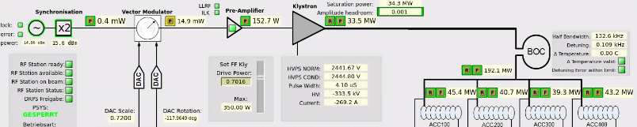
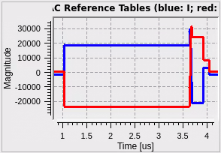
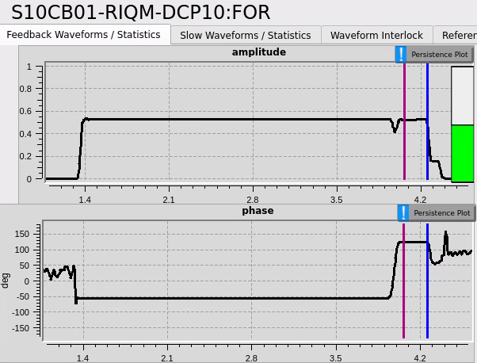
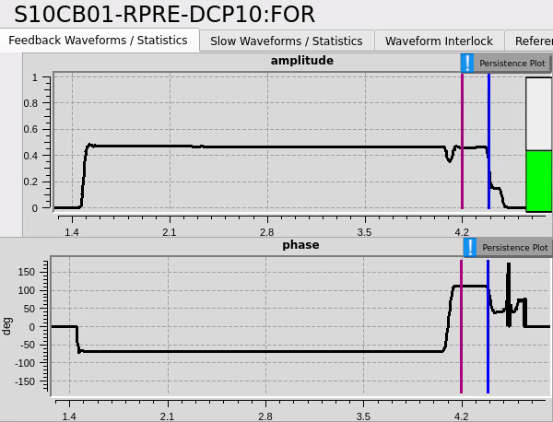
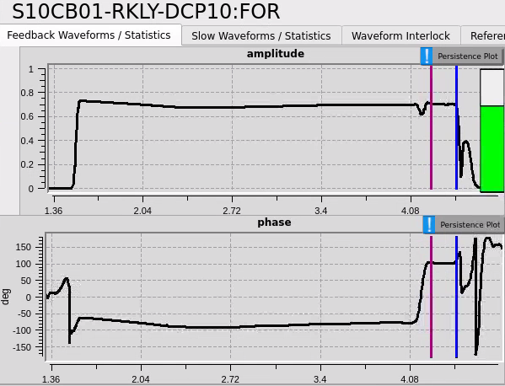
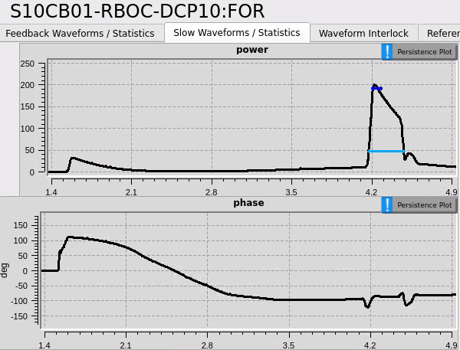
Start-to-end Simulation with RF and Beam Models
Goals: Build a virtual machine to study the final effects on all 3 bunches for the proposed RF tuning knobs; evaluate the feasibilities of the proposed knobs; Estimate the required bandwidths and gradients for the correction RF station.
Determine RF pulse shapes for all RF stations output by LLRF.
Simulate for all RF stations the shapes of pulses injecting into the TW structures.
Determine the RF pulse region for beam interaction.
Estimate the amplitudes and phases for all 3 bunches considering the TW structure model (e.g., group velocity variations along the structure).
Calibrate the ACC voltages and beam phases for all 3 bunches using the machine RF calibrations for bunch1.
Add beam loading effects for downstream bunches.
Apply the info above to the longitudinal tracking code to estimate the beam parameters for all 3 bunches.
Waveforms produced by LLRF DACs and processed by the RF driving chain components (bandwidth limits and distortions).

Slide 7
RF System Modeling

Slide 8
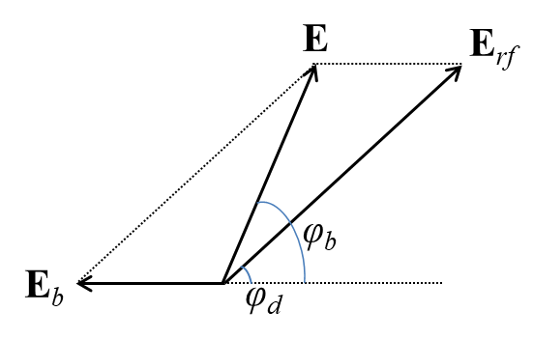
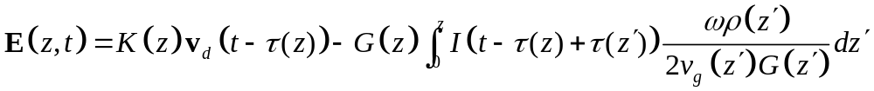
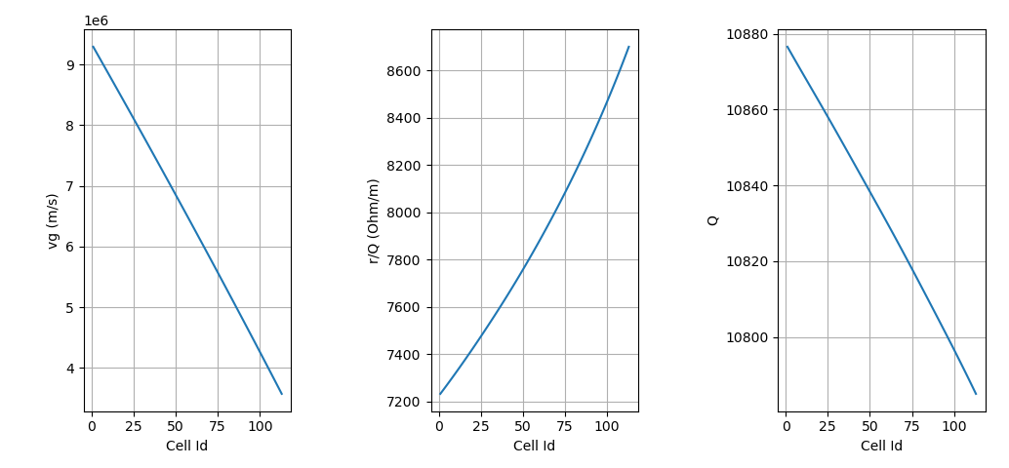
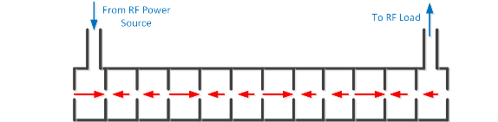
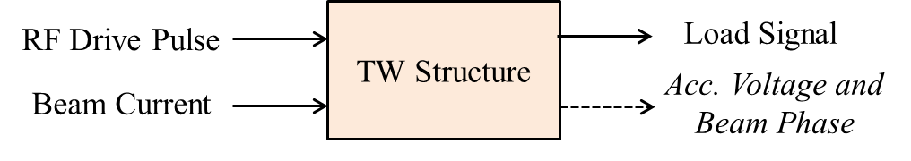
Traveling-wave (TW) Structure Model
Solution to gradient:
The RF induced gradient at location z is produced by the RF drive power injected τ(z) earlier than the observation time and attenuated by the TW structure fraction between 0 and z.
The beam induced gradient at a location z has two contributions: 1). Induced by the bunch that passes through the location z at the observation time; 2). The fields in previous cells induced by earlier bunches and transmitted to the location z at the observation time.
Vector relation between RF- and beam-induced gradients and the overall gradient
Example of cell-dependent parameters
TW structure model

Slide 9
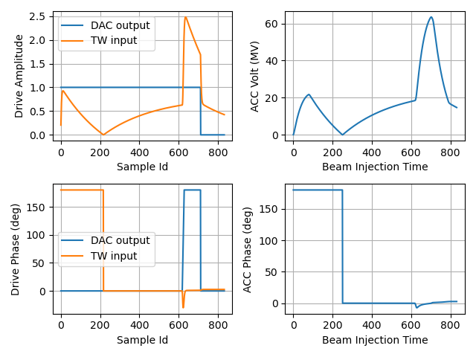
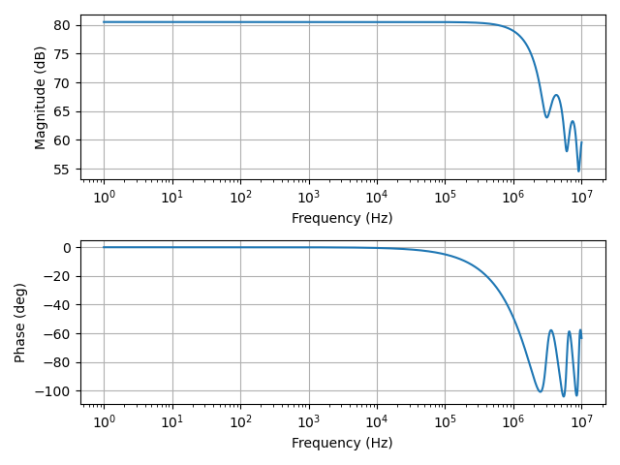
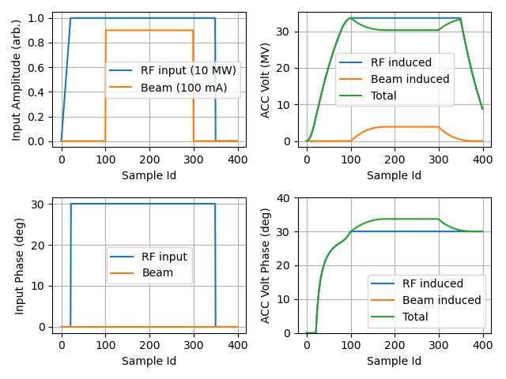
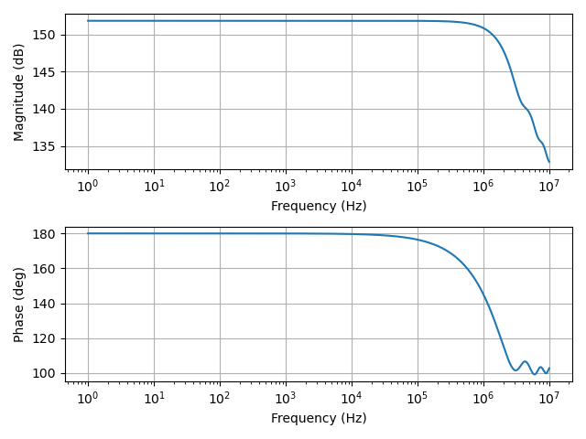
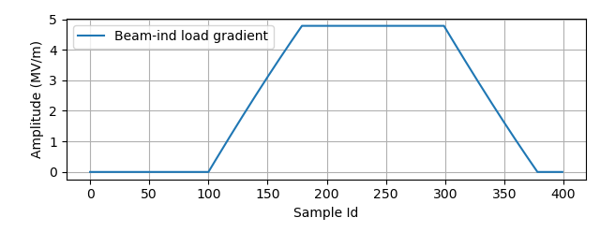
RF and Beam induced Accelerating Voltage
RF-induced accelerating voltage (V_{acc,rf} ) in a TW structure (left) and the frequency response of the TW structure from RF input → V_{acc,rf} (right)
SwissFEL C-band TW Structure
½ bandwidth: 1.37 MHz
Beam-induced accelerating voltage (V_{acc,b} ) in a TW structure (left) and the frequency response of the TW structure from beam current → V_{acc,b} (right)
Beam-induced gradient at the TW structure load

Slide 10
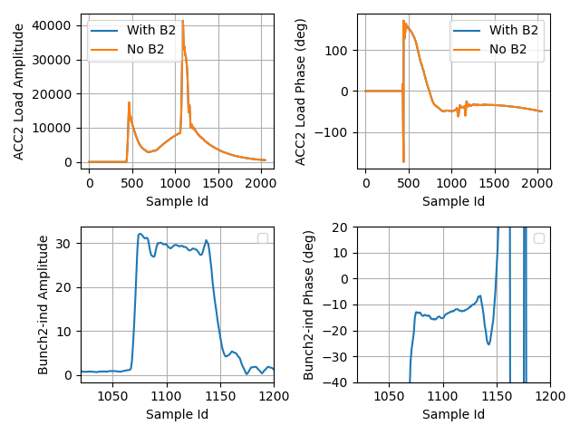
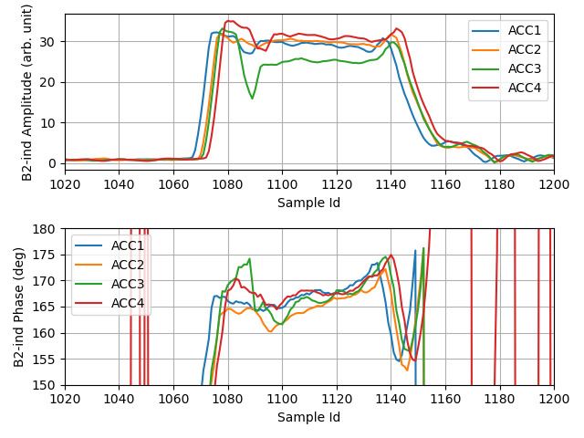
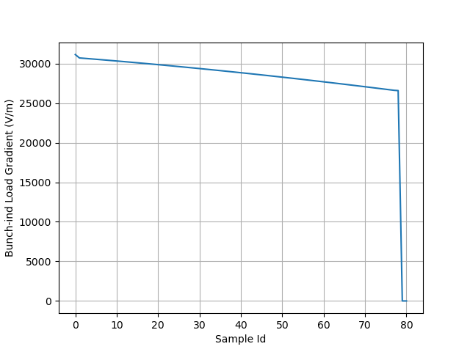
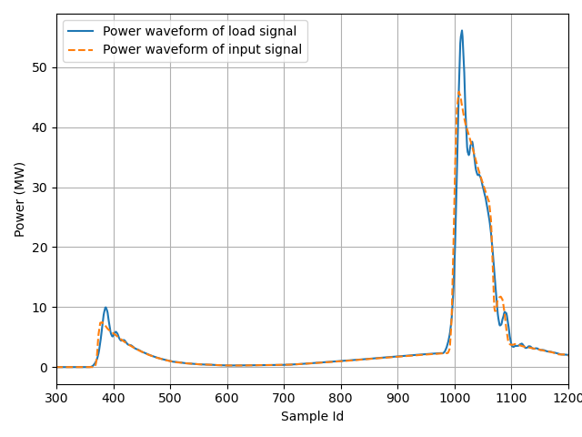
Single-bunch induced Load Signal
Measurement: Subtract the load waveforms w/o beam
Applications:
Determine the bunch injection time
Examine the phase balance of multiple structures
Examine the detuning of a TW structure
Calibrate the TW structure RF drive power and accelerating voltage
Measurement of bunch-induced load signal
Bunch-induced load signal of 4 TW structures
Theoretical bunch-induced gradient with 200 pC charge
TW structure input power estimate

Slide 11
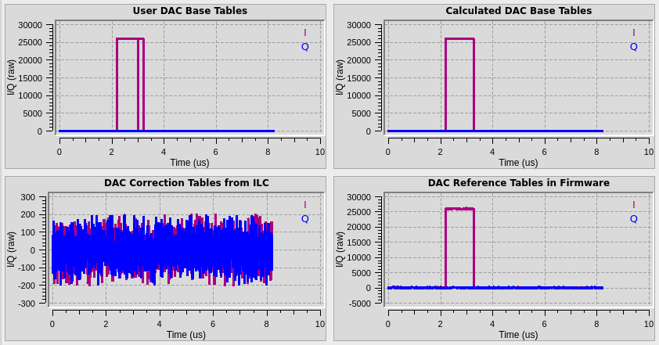
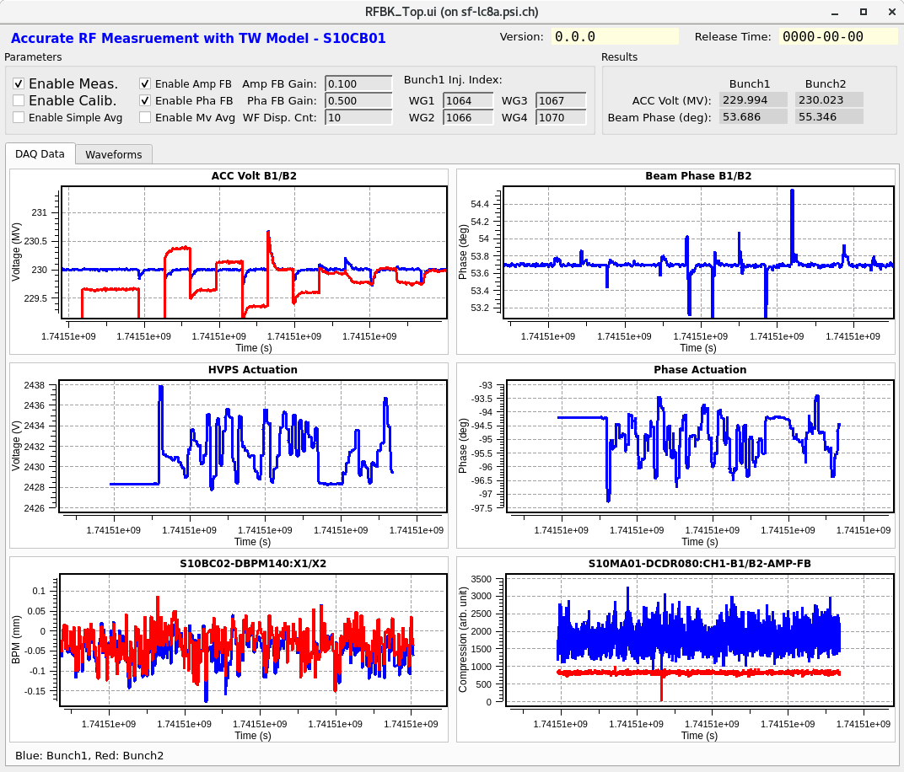
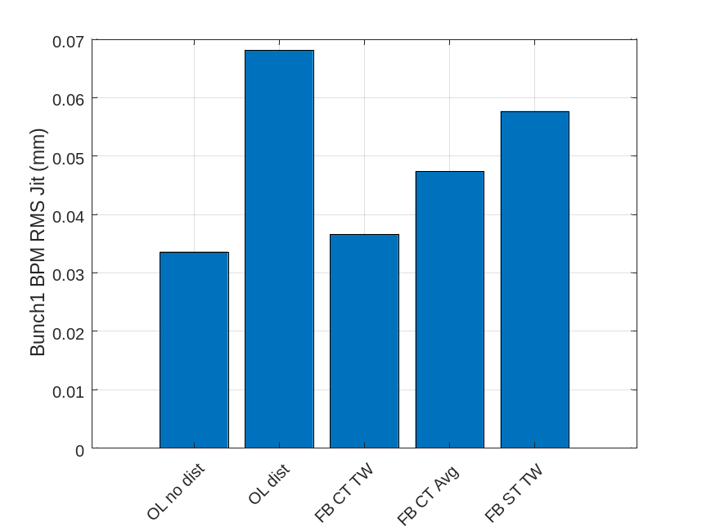
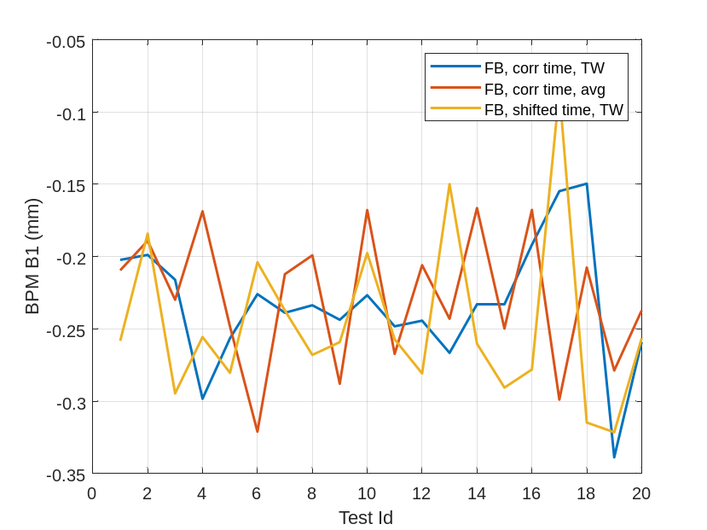
TW Structure Model Validation at SwissFEL
Validation with beam stability under RF feedback. Random disturbance is injected to S10CB01 (first C-band station of Linac1), and the beam stability is checked for the following RF feedback configurations:
  Open loop with no disturbance (OL no dist)
  Open loop with disturbance (OK dist)
  Closed loop with correct time window and TW model (FB CT TW)
  Closed loop with correct time window and simple average (as in SwissFEL) (FB CT Avg)
  Closed loop with shifted time window (10 samples to left) and TW model (FB ST TW)
Random disturbance added to the LLRF output (DAC table)
Beam energy stability with different FB strategies
BPM data of 20 observations
Python-based FB software for testing at SwissFEL

Slide 12
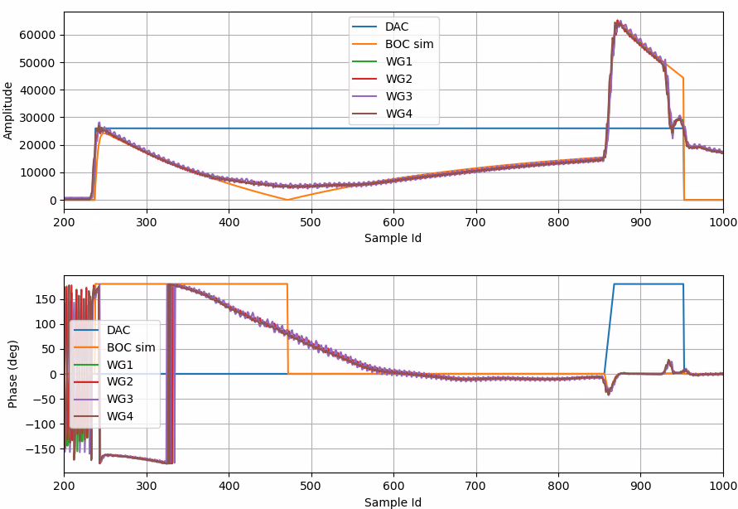
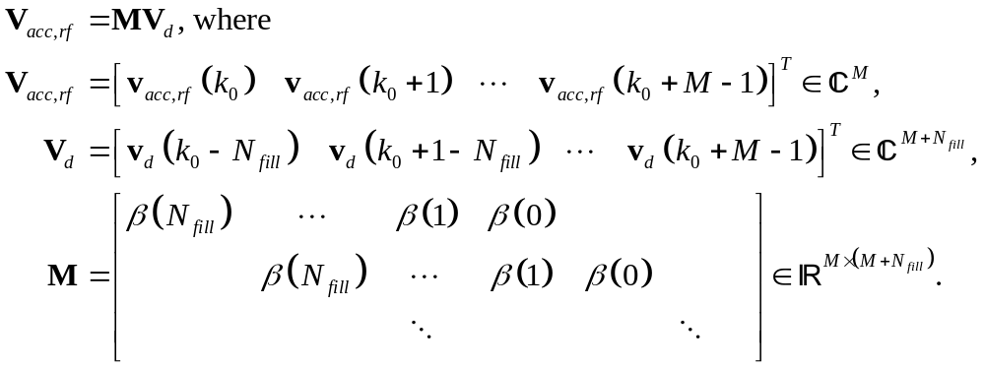
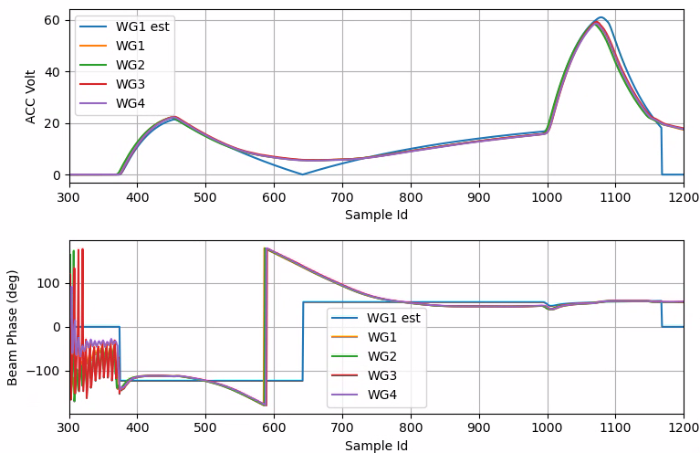
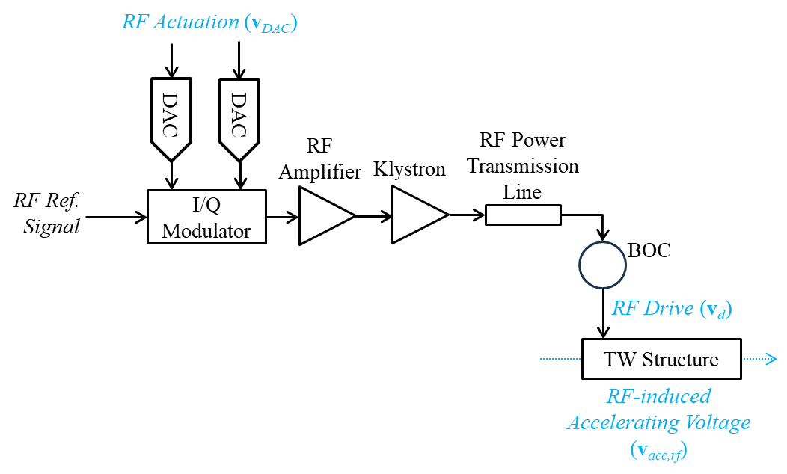
RF Station Model
RF components response matrices derived from their impulse responses:
TW structure model:
Simulation of TW structure input signals
SwissFEL C-band RF station block diagram
Simulation of TW structure accelerating voltage

Slide 13
Simulation Software

Slide 14
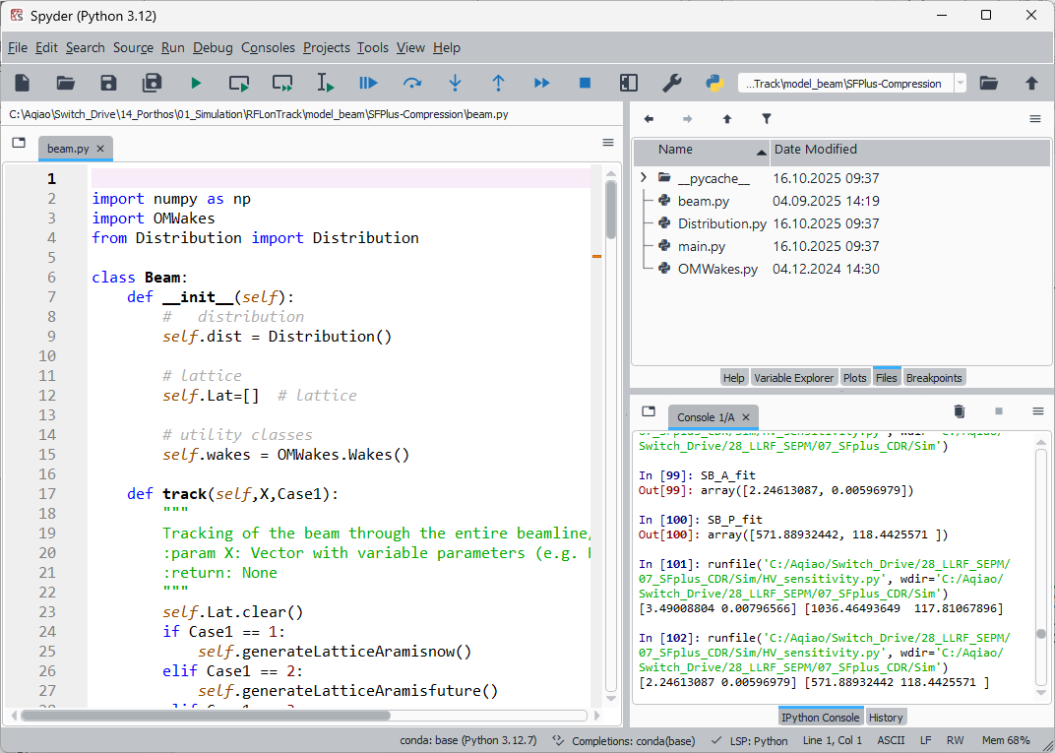
Inputs from Beam Dynamics Expert
Beam tracking code (Python) with the following features:
For SwissFELplus lattice layout
Multi-particle longitudinal phase-space tracking
Longitudinal phase-space representation & beam generation
Bunch profile slicing and current reconstruction
RF structure acceleration & energy chirping
Short-range wakefield effects
Magnetic bunch compression up to 3rd order
Longitudinal space charge (LSC) effects
Beam diagnostics & phase space analysis

Slide 15
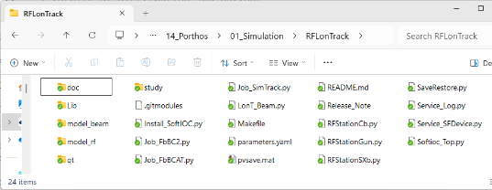
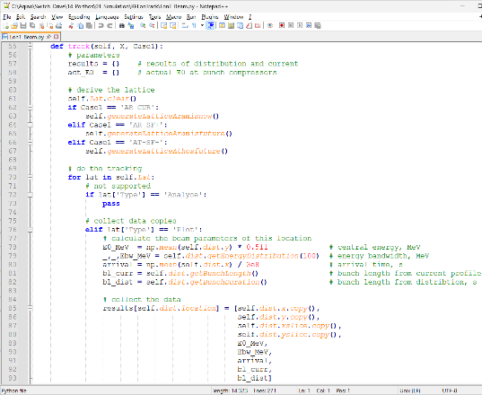
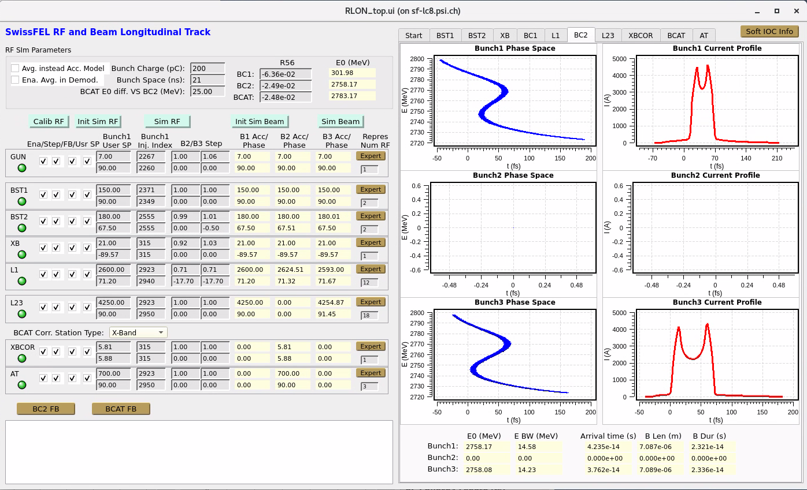
Simulation Code
A Python soft IOC (ooEpicsPy based) with the following features:
  Model RF system: limited bandwidth of amplifier and klystron, SW cavity and TW structure model, calibration with existing RF stations, beam loading
  Start-to-end beam tracking for all 3 bunches
  Beam energy and bunch length feedback around BC2 (for Bunch3) and BCAT (for Bunch2)
Python soft IOC code for RF-beam tracking (RFLonTrack)
GUI of RFLonTrack

Slide 16
3-bunch Setup and Feedback

Slide 17
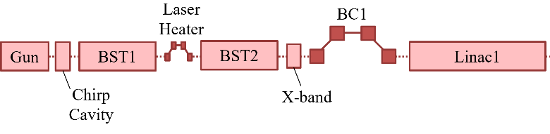
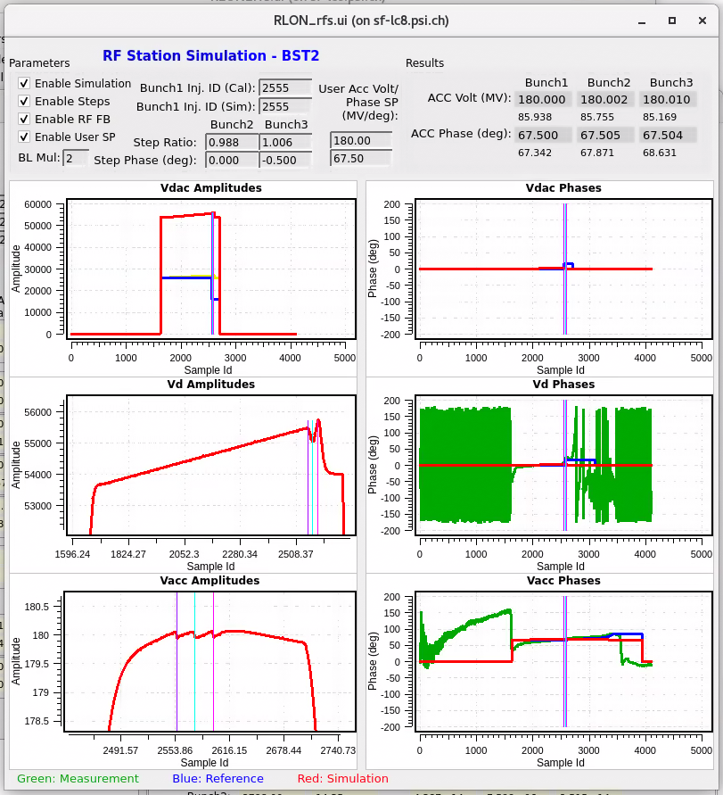
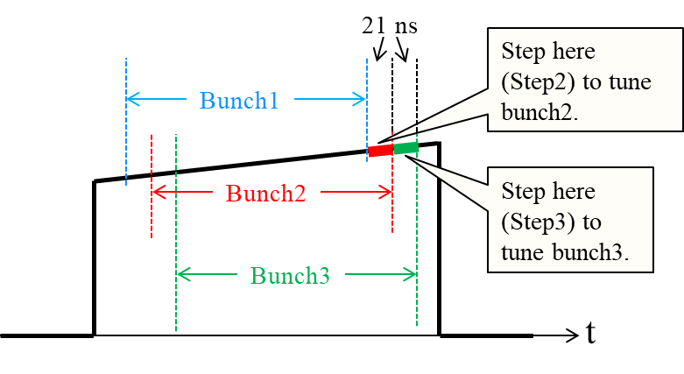
3-bunch Operation Setup
S-band RF stations at BST2
  Use RF pulse amplitude/phase slopes to equalize Bunch1 and Bunch2 at BC1
  Tune Step3 to optimize Bunch3 parameters at BC1
RF Station | Acc. Voltage Tuning Range | Acc. Phase Tuning Range (deg)
S-band Gun (SW Cavity) | ±1 % | ±0.8
S-band (TW Structure) | ±1 % | ±0.7
X-Band (TW Structure) | ±14.3 % | ±10
C-band (TW Structure) | ±1.4 % | ±1

Slide 18
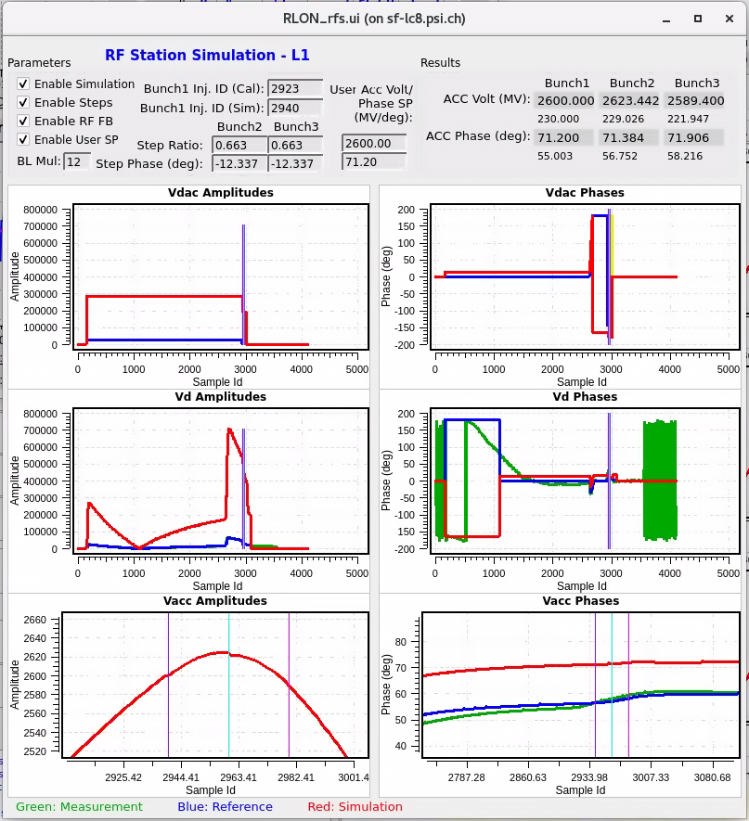
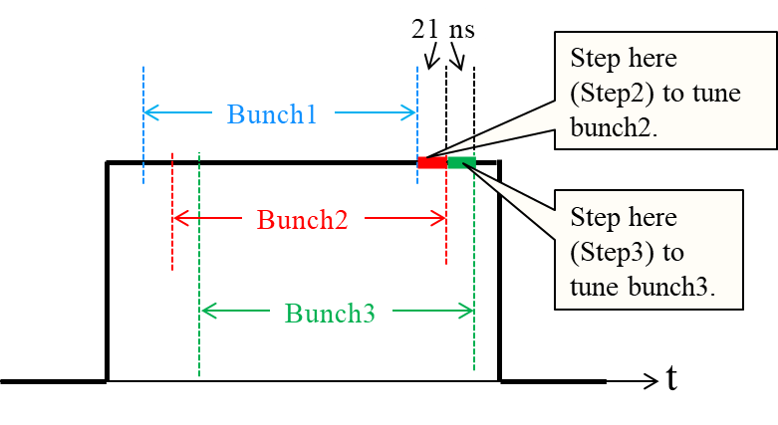
3-bunch Operation Setup (cont.)
C-band RF stations (with BOC) at Linac1
  Adjust the RF pulse delay so that Bunch3 gains larger energy than Bunch1
  Use the Step2 and Step3 (with the same setting) to adjust Bunch3 parameters
    Equalize the energy of Bunch3 and Bunch1
    Adjust the bunch length of Bunch3
  Bunch2 will get larger energy, which should be defined as the reference energy for BCAT

Slide 19
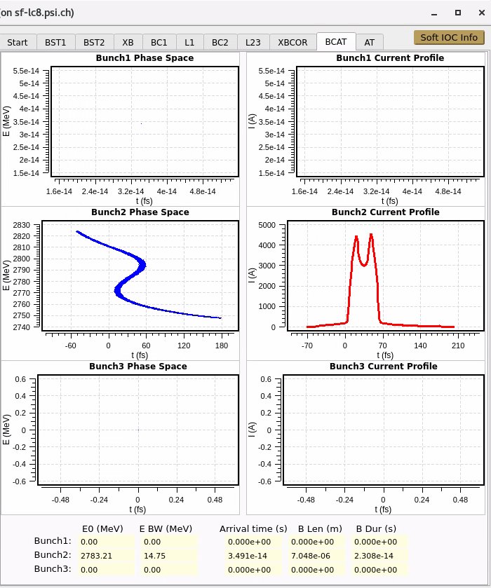
3-bunch Operation Setup (cont.)
After setup, Bunch1 and Bunch3 have the same energy and bunch length
After setup, Bunch2 has ~25 MeV higher energy than Bunch1/3, and same bunch length

Slide 20
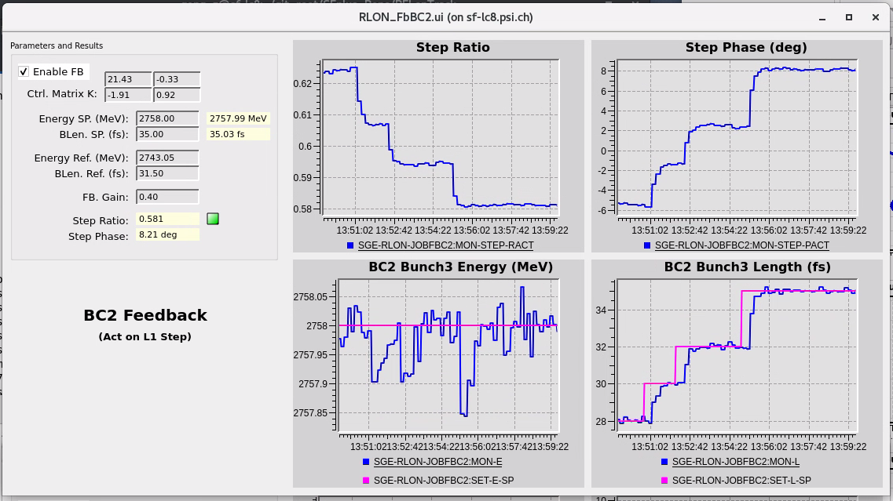
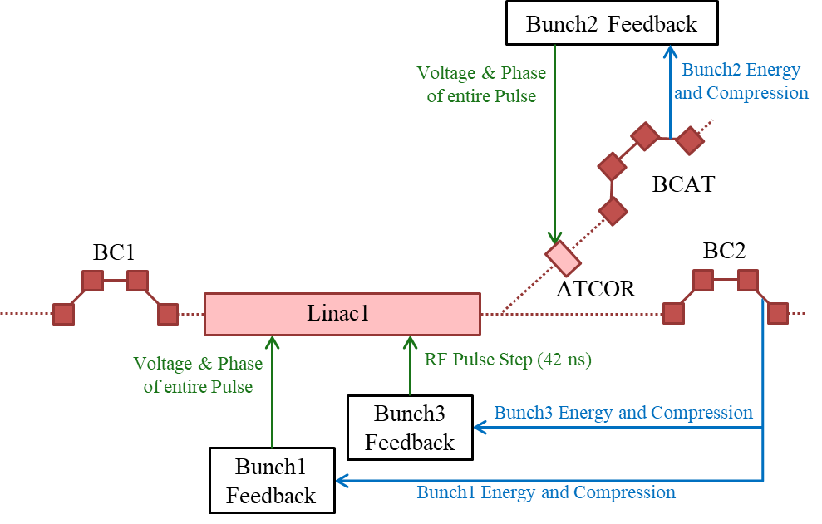
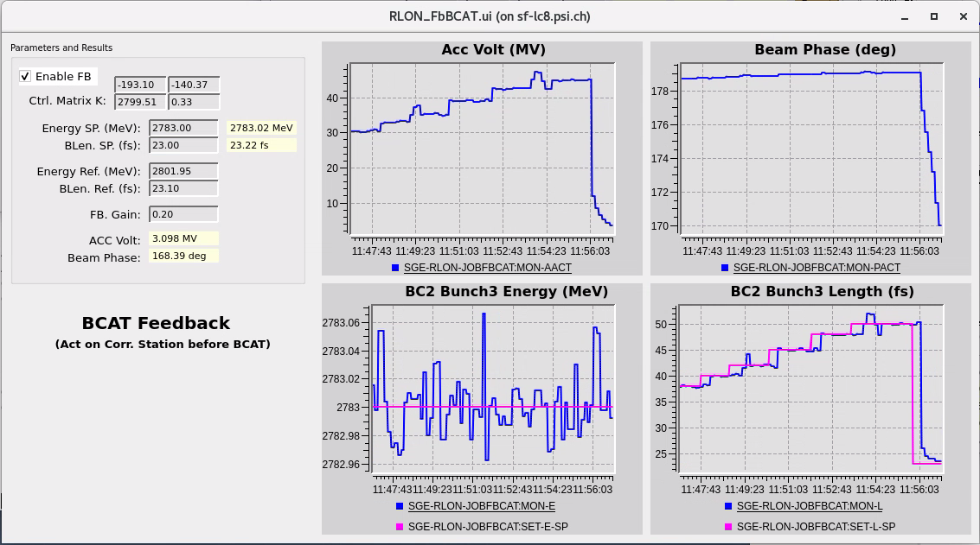
Feedback for Bunch3 (BC2) and Bunch2 (BCAT)
Bunch3 FB: act on Linac1 RF pulse Step2 & Step3
Bunch2 FB: act on ATCOR amplitude and phase
Adjust Bunch3 parameters (with Linac1 RF pulse steps) will disturb Bunch2. The disturbance will be compensated for by Bunch2 FB using ATCOR
Wrong label on panel, should be BCAT Bunch2 Energy and Length

Slide 21
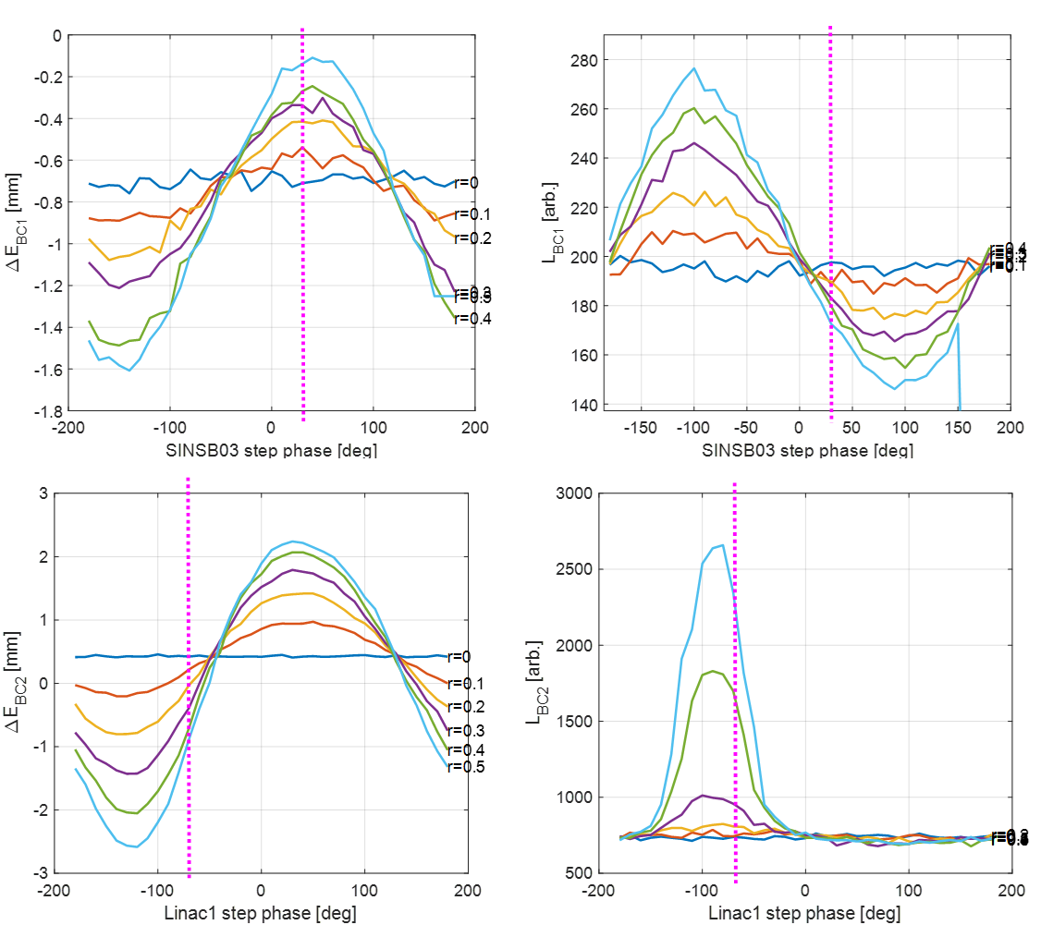
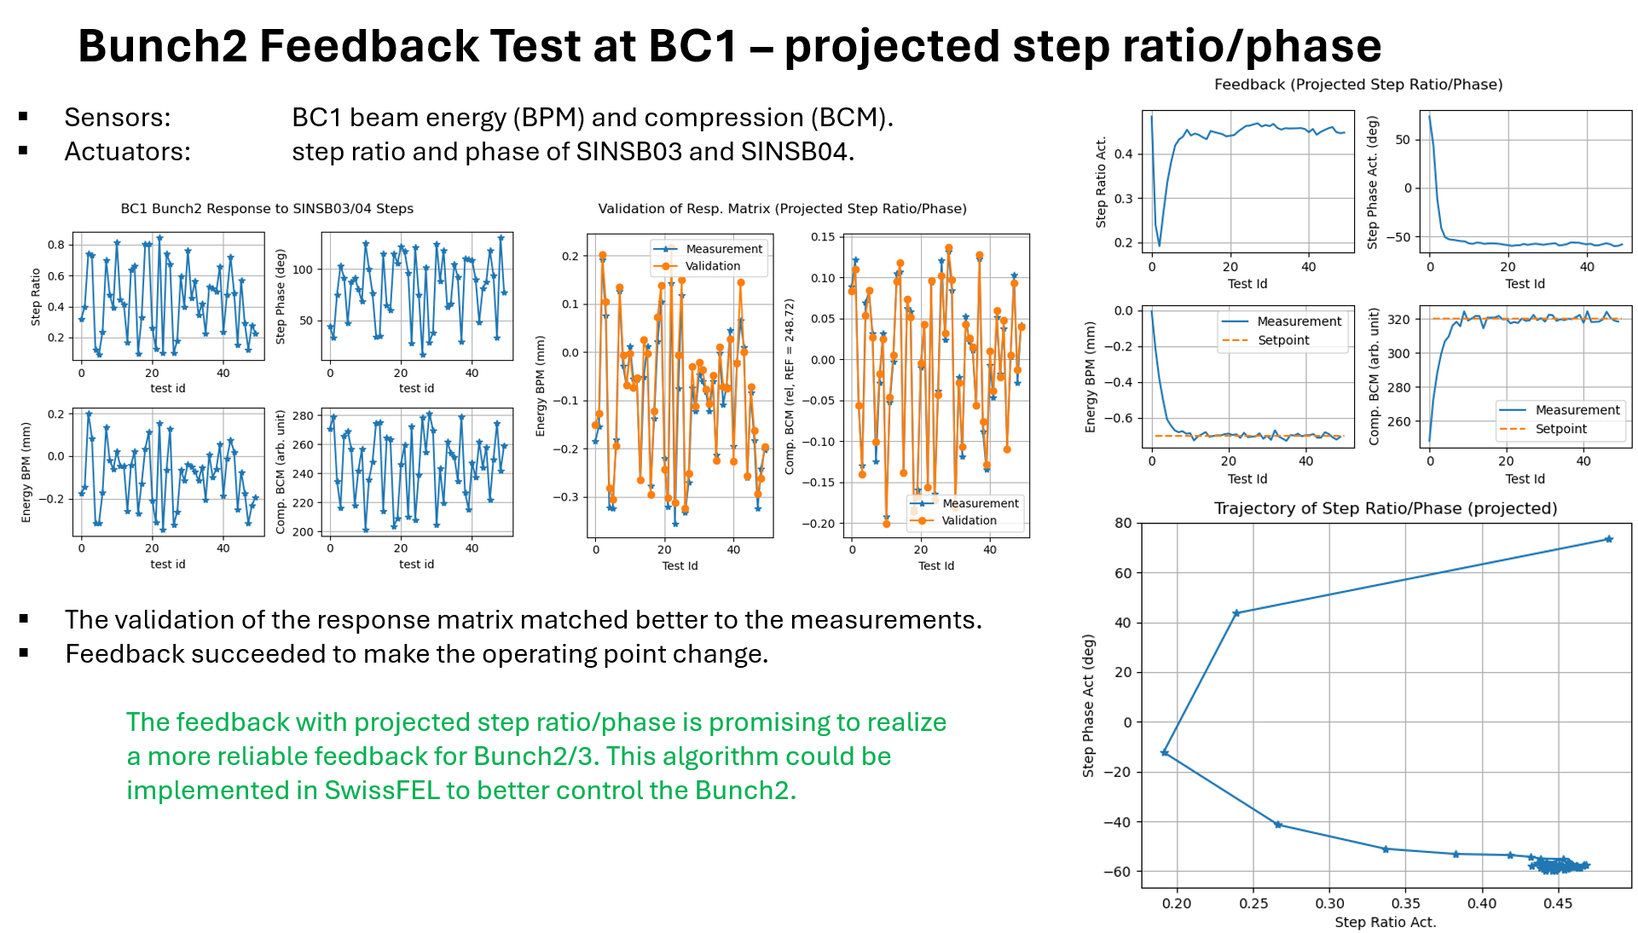
Feedback Algorithm
MIMO (2 inputs, 2 outputs) controllers are applied to the FB at BC2 and BCAT:
  Inverse the response matrix with regularization => more robust control
  Use I/Q control instead of amplitude/phase control (RF is represented as real/imaginary parts instead of amplitude/phase)
Full-range response of beam energy / bunch length to RF pulse step ratio / phase. The vertical lines indicate the operating point

Slide 22
Conclusion and Outlook

Slide 23
Conclusion and Outlook
Conclusions:
  3-bunch operation is preliminarily proved to be feasible for SwissFELplus/Porthos to supply 3 beamlines simultaneously at 100 Hz.
  The LLRF tuning knobs for the 3-bunch operation, including the RF pulse slops and RF pulse steps, has been proved to be valid for both setting up the 3 bunches and feedback controls of them.
  The TW structure model and the RF station model matches well the physical behavior of the system.
  Faster LLRF DACs are required to improve the timing resolution of the RF pulse steps. For SwissFELplus, CPCI-Serial based LLRF will be designed adopting DACs with 500 MSPS.
Outlook:
  Further study is planned to evaluate the tuning of 3-bunch operation with the RF pulse waveform shapes using the TW structure model and optimization algorithms.
  Validate the control strategies for 3-bunch setup and feedback at SwissFEL operated with 2 bunches.
  Implement the 3-bunch control strategy into LLRF firmware and automation software.
  Apply the TW structure model and control methods to the 4-bunch operation scenario of the FCC-ee injector.

Slide 24

Thank you!

