Slide 1
Minimizing Unwanted Beam Current
In The Electron-Ion Collider
Arshdeep Singh on behalf of the EIC LLRF Team
2026-10-13

Slide 2
Overview
Introduction & Background
Nominal Conditions
  Bunch Splitting
  Beam Current
Beam Current Minimization
  Strategy
  Deviations
  Use of feedback
Conclusion

Slide 3
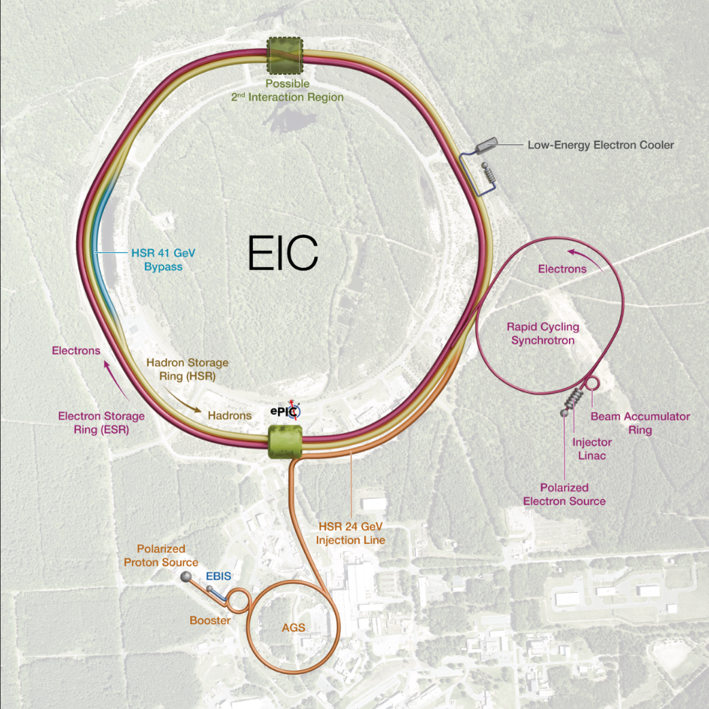
EIC Overview
The EIC is a future collider to be built at BNL
  High luminosity :
    Between 10³³-10³⁴ cm⁻²s⁻¹
  Wide range of COM energies :
    ~ 20-140 GeV
  Polarized electron and hadron (p, He-3) beams
    ~ 70 %
The EIC will repurpose hardware from RHIC
  28 MHz and 197 MHz cavities

Slide 4
Hadron Storage Ring (HSR) Overview
To reach it’s peak luminosity, the HSR will perform bunch splitting
  Perform a 1 => 2 => 4 bunch split
    From H=315 to H=1260
The HSR will first capture and accelerate the beam, then perform bunch splitting, and finally compress the beam for collisions
Frequency [MHz] | Function | # Cavities | V / Cavity [MV]
24.6 | Capture/Acceleration | 4 | 0.150
49.2 | Splitting | 3 | 0.167
98.5 | Splitting | 4 | 0.150
197 | Storage | 8 | 0.750
591 | Storage | 4 | 4.0
Table : Overview of RF Systems in the HSR

Slide 5
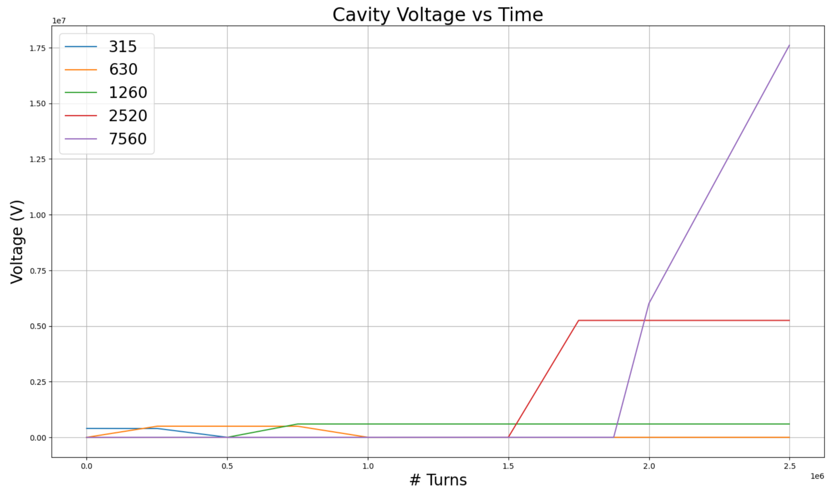
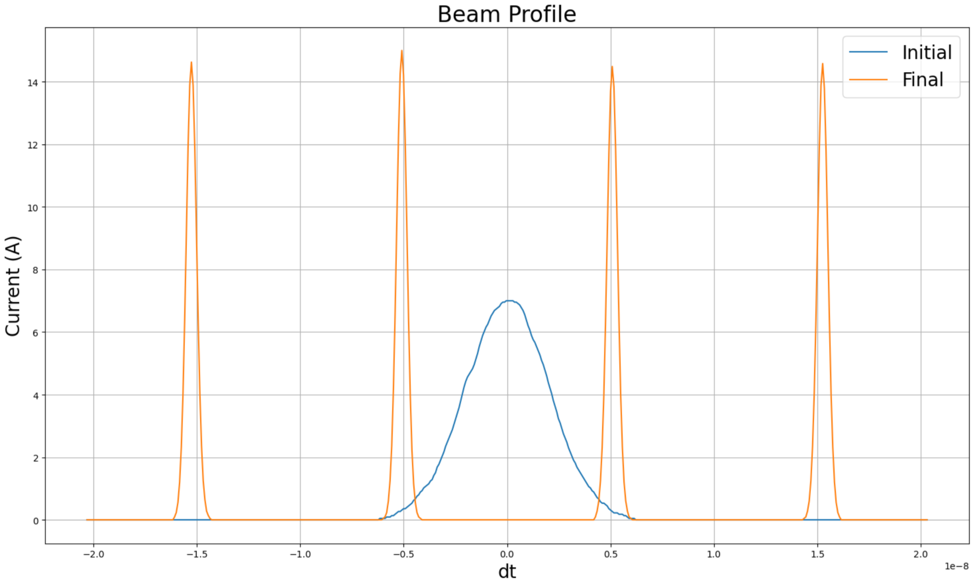
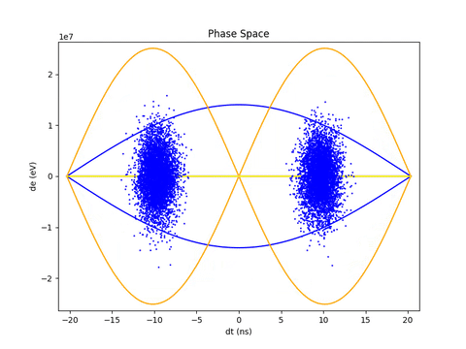
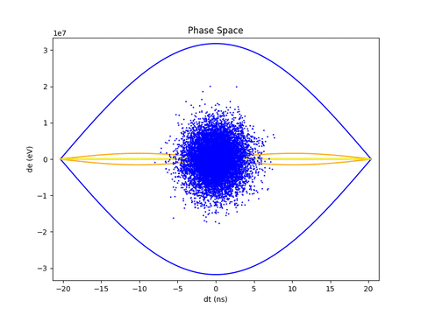
Nominal Bunch Splitting
DC current of 1 A and a peak current of about 15 A
Notes:
Mention, the voltage program is not optimized in any way
- its a very general program, slow enough to be adiabatic

Slide 6
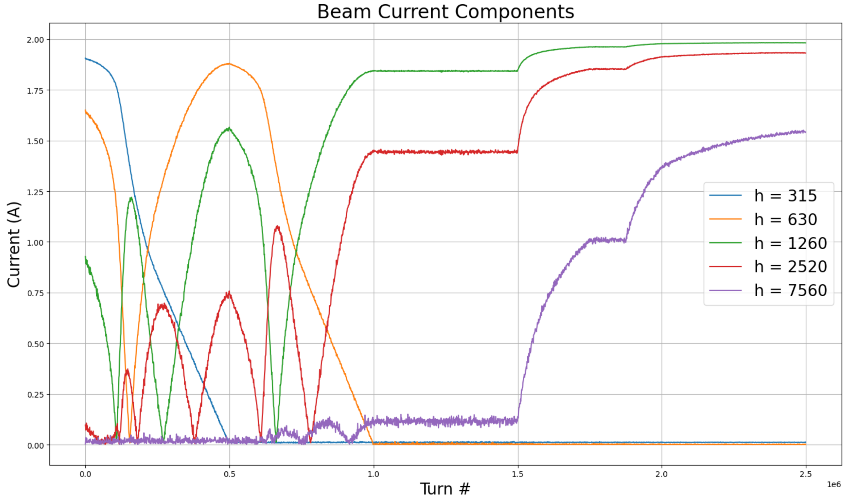
Nominal Beam Current
The beam current at each RF harmonic evolves through the splitting process
All HSR RF systems will use analog feedback for impedance reduction
  > 35 dB loop gain, ~ 300 ns loop delay
When VC ~= 0 V, the PA has to be equal and opposite the beam current
  Can run into power limitations due to high beam current in the EIC
RF beam current at each harmonic WRT turn #

Slide 7
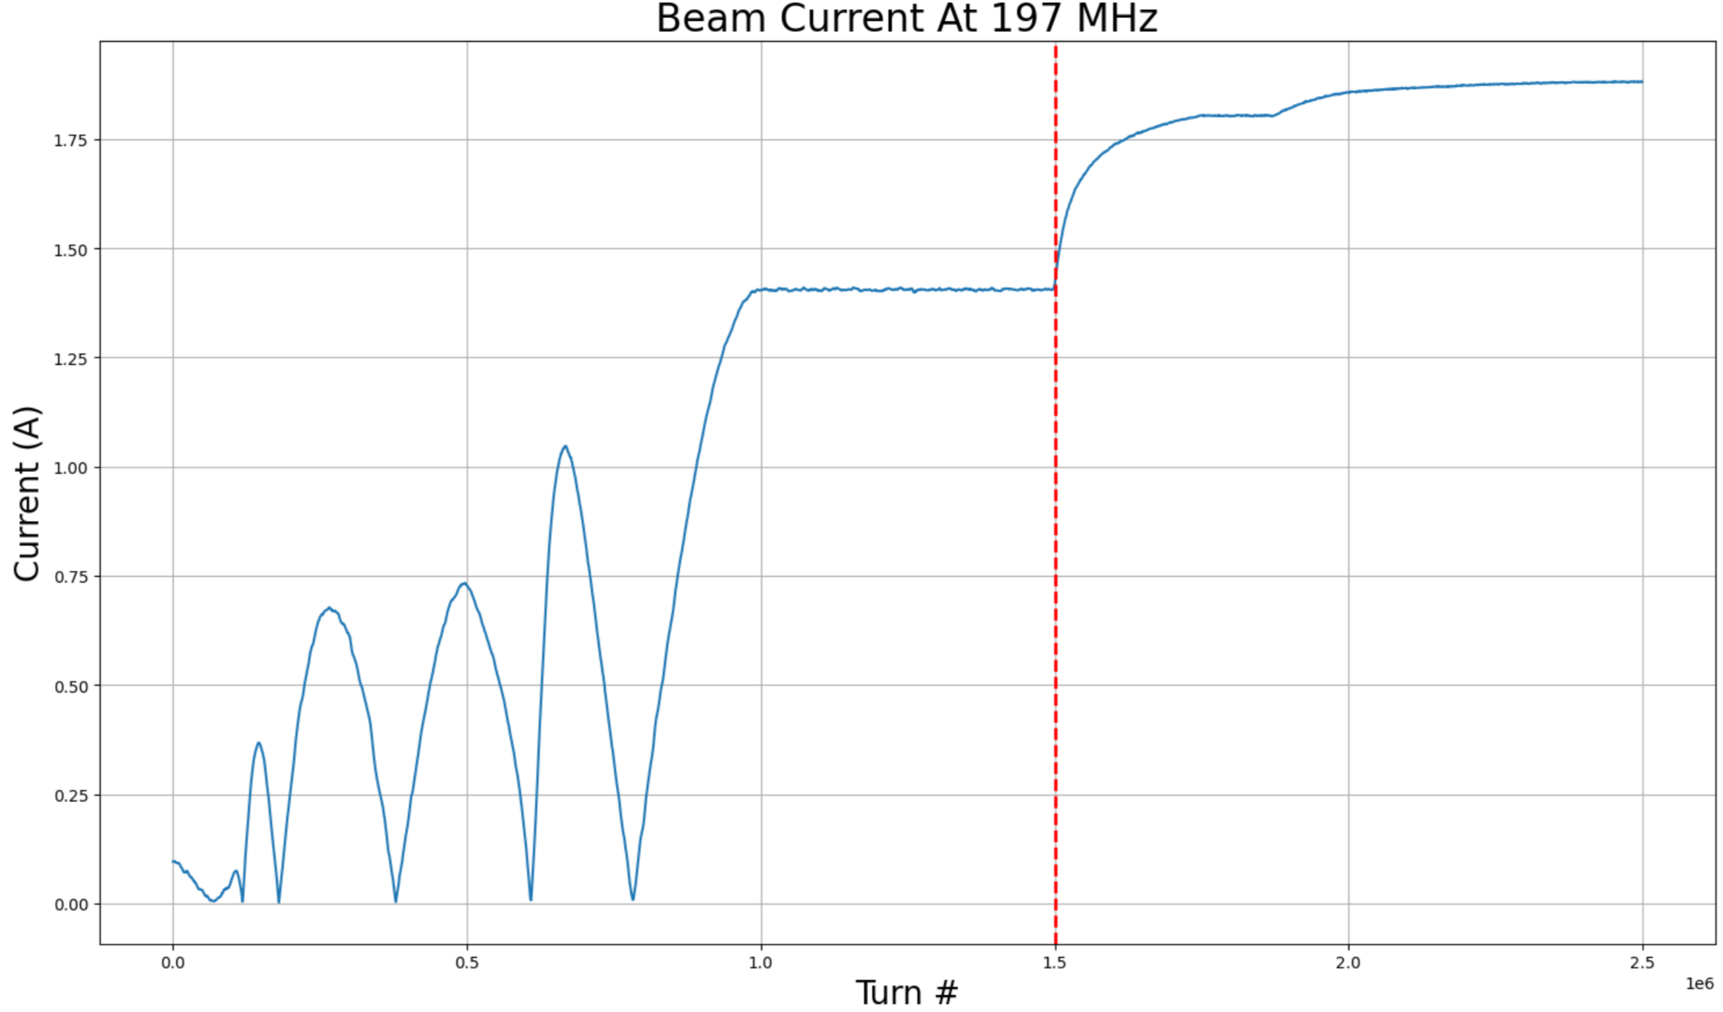
197 MHz Beam Component
The 197 MHz (H=2520) beam component is of particular concern. Doing some rough calculations:
  The 197 MHz systems will reuse RHIC hardware, the PA is limited to around 10 A anode current
  With a transformation ratio of 1:117 from the PA to the cavity, we get an upper limit for the generator current of about 85 mA
  The 197 MHz beam component reaches almost 1.5 A while Vc = 0 V, more than 17 times what the generator can provide
  Unmitigated beam-induced voltage will diminish achievable luminosity
The red line indicates when the voltage on the 197 MHz cavities are ramped up

Slide 8
Minimizing The 197 MHz Beam Component
Instead of fighting the full beam-loading, we can minimize it
The EIC has 8 197 MHz cavities, one of these can be counterphased and used as a “defocusing” cavity
  We can reshape the bunch to minimize the 197 MHz beam component [M. Blaskiewicz]
Most likely, the defocusing cavity cannot be converted back to a focusing cavity after the bunch splitting is complete [K. Mernick]
  Will need to cross the cavity resonance using the tuner
    Strong beam-loading
  We don’t need the full voltage from 8 cavities
    Need enough bucket area to transfer the beam to the 591 MHz bucket. Can be done with 7 focusing and 1 defocusing cavity.

Slide 9
Finding The Defocusing Voltage Program
Longitudinal tracking simulation is used to determine the defocusing voltage program:
  At t=0, perform a voltage scan (phase is either 0 or π) and find the value which minimizes the 197 beam component
  Then, every N turns, scan around the previous voltage value until the beam component is again minimized
  The defocusing phase alternate between 0 and π (in accordance with the beam phase)*
If we calculate the defocusing voltage often enough (if N is small) and if the granularity of our voltage scan is fine enough:
  We will end up with a smooth voltage program that minimizes the beam component while preserving adiabaticity and emittance
* more details on the next slide

Slide 10
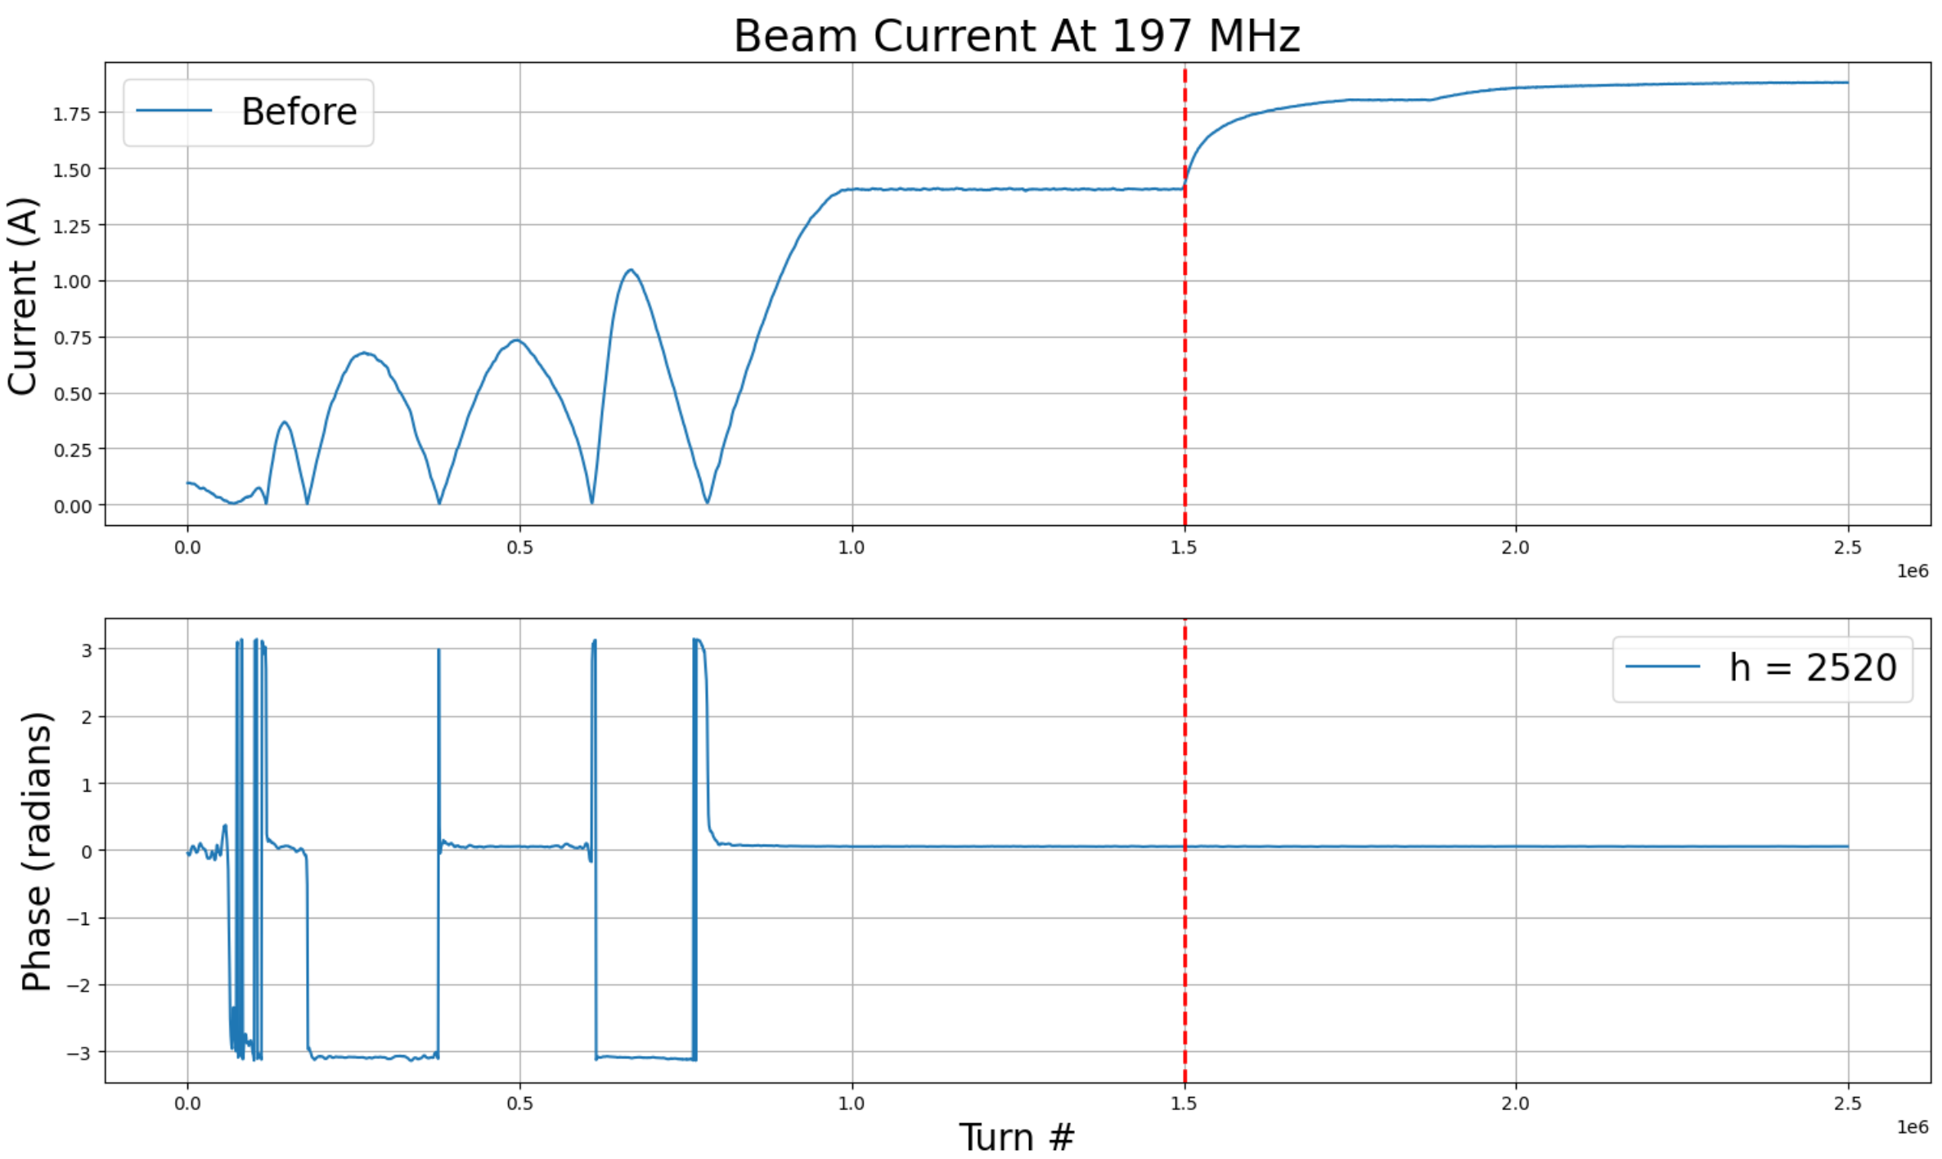
Note On The Defocusing Phase
If we look at the beam current and phase at 197 MHz during the nominal split:
Notice the beam phase switches each time the current goes to 0
The defocusing voltage will do the same
  No issue with suddenly jumping between phases as the switch will happen when the voltage is at 0

Slide 11
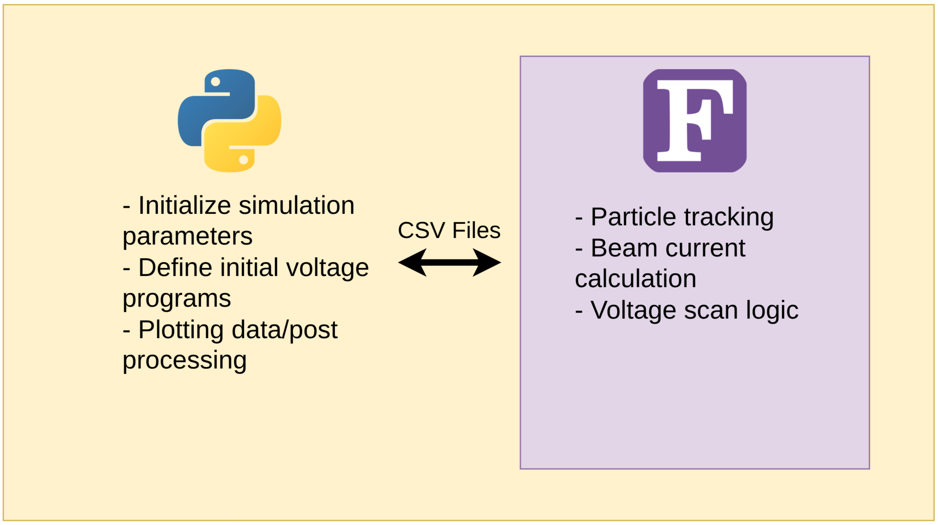
The Simulation Code
The simulations are fairly simple : longitudinal tracking + a few calculations
The code is written in house. It is a combination of FORTRAN wrapped in Python
  Take advantage of OpenMP in FORTRAN for speed

Slide 12
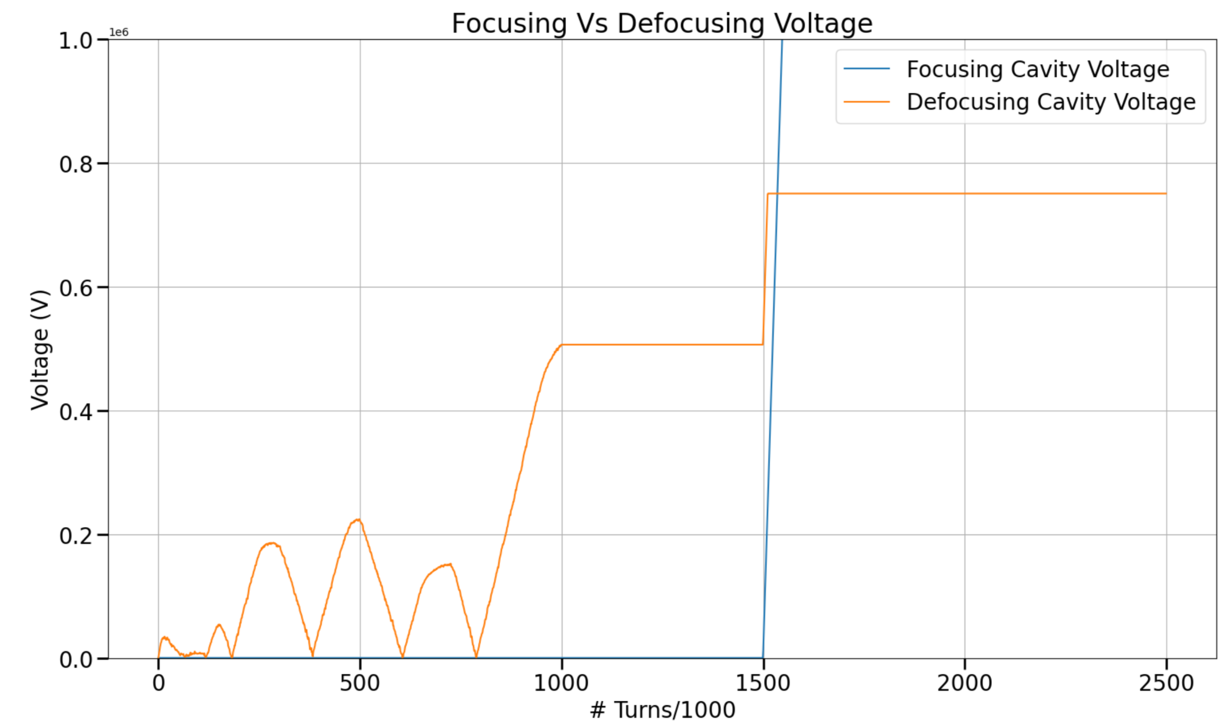
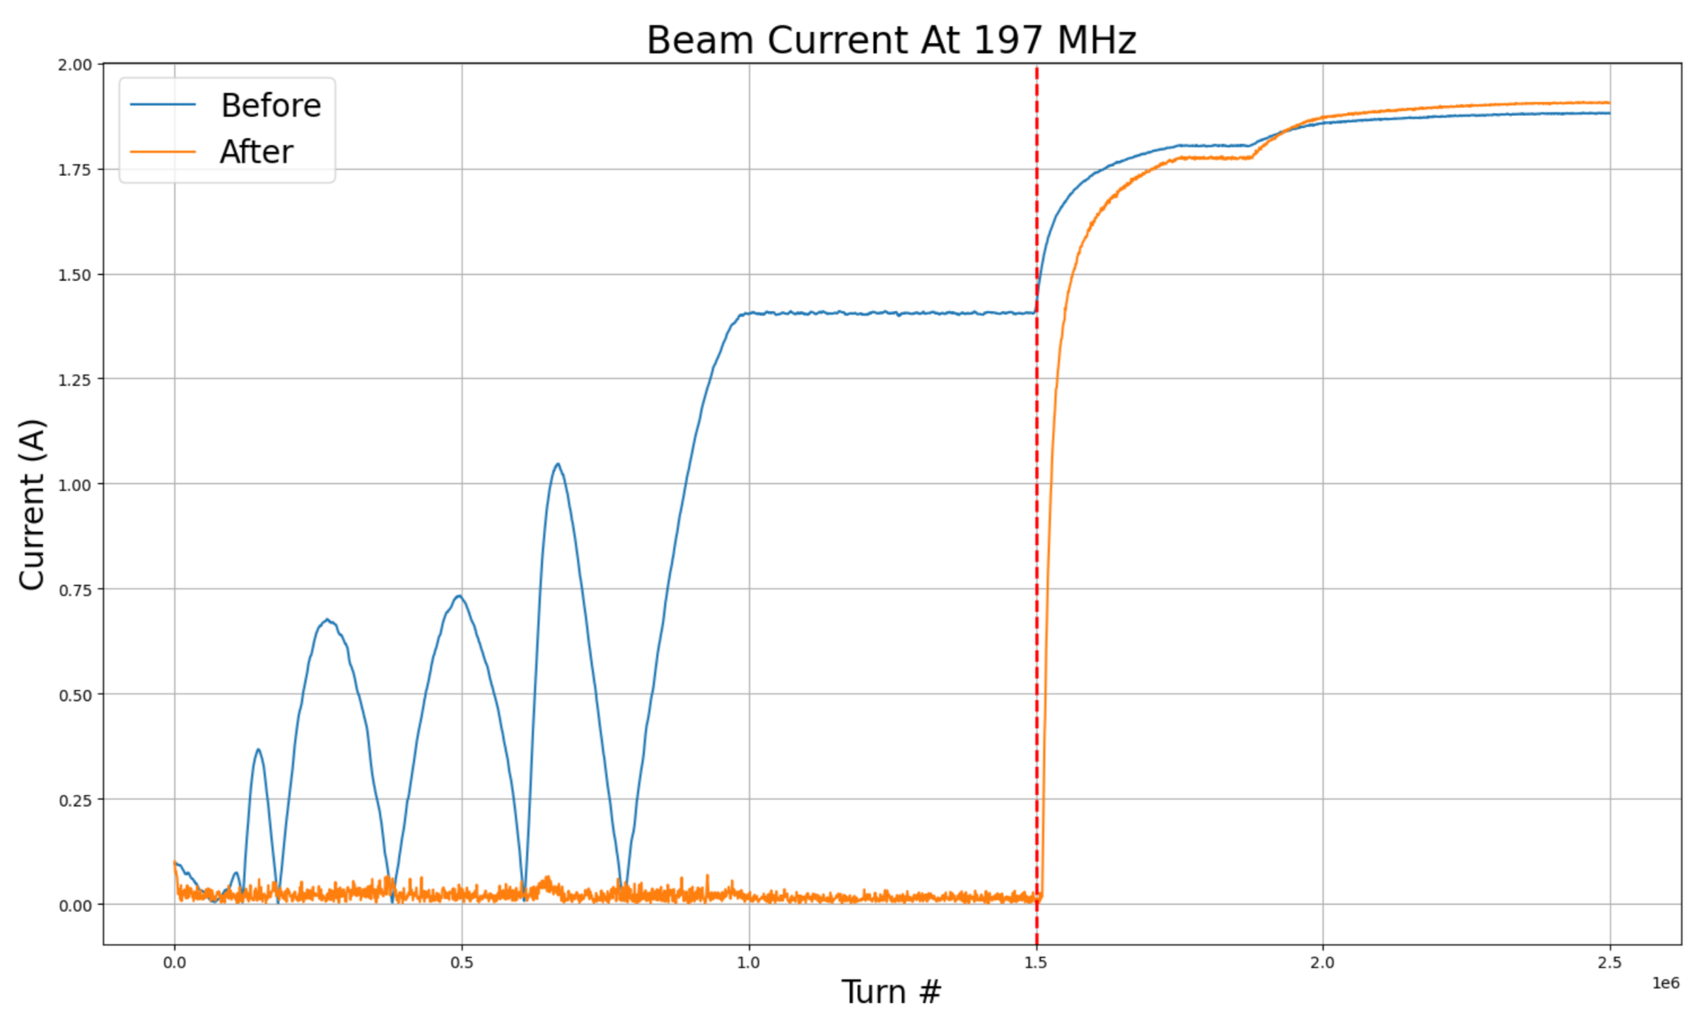
Initial Results : Defocusing Voltage
Ran simulations using 100e3 macroparticles

Slide 13
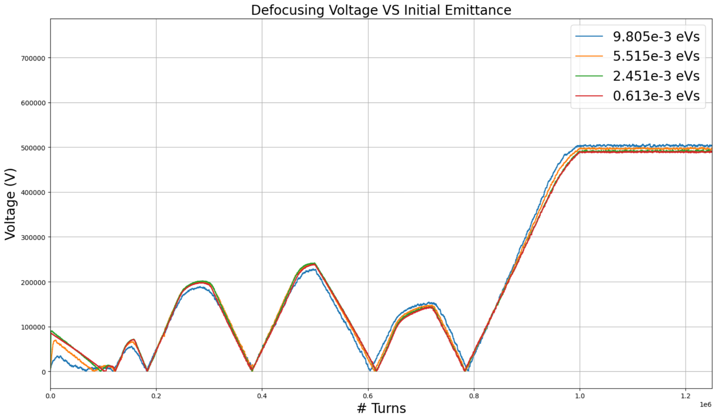
Effect Of The Initial Emittance
Ran simulations with varying initial emittances, not significant dependence found
  Any deviations could be corrected with feedback*
$ϵ_{0}=σ_{τ}σ_{E}$
* more details on the next slide

Slide 14
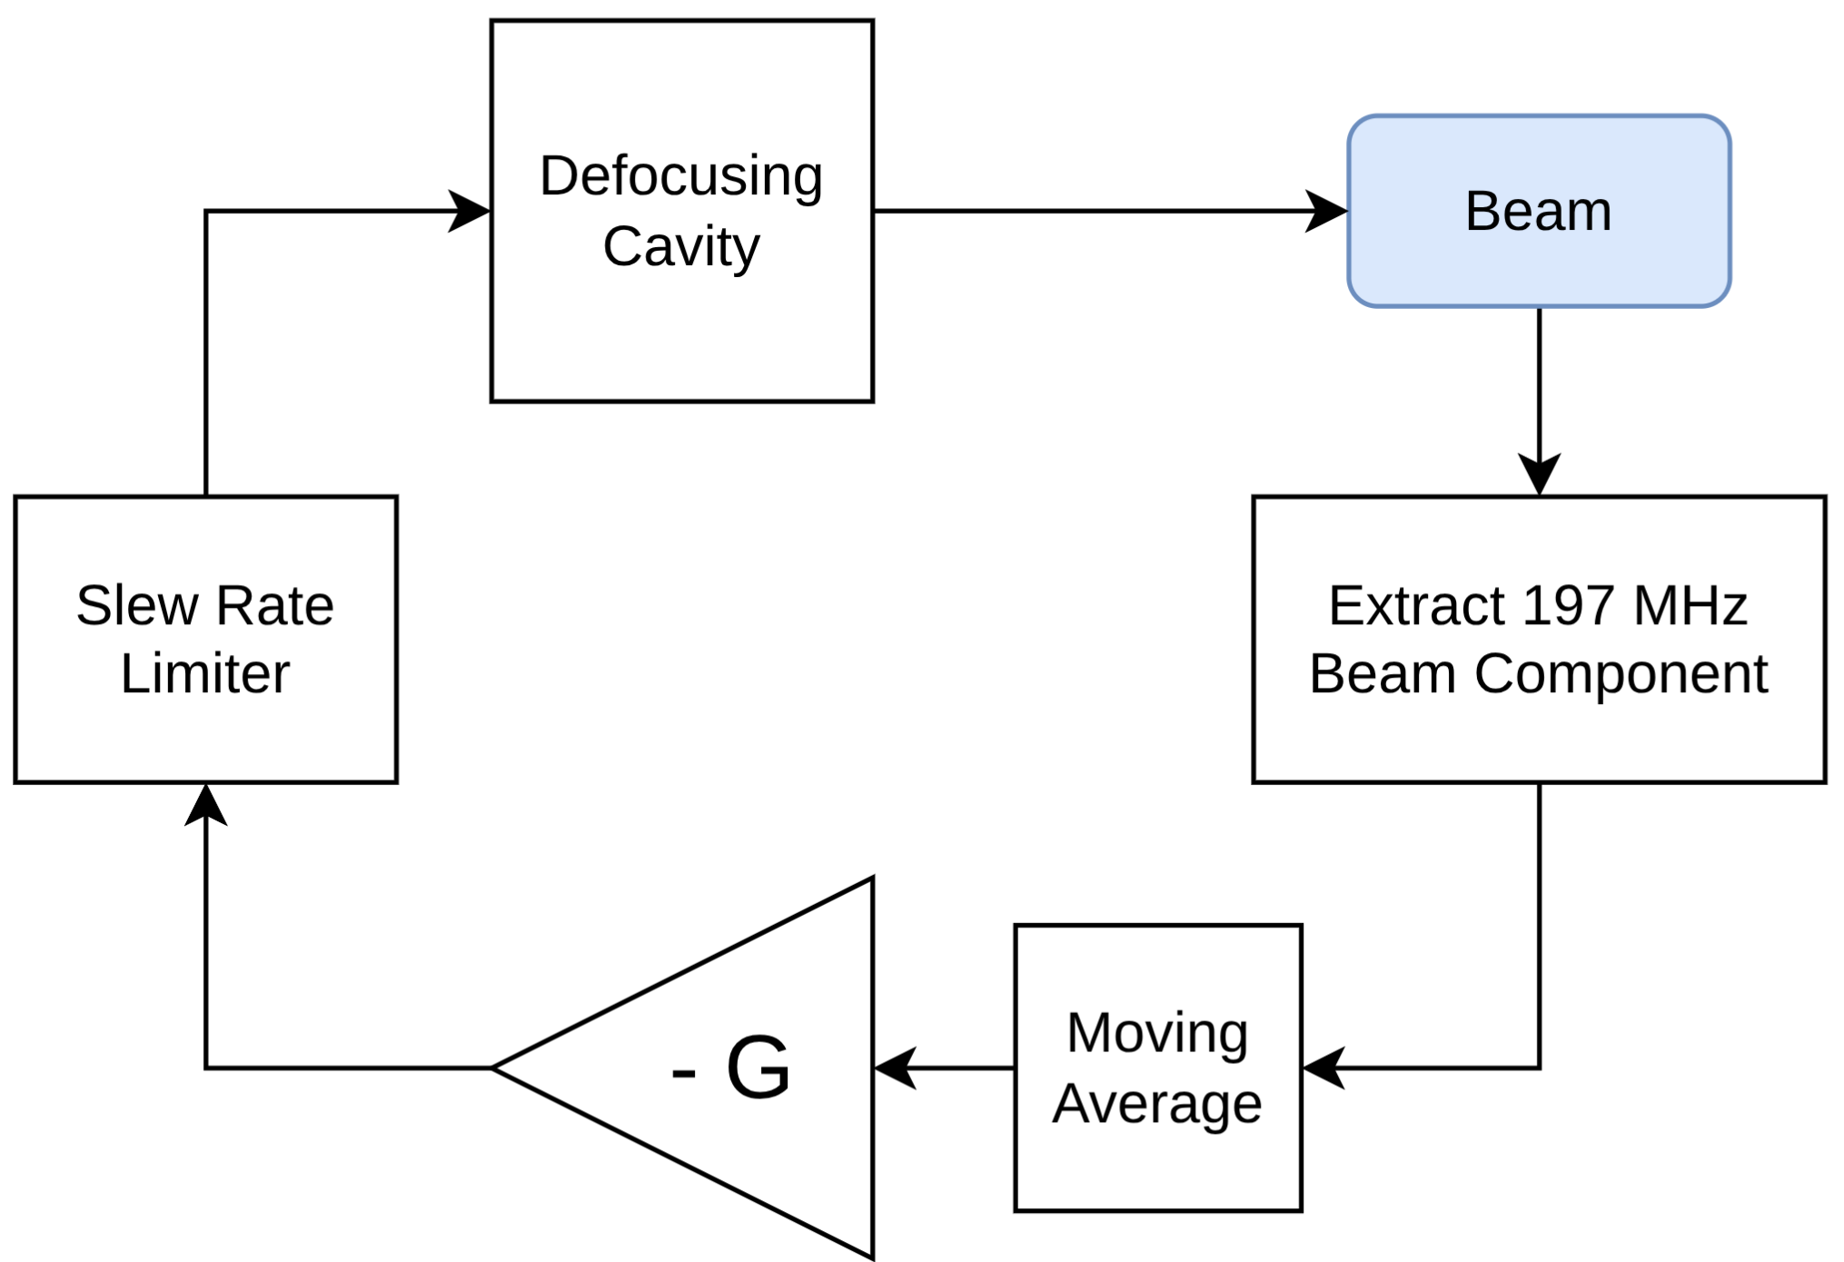
Using Feedback For The Defocusing Voltage
A “standard” defocusing voltage program can be calculated based on the planned bunch splitting voltage program
Can use feedback with low gain to regulate the defocusing voltage
  High gain can lead to emittance blowup
  Feedback would be enabled after the initial beam current is minimized

Slide 15
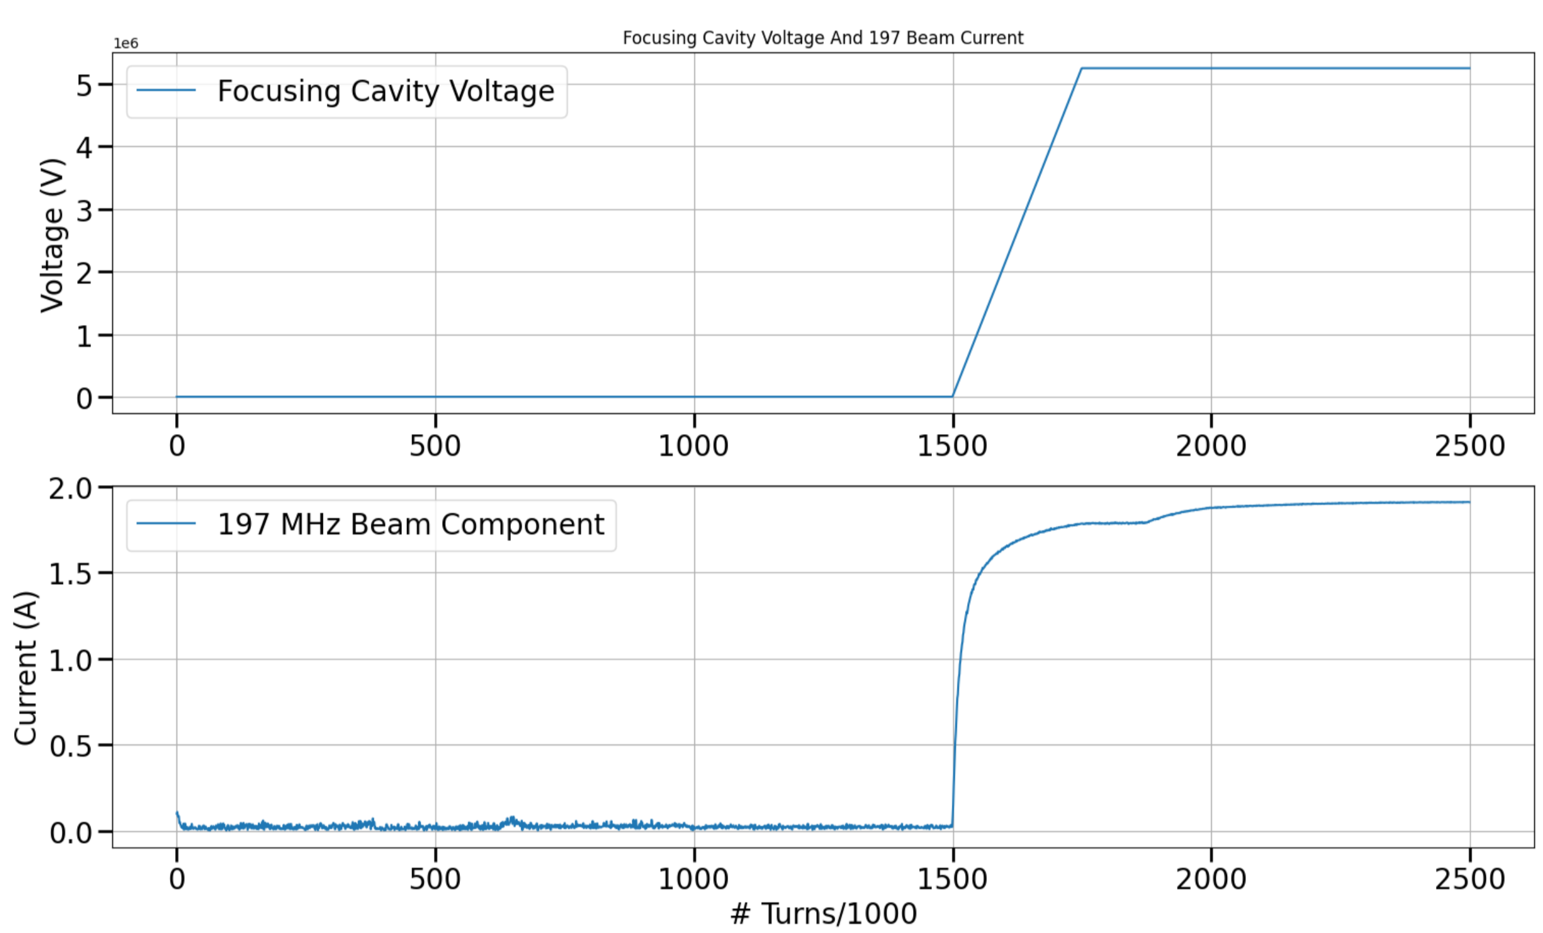
Bringing Up The Focusing Cavities
The 197 MHz beam component quickly rises as the focusing cavities are brought up
  We get over 85 mA when focusing cavities reach around 15 kV
    ~ 2 kV per cavity, assuming 7 focusing cavities
  Optimal detuning requires detuning by ~ 600 kHz
$Δf_{opt}=f_{RF}\frac{\frac{R}{Q}I_{RF}}{2V_{C}}cos\left(ϕ_{s}\right)$

Slide 16
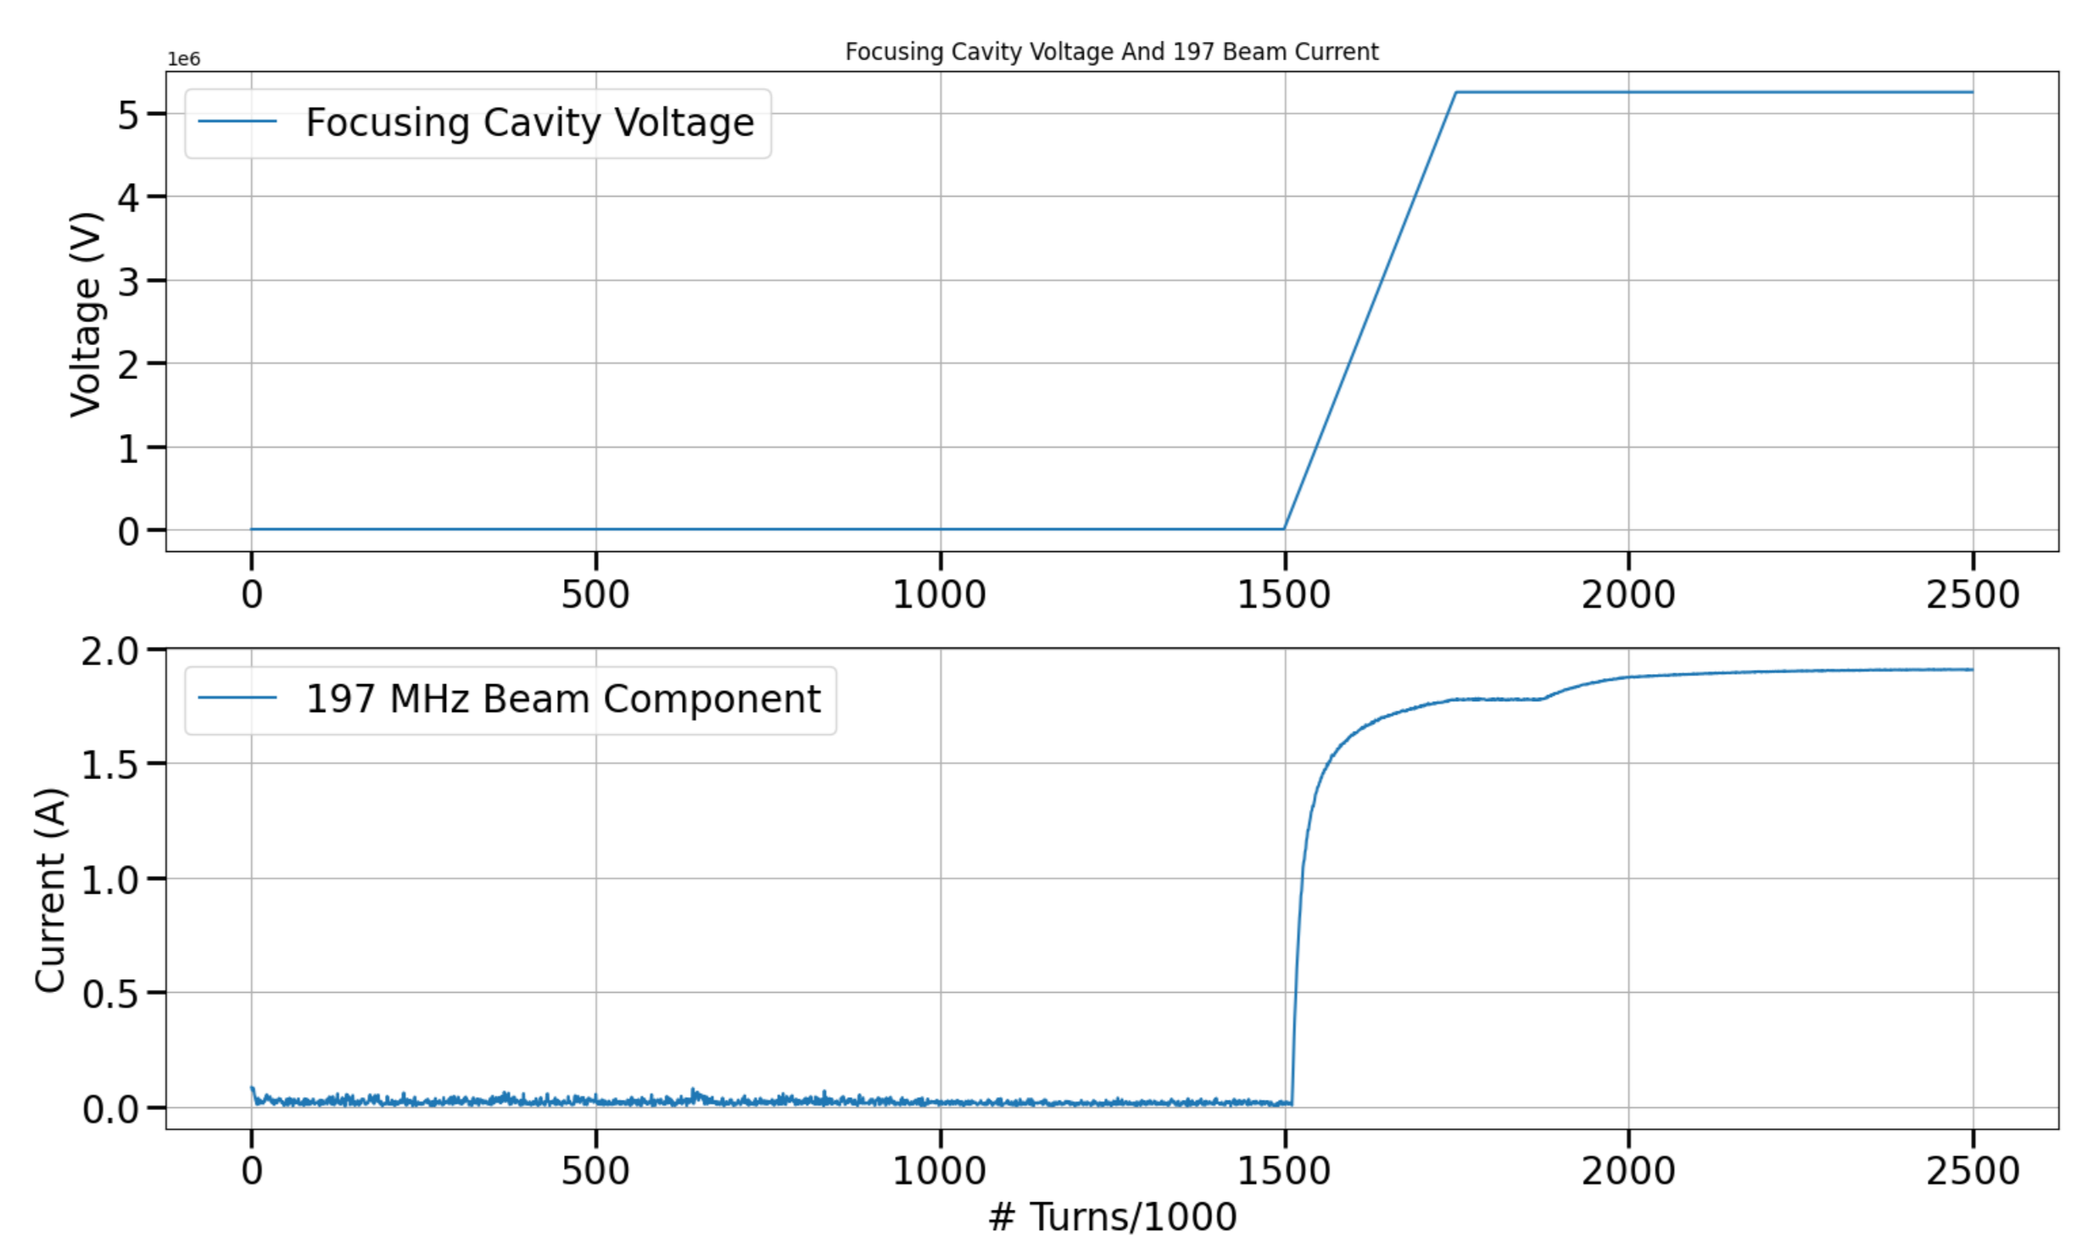
Bringing Up The Focusing Cavities (cont.)
We can increase the voltage on the defocusing cavity as the focusing cavities are brought up
Now we have around 37 kV (300 kV total) per cavity when beam is at 85 mA
  Optimal detuning of ~ 32 kHz
Starts increasing slightly later

Slide 17
Future Work and Conclusions
Installed power is not enough to safely perform bunch splitting in the HSR of the EIC
A defocusing cavity scheme is utilized to minimize beam loading and safely perform bunch splitting
Beam-loading effects should be minimal on the defocusing cavity
  Developing a full BLonD simulation to validate the defocusing scheme
  Study effects of transient beam-loading
Thank you for listening, any questions?

Slide 18
Acknowledgments
Thanks to the EIC RF team for their advice, support, and feedback. S. V. Andres, M. Blaskiewicz, K. Mernick, F. Severino, G. Narayan, W. Xu, B. Xiao, S. Mai, A. Fahey and others.

