Slide 1
Photonic RF phase monitor
Russell Wilcox
Qiang Du, Tianhuan Luo, Shreeharshini Dharanesh Murthy, Will Wright, Alessandro Ratti
LLRF Workshop
October 14, 2026

Slide 2
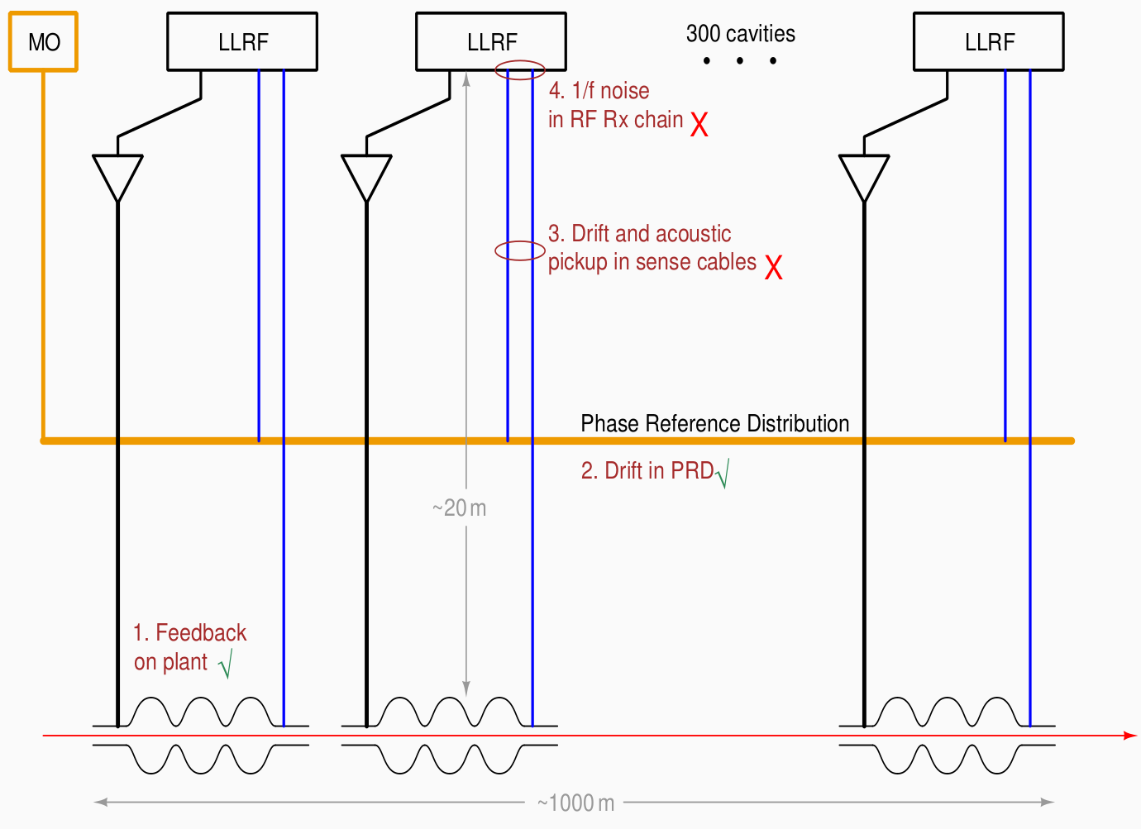
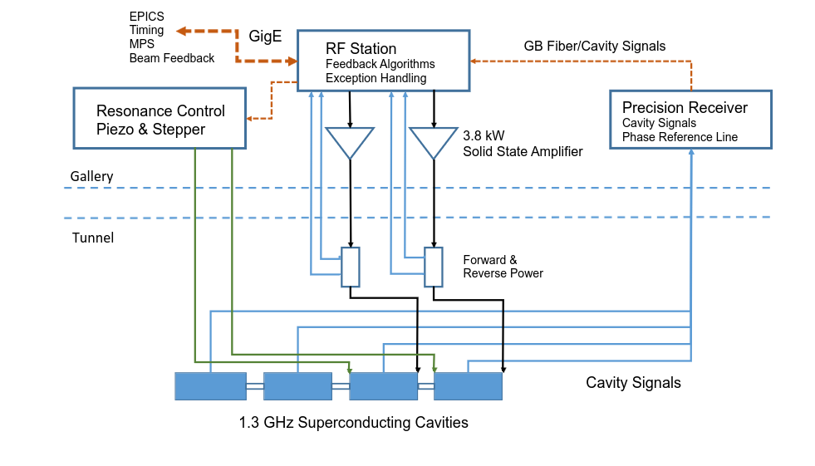
Sensor cable length drift affects precision LLRF control
LCLS-II LLRF control:
Measured out-of-loop RMS time jitter: 3.4 fs (0.1Hz – 5kHz)
20m coax, 0.185 ppm /°C, time drift: 12 fs / °C
Precision feedback requires time-stabilized measurement

Slide 3
We propose time sensing via interferometry, and phase modulator transducer
Need stable (or measured) optical delay to sensor
  Popular: stabilized sampling pulses to EO transducer
    [M.K.Czwalinna, LLRF Workshop 2024]
    One sample per optical pulse
Proposed: CW to EO transducer, return modulated light
  Continuous data
  No bias, phase modulation is linear with voltage
  No electronics in radiation environment
Use optical interferometry for delay measurement
  Detect time delay with high precision:
    [R. Wilcox et al, Opt. Lett. 34, p3050 (2009)]
  Can separate carrier and modulation information
Use coherent fiber telecom components
  Optical phase detectors are mature tech:
    [K. Kikuchi, IEEE JLT 34, p157 (2016)]
e.g. EuXFEL:
RF
bias
pulses
partial
reflector
Ampl. mod.
(MZM or SGI)
electronics
time-stabilized link
This talk:
RF
CLK
CW
circulator
Phase mod.
time-measured link

Slide 4
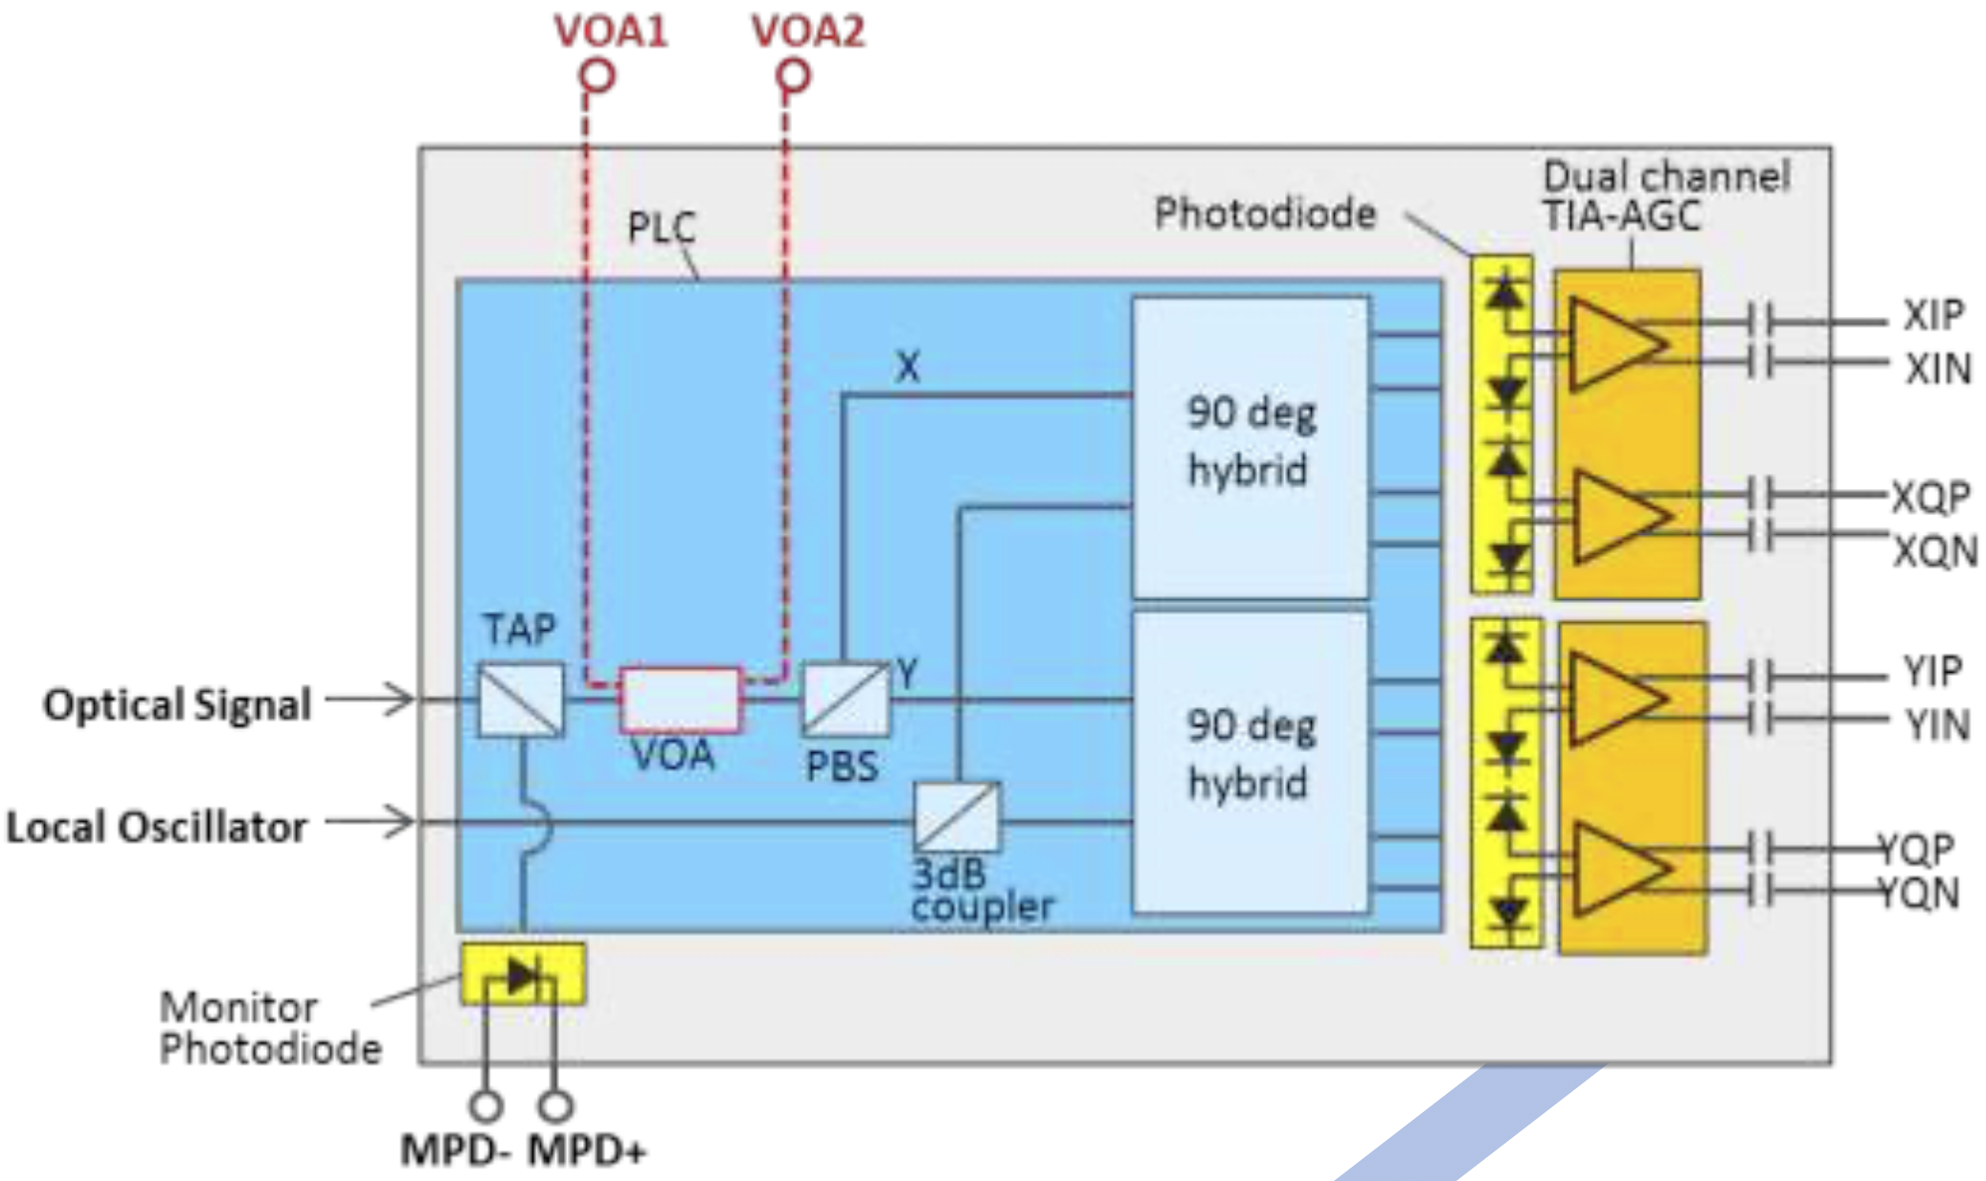


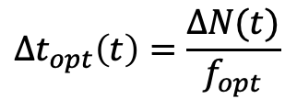

System block diagram
time drift:
added optical phase
$$Δt_{opt}\left(t\right)=\frac{ΔN(t)}{f_{opt}}$$
$$φ_{RF}(t)=\frac{π}{V_{π}}V_{RF}(t)$$
pol. control
sig.
phase mod
cavity
laser
ICR
DSP
LLRF controls
temperature
controlled
enclosure
freq. shift
LO
adds $ω_{IF}$ to $ω_{opt}$
$$ω_{IF}t$$
Integrated
Coherent
Receiver
Phase modulator needs no bias or electronics
Interferometry: sub-fs Δdelay measurement
Coherent telecom devices: advanced functions, well-developed, low cost
  Doesn’t need LO sync or clock recovery
[Fujitsu FIM24725]

Slide 5
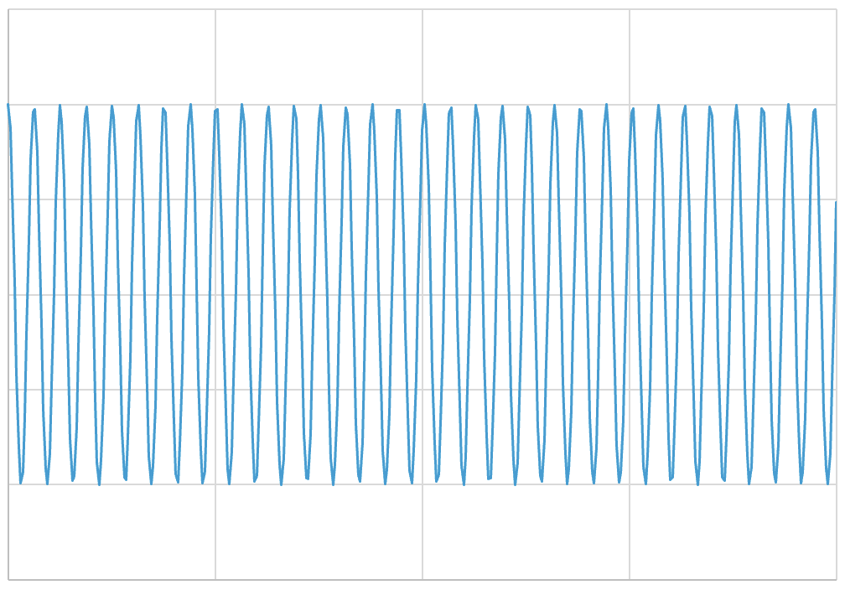
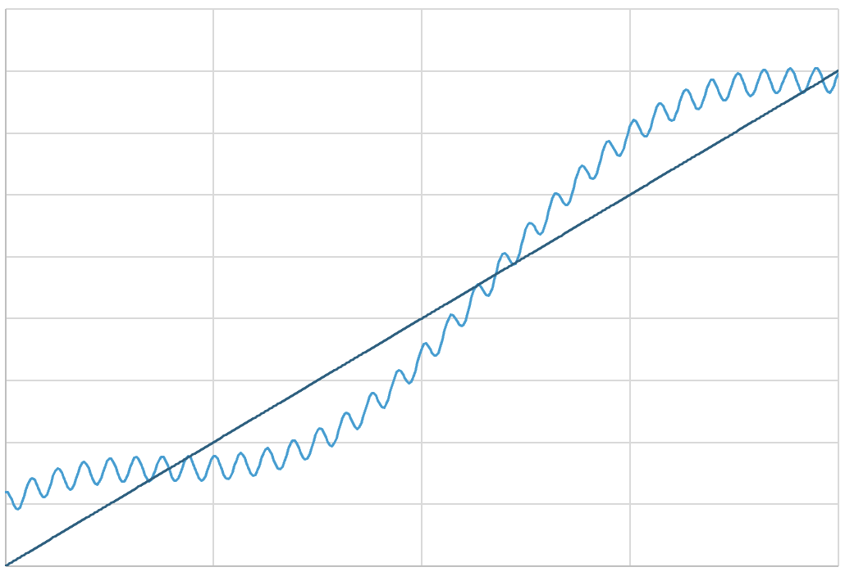
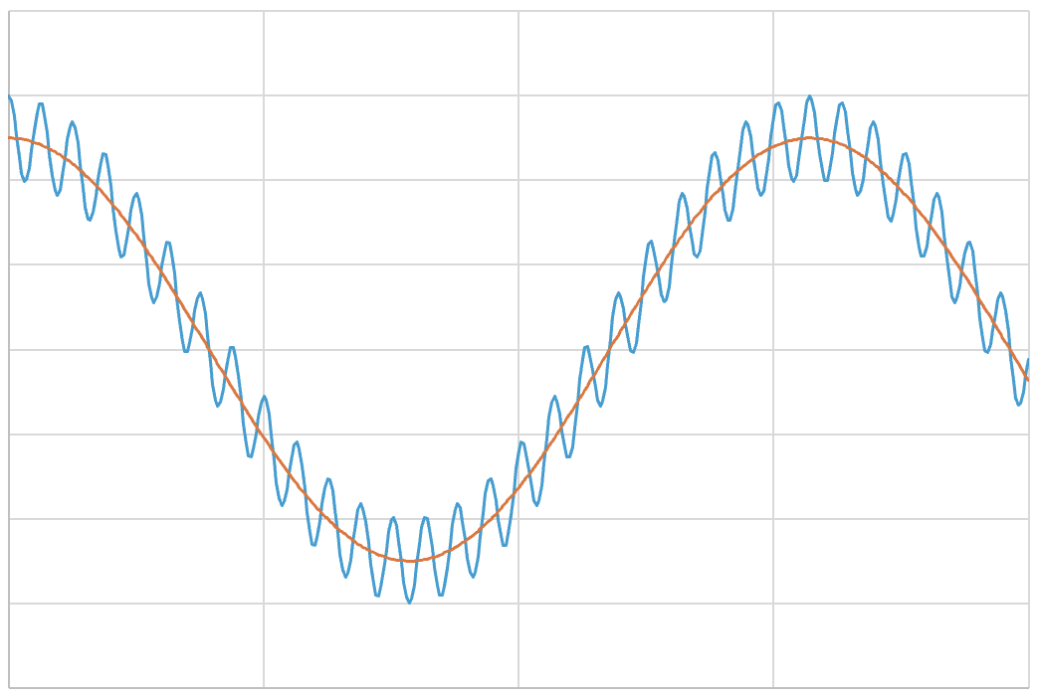
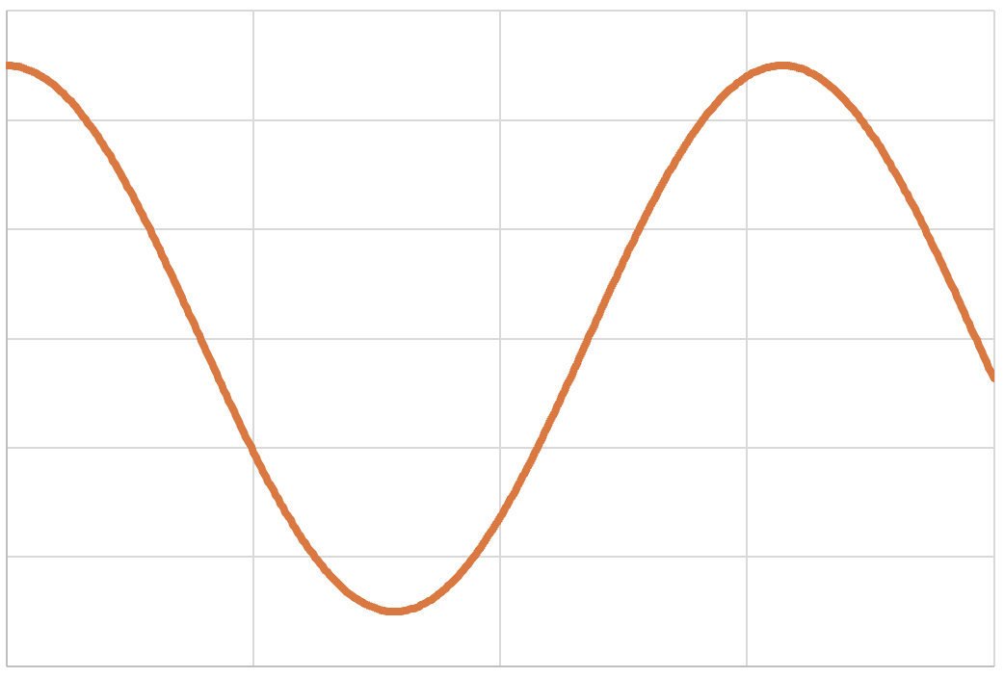






Diagram of demodulation process
phase
phase
phase
time
time
time
I
$φ_{RF}\left(t\right)=π\frac{V}{V_{π}}cos(ω_{RF}$($t$)+$Δφ_{RF}(t))$
ICR
ADC
rectangular to polar
subtract
HPF
time shift
Q
phase
$$ΔN\left(t\right)=\frac{{Δφ}_{IF}(t)}{2π}$$
$$Δt_{g}(t)$$
LPF
divide by
$$Δt_{p}(t)$$
multiply by
$$ω_{IF}t$$
X, Y amplitude
polarization calculation
X, Y IF phase
group/phase correction
$$2f_{opt}$$
RF amplitude
Drift corrected
Proportional to sensor voltage
RF amplitude is derived from polar phase, not amplitude
Works for any waveform, e.g. pulses
$φ_{RF}\left(t\right)=π\frac{V}{V_{π}}cos(ω_{RF}$($t−Δt_{g}(t)$)+$Δφ_{RF}(t−Δt_{g}(t)))$
known
RF phase error data,
used for feedback

Slide 6
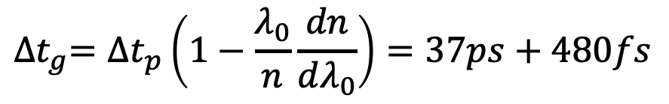
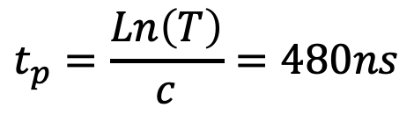
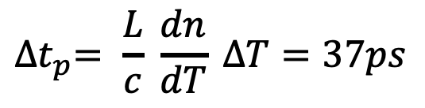
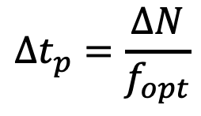
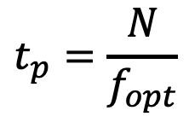
In principle, optical time delay correction uncertainty <1fs
Scheme: track changes in number of roundtrip waves, 2ΔN via IF phase
  Calculate phase delay Δt_{p} and multiply by correction to get group delay Δt_{g}
What intrinsic optical accuracy, given L = 100m, ΔT = 10˚C?
the problem
$$t_{p}=\frac{N}{f_{opt}}$$
each wave is 5fs, 1˚is 14as
$$t_{p}=\frac{Ln\left(T\right)}{c}=480ns$$
stability <3x10⁻¹⁰ or <150as (Rb locked laser)
[e.g. Radiantis “Locked Laser”]
$${∆t}_{p}= \frac{L}{c} \frac{dn}{dT} ∆T=37ps$$
$$∆t_{p}=\frac{∆N}{f_{opt}}$$
accuracy <3x10⁻⁸ or 1as
known to 3x10-8 (0.014as)
$${∆t}_{g}={∆t}_{p}\left(1−\frac{λ_{0}}{n}\frac{dn}{dλ_{0}}\right)=37ps+480fs$$
No assumptions about what caused delay
(temp, air pressure, strain)
known to 10-4 (50as)
with 10-4 thermal correction (50as)
known to 10-4 (50as)
with 10-6 thermal correction (1as)

Slide 7
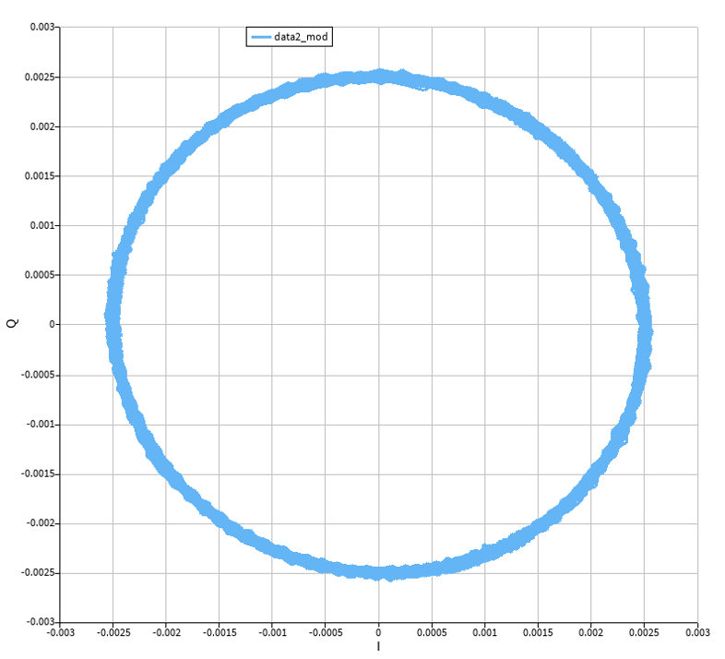
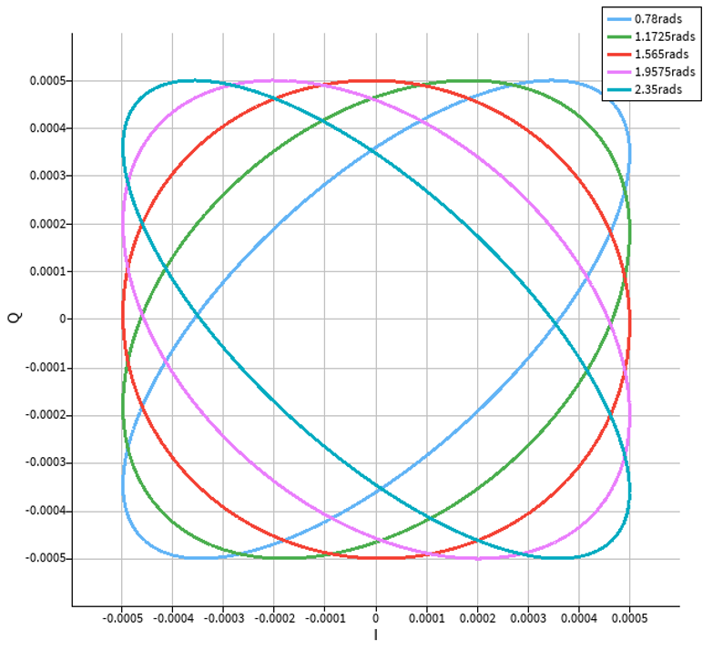
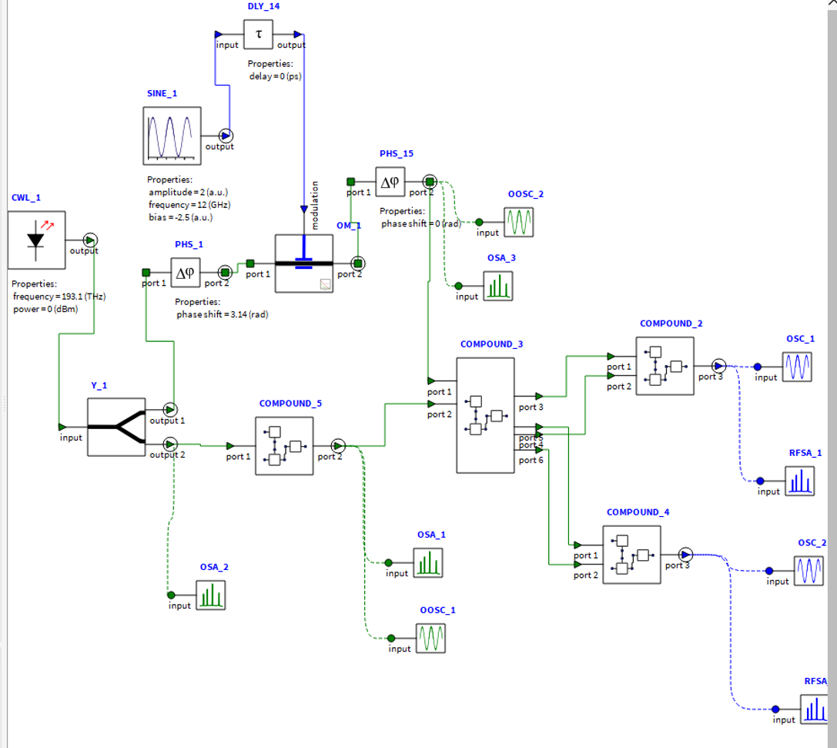
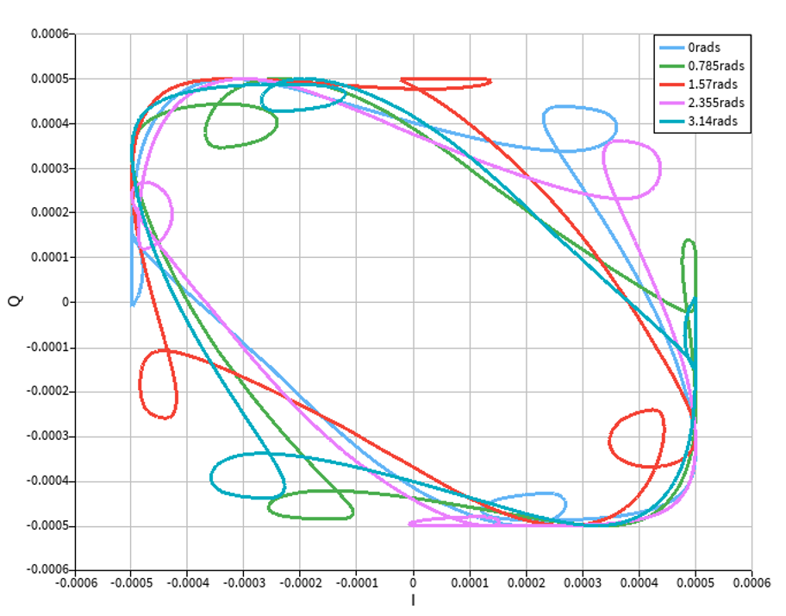
Simulations show effects of errors
ANSYS Lumerical Interconnect model:
Ideal plot with photodetection noise
Phase error in 90-degree optical hybrid
RF signal
input
phase
modulator
Q
Q
optical
hybrid
I
I
I and Q offset 4% of an IF period, and with different optical phase delays
laser
I and Q
output
Q
I
frequency
shifter
differential
photodiodes
Use simulation to estimate effect and
magnitude of error, compare with experiment

Slide 8
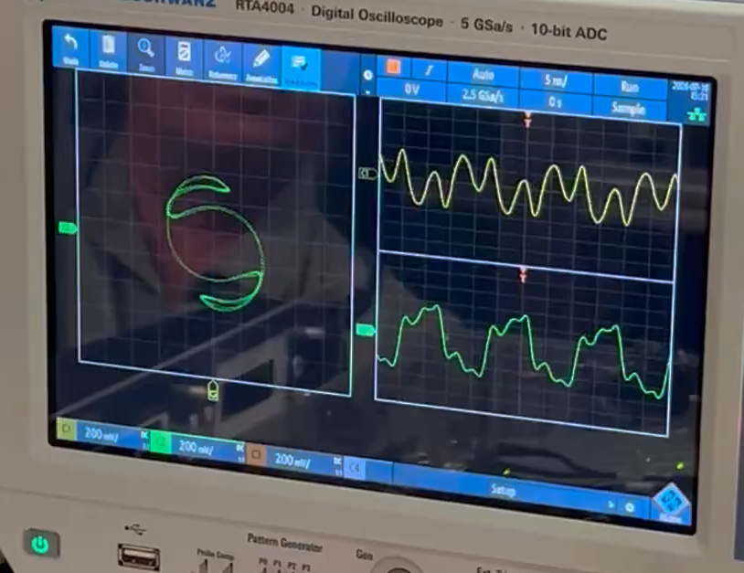
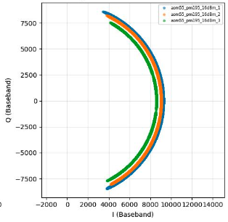
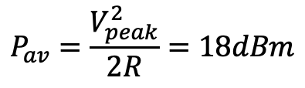
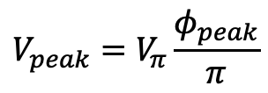
First experiment, no transport fiber
sig.
Xilinx ZCU208
laser
phase mod
I /Q, I (t), Q (t), showing optical phase drift
with RF = 110MHz, IF = 55MHz:
ICR
DSP
freq. shift
LO
detecting RF amplitude (optical phase subtracted):
7V (spec)
1.12rad (observed)
Ø_{peak}
$$V_{peak}=V_{π}\frac{φ_{peak}}{π}$$
≈ 2.5V
$$P_{av}=\frac{V_{peak}^{2}}{2R}=18dBm$$
Power to modulator = 16dBm
Amplitude measurement is insensitive to optical power variations

Slide 9
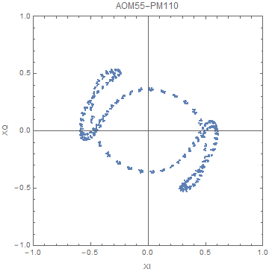
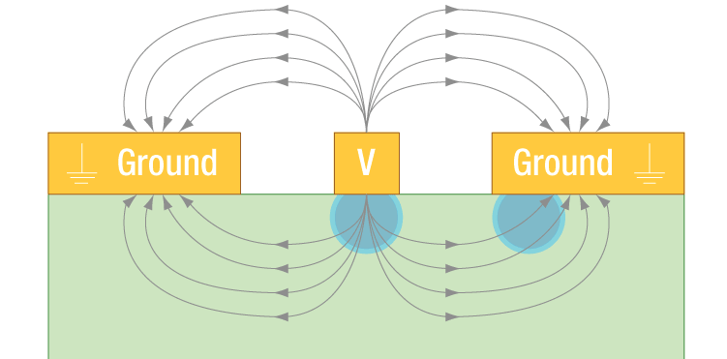
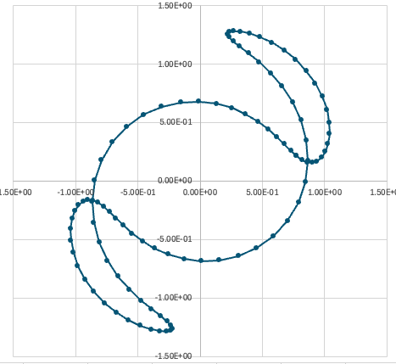
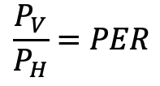
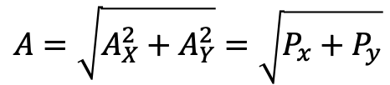
Polarization modulation
IQ plots for one polarization:
P_{V}
$$\frac{P_{V}}{P_{H}}=PER$$
experiment
P_{V}
Y
P_{H}
P_{H}
X
EO phase modulator
Output projected on X and Y axes of ICR
ICR sees:
mod depth
V,H dephasing
$$P_{YorX}=\left(1+\frac{1}{PER}\right)P_{V}±2\frac{P_{V}}{\sqrt{PER}}cos⁡(\left(1−\frac{1}{3}\right)Mπ\cos\left(ω_{RF}t\right)−Δφ_{pol})$$
simulation
constant
time-varying
40% p-p modulation even with PER=20dB, considered good.
$$A=\sqrt{A_{X}^{2}+A_{Y}^{2}}=\sqrt{P_{x}+P_{y}}$$
If polar amplitude is then that should fix it

Slide 10
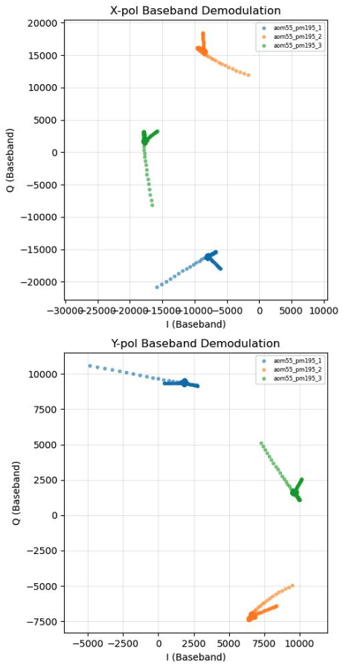
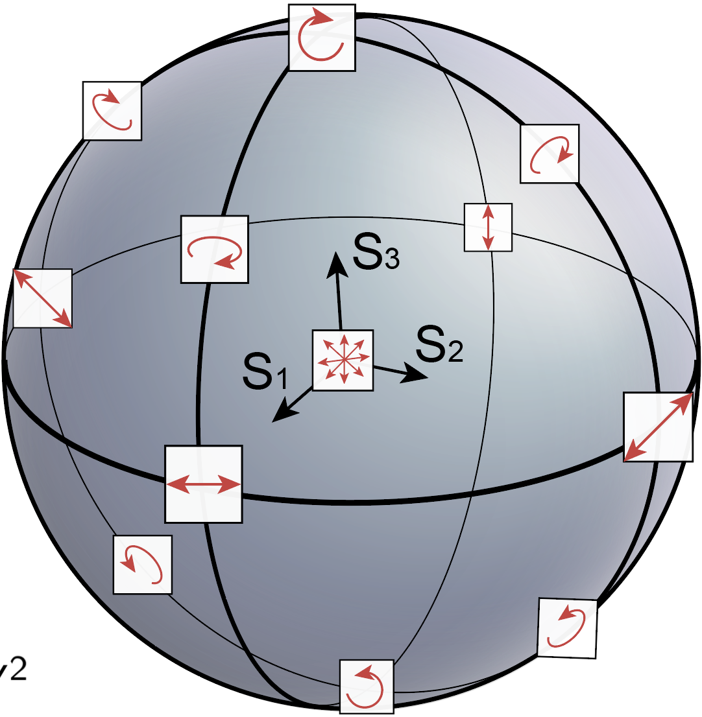
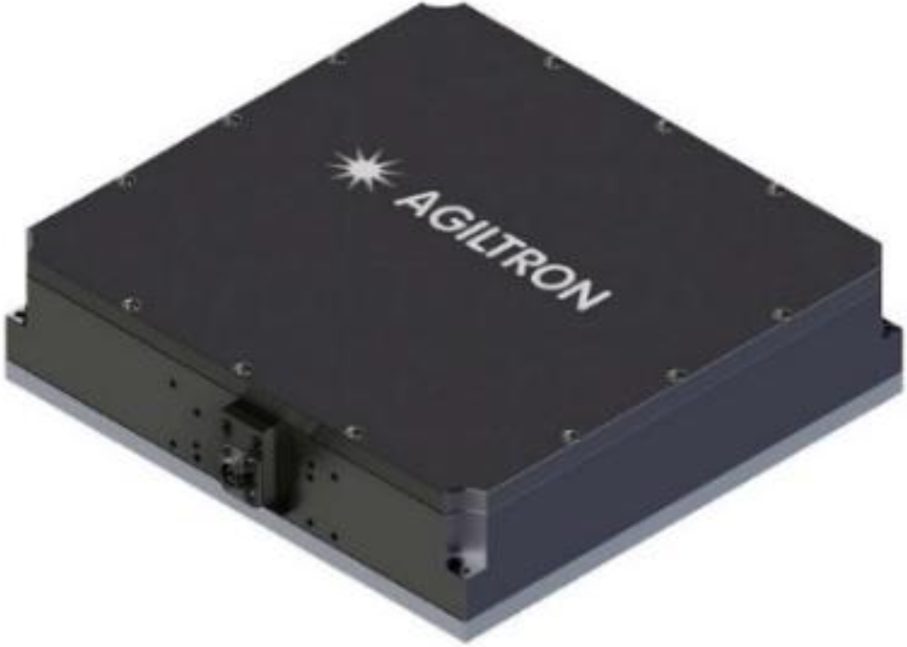
Polarization correction
Maintain polarization at modulator by compensating fiber depolarization without dithering
Three measurements of RF phase, not drift corrected:
sent state is constant
polarization varies only within here
constant return state, fixed by polarizer
X
Y
some constant state initially set when signal is maximized
linear
polarizer
radius = 18k
radius = 10k
pol. control
A_{X},Ø_{X1}
A_{Y},Ø_{Y3}
A_{X},Ø_{X2}
A_{Y},Ø_{Y2}
phase mod
ICR
DSP
A_{X},Ø_{X3}
manual controller
(equalize X,Y)
A_{Y},Ø_{Y1}
Ø_{Xn} - Ø_{Yn} = 165˚ (phase difference)
A_{X}/A_{Y} = E_{Xsig}/E_{Ysig} = 1.8 (amplitude ratio)
Complete polarization state is known
USB connected 3-waveplate rotator:

Slide 11
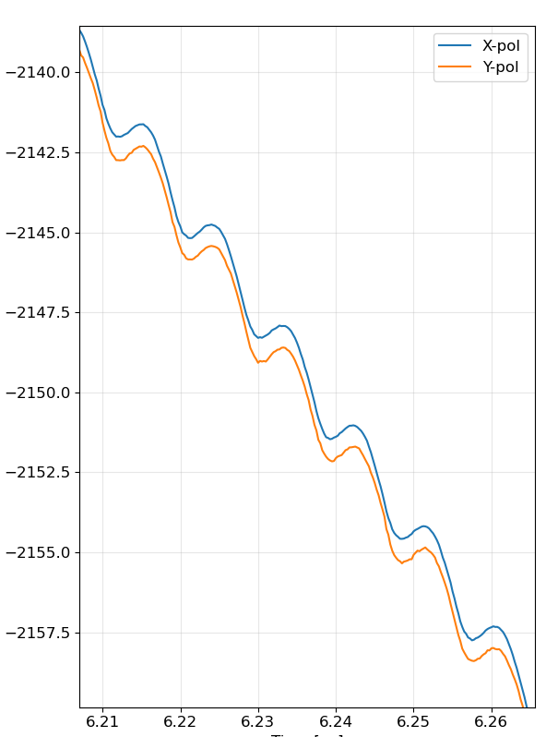
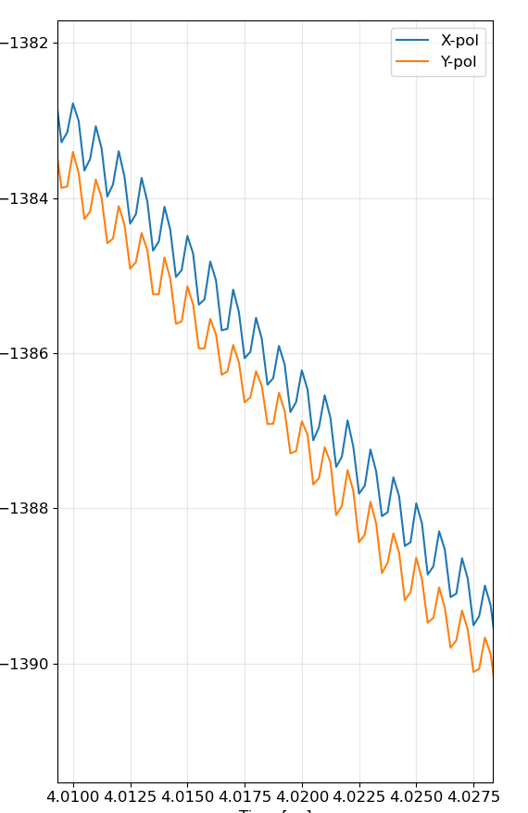
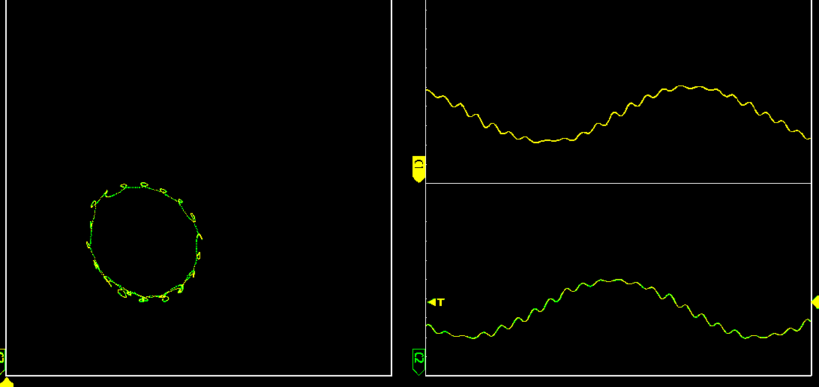

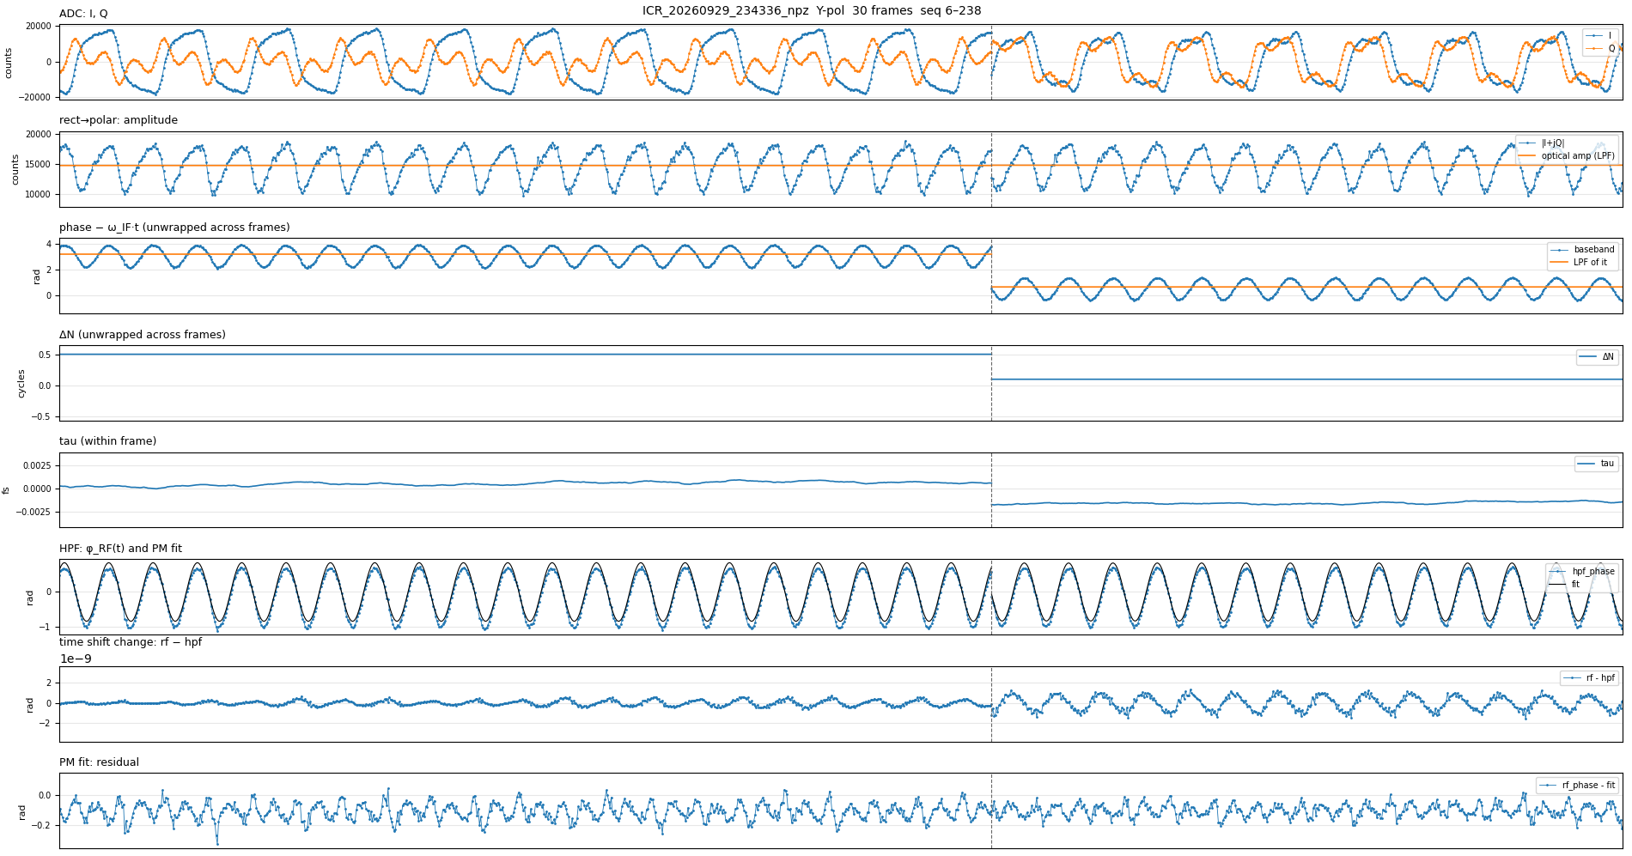
Short term data, 4GHz sample rate
polar phase:
RF = 110MHz
IF = 55MHz
RF = 1GHz
IF = 55MHz
I vs Q (1GHz)
I
IF phase, rad
Q
slope
is IF
RF cycle
polarization
phase shift
two readings 0.5sec apart:
1/IF
1/IF
Sine fit gives RF phase
time, µs
time, µs
IF phase v time
LPF gives optical drift
One datum per 10µs reading

Slide 12
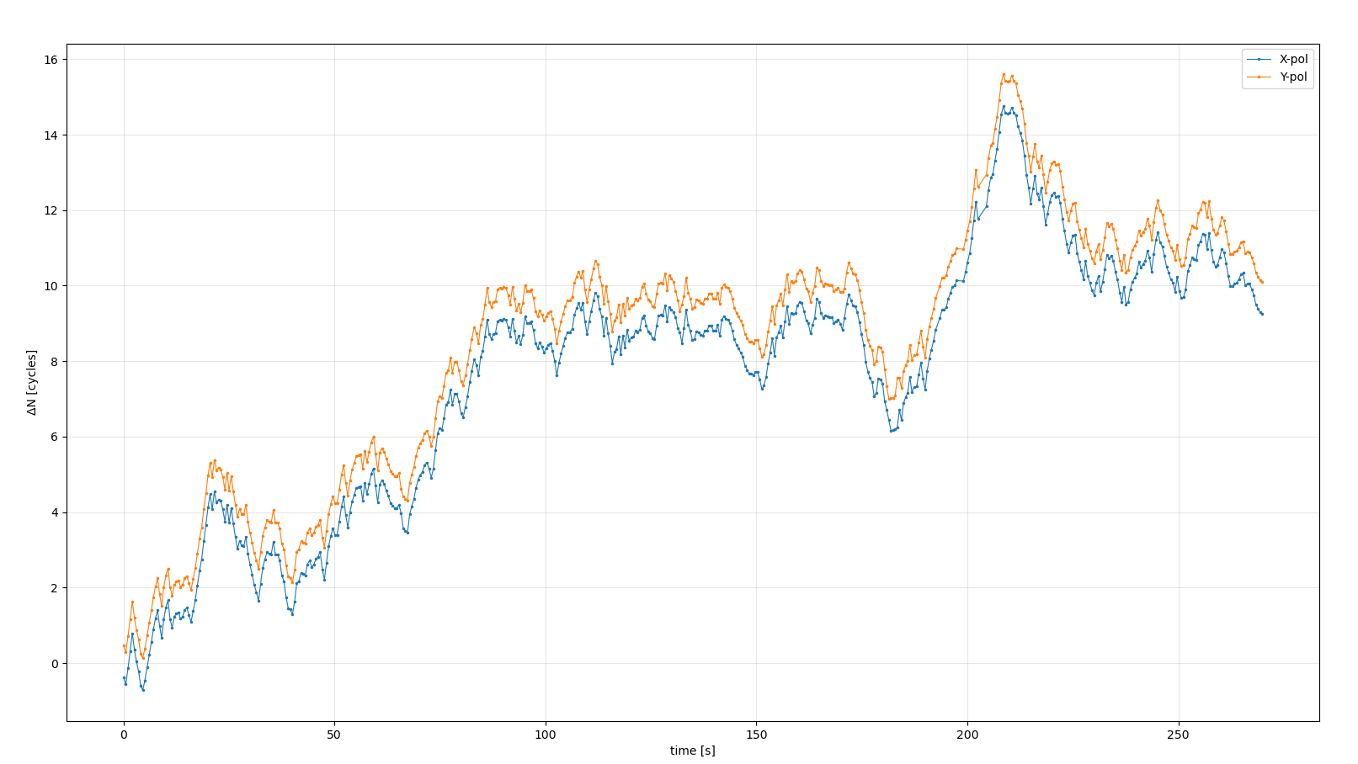
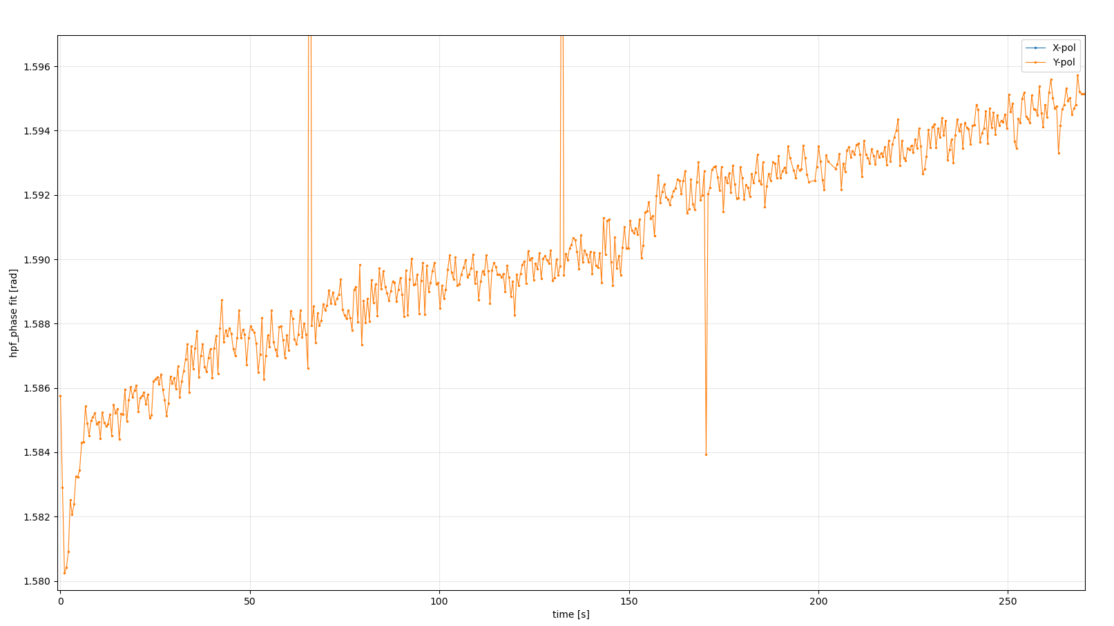
Longer term data: 4 minutes of readings at 2Hz
X and Y polarization optical phase drift:
Y polarization RF (1GHz) phase drift:
16
16
14
14
12
12
10
10
ΔN, optical waves
8
8
RF phase, milliradians
6
6
4
drift 1.6ps
jitter ~300fs pp (~100fs RMS)
1Hz-100kHz
drift 75 fs pp
4
2
2
0
0
0
50
100
150
200
250
0
50
100
150
200
250
time, sec
time, sec
With current setup, correlation with ΔT is unclear
Vertical X-Y displacement is polarization
Won’t track vibration, acoustics >1Hz
Modulator drive RF has same drift and jitter
Drift: amp heating up?
Jitter: DSP board?
            400fs 1-1M RMS for this board [V. Moore in this workshop]

Slide 13

Next experiment
100m
sig.
phase mod
laser
ICR
DSP
temperature
controlled
enclosure
freq. shift
LO
$$ω_{IF}t$$
New features:
Practical configuration
RX fibers, components in thermally stable box
Loose coil of 100m fiber with heater
Controlled test delay in signal path
Goals:
Demonstrate design parameters
Develop calibration and operation procedures

Slide 14
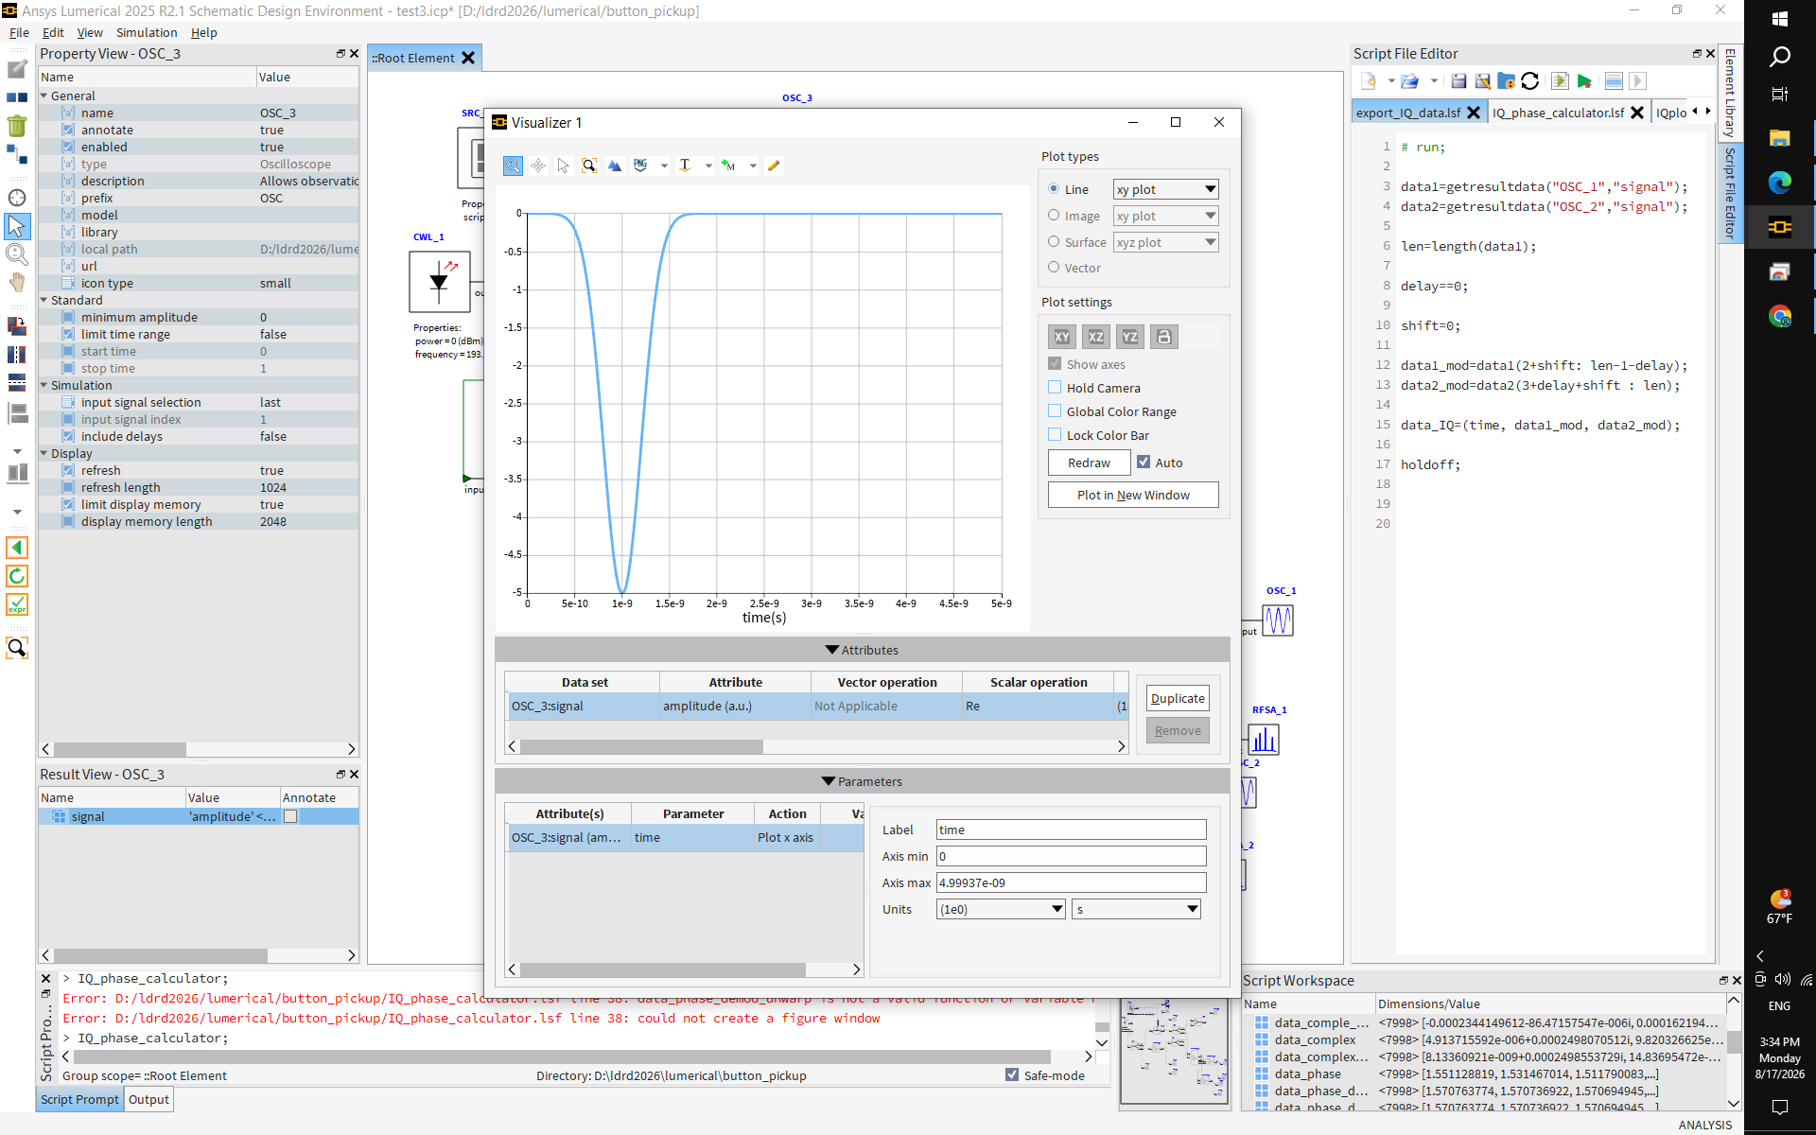
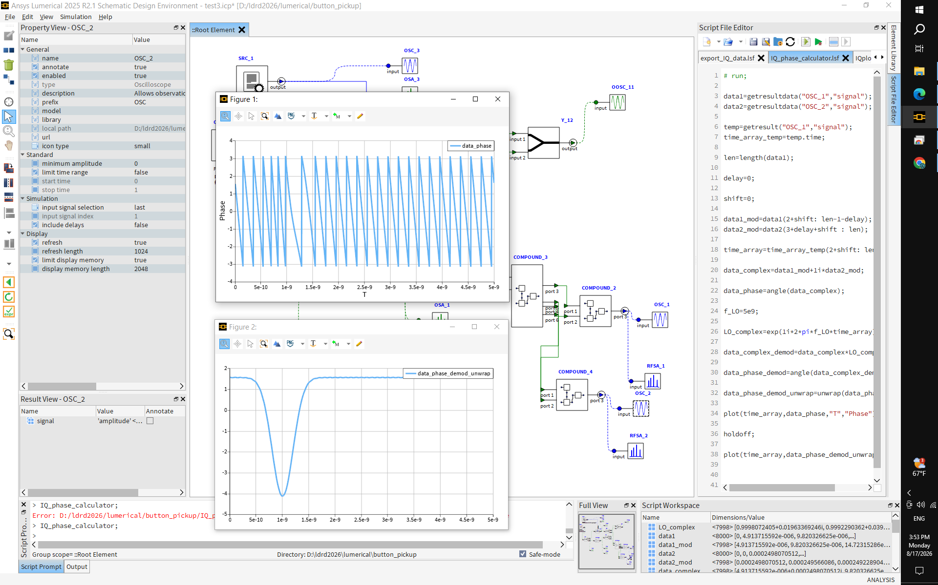
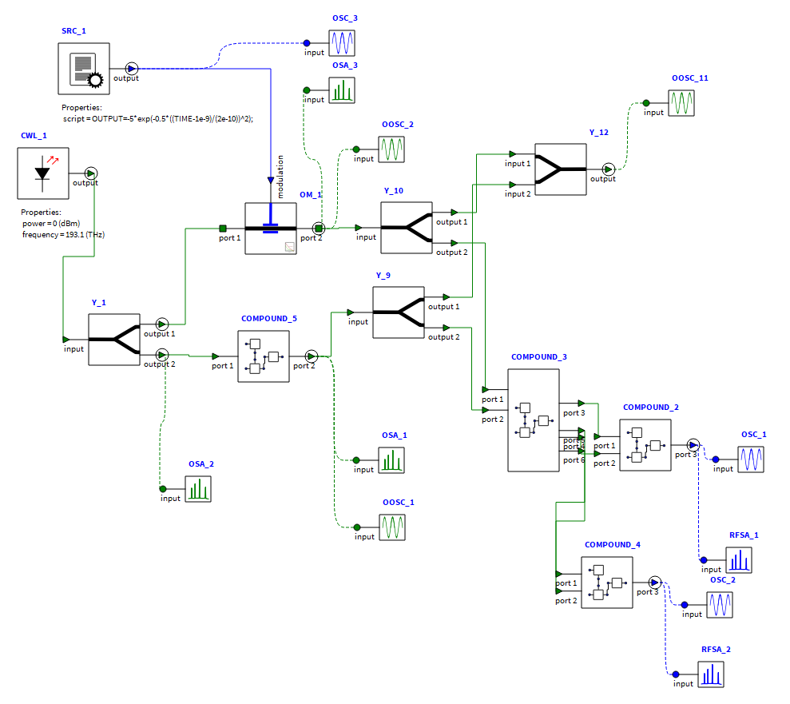
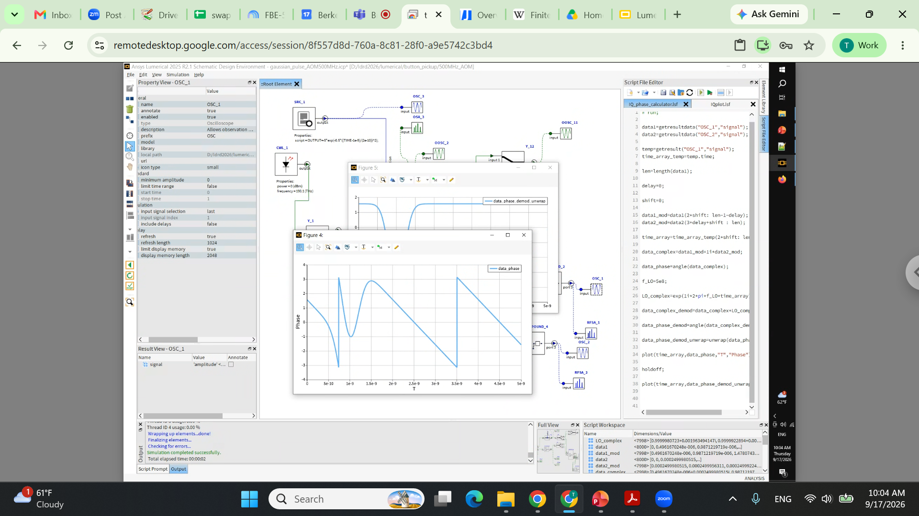
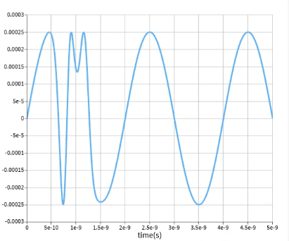

Other applications: bunch arrival, length monitor
200ps gaussian pulse input to phase modulator...
...exactly reproduced after demodulation:
demodulation
I
rect. to
polar
IF = 500MHz
Commercial LN modulator BW up to 30GHz
Use 60GHz scope or digitizer
Q

Slide 15
Other applications: pulsed laser timing
laser amplifiers
modelocked laser
cavity piezo
phase mod
RF monitor receiver
phase mod
PD
LLRF controls
PLL synchronizer
master clock
reference RF (setpoint)
If LLRF loop latency is <10µs, bandwidth is limited by cavity actuator
Reference RF is not independently stabilized

Slide 16
Conclusions
A time-corrected, CW RF/pulse monitor has been designed, modeled and principles demonstrated
RF amplitude and phase, optical polarization and time delay change have been measured in basic demo
  Ongoing work to reach useful spec
Numerical modeling supports experiments, tests effect of error sources
  Model has shown usefulness for pulse measurements
Theoretically, optical scheme contributes <1fs uncertainty to time delay change measurement
  Receiver hardware needs to be mechanically stabilized
  Digitizer and clock need to be low jitter
Developing concepts for synchronized multichannel operation
Thanks for your attention

