Slide 1



Mechanical-Mode System Identification
for Superconducting Cavities
Grey-Box and Closed-Loop Chirp Methods
Yilin Miao, Feng Qiu
Institute of Modern Physics, Chinese Academy of Sciences
13-15 October 2026
Nova Gorica, Slovenia
1
Notes:
Slide 1. Mechanical-Mode System Identification
Target 0:25
Good afternoon. I am Yilin Miao from the Institute of Modern Physics, Chinese Academy of Sciences. Today I will present our work on mechanical-mode identification in superconducting cavities. I will introduce the grey-box method developed by Feng Qiu and colleagues, followed by our closed-loop chirp method. Both methods use RF measurements to characterize cavity mechanical dynamics.
Sources: F. Qiu et al., NIM A 1012 (2021) 165633, doi:10.1016/j.nima.2021.165633; Y. Miao et al., Closed-loop chirp characterization of mechanical modes in superconducting radio-frequency cavities, supplied manuscript

Slide 2
01
Electromechanical instability and transfer functions
02
Grey-box platform, model and validation
CONTENTS
Chirp platform, excitation and processing
03
04
Experimental comparison and conclusions
2

Slide 3
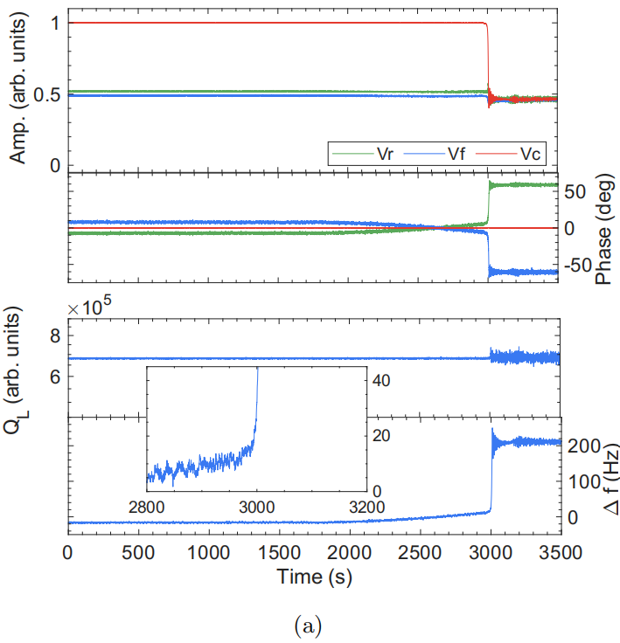
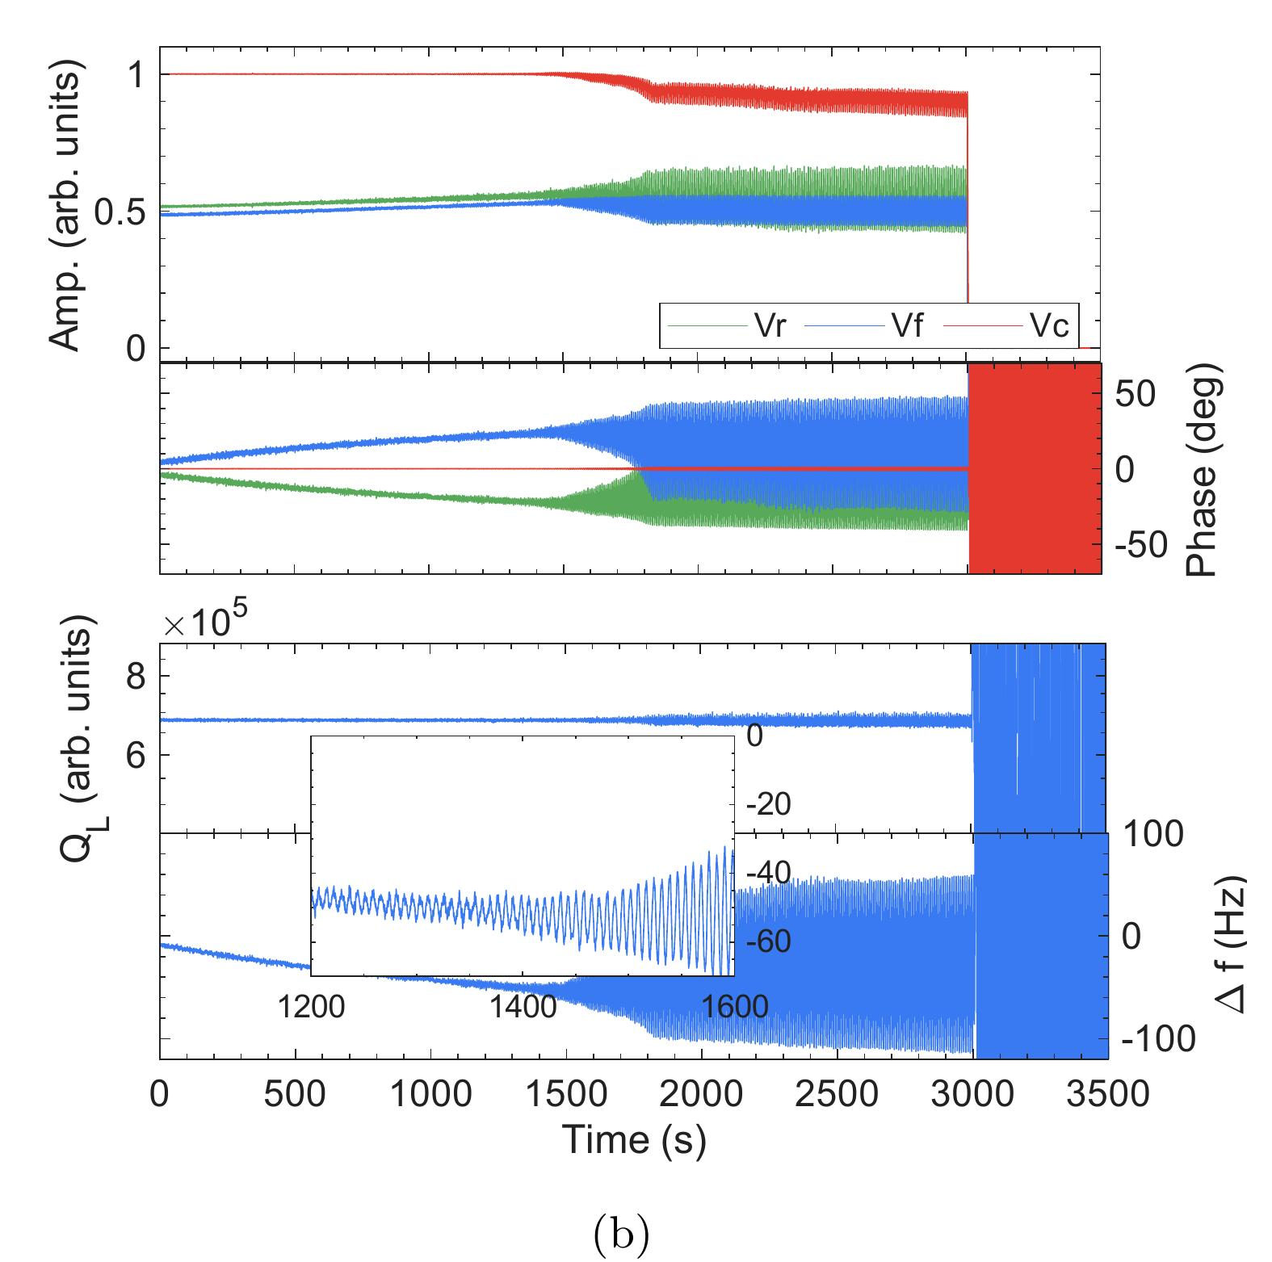
Mechanical Modes and Detuning
Mechanical deformation shifts cavity resonance and affects RF-field stability.
Lorentz-force coupling can produce monotonic or oscillatory instability.
Lorentz-force path
Squared field
K(s)
Cavity detuning
E²(t)=u(t)
Δf(t)
Δf_{LF}(s) = K_{LF}(s) U(s)
Characterize the mechanical frequency response
Identify the dominant modal frequencies——Mechanical modes
Oscillatory instability
Monotonic instability
A dynamic model supports detuning analysis and later control studies.
Y. Miao et al., Fig. 1(a,b). F. Qiu et al., NIM A 1012 (2021) 165633, Eq. (2).
3

Slide 4
Grey-Box Platform: CAFe
2021 grey-box study: CAFe proton linac at IMP
CAFE superconducting section: 4 cryomodules, 23 cavities
CM1
CM2
CM3
CM4
6 × HWR010
6 × HWR010
6 × HWR010
5 × HWR015
CAFE cavity operating ranges
Parameter | Units | HWR010 | HWR015
f_{RF} | MHz | 162.5 | 162.5
βopt | dimensionless | 0.10 | 0.15
Q_{L} | dimensionless | 3×10⁵–1×10⁶ | 6×10⁵–8×10⁵
f_{half} | Hz | 80–270 | 100–135
r/Q | Ω | 225 | 382
Epeak | MV/m | 25–35 | ≈30
KLFD | Hz/(MV/m)² | −0.4 to −0.25 | ≈−0.2
Experiment Cavities
HWR1
QL ≈ 4×10⁵
f0.5 ≈ 200 Hz
HWR2
QL ≈ 9×10⁵
f0.5 ≈ 90 Hz
The CAFE ranges provide platform context; the 2021 study reports its own measurement conditions.
Qiu et al. (2021), Section 2. Yu et al., Atomic Energy Sci. Technol. 59 (2025), Table 1. Chen et al., HIAT2025, slide 10.
4

Slide 5
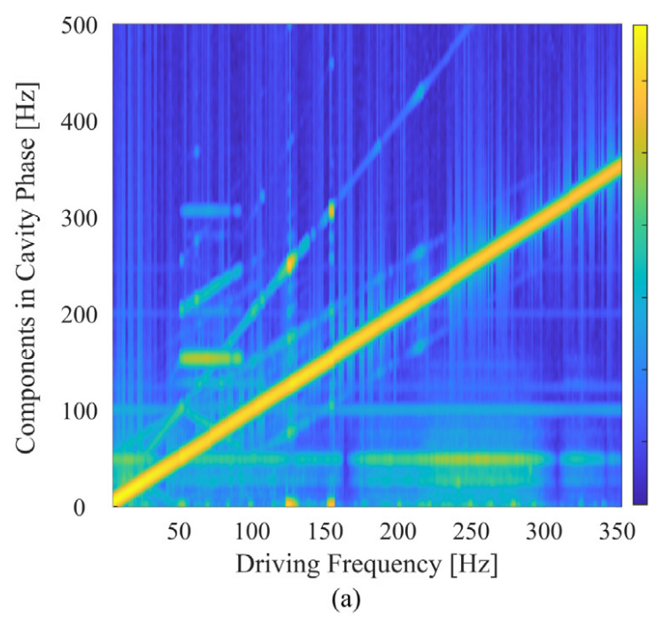
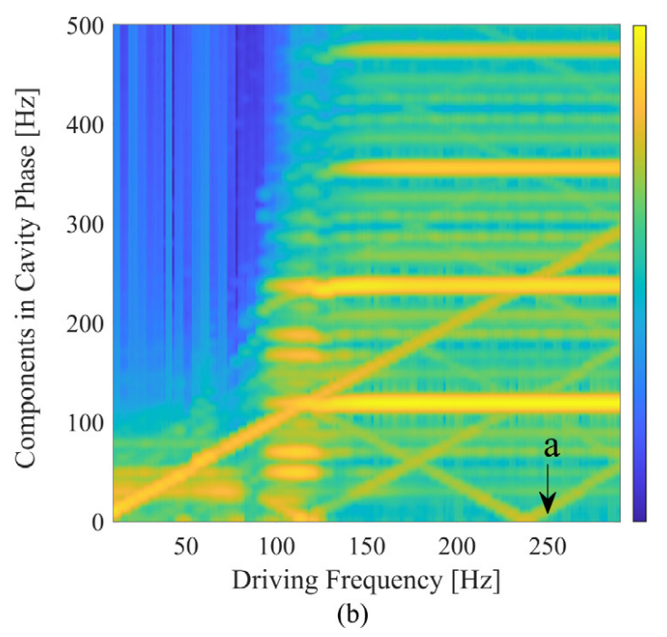
Limitations of Stepped-Sine Scans
Point-by-point dwell makes a frequency scan time-consuming.
Ponderomotive oscillations can obscure the forced response.
Normal forced response
Response with oscillation
CAFe HWR2: a 250 Hz drive produced an oscillatory field near 115 Hz.
F. Qiu et al., NIM A 1012 (2021) 165633, Fig. 4, Section 2.
5

Slide 6
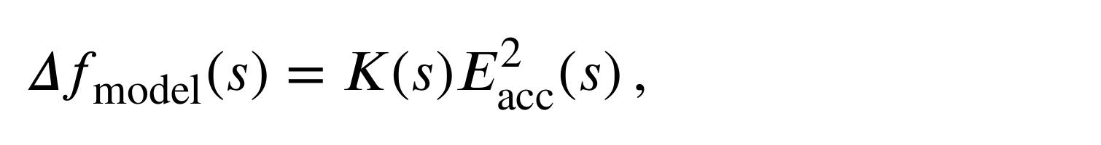
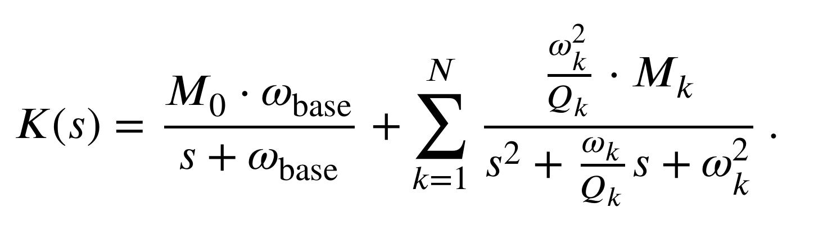
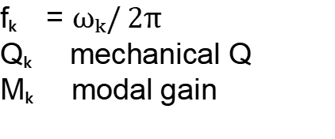
Physics-Informed Grey-Box Model
First-order background
Squared field
Total response
E²acc(t)
Sum of branch outputs
N second-order modes
Modal parameters
fₖ = $ωₖ/ 2π$
Qₖ mechanical Q
Mₖ modal gain
Known modal structure + parameters estimated from measured transients
F. Qiu et al., NIM A 1012 (2021) 165633, Eqs. (2)–(4).
6

Slide 7
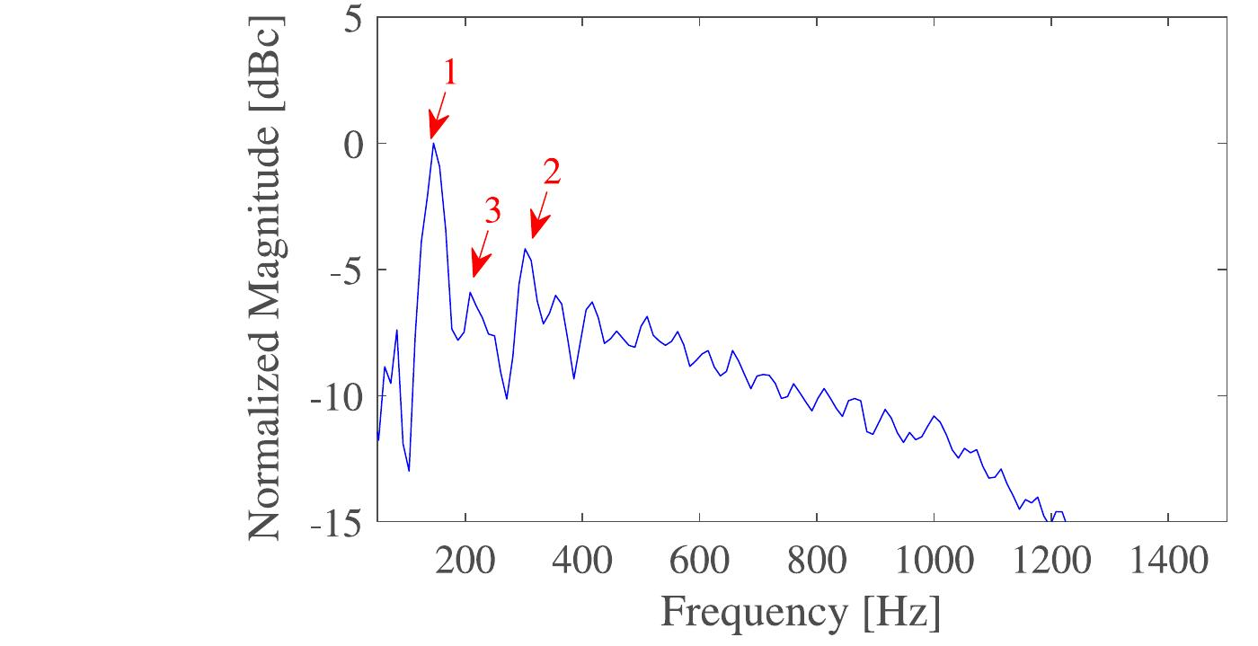



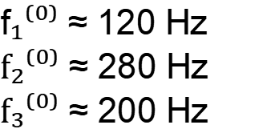
Grey-Box Parameter Estimation
Recorded data
Frequency guesses
Physical model
Parameter fit
E²acc(t), Δf(t)
Spectrum of transient
MATLAB idgrey
MATLAB greyest
Initial frequency values
f$₁⁽⁰⁾$ ≈ 120 Hz
$f₂⁽⁰⁾$ ≈ 280 Hz
$f₃⁽⁰⁾$ ≈ 200 Hz
After many iterations
$$∆fmodel$$
$$∆freal$$
$ωₖ⁽⁰⁾$ = $2πfₖ⁽⁰⁾$
Estimate $M₀, ωbase and \{Mₖ, ωₖ, Qₖ\}$
Spectral peaks initialize the fit; measured input-output dynamics determine the model.
F. Qiu et al., Fig. 8, Section 3. 120, 280 and 200 Hz are initialization values, not final fitted parameters.
7

Slide 8
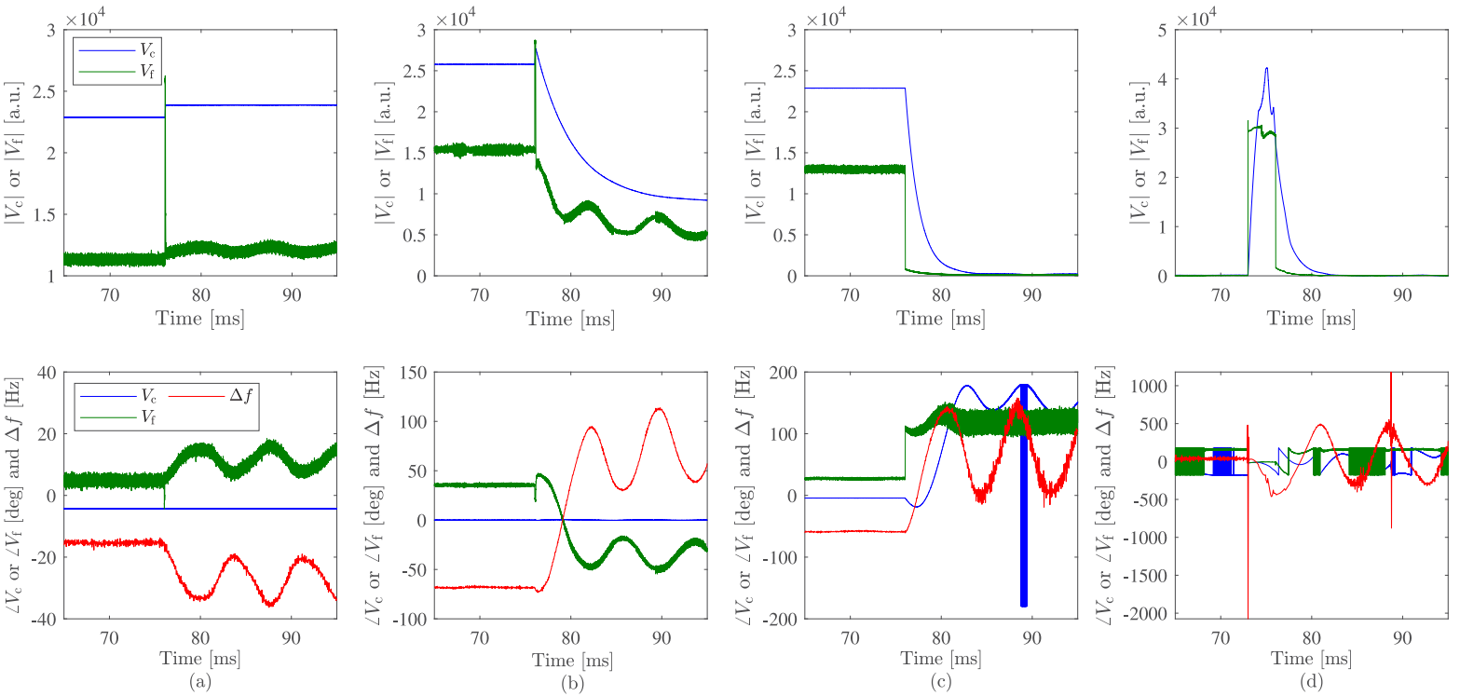
Grey-Box Identification Data
Rapid field changes excite the cavity mechanical response.
Use routine operating events as input-output records.
Measured input
Squared accelerating field
Reconstructed output
Cavity detuning Δf(t)
(a) Fast Setpoint Tracking
(b) Power-Fault Field Decay
(c) RF-Off Field Decay
(d) Pulsed RF
Operating transients provide measured input-output records for identification.
F. Qiu et al., NIM A 1012 (2021) 165633, Fig. 7(a–d), Eqs. (1)–(2).
8

Slide 9
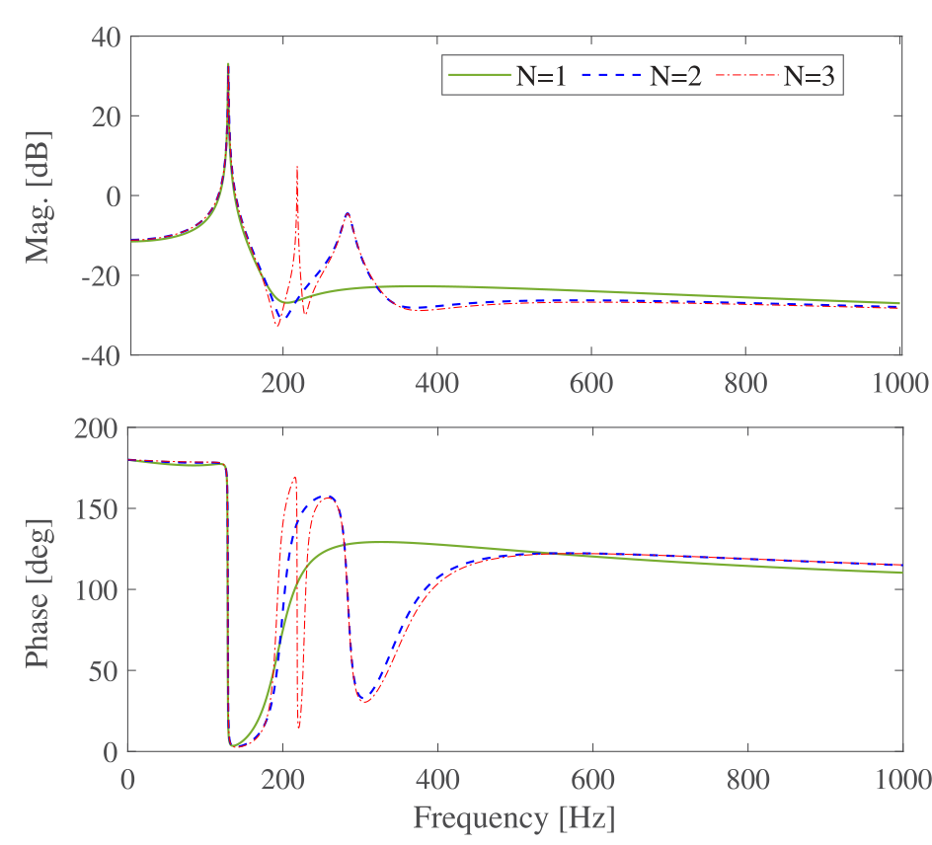
Identified LFD Transfer Function
Frequency-domain model output
Additional branches produce extra resonant features.
Magnitude and phase follow from the fitted model.
One parameter set supports time- and frequency-domain evaluation.
N = 1 | N = 2 | N = 3
Operating waveform data yield a compact LFD transfer function.
F. Qiu et al., Fig. 9, Section 3. The curves show fitted models rather than a new stepped-sine measurement.
9

Slide 10
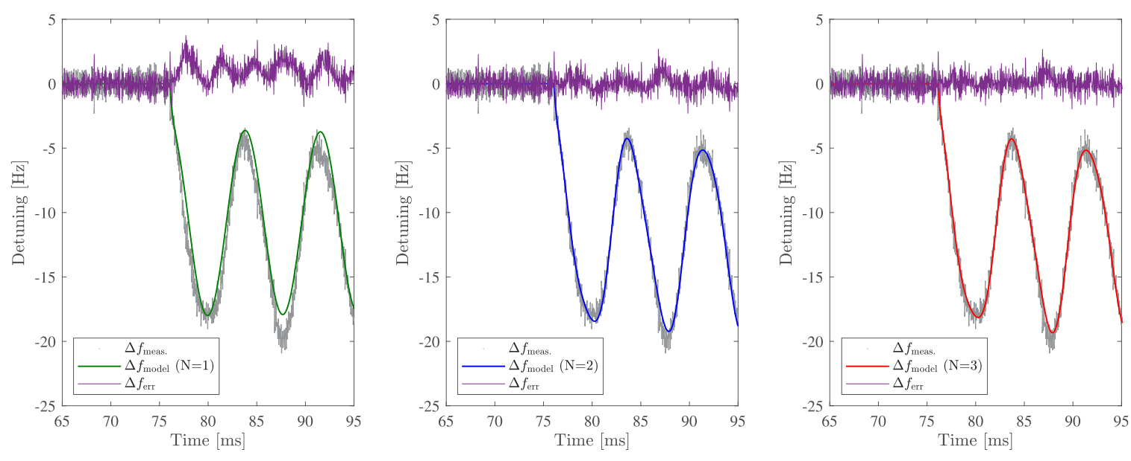
Model Order and Transient Fit
The same fast-setpoint record tests N = 1, 2 and 3.
N = 1
N = 2
N = 3
N = 3 gives the best transient match among the tested model orders.
F. Qiu et al., Fig. 10, Section 3. Grey: measured detuning. Green/blue/red: model prediction. Purple: residual.
10

Slide 11

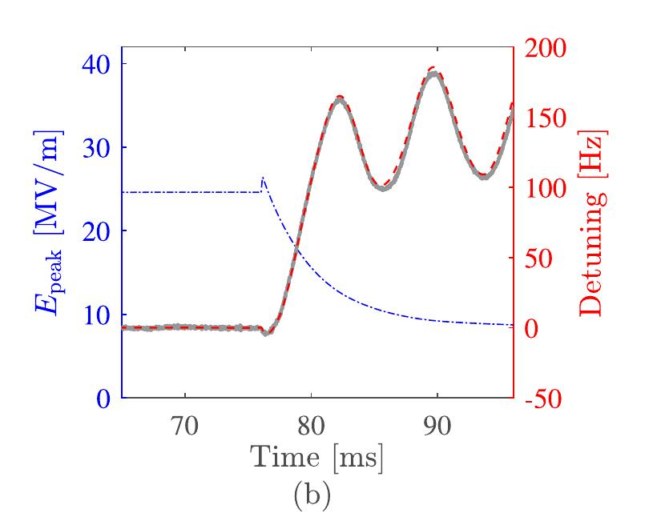
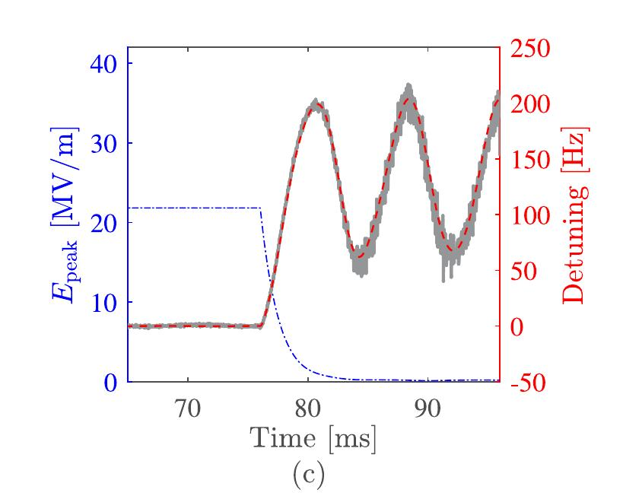
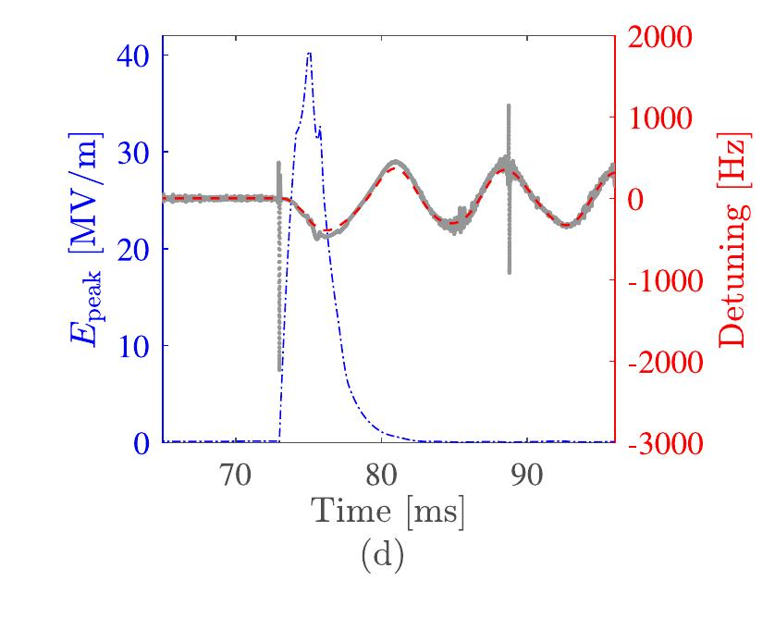
Grey-Box Validation
One N = 3 parameter set predicts detuning under different measured field inputs.
RF trip
RF switch-off
Pulsed RF
Other RF events test the predictive behavior of the fitted mechanical model.
F. Qiu et al., NIM A 1012 (2021) 165633, Fig. 11(b–d), Section 4.
11

Slide 12
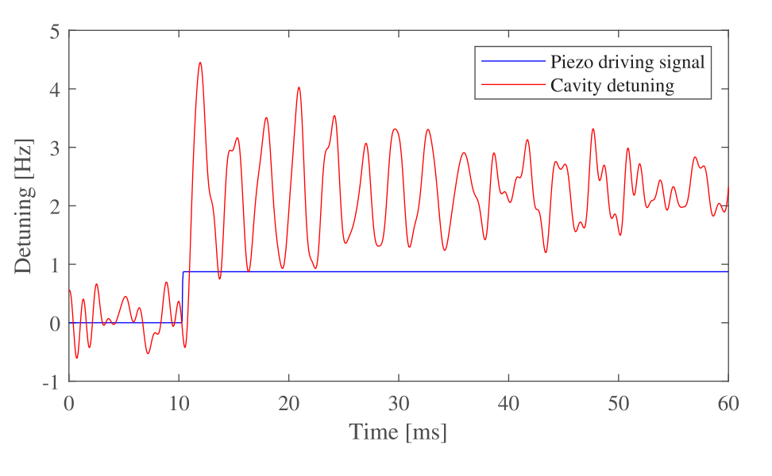
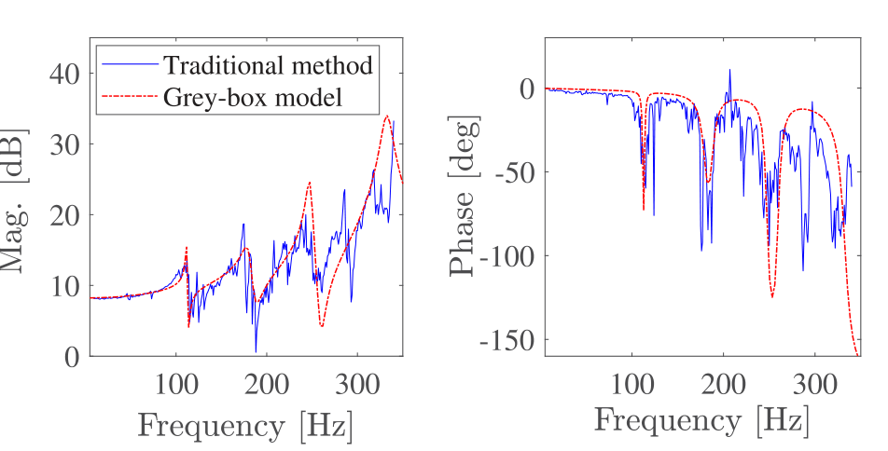
Grey-Box Piezo Validation at cERL
Separate case: cERL ML1, 1.3 GHz nine-cell cavity
Piezo step response for estimation
N = 4 model versus reference
Square-wave responses provide an additional time-domain check.
The grey-box structure also describes dominant dynamics in a piezo-tuner system.
F. Qiu et al., Figs. 12–14, Section 4. Distinct from the CAFe N = 3 LFD case.
12

Slide 13
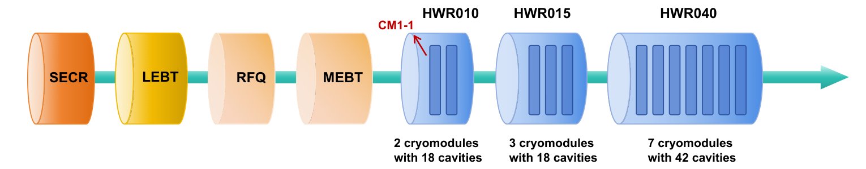
Chirp Platform: IP-SAFE
12 cryomodules, 78 SRF cavities; measurement on CM1-1 / HWR010
Parameter | HWR010 | HWR015 | HWR040
f_{RF} (MHz) | 162.5 | 162.5 | 325
β_{opt} | 0.10 | 0.15 | 0.40
QL | (0.6–1.2)×10⁶ | (0.7–1.6)×10⁶ | (2.2–3.0)×10⁶
f_{0.5} (Hz) | 63–126 | 51–110 | 61–74
r/Q (Ω) | 158.3 | 287.0 | 244.6
Typical Epeak (MV/m) | ≈26 | ≈28 | ≈29
KLFD [Hz/(MV/m)²] | −0.4 to −0.2 | −0.2 to −0.1 | −0.4 to −0.1
CM1-1 scan setting: E₀ = 17 MV/m, 5–400 Hz, amplitude and phase feedback active
Y. Miao et al., Fig. 2 and Table 1, Sections II and IV. Typical cavity fields differ from the 17 MV/m scan baseline.
13

Slide 14
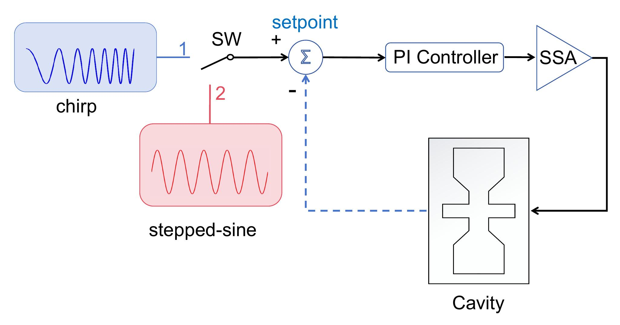
Closed-Loop Chirp Measurement
Chirp and stepped-sine enter the amplitude-setpoint path.
Amplitude and phase PI feedback remain active.
Broadband excitation
5–400 Hz
Single programmed sweep
Closed-loop stability
More stable than conventional open-loop measurement.
The existing LLRF path provides fast broadband mechanical excitation.
Y. Miao et al., Fig. 4, Sections II–III. No external mechanical actuator is required.
14

Slide 15
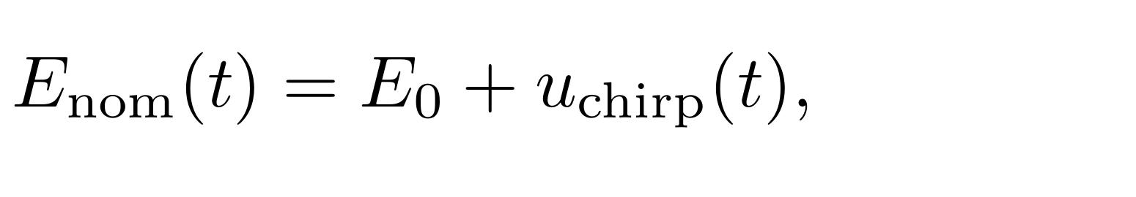

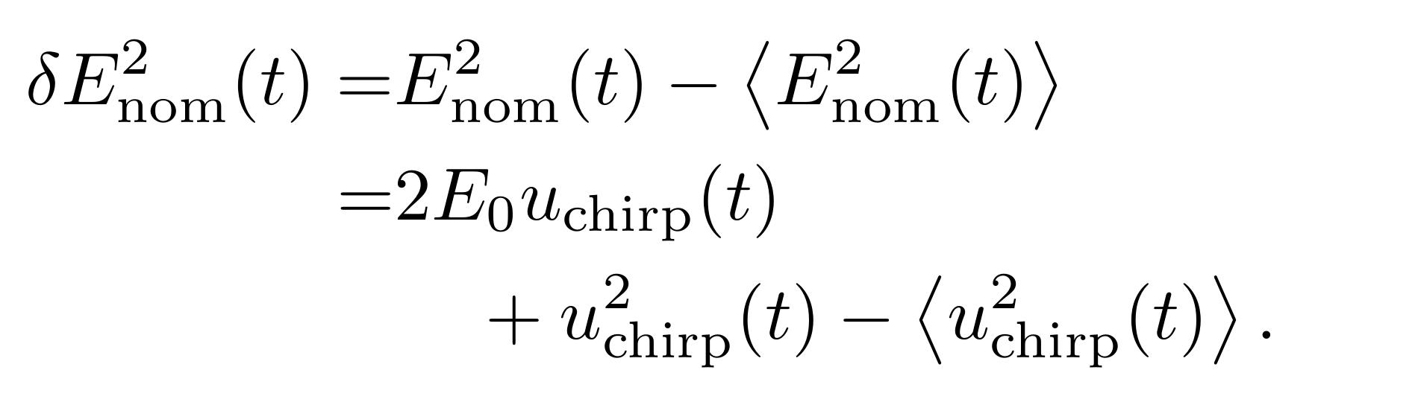

Chirp and the Squared-Field Input
Lorentz-force excitation follows the delivered squared field.
Cross term
Fundamental chirp component
Self-squared term
Second-harmonic component
Input:
Measured identification input
$$x(t) = δE²nom(t)$$
The command sets the desired field; the measured squared field gives the actual input.
Y. Miao et al., Eqs. (7)–(11). Anom = 2E₀Echirp,pk + Echirp,pk² / 2, in (MV/m)².
15

Slide 16
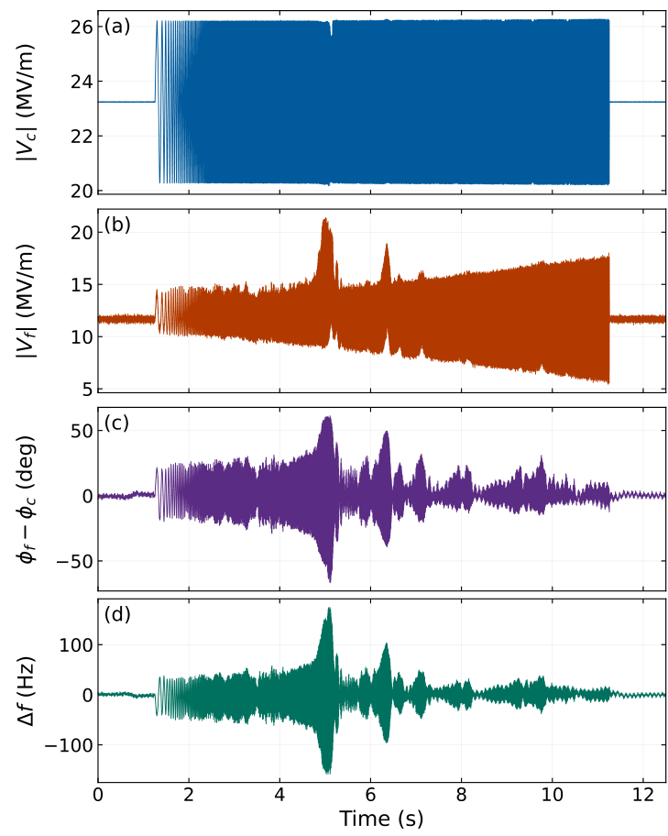
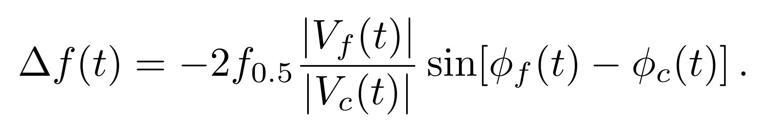
RF Vectors and Detuning
Representative calibrated RF signals
Closed-loop no-beam reconstruction
Output:
Calibrated I/Q supplies magnitudes and phases.
Strong overcoupling: β / (1 + β) ≈ 1.
Small cavity-phase derivative under feedback.
Mean-removed output
$y(t) = Δf(t) − ⟨Δf(t)$⟩
The cavity-envelope relation connects measured RF vectors to detuning.
Y. Miao et al., Fig. 6, Eqs. (2)–(5). This RF-vector record differs from the 17 MV/m tracking example.
16

Slide 17
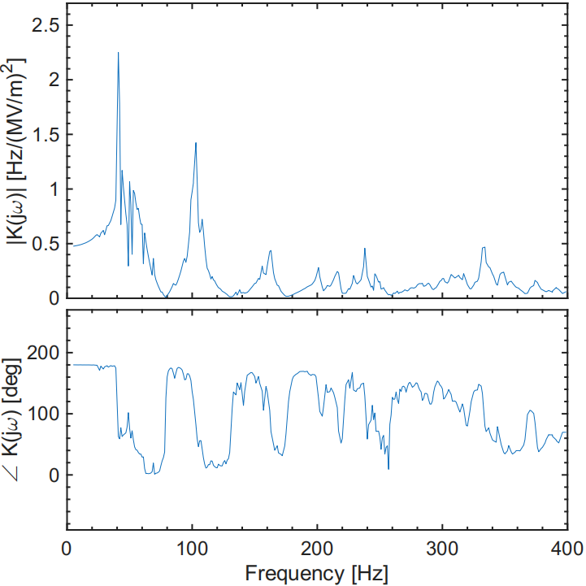

Frequency-Response Estimation
Use synchronized, mean-removed input and reconstructed output.
Measured squared field
Reconstructed detuning
x(t)
y(t)
FFT
FFT
X(jω)
Y(jω)
Complex ratio
$$K(jω) = Y(jω) / X(jω)$$
Magnitude peaks: candidate modal frequencies
A raw detuning spectrum also reflects the frequency content of the excitation.
Y. Miao et al., Eq. (6), Section III. Noise, calibration and stationary microphonics still affect the estimate.
17

Slide 18
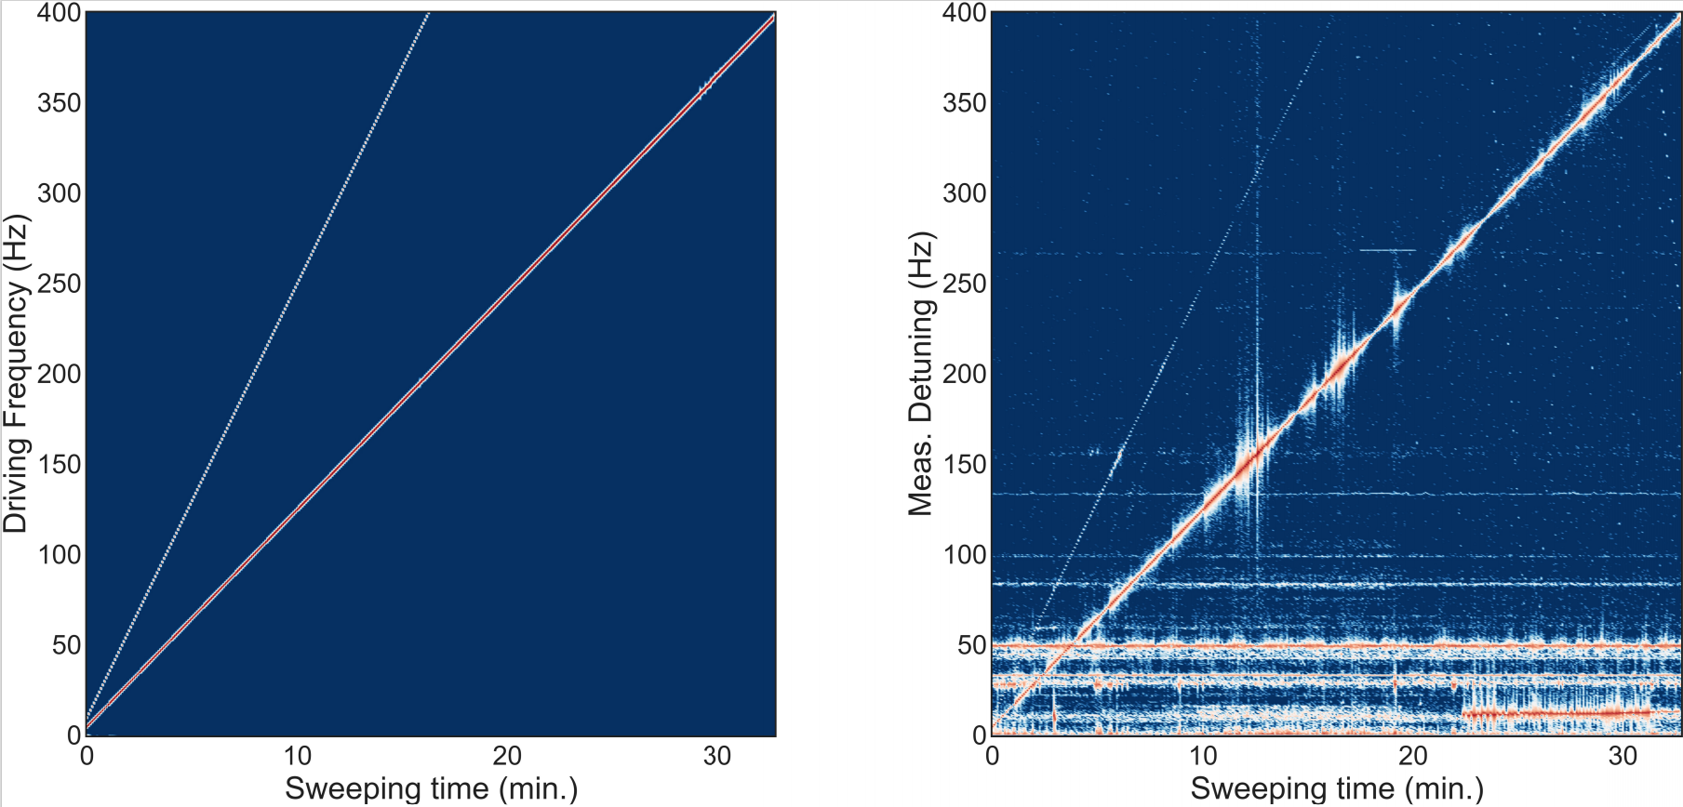
Stepped-Sine Excitation and Detuning Response
5–400 Hz, 1 Hz steps, 5 s per step, total scan time ≈ 33 min.
Fundamental and second-harmonic ridges appear in both input and output.
The second harmonic originates from the quadratic field dependence of the Lorentz force.
Horizontal bands in detuning indicate stationary microphonics.
Y. Miao et al., Fig. 8(a–c), Section IV.B. This is an input-waveform mismatch metric.
18

Slide 19
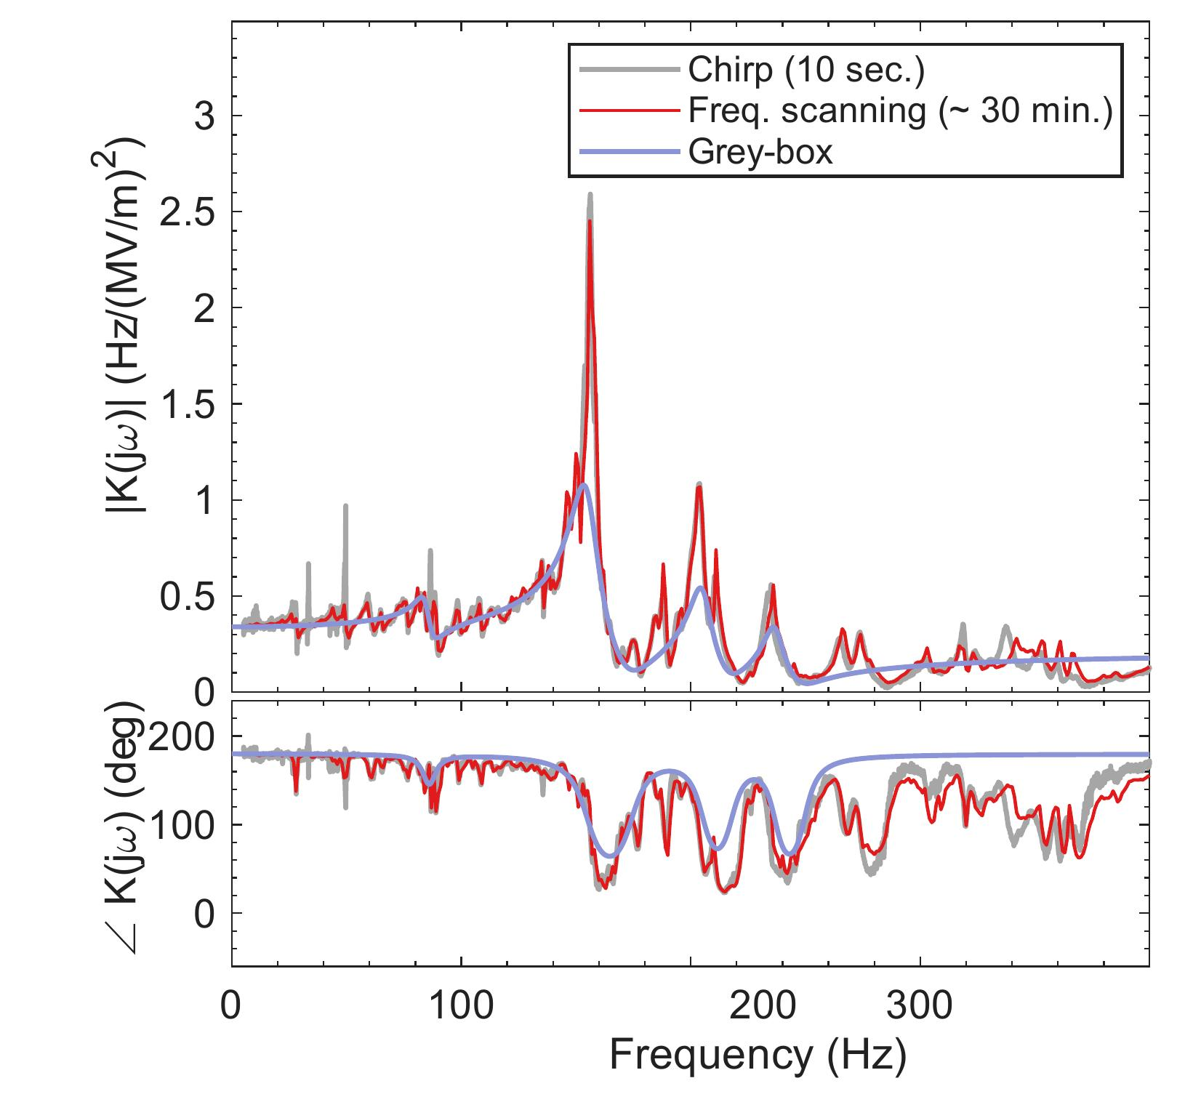
Comparison with Reference Methods
IP-SAFE CM1-1: chirp, stepped-sine and grey-box recover the dominant resonances.
Acquisition time
10 s
33 min
Chirp
Stepped-sine
Metric vs reference | Chirp | Grey-box
Mean peak error (Hz) | 0.80 | 1.38
Max. peak error (Hz) | 1.60 | 3.20
Magnitude RMSE (dB) | 2.11 | N/A
Peak errors: four representative modes
N/A: not reported for the grey-box result
Y. Miao et al., Fig. 9 and Table 2. Stepped-sine acquisition: 396 points × 5 s = 1980 s.
19

Slide 20
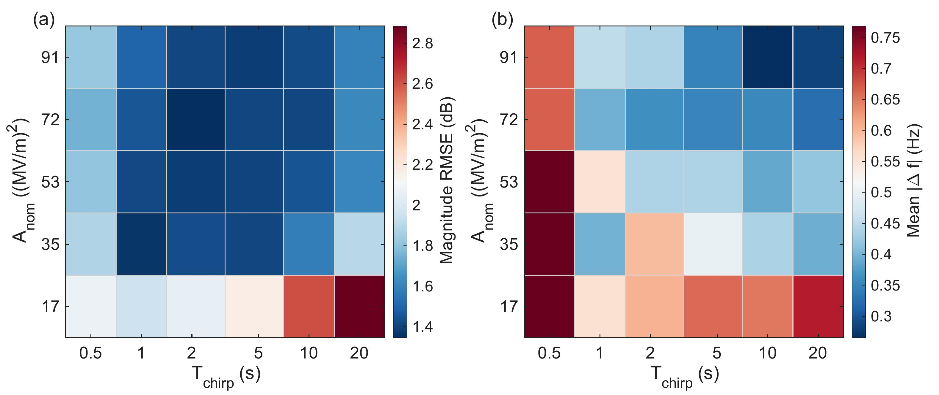
Duration and Excitation Strength
CM1-1 at Epeak = 17 MV/m with approximately fixed acquired sample count.
A_{nom}: Nominal squared-field excitation strength of chirp signal
T_{chirp}: Chirp sweep duration
Magnitude RMSE
Mean modal-frequency difference
For this configuration: moderate-to-large excitation and roughly 2–10 s.
Y. Miao et al., Fig. 11(a,b). Duration preference depends on sampling constraints.
20

Slide 21
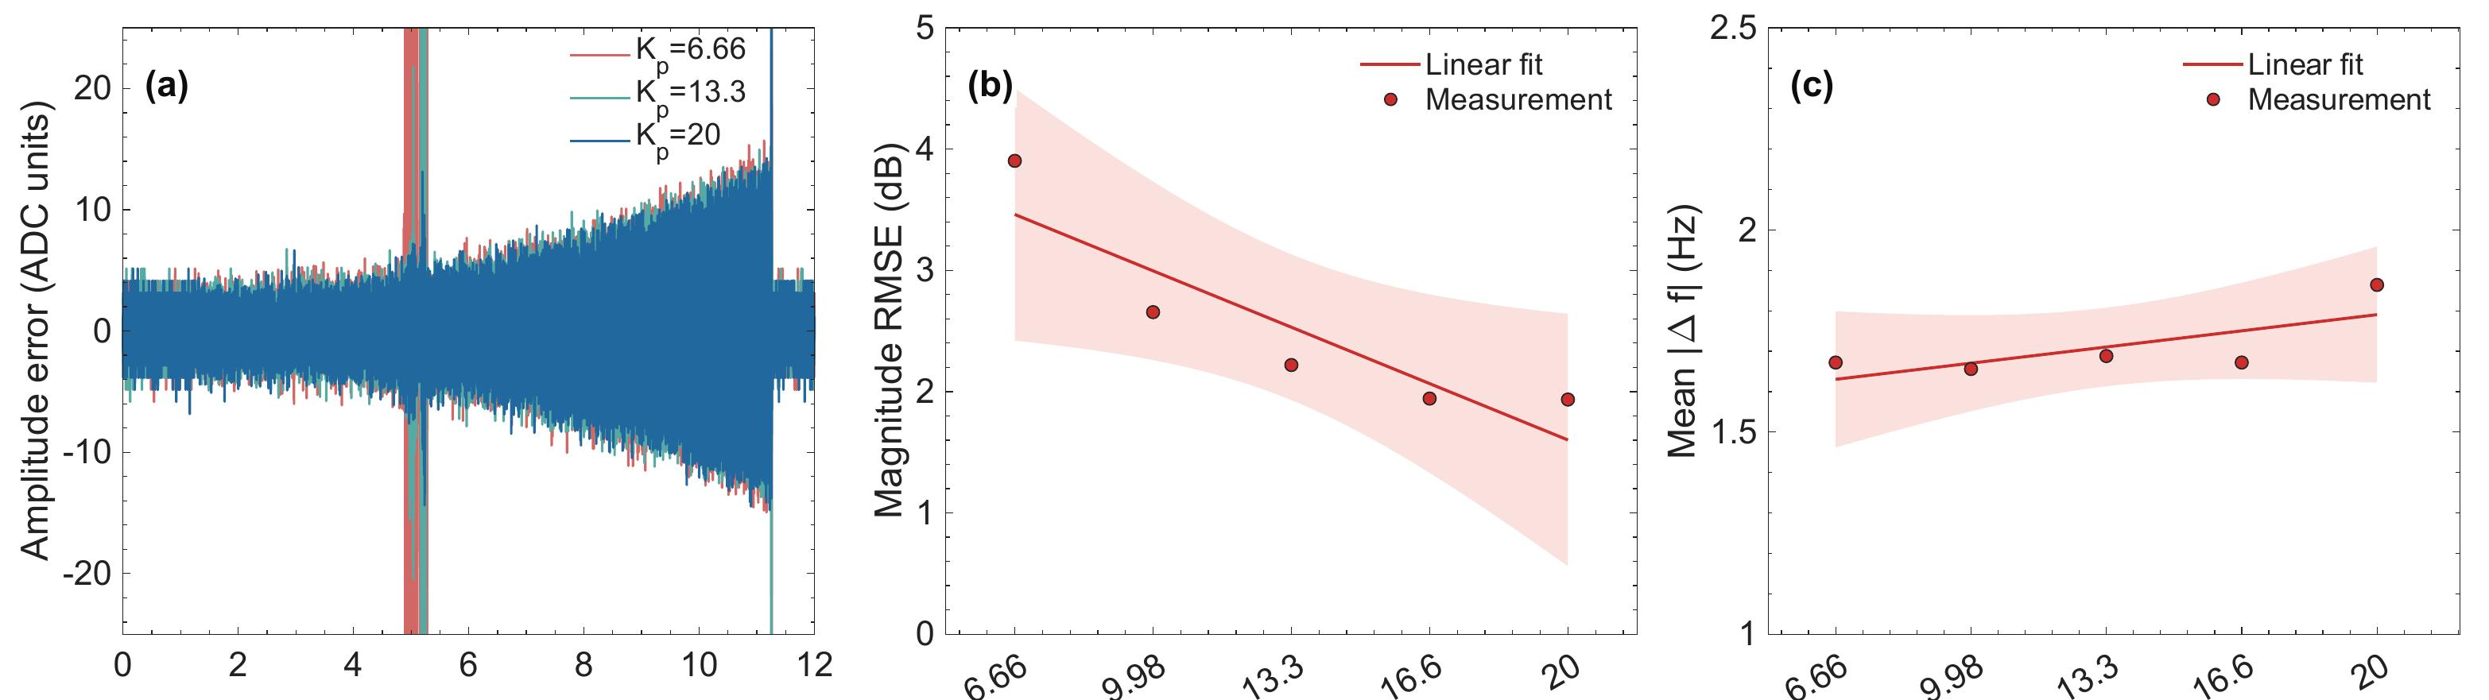
Influence of LLRF PI Settings
Amplitude-loop proportional-gain scan, with phase-loop parameters fixed.
Tracking near resonance
Magnitude RMSE
Mean frequency difference
Local error burst at low gain
3.90 to 1.93 dB
1.66–1.86 Hz
Y. Miao et al., Fig. 13(a–c). Phase-loop dependence is weaker over the tested range.
21

Slide 22
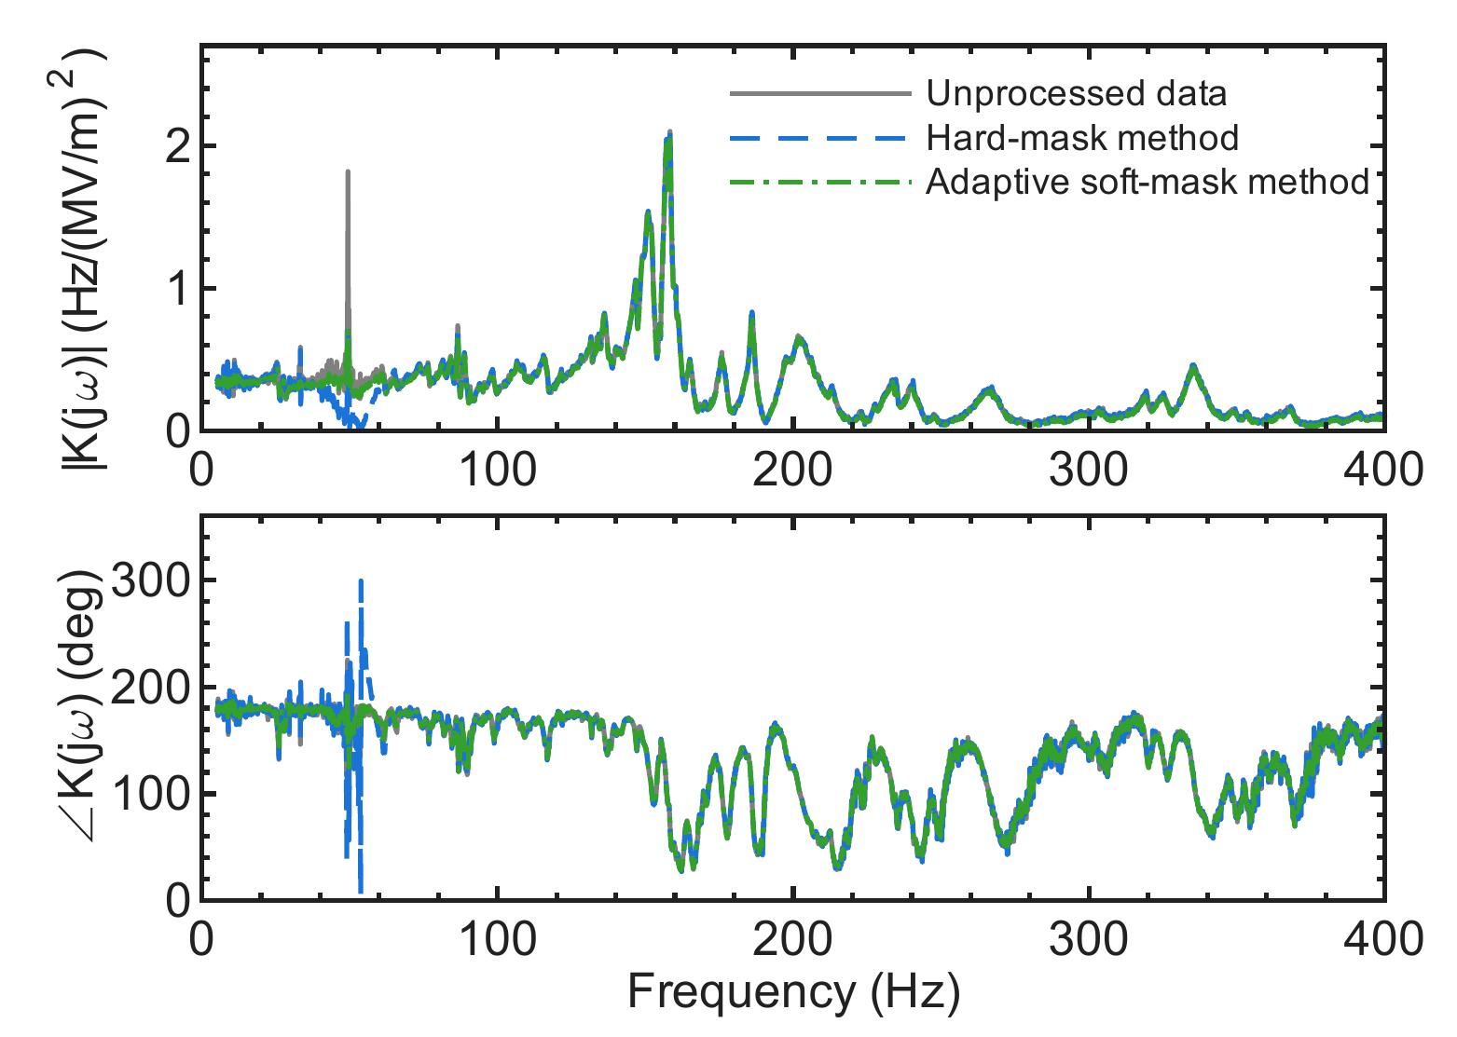
Microphonics and Preprocessing
Stationary microphonics can create local features unrelated to the chirp.
Around 50 Hz
Unprocessed
Local magnitude anomaly
and phase disturbance
Fixed-band hard mask
Stronger local distortion
Median-background soft mask
Smaller anomaly and better
phase continuity
This is detuning-signal preprocessing rather than active vibration cancellation.
Y. Miao et al., Fig. 15, Section V.C. The hard-mask band is 45–65 Hz.
22

Slide 23
Roles of the Two Approaches
Aspect | Grey-box identification | Closed-loop chirp
Excitation | Operational transients | Controlled broadband sweep(chirp)
Primary output | Compact parametric model | Measured frequency response
Advantages | Without dedicated RF interruption | Rapid broadband identification of mechanical modes
Key condition | Modes excited above the noise | Reliable tracking and RF reconstruction
Model-oriented applications
Rapid broadband characterization
Both approaches characterize mechanical dynamics through measured RF information.
F. Qiu et al., Section 4. Y. Miao et al., Introduction and Sections IV–V.
23

Slide 24
Conclusions
Two complementary methods were presented to characterize the mechanical modes of superconducting cavities.
Grey-box identification estimates physical model parameters from recorded RF transients and reconstructs the mechanical transfer function.
Grey-box identification uses routine operational data without dedicated RF interruptions, but mainly captures the dominant mechanical modes.
Closed-loop chirp enables rapid broadband identification, with good agreement with stepped-sine measurements, and resolves a broader set of mechanical modes within the measurement range.
F. Qiu et al., NIM A 1012 (2021) 165633. Y. Miao et al., Table 2 and Sections IV–V.
24

Slide 25
Thanks for your attention
Notes:
Slide 27. Thank You
Target 0:10
I would like to thank Feng Qiu, our collaborators and the operation teams for their support. Thank you for your attention. I will be happy to take questions.
Sources: F. Qiu et al., NIM A 1012 (2021) 165633, doi:10.1016/j.nima.2021.165633; Y. Miao et al., Closed-loop chirp characterization of mechanical modes in superconducting radio-frequency cavities, supplied manuscript

Slide 26





Grey-Box Parameter Estimation
Measured RF transients
Initialize grey-box model
Unknown parameters
u(t) = E²acc(t)
y(t) = Δfmeas(t)
Choose N and initial $θ⁽⁰⁾$
Physical structure: idgrey
$$θ = \{M₀, ωbase,$$
$$Mₖ, ωₖ, Qₖ\}$$
measured input
$θ⁽⁰$⁾
Predict detuning
Compare with measurement
Grey-box model + u(t)
Δfmodel(t; $θ⁽ʳ⁾$)
e(t) = y(t) − Δfmodel(t)
Evaluate fitting error
Converged?
No
Yes
updated θ
Update parameters
Identified model
Adjust θ to reduce error
$θ⁽ʳ⁾$ becomes $θ⁽ʳ⁺¹⁾$
Obtain K(s)
Check other RF events
Parameter iteration in greyest (fixed N)
Iteratively adjust physical parameters to reproduce measured detuning.
F. Qiu et al., NIM A 1012 (2021) 165633, Section 3. Conceptual parameter-estimation loop.
Notes:
The physical model structure is known, while its modal parameters are unknown. We first record the squared cavity field and the corresponding detuning. The transient spectrum provides initial frequency guesses, and idgrey defines a model with a chosen number of modes. For a current parameter set, the model uses the measured field input to predict detuning. We compare this prediction with the measured detuning and evaluate the fitting error. The estimator adjusts the parameters and repeats the calculation until convergence. The fitted model gives the transfer function, which is then checked against other RF events. This diagram illustrates the conceptual parameter-estimation loop in greyest; it is separate from the RF feedback loop. The model order N stays fixed within each fit. The next slide compares fits with different values of N.
中文讲解：先固定机械模数量N，给模态频率、机械品质因数和耦合参数一组初值。将实测腔场的平方输入模型，计算预测失谐，与实测失谐比较。根据误差更新参数，再重新计算，直到达到收敛条件。最终得到传递函数，并用其他RF事件验证。
Source: F. Qiu et al., NIM A 1012 (2021) 165633, Section 3, Eqs. (3)–(7), Figs. 8–10. This is a conceptual estimation flow, not an assertion of a particular optimization algorithm or numeric stopping threshold. MATLAB idgrey/greyest documentation: https://www.mathworks.com/help/ident/ref/greyest.html

