Slide 1
RF cavity feedback for high-intensity counter-rotating beams in the proposed muon collider RCS chain
Leonard Thiele (University of Rostock, CERN),
S. Albright, R. Calaga, H. Damerau, A. Grudiev, E. Lamb, S. Lauber, U. van Rienen

Slide 2
Outline
Muon collider complex overview
Introduction to acceleration chain
RF system overview
Impact of beam loading on beam dynamics
Cavity feedback
Phase loops
Conclusion and outlook

Slide 3
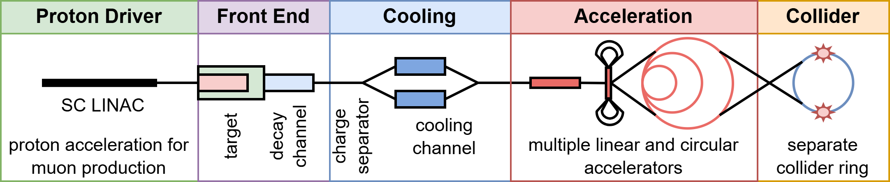
Muon collider complex
Muon production
  Cooling channel necessary to reduce 6D emittance of beam
Two high-intensity bunches with $2.7×{10}^{12}$ particles per bunch in accelerators and collider
  one $μ^{+}$ and one $μ^{−}$

Slide 4
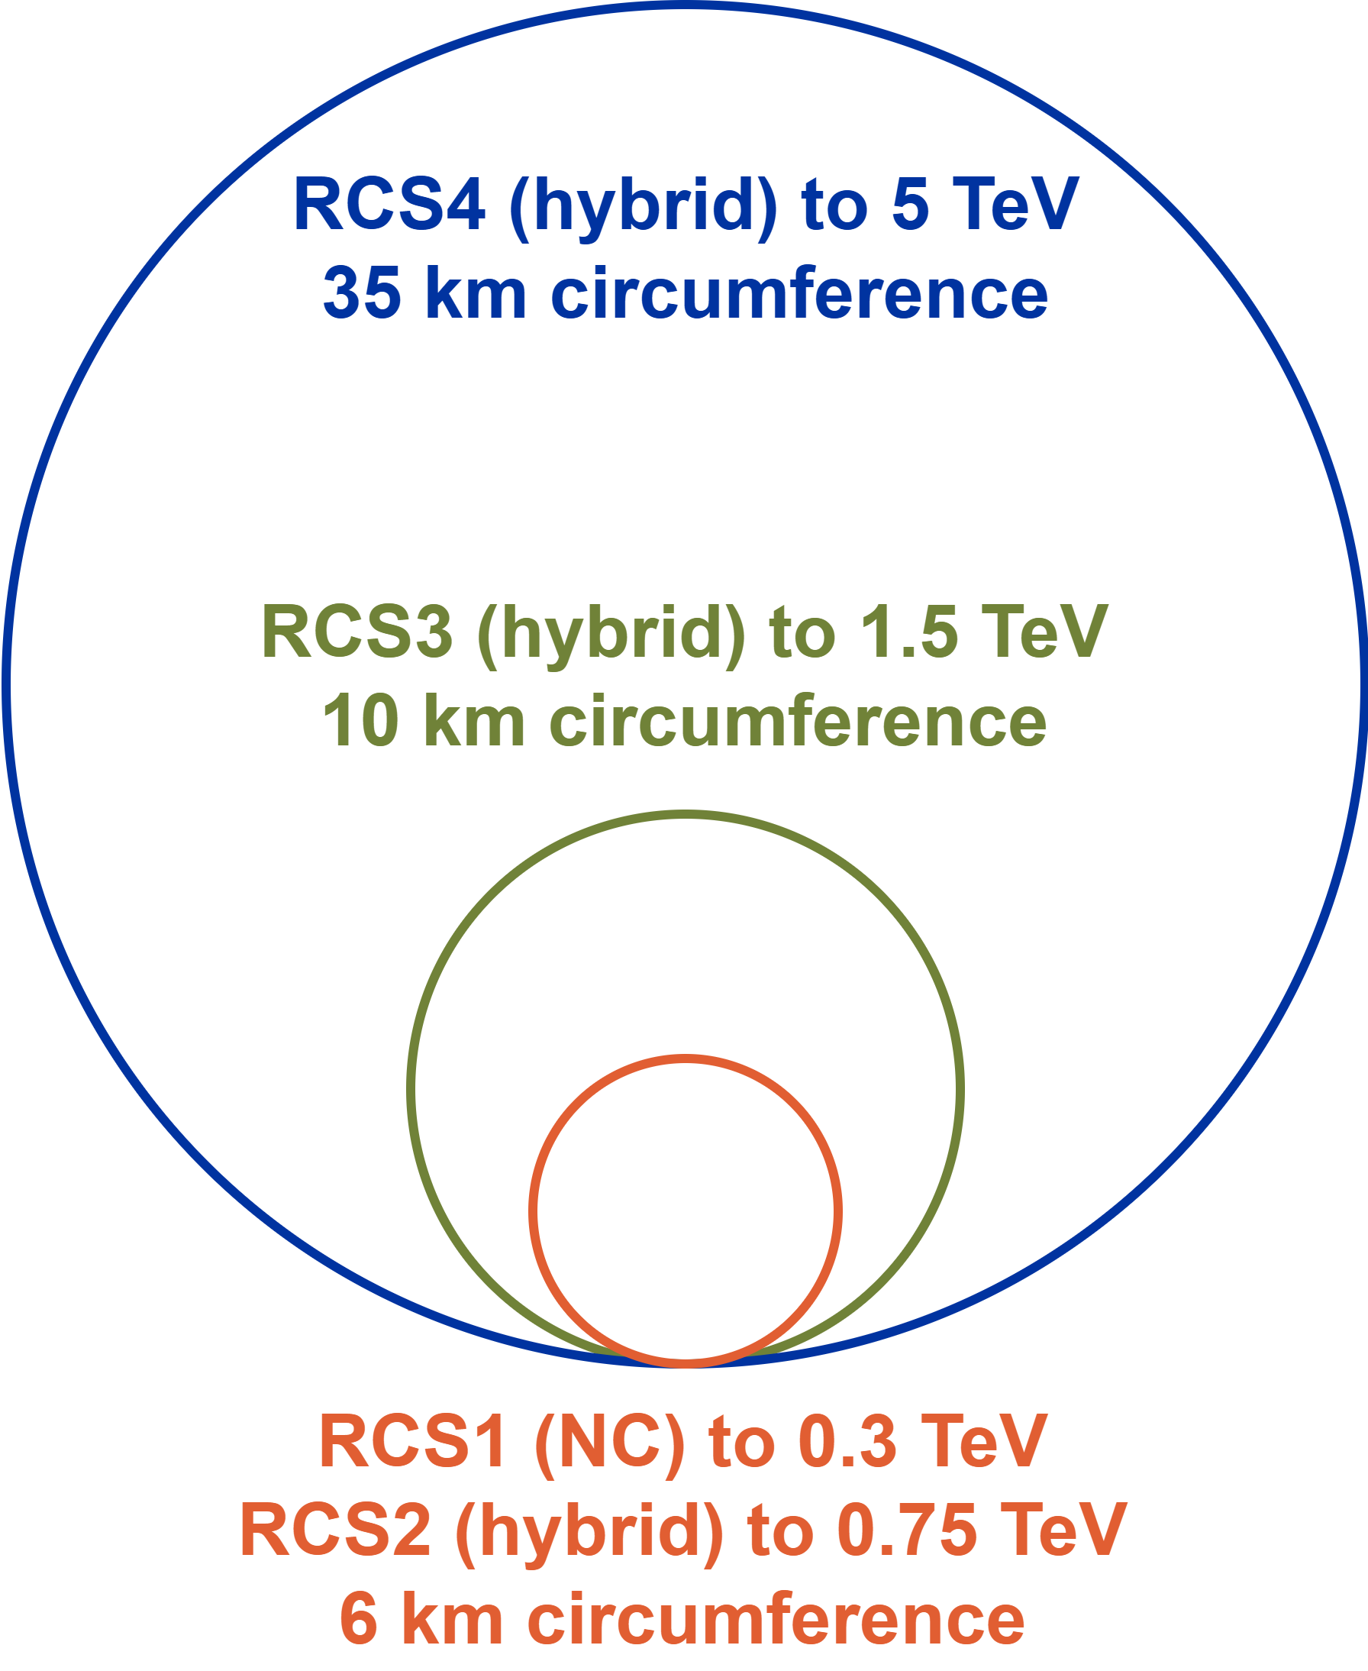
Introduction
High-energy acceleration
Chain of four rapid cycling synchrotrons (RCS)
  Accelerating the beam from $63 GeV$ to $5 TeV$
Hybrid RCS
  Combination of normal-conducting (NC) and superconducting (SC) magnets
Muon decay $τ_{μ}=γ×2.2 μs$
  Fast acceleration: kT/s magnet ramp rate
  Tens of gigavolt per turn of acceleration
  Low number of turns ($17…66$)
  Changing intensity (10 % per ring)
Collider requirement:
  Minimal emittance growth through chain

Slide 5
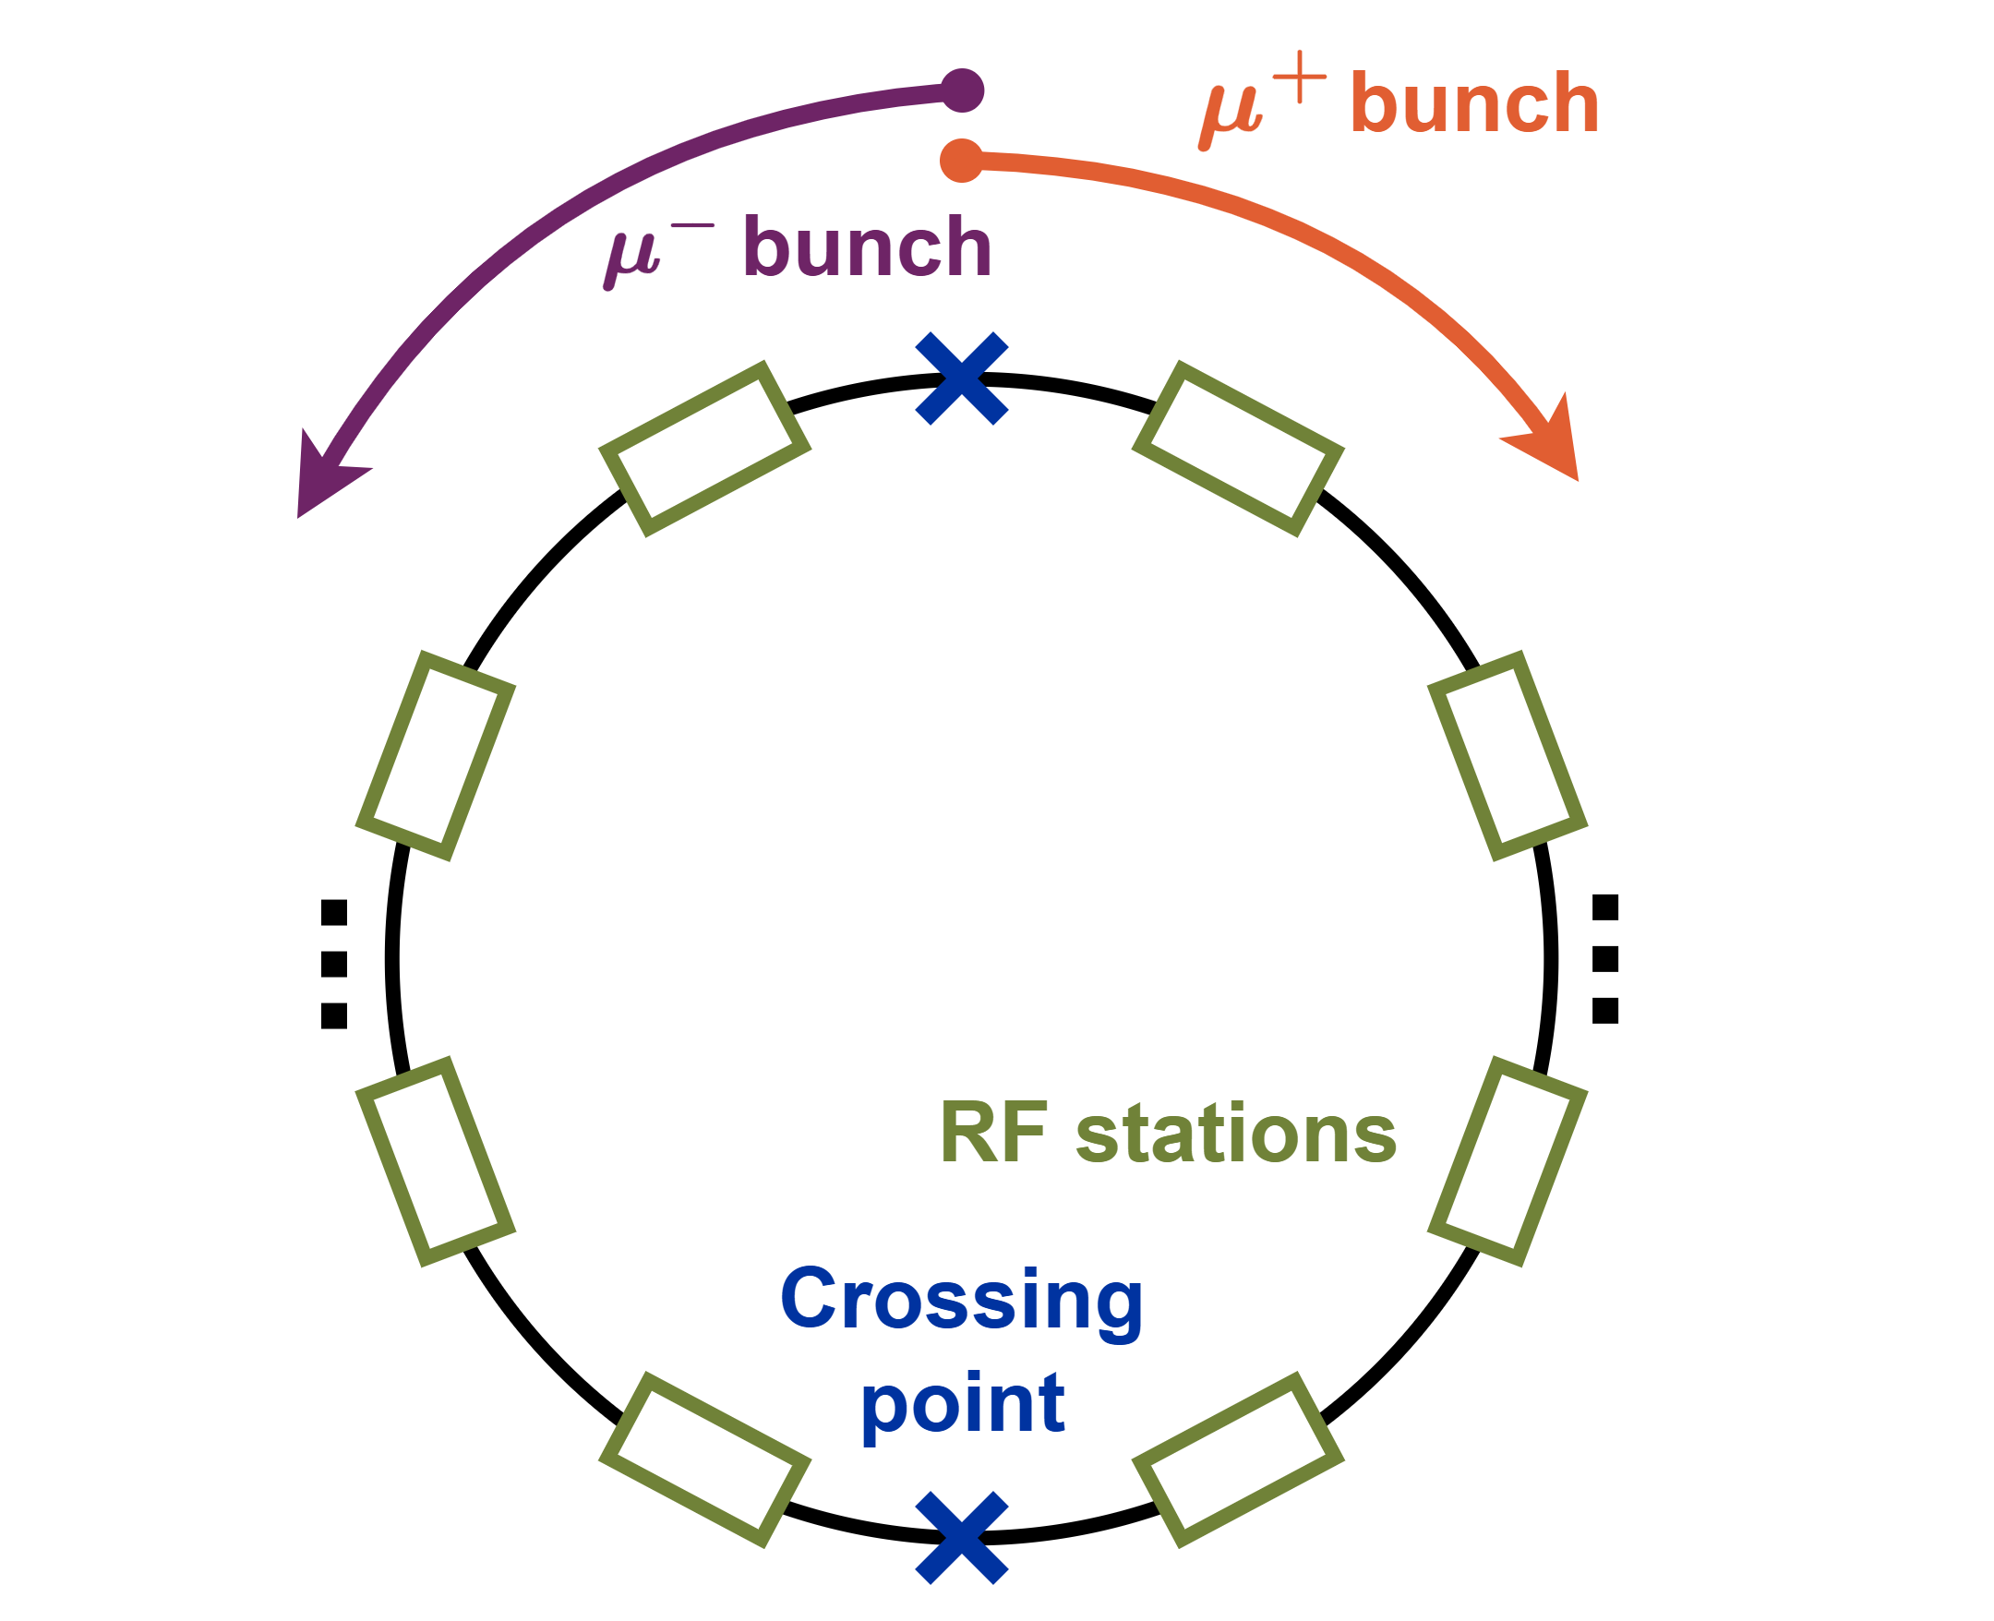
RCS chain RF system
Baseline cavities: TESLA-like 9-cell $1.3 GHz$
  High gradient of $30 MV/m$ with proven SC technology
  1000s of cavities
Moderate average beam currents
  Shared RF system for both beams
High voltage per turn
  High synchrotron tune $Q_{s}$(up to $1.2$)
  Distribution of RF system around circumference
  Reduction in effective $Q_{s}∝1/n_{stations}$
Two counter-rotating beams with high-Q cavity
  Interaction between multiple passages of one bunch
  Interaction between counter-rotating (CR) bunches

Slide 6
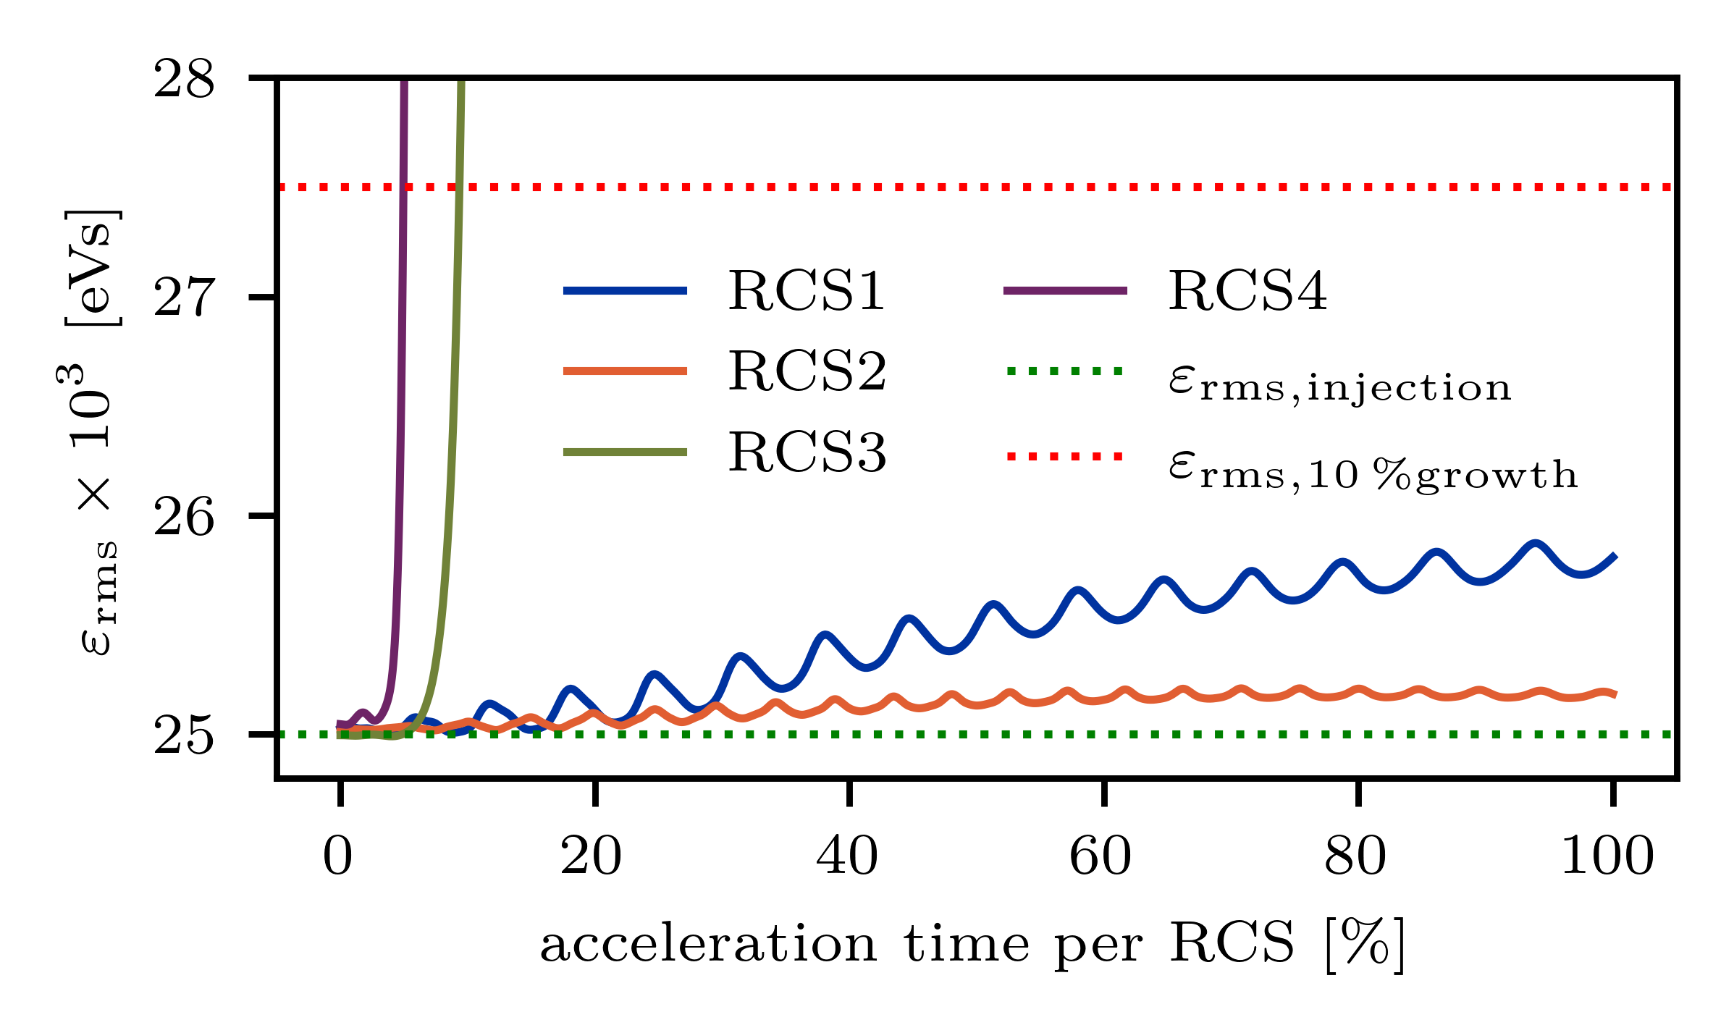
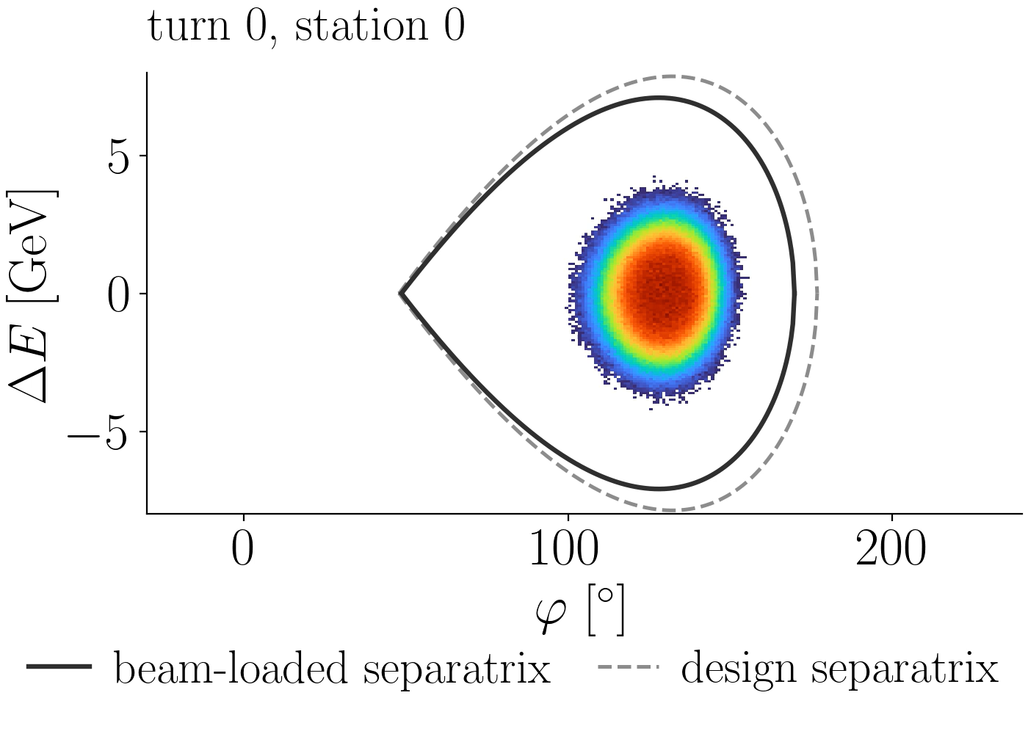
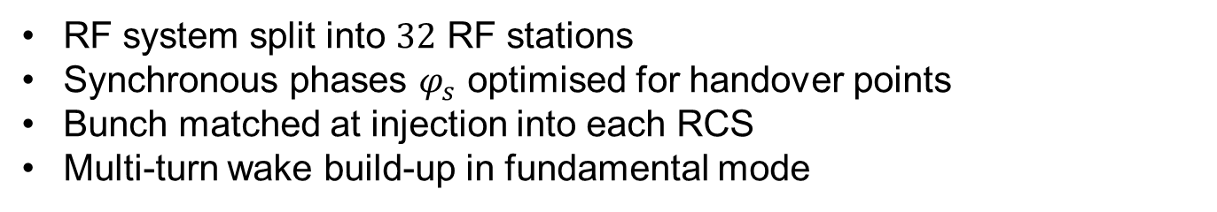
First Simulation Without Feedback
RF system split into 32 RF stations
Synchronous phases $φ_{s}$ optimised for handover points
Bunch matched at injection into each RCS
Multi-turn wake build-up in fundamental mode
RCS3

Slide 7
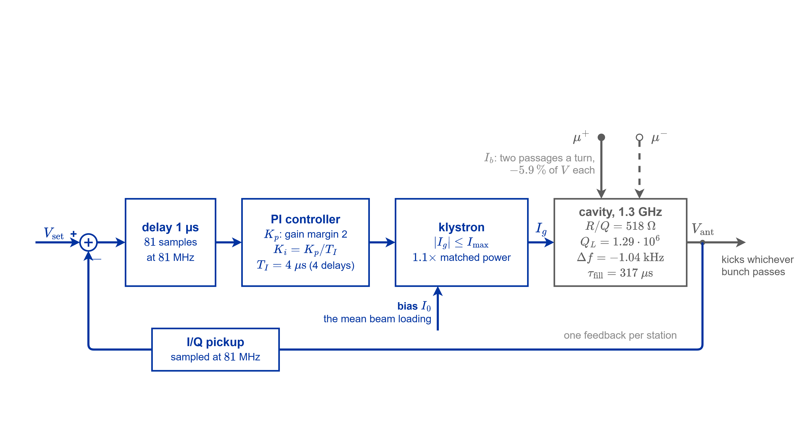
Motivation/Architecture
Use direct RF feedback to damp beam-induced voltage before arrival of next bunch (either counter-rotating or next turn)
Transients of power and voltage important in RCS chain
  Filling time on the order of acceleration time
Assumption: perfect tuner and klystron

Slide 8
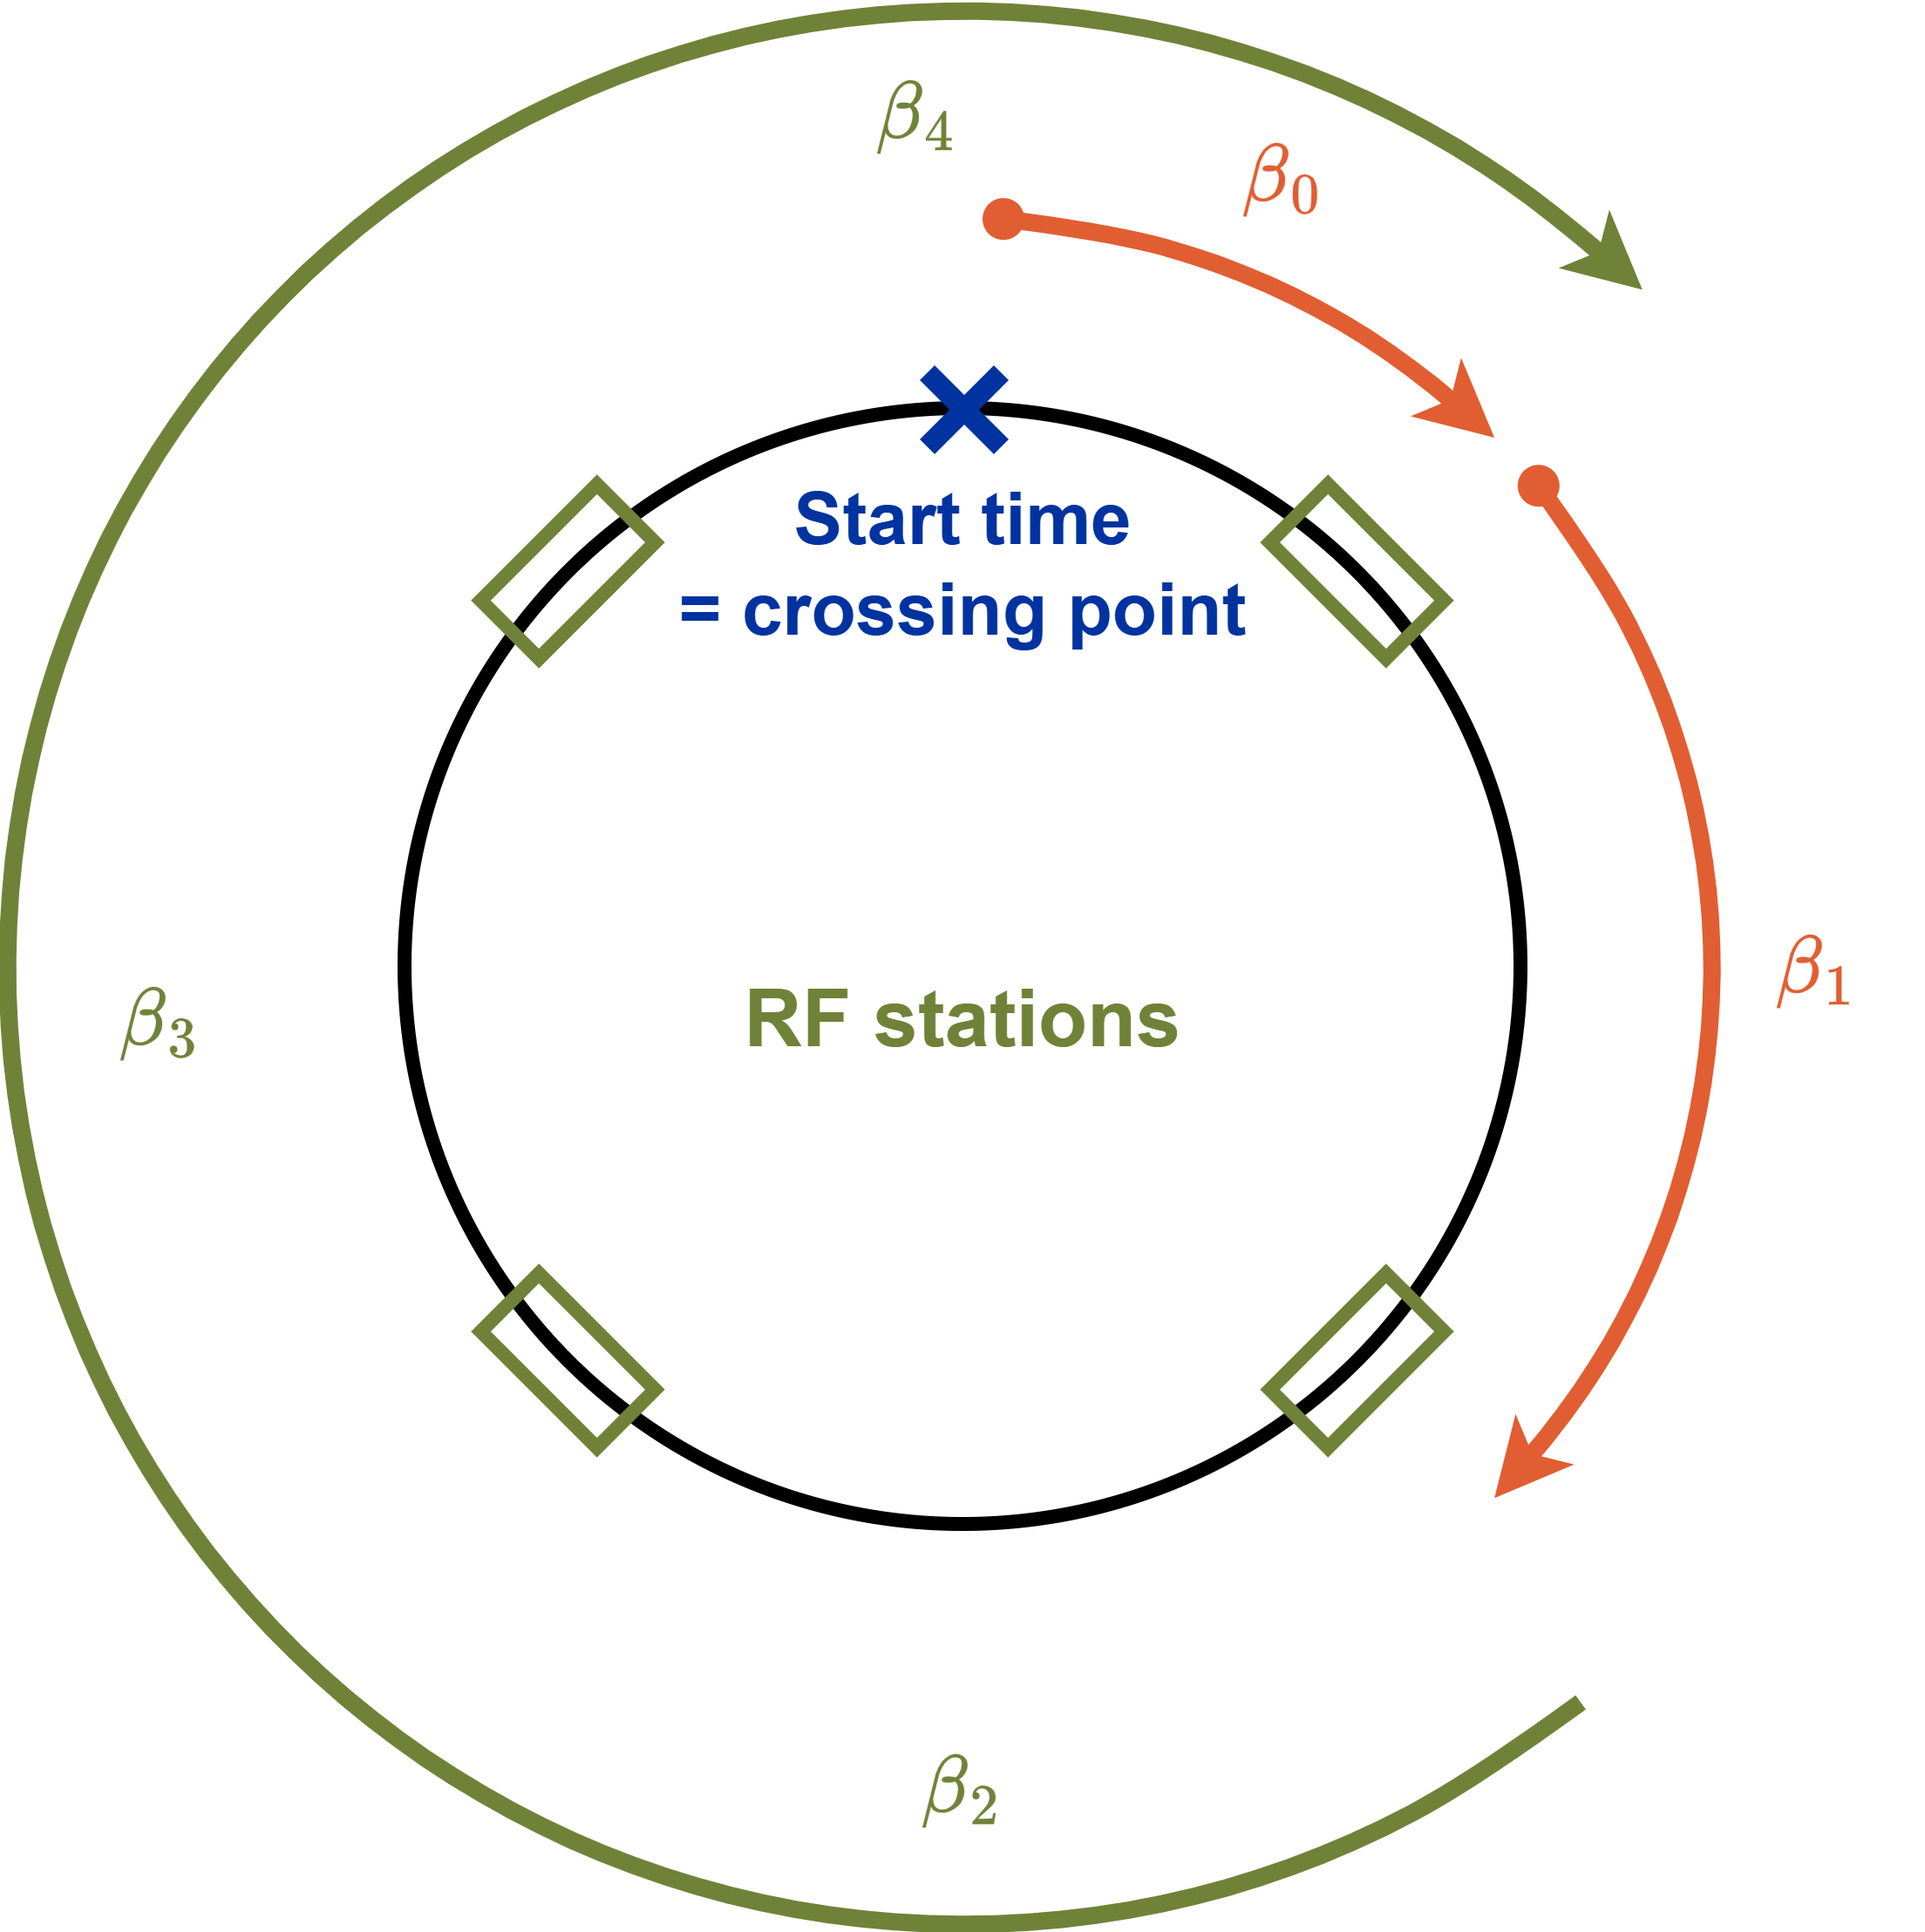
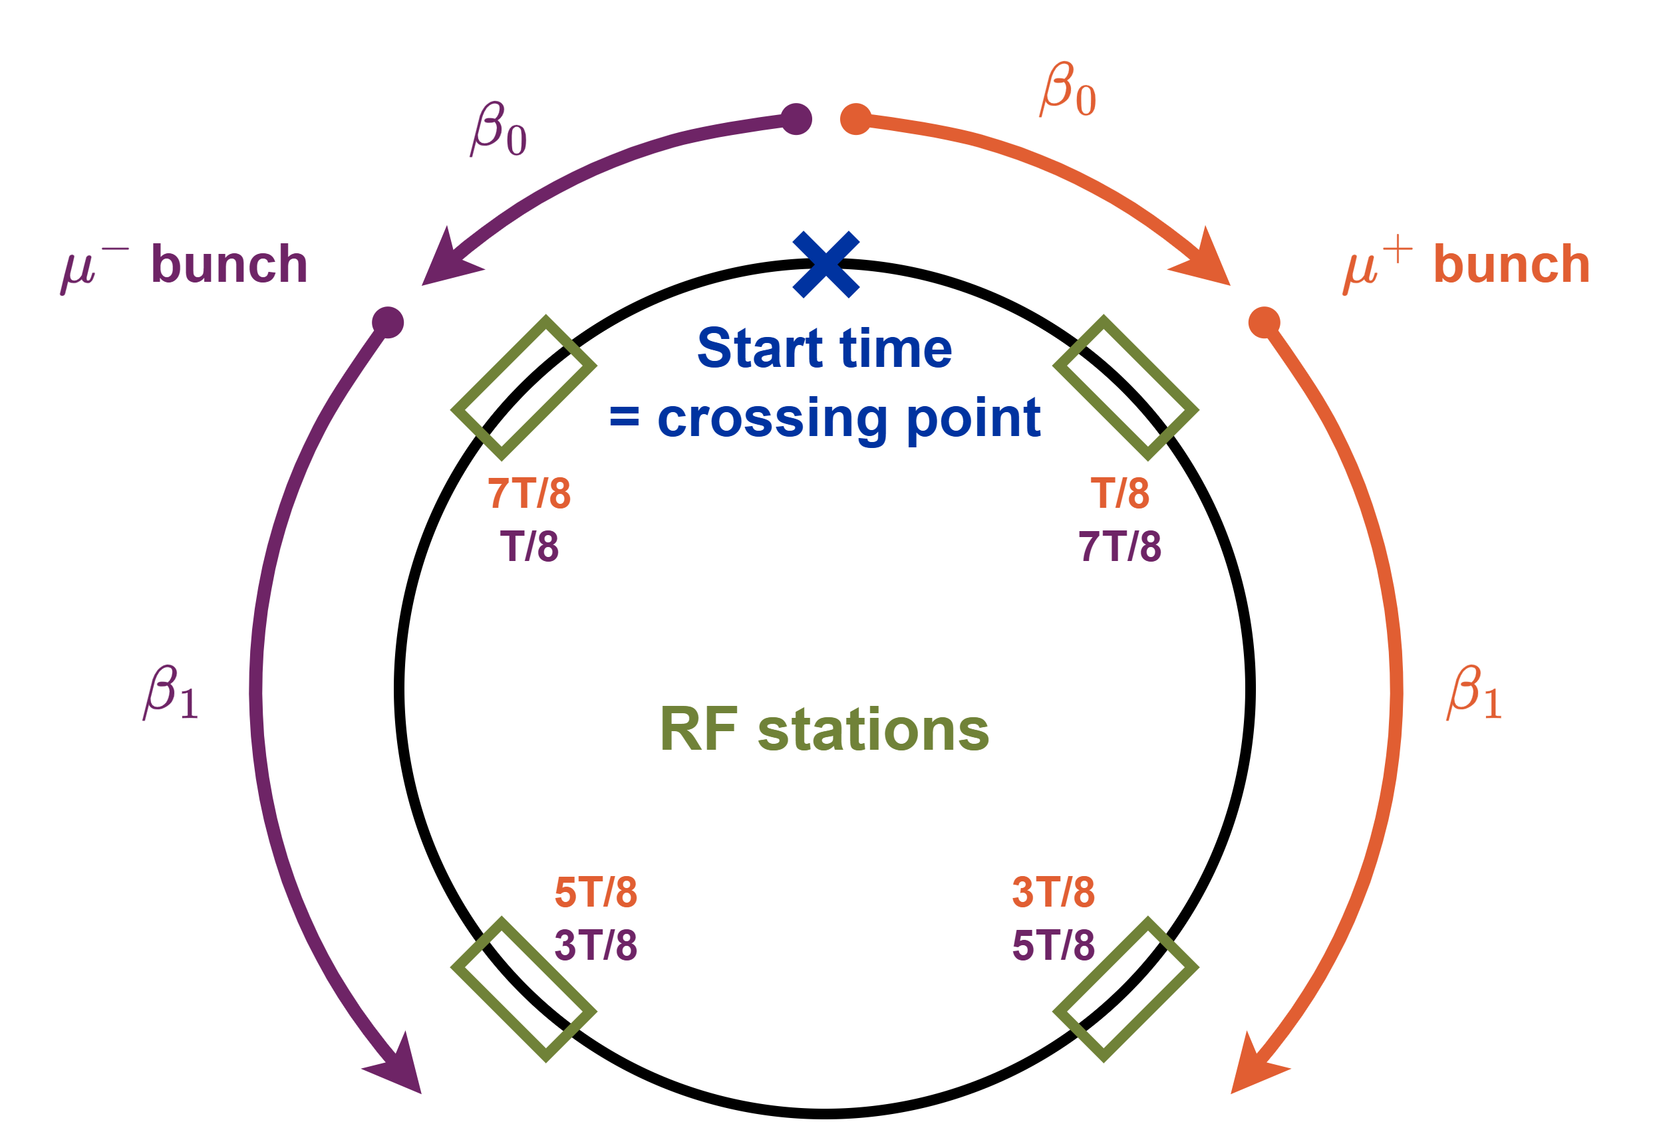
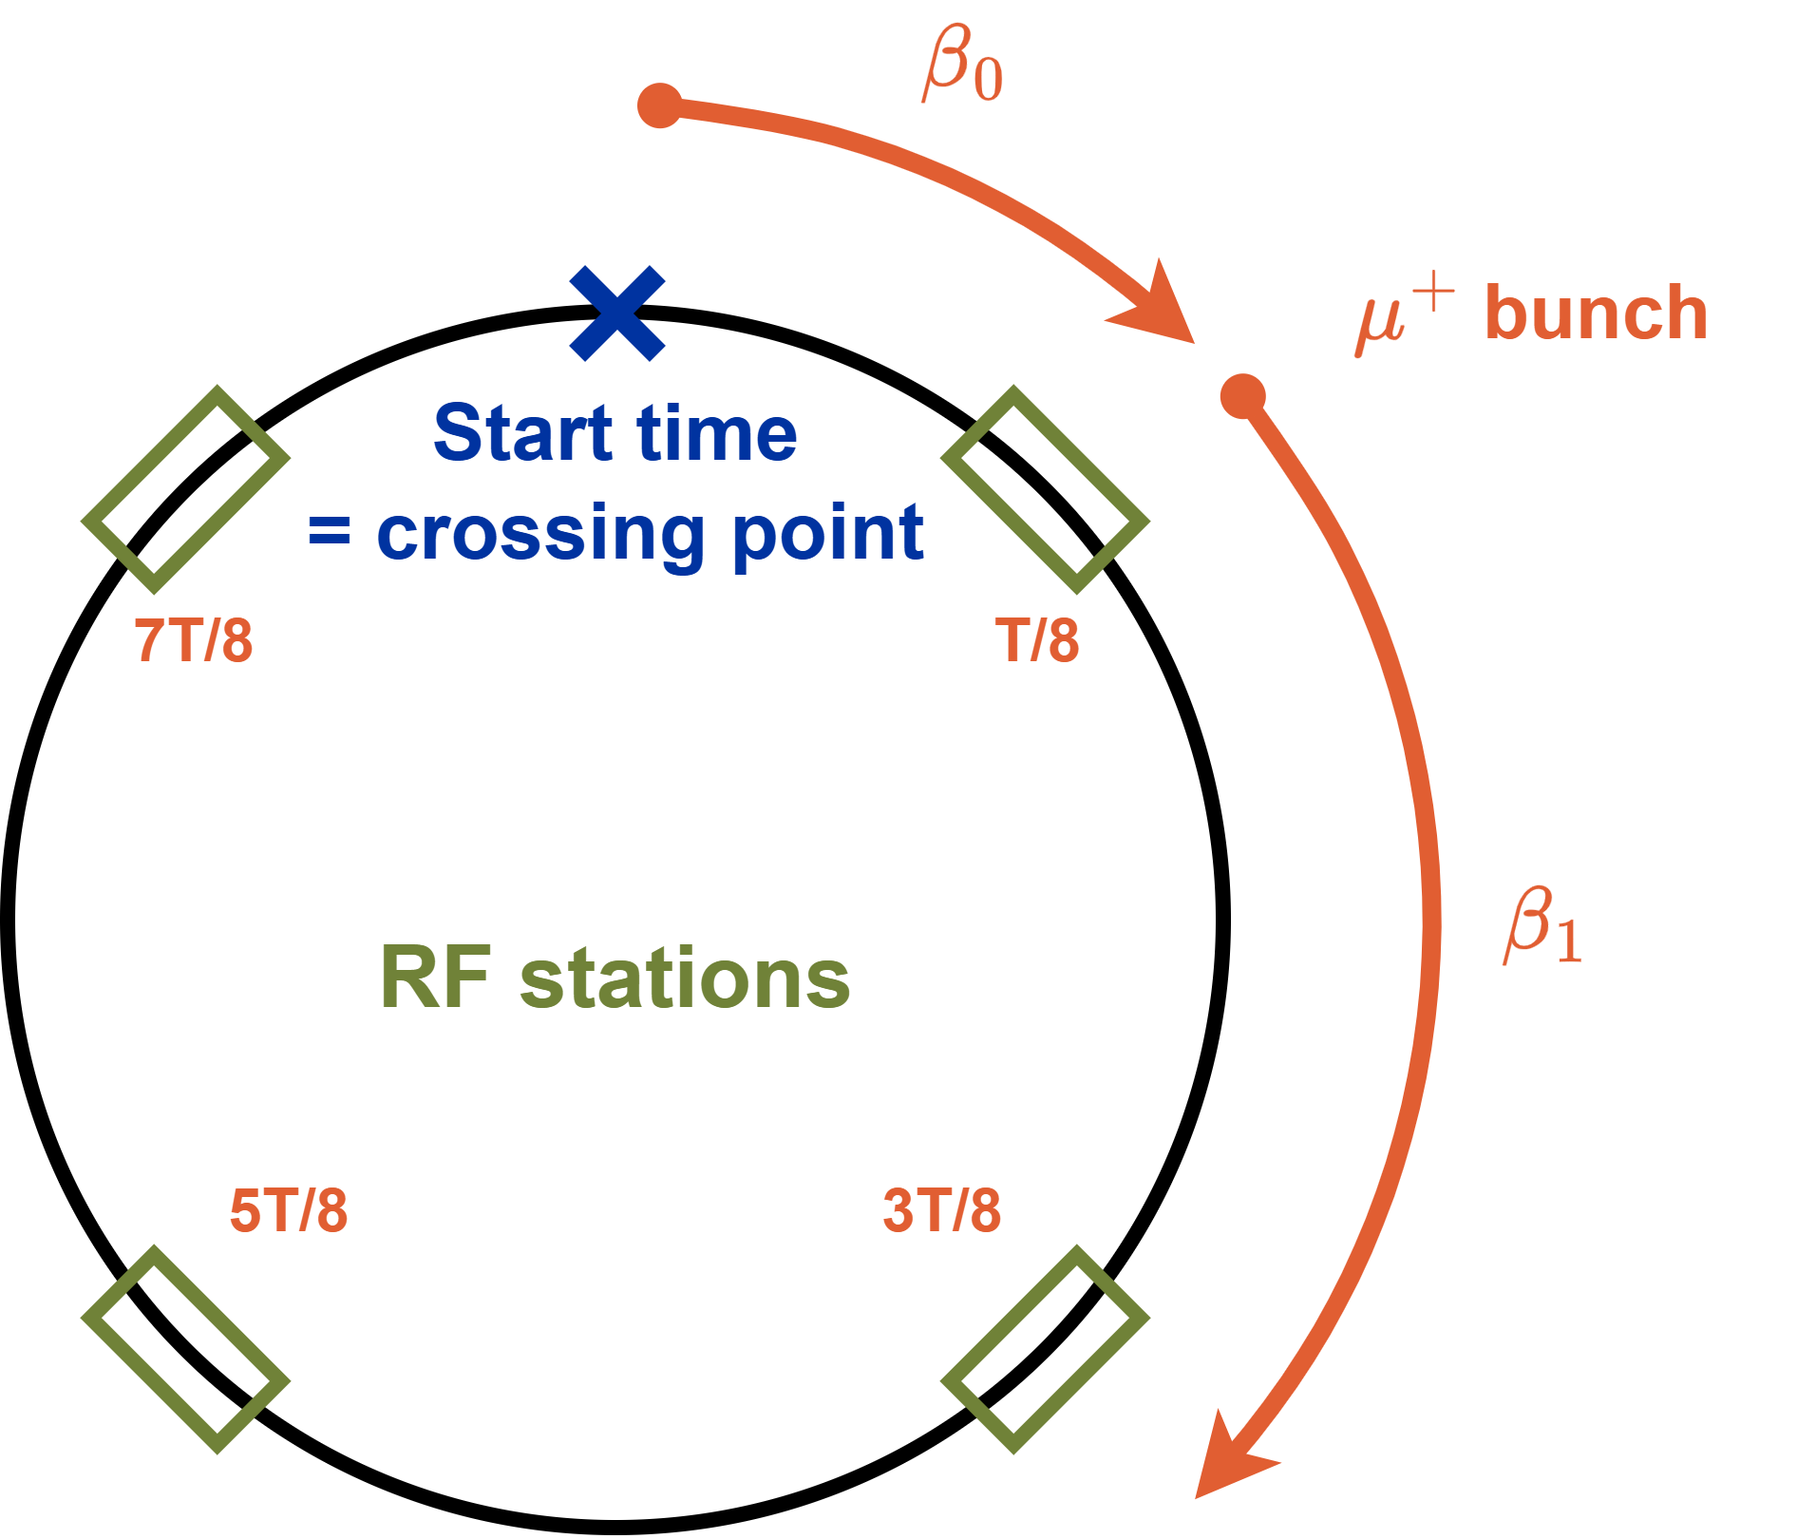
Cavity Feedback Modelling
Extended Beam Longitudinal Dynamics (BLonD) from CERN
Starting point for implementation
  BLonD LHC cavity feedback model
Most important difference:
  Energy changes during turn
    Revolution frequency changes
    Loop and cavity frequency need to follow
    Partial calculation of voltage in beam-free segments
  Two counter-rotating beams
    Partial calculation allows in-place calculation

Slide 9
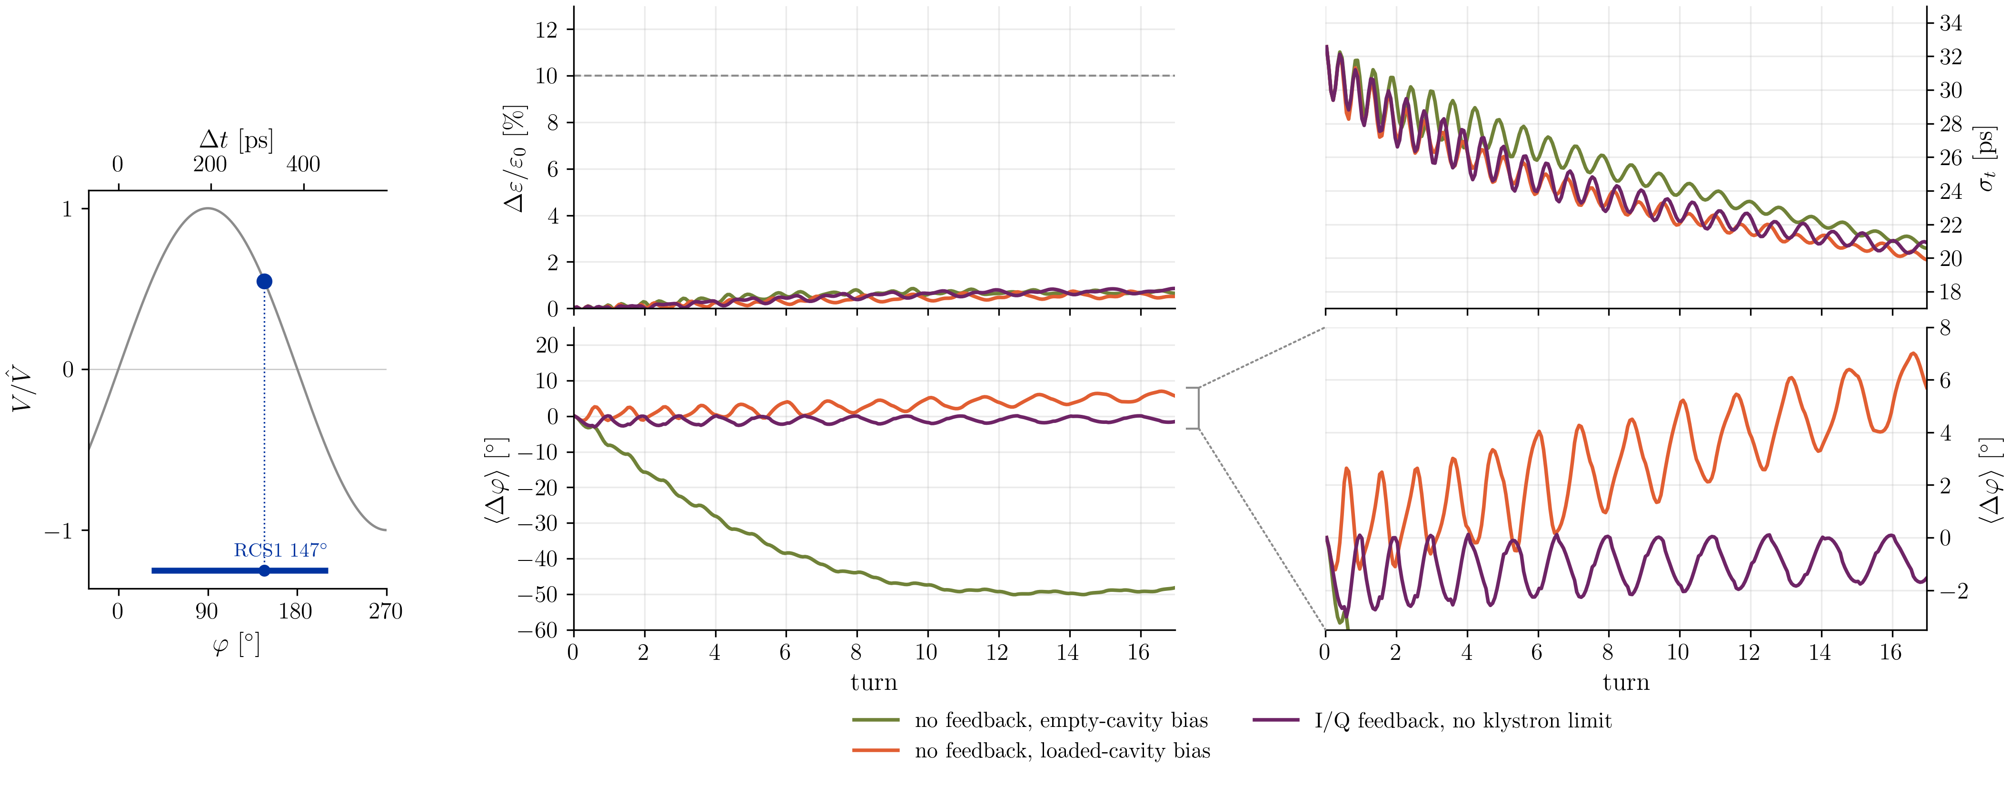
Cavity Feedback in RCS1
bunch length
emittance growth
synchronous/accelerating phase
bunch phase
Stable area

Slide 10
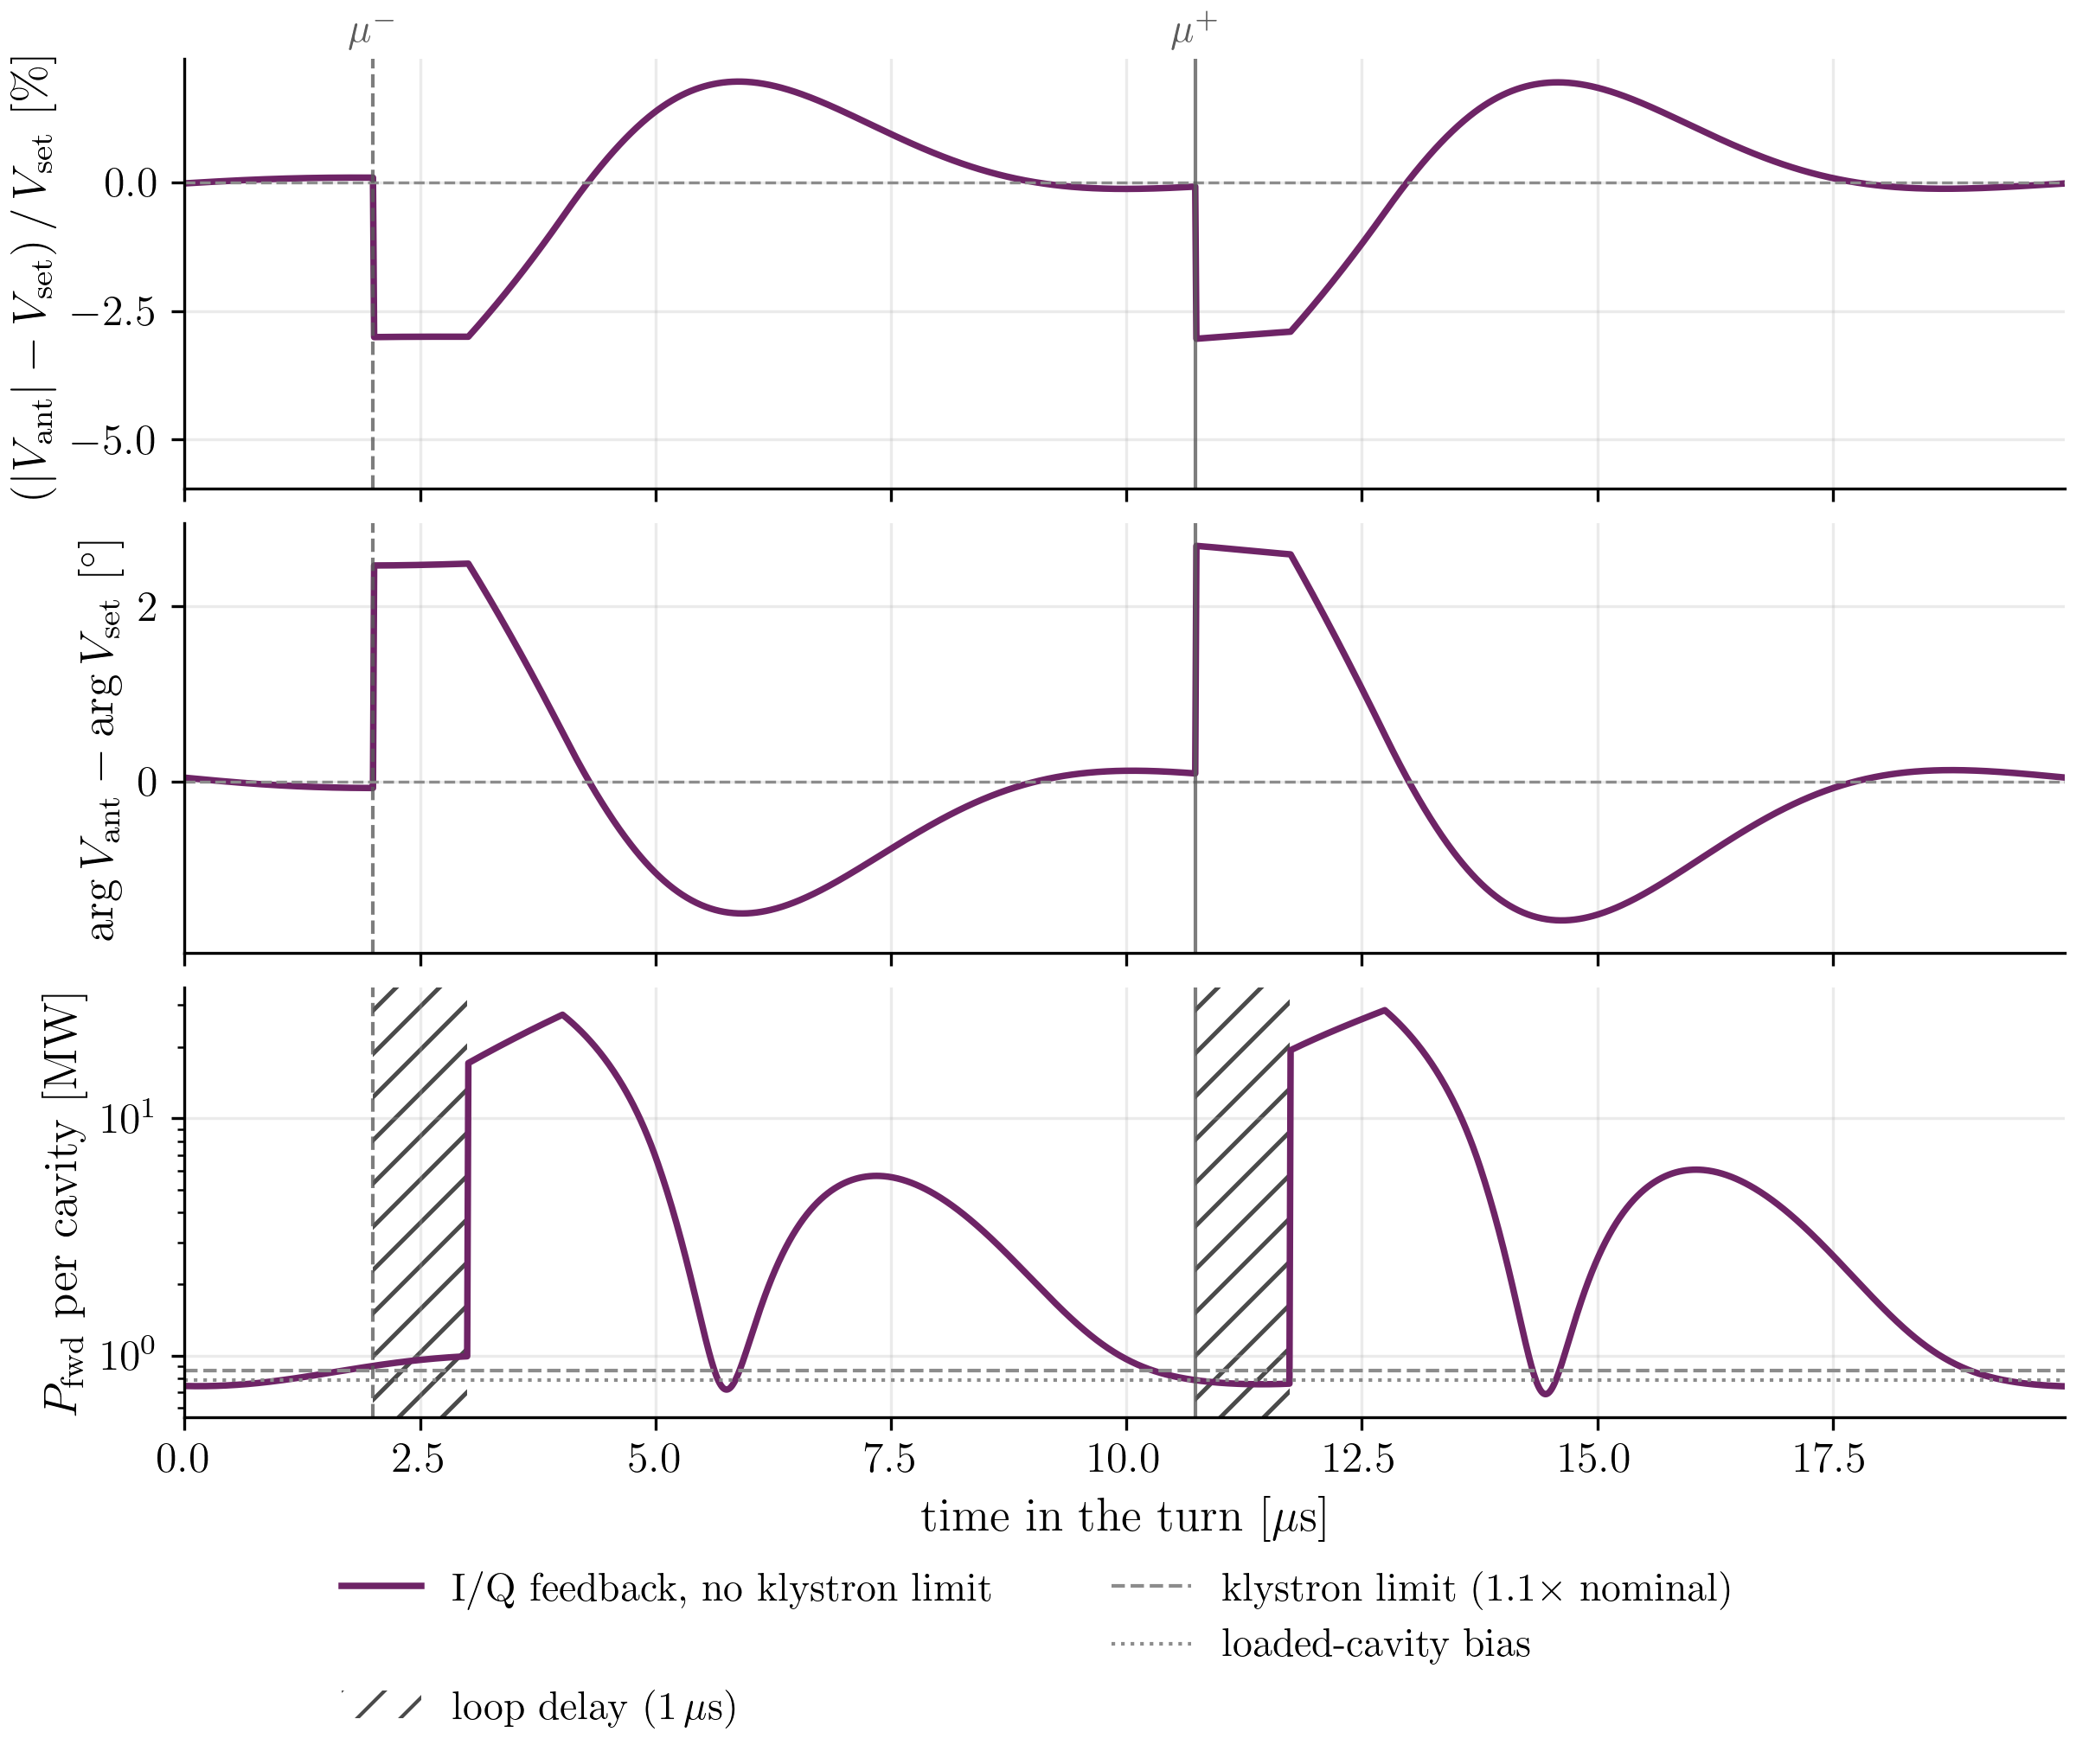
Voltage Evolution in RCS1
4th/16 stations
  Most regular bunch arrival times
Without Klystron limit
  Voltage gets corrected before arrival of next bunch
  High power draw (12x nominal)

Slide 11
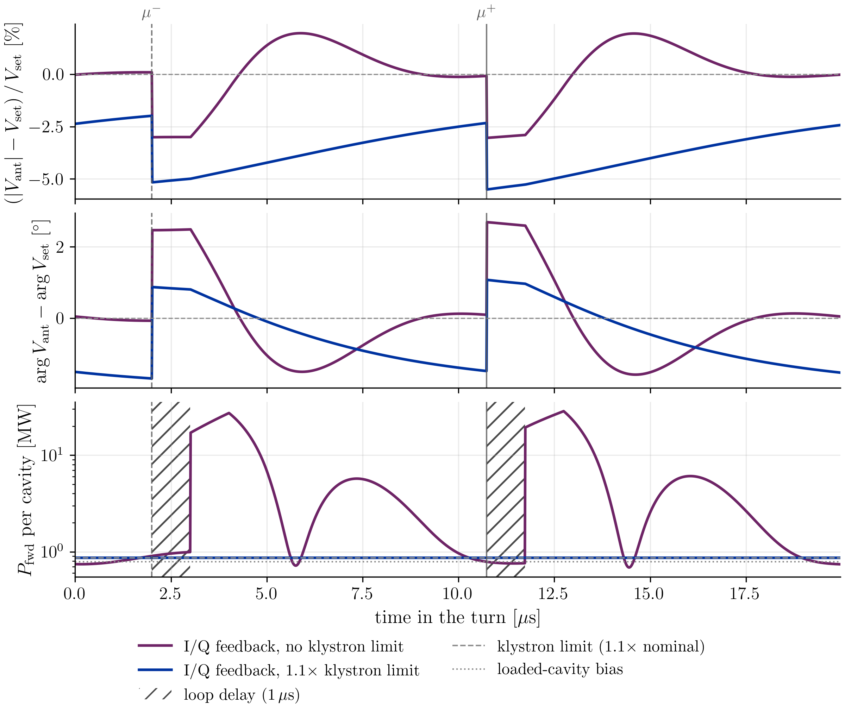
Voltage Evolution in RCS1
4th/16 stations
  Most regular bunch arrival times
Without Klystron limit
  Voltage gets corrected before arrival of next bunch
  High power draw (12x nominal)
With Klystron limit
  Phase error at bunch arrival small

Slide 12
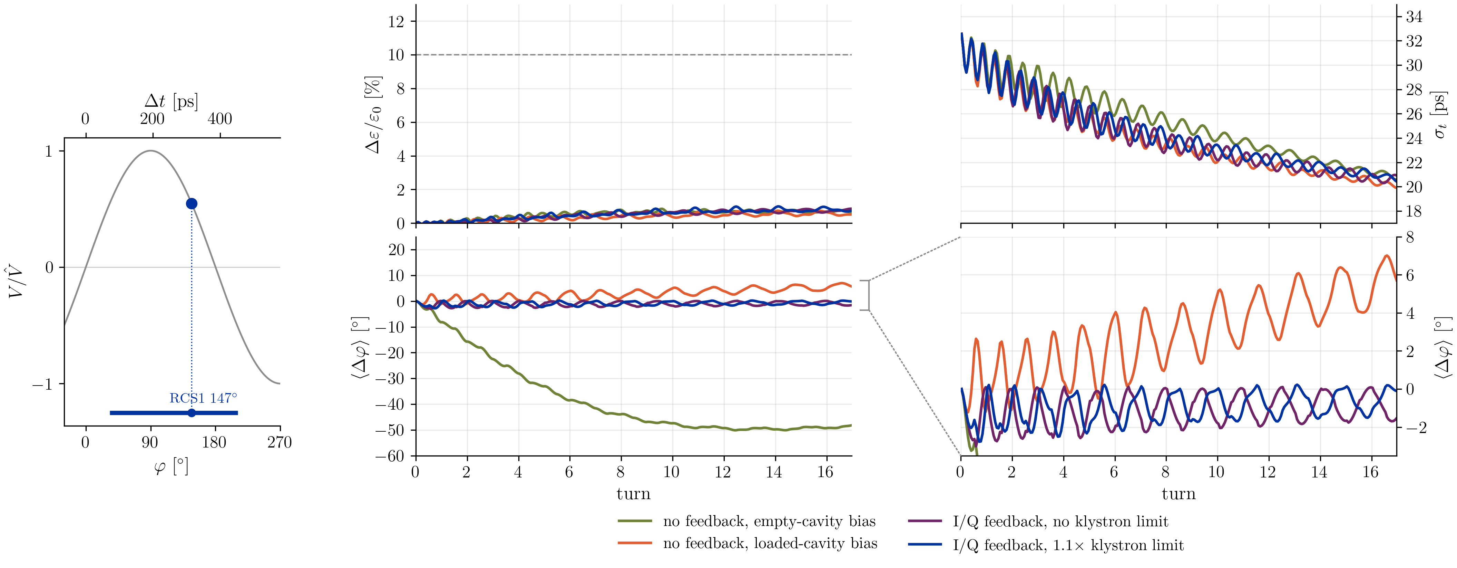
Cavity Feedback in RCS1
synchronous/accelerating phase
Stable area

Slide 13
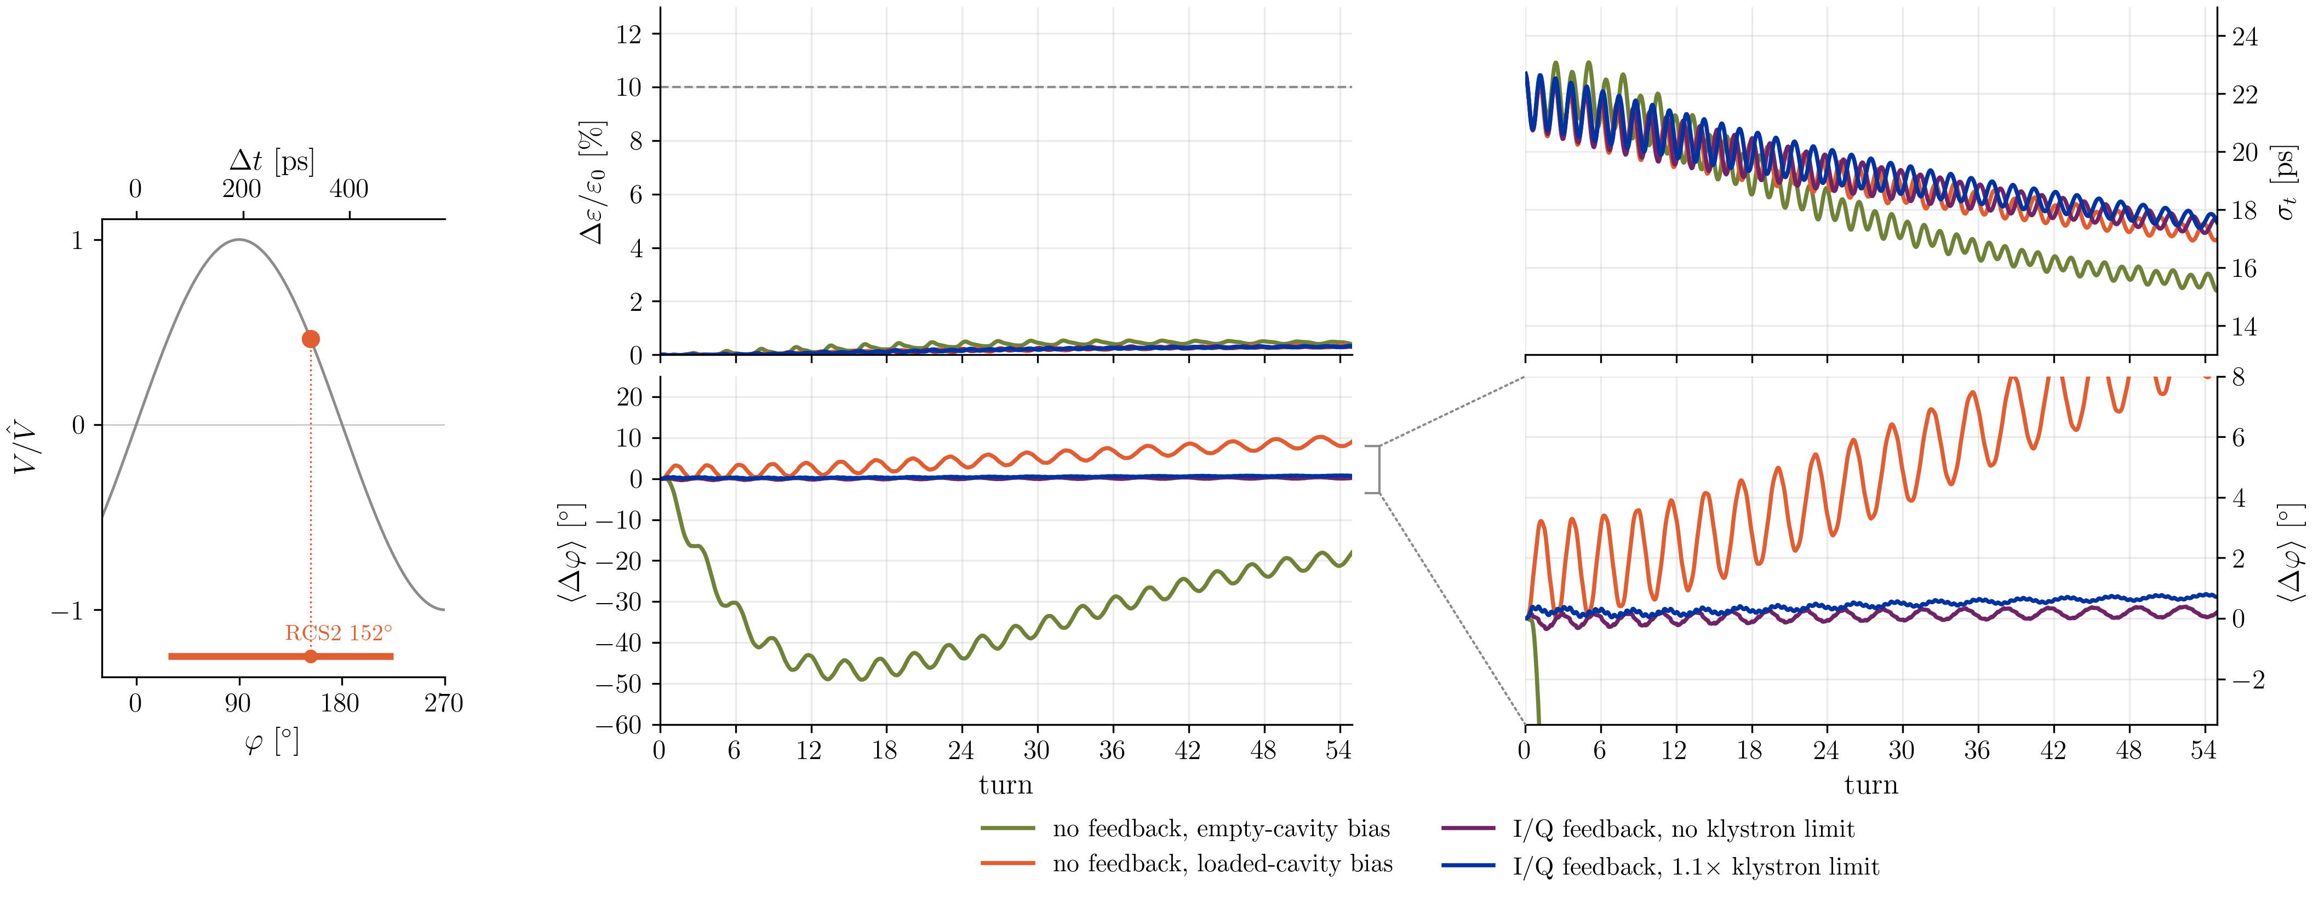
Cavity Feedback in RCS2

Slide 14
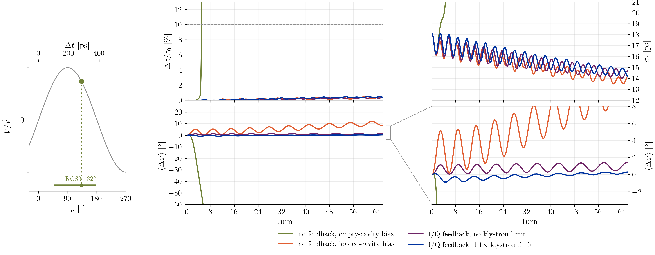
Cavity Feedback in RCS3
Smaller $φ_{s}$ → smaller stable area:
Larger centroid motion, unstable without adjusted bias

Slide 15
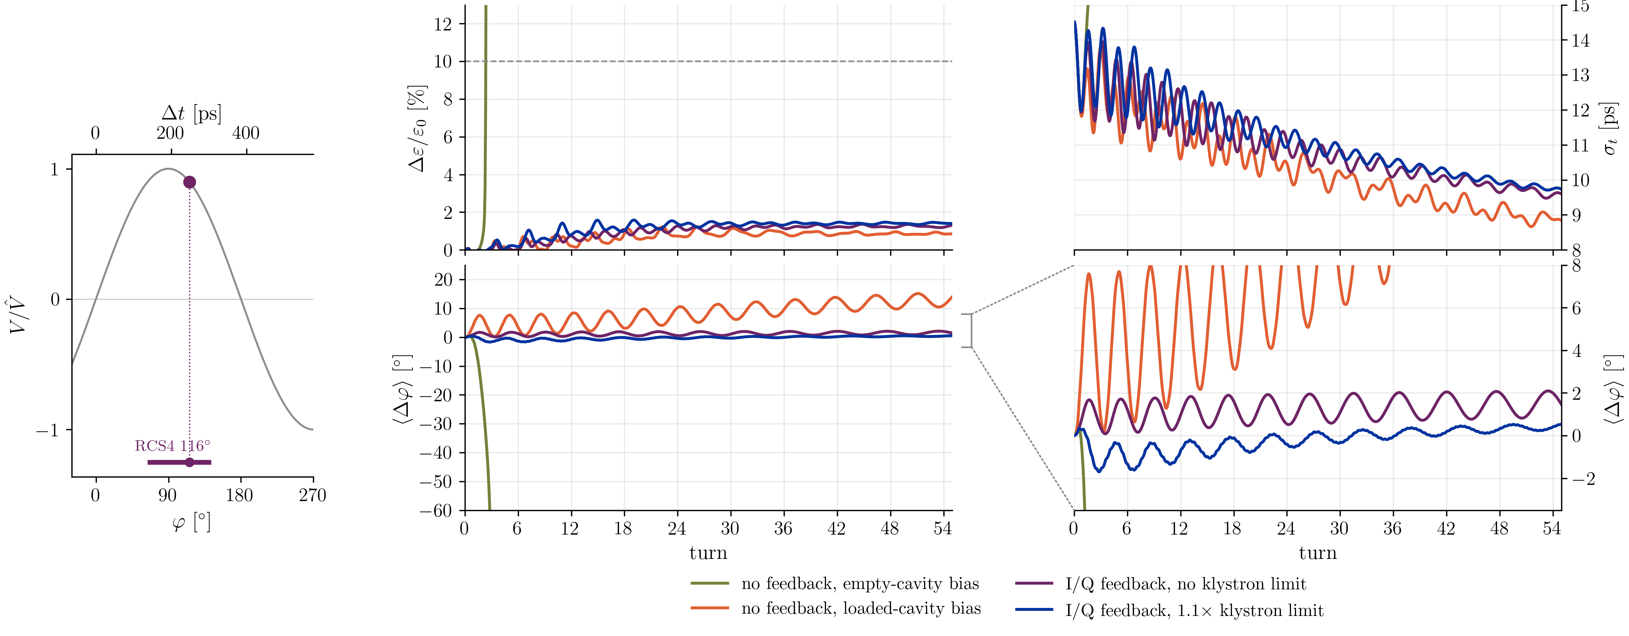
Cavity Feedback in RCS4

Slide 16
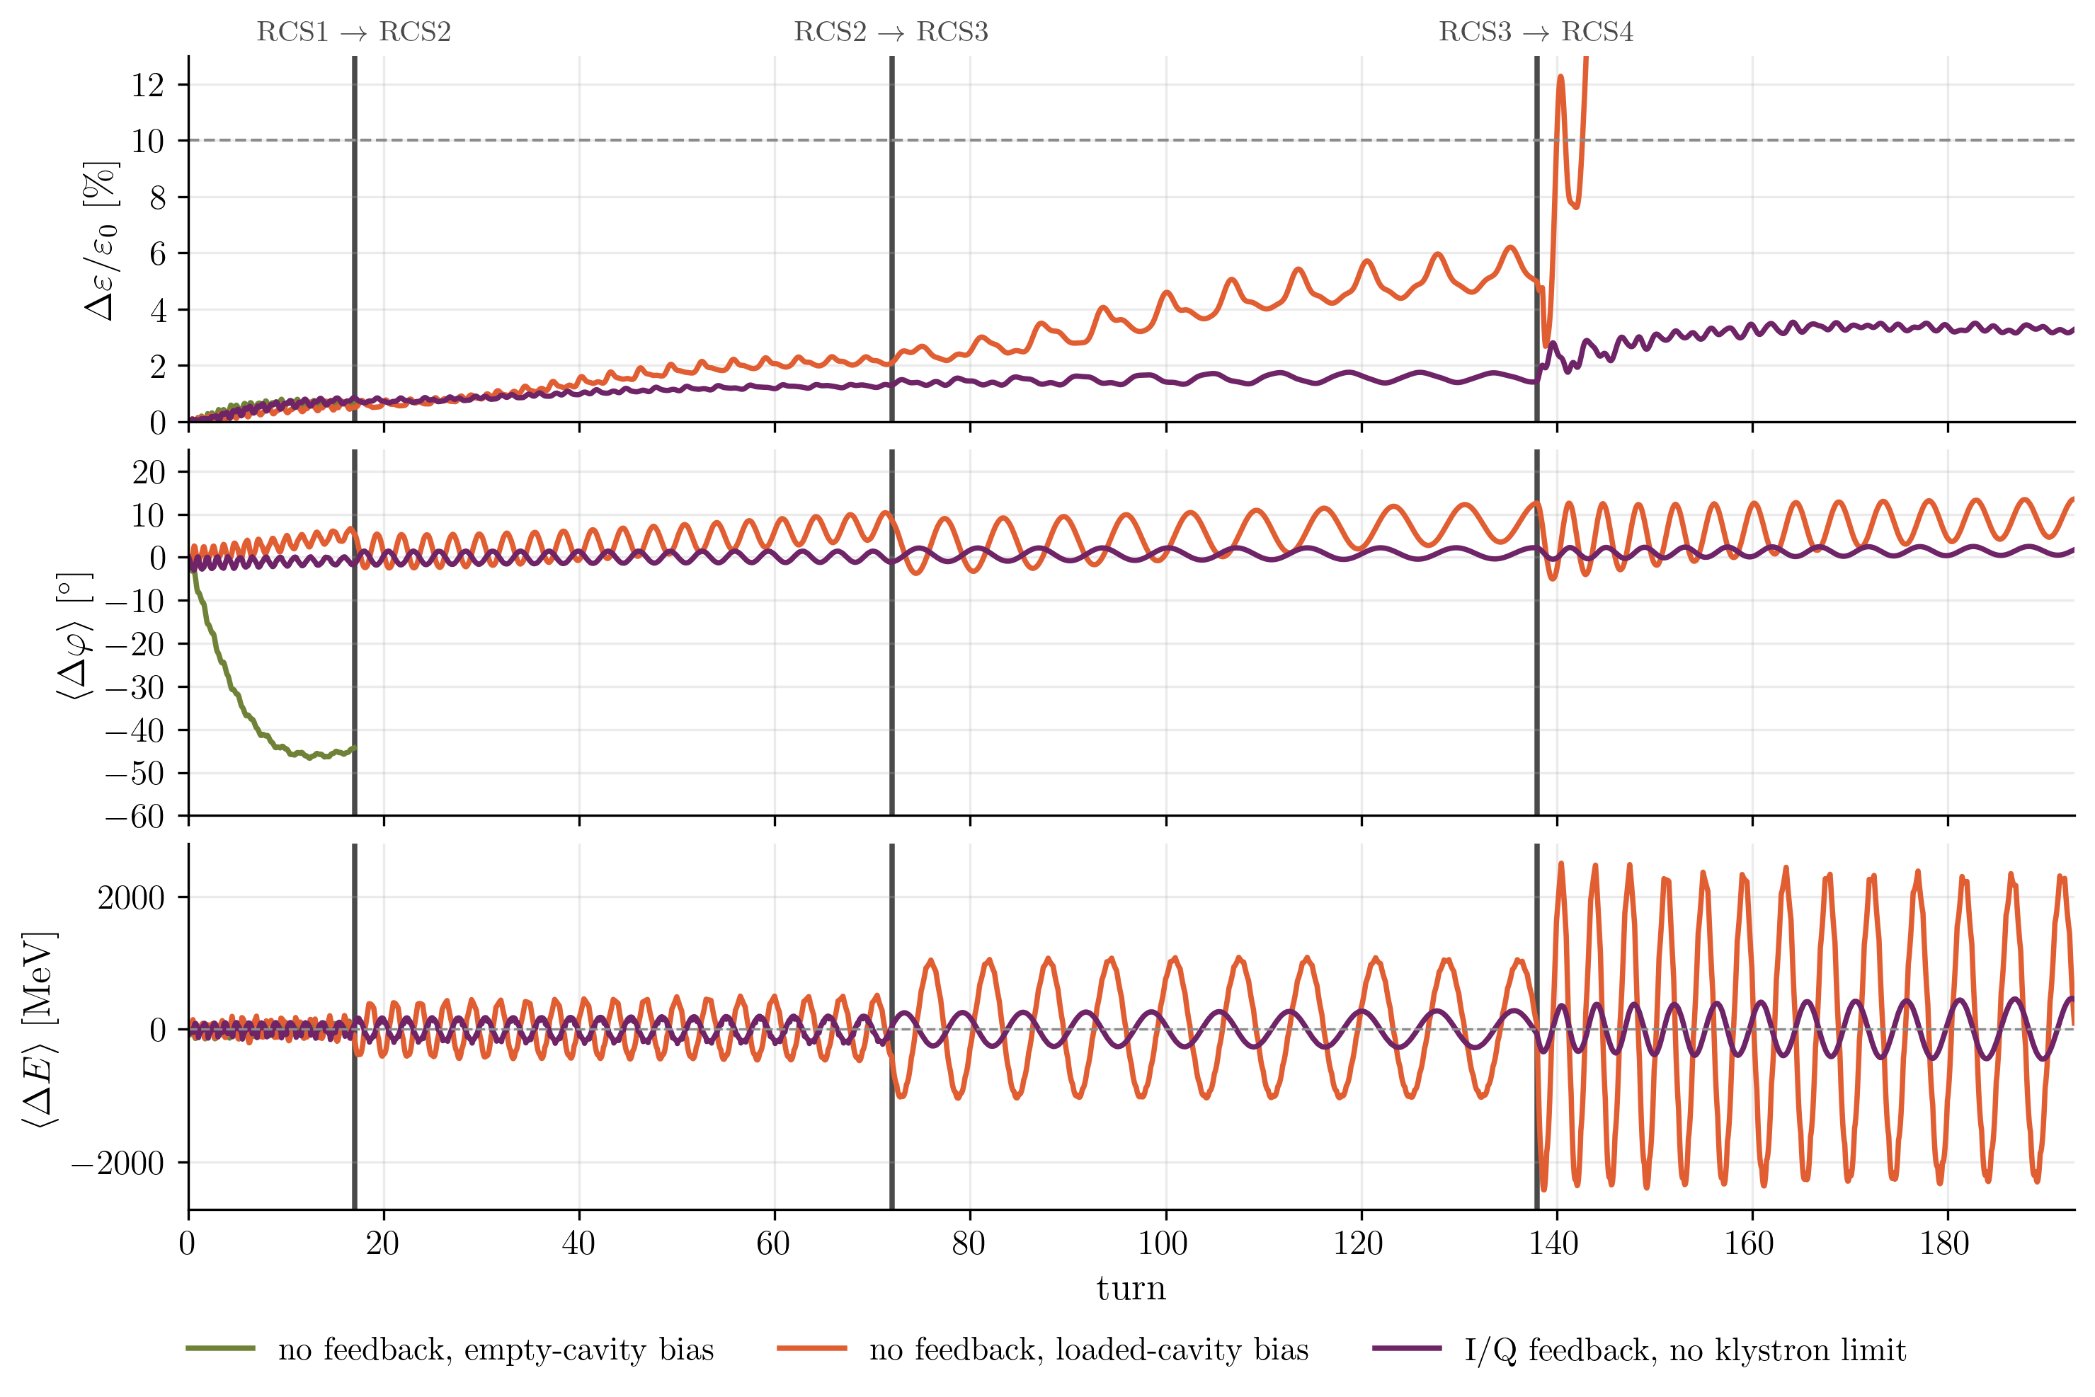
Cavity Feedback in the
RCS Chain
Carry over of energy/phase errors

Slide 17
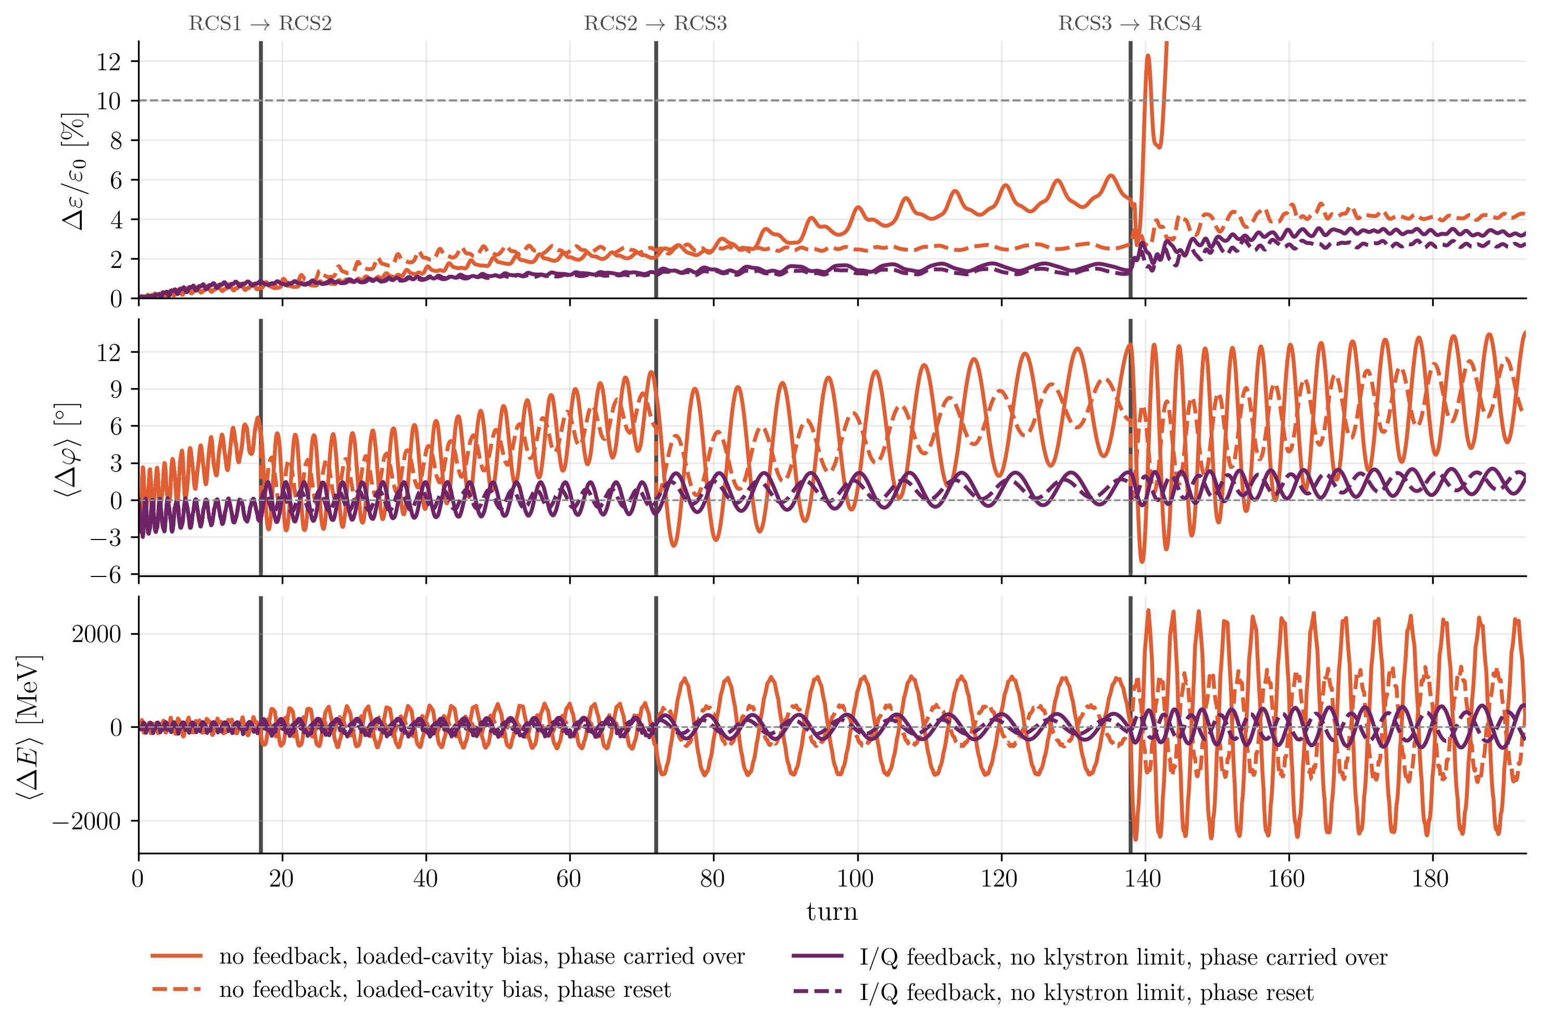
Cavity Feedback in the
RCS Chain
Carry over of energy errors
Ejection phase can be calculated from injection phase
  Enough time to change angle of cavities in next RCS
  Phase error reset at injection
  No error buildup

Slide 18
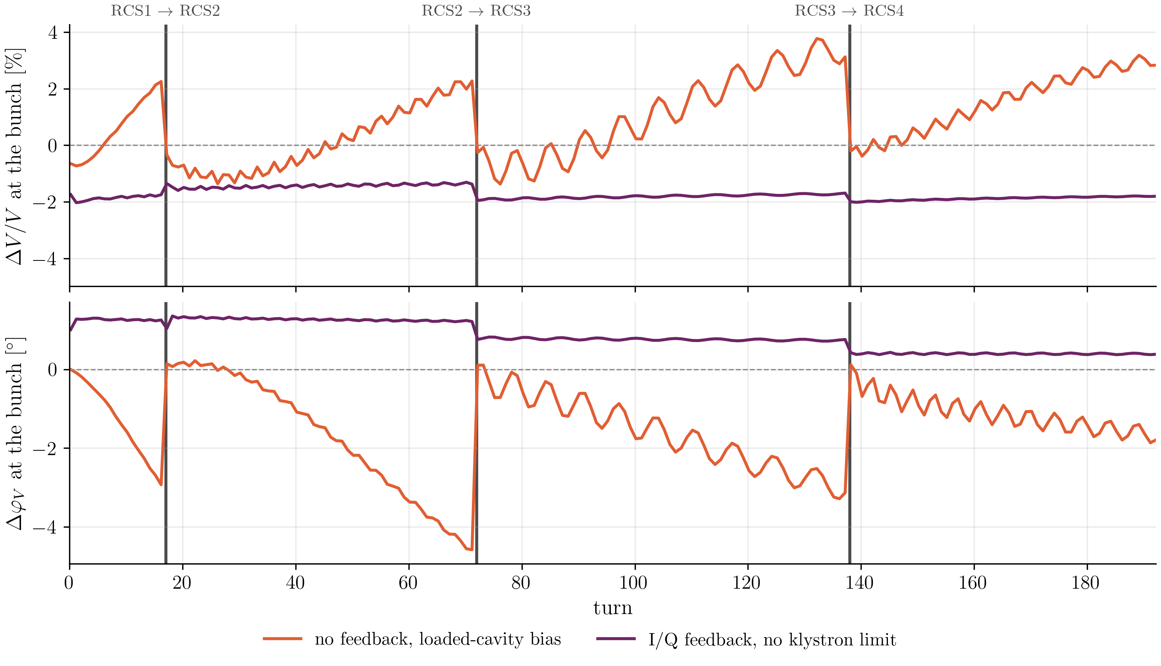
Voltage Amplitude/Phase Errors
Origin of drift in beam phase:
  Phase drift of cavity voltage
  Changing beam current during acceleration due to muon decay

Slide 19
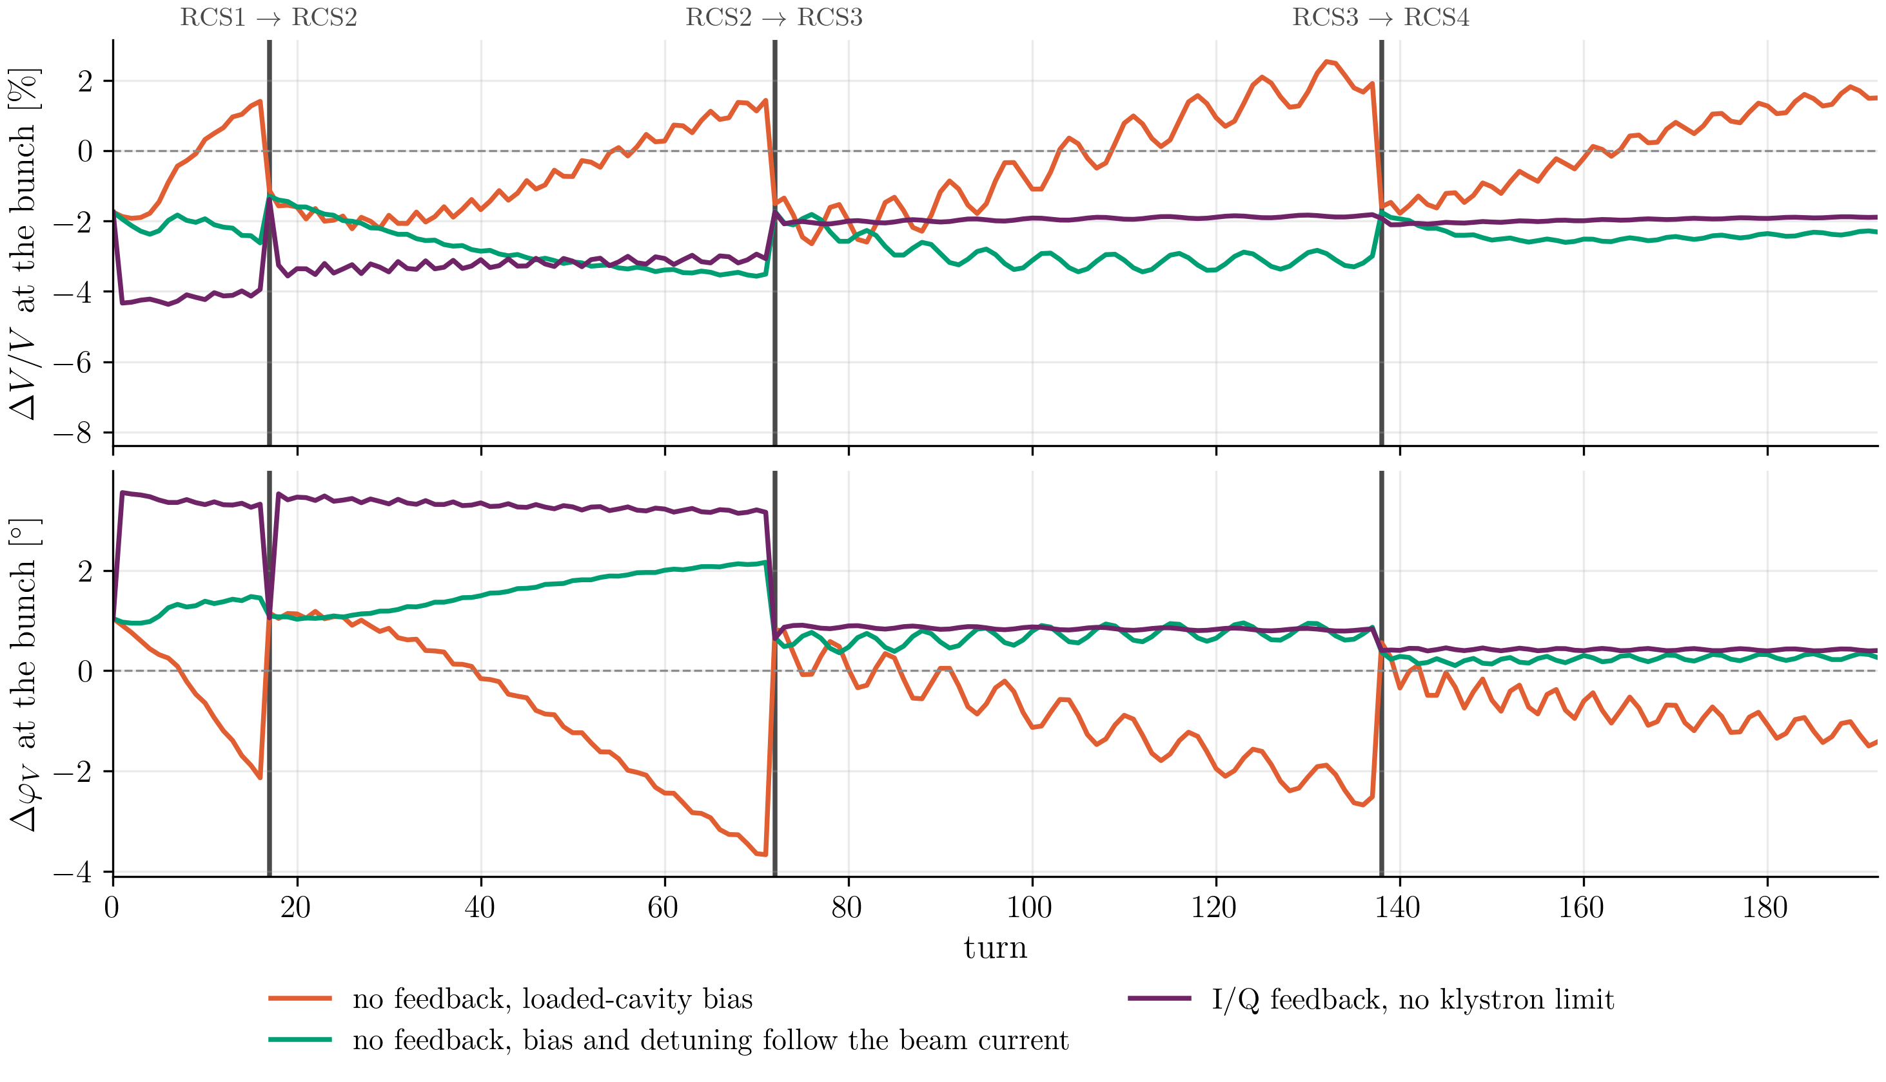
Voltage Amplitude/Phase Errors
Changing beam current during acceleration due to muon decay
Mostly compensates phase drift of cavity voltage

Slide 20
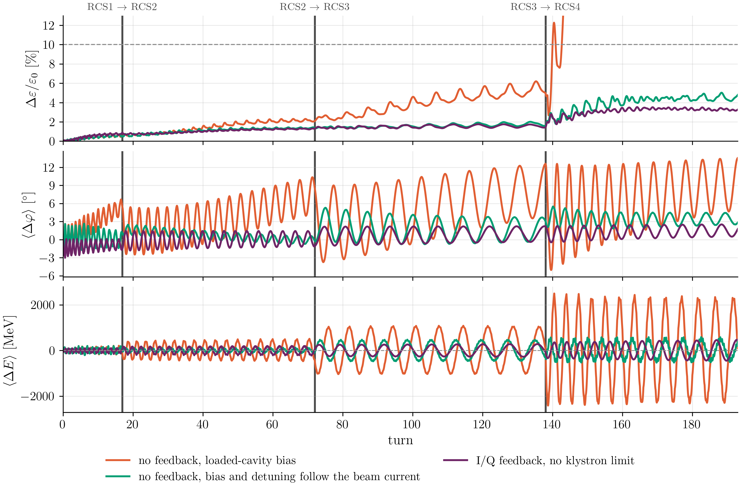
Cavity Feedback in the
RCS Chain
Carry over of energy/phase errors
With loaded bias current changing according to beam current:
  Phase drift can be avoided

Slide 21
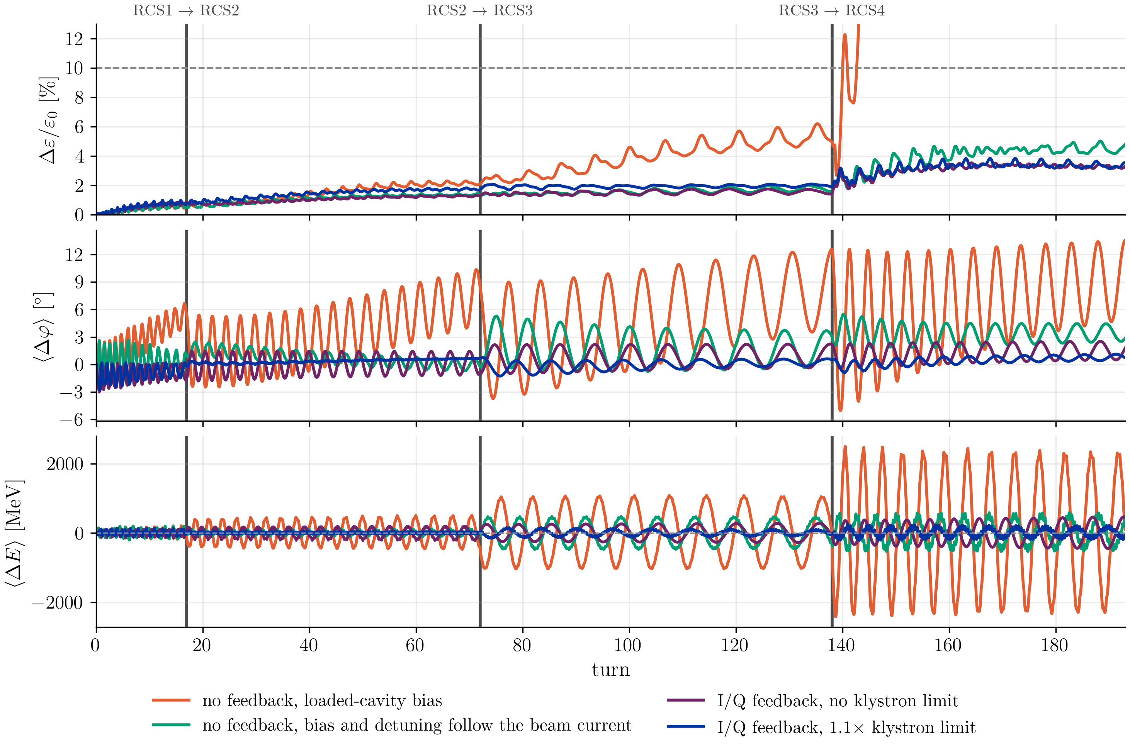
Cavity Feedback in the
RCS Chain
Carry over of energy/phase errors
Klystron limit does not harm beam

Slide 22
Cavity Feedback Summary
Different $φ_{s}$ throughout chain
  Change requirements for feedback
Adjustment of current to include beam loading would be sufficient for stability
  Large drift of centroid
    Adjustment of generator current and detuning to anticipate decay
    Or phase correction in following accelerator
With cavity feedback:
  Reduced drift of centroid
  Limitation of klystron power does not harm beam
  Remaining centroid oscillation → potential issue in collider (energy offset)
  No injection error in RCS1 included until this point
  Phase loop

Slide 23
Phase Loop Considerations
Global phase loop as in CERN accelerators, like LHC/PSB → not feasible
Relation between $f_{rev}$ and $f_{s}$ prevents once-per-turn correction:
  Aliasing
  Distribution of signal would result in long delay in comparison to $t_{s}$
Distribution throughout the ring (every station has its own phase loop)
 | $f_{rev}$ [kHz] | $f_{s}$ [Hz] | $$Q_{s}$$ | $t_{s}$ [ms]
LHC | $$11.2$$ | $$55$$ | $$0.005$$ | $$18$$
PSB | $$1000$$ | $$1700$$ | $$0.002$$ | $$0.6$$
RCS1 | $$50$$ | $$62500$$ | $$1.25$$ | $$0.016$$
RCS2 | $$50$$ | $$21200$$ | $$0.4$$ | $$0.05$$

Slide 24
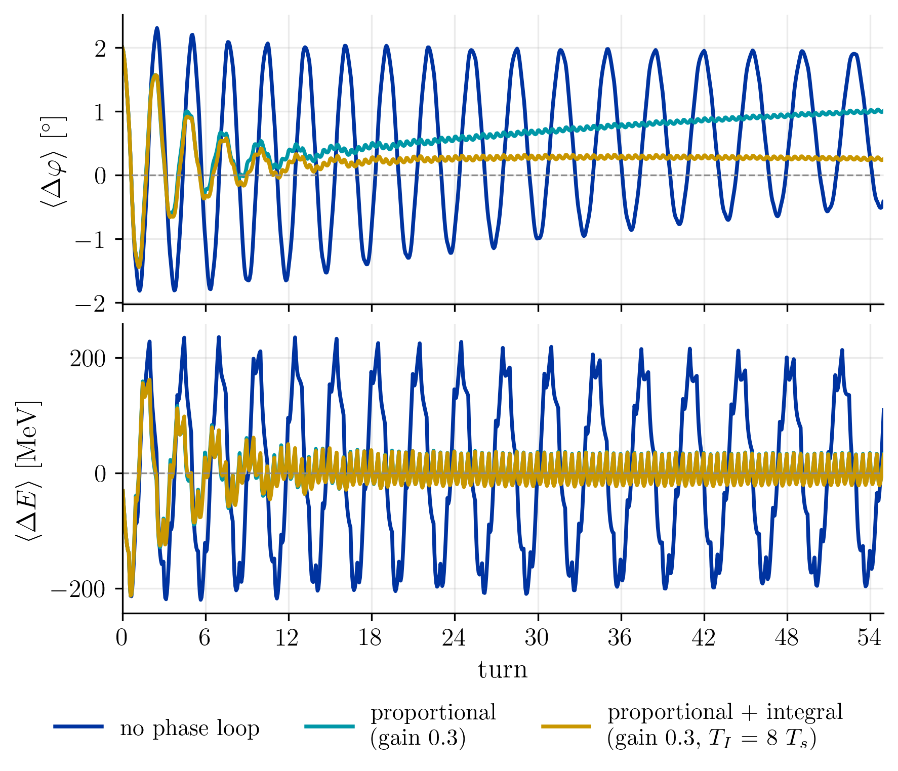
Phase Loop RCS2
Loop parameters optimised based on final oscillation amplitude and offset

Slide 25
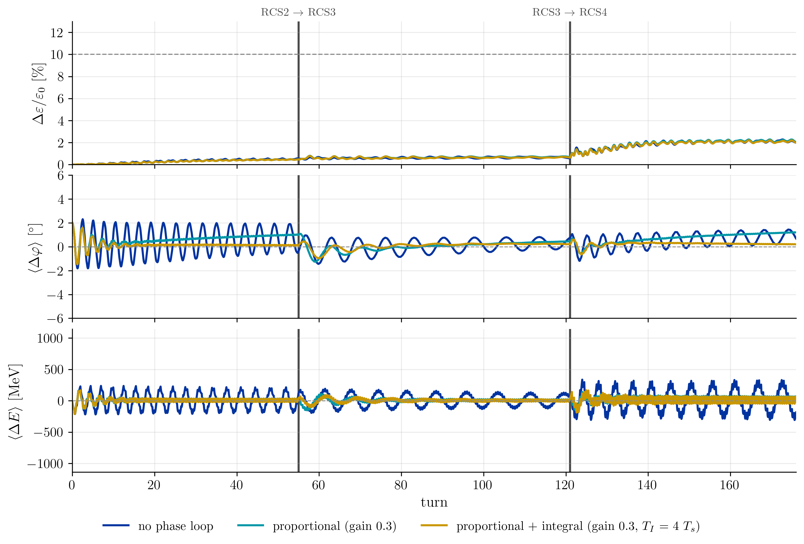
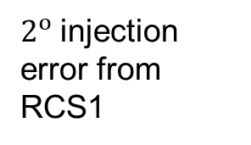
Phase Loop in RCS Chain
$2^{o}$injection error from RCS1

Slide 26
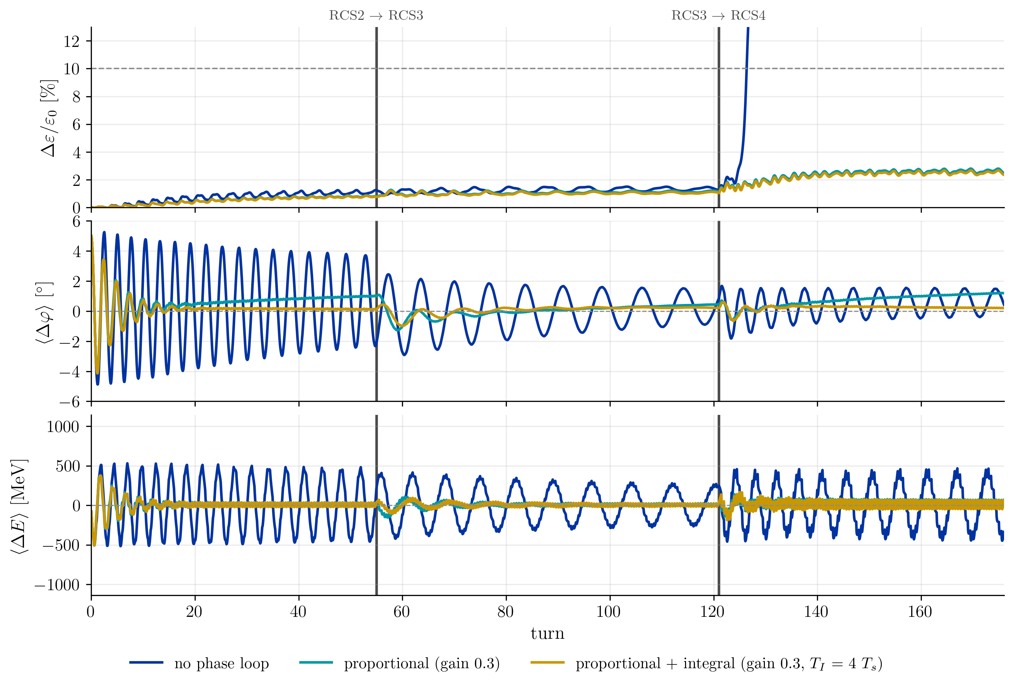
Phase Loop in RCS Chain
$5^{o}$injection error from RCS1

Slide 27
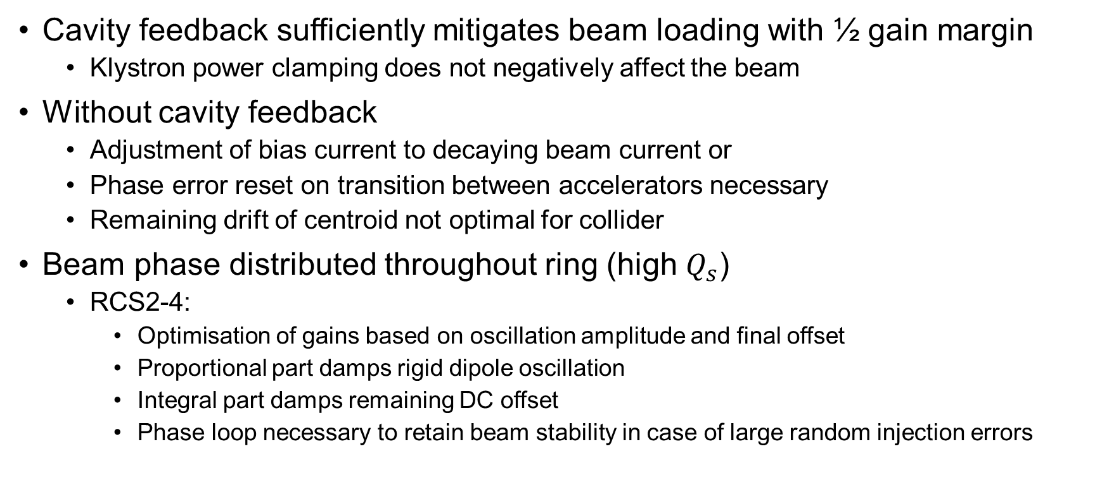
Conclusion
Cavity feedback sufficiently mitigates beam loading with ½ gain margin
  Klystron power clamping does not negatively affect the beam
Without cavity feedback
  Adjustment of bias current to decaying beam current or
  Phase error reset on transition between accelerators necessary
  Remaining drift of centroid not optimal for collider
Beam phase distributed throughout ring (high $Q_{s}$)
  RCS2-4:
    Optimisation of gains based on oscillation amplitude and final offset
    Proportional part damps rigid dipole oscillation
    Integral part damps remaining DC offset
    Phase loop necessary to retain beam stability in case of large random injection errors

Slide 28
Outlook
Analyse stability of optimised values against different injection errors
Reoptimisation of $φ_{s}$ using feedbacks with phase loops
  Might allow for lower count of cavities
Lower order modes interaction with cavity loop [1]
Model refinement
  Klystron saturation and bandwidth
  Tuner errors
[1]: https://journals.aps.org/prab/pdf/10.1103/PhysRevSTAB.10.052001

Slide 30
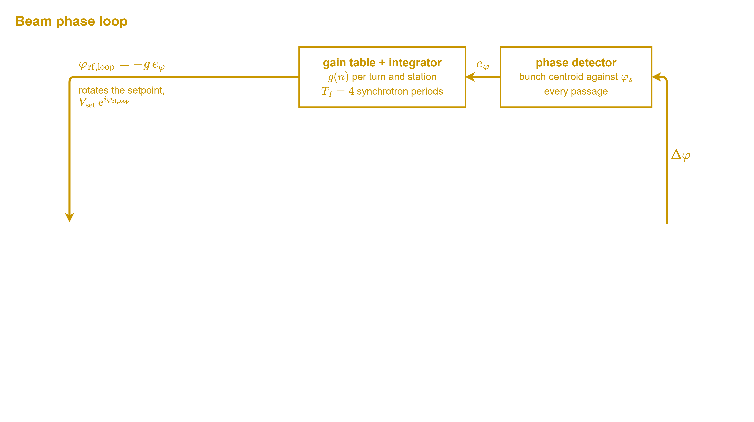
Phase Loop Schematic

Slide 31
Parameter comparison to existing machines
 | RCS chain | European XFEL | LHC | LEP2 | JPARC RCS
Beam current [mA] | 43 … 5 | 1 | 580 | 6 | 8000
Acceleration time [ms] | 0.34 … 6 | - | long | - | 20
Installed RF voltage [GV] | 15…90 | 20 | $$≈0.006$$ | 3 | 0.0004
Bunch length [ps] | 31 … 10 | 5 | 375 | 35 | 150000
Bucket filling factor | 0.05…0.2 | - | 0.35…0.7 | 0.05…0.1 | 0.5

Slide 32
Cavity feedback modelling
Two-grid approach
  Fine grid during bunch passage
  Coarse grid to determine voltage evolution between bunch passages
    Determine initial voltage at beam passage
    Reference frequency follows beam energy
    Without following reference in tracking of internal state
      Phase error at next bunch passage

Slide 33
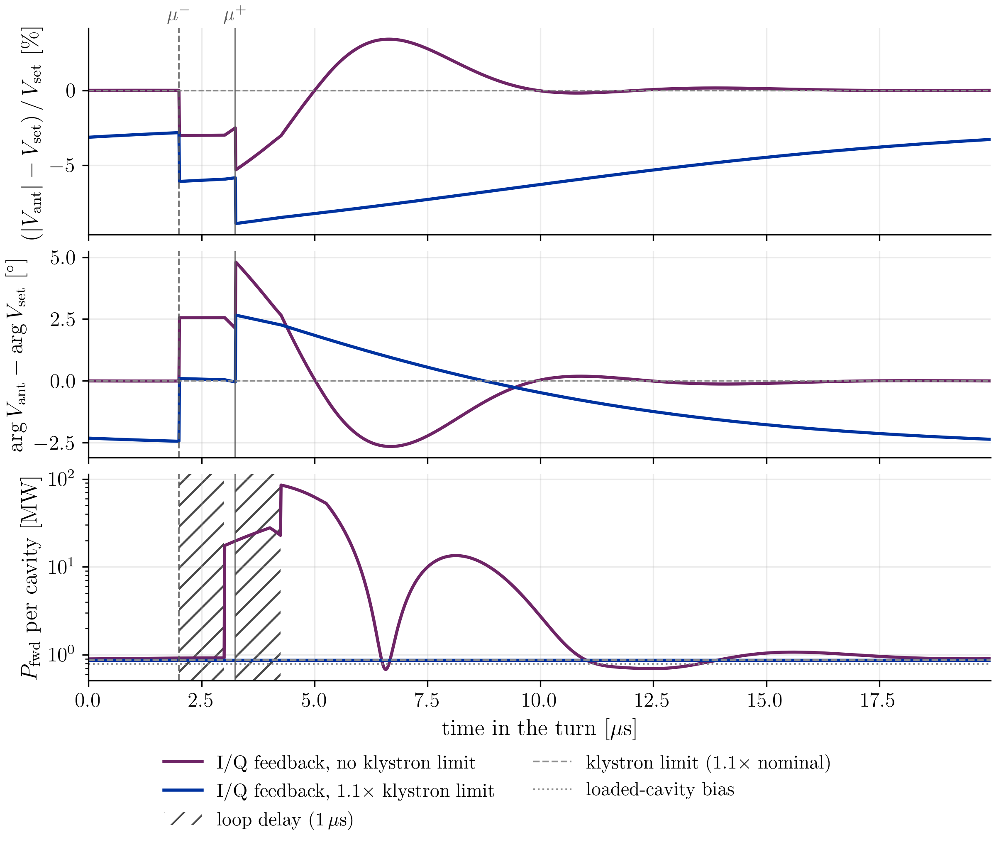
Voltage evolution in single RCS
Station 1:
Bunches pass immediately after each other with large gap

Slide 34
Introduction
High-energy acceleration
 | RCS1 | RCS2 | RCS3 | RCS4
Beam current [mA] | 43 | 39 | 20 | 5
Acceleration time [ms] | 0.34 | 1.1 | 2.4 | 6.4
Energy gain per turn [GeV] | 15 | 8 | 11 | 64
Bunch length [ps] | 31 … 22 | 22 … 18 | 18 … 14 | 14 … 10
Notes:
Average gradient: 2.44, 1.33, 1.06, 1.83, RCS4: ratio between ramping and SC is more in favor of ramping (4km vs 20km)

Slide 35
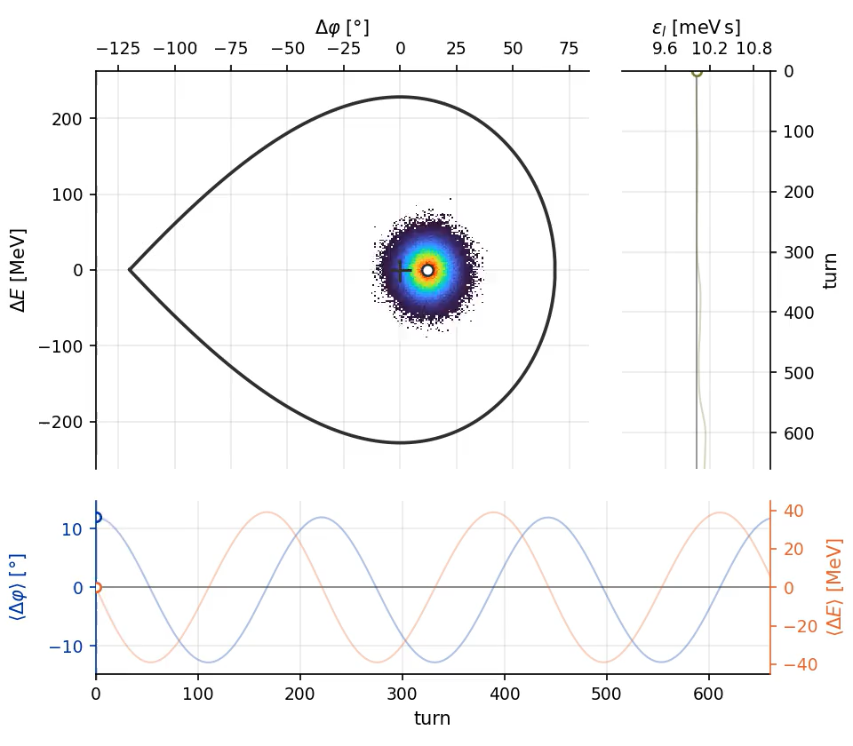
Rigid dipole oscillation

Slide 36
RCS chain parameters consolidated parameter document

Slide 37
Phase loop in RCS1

Slide 38
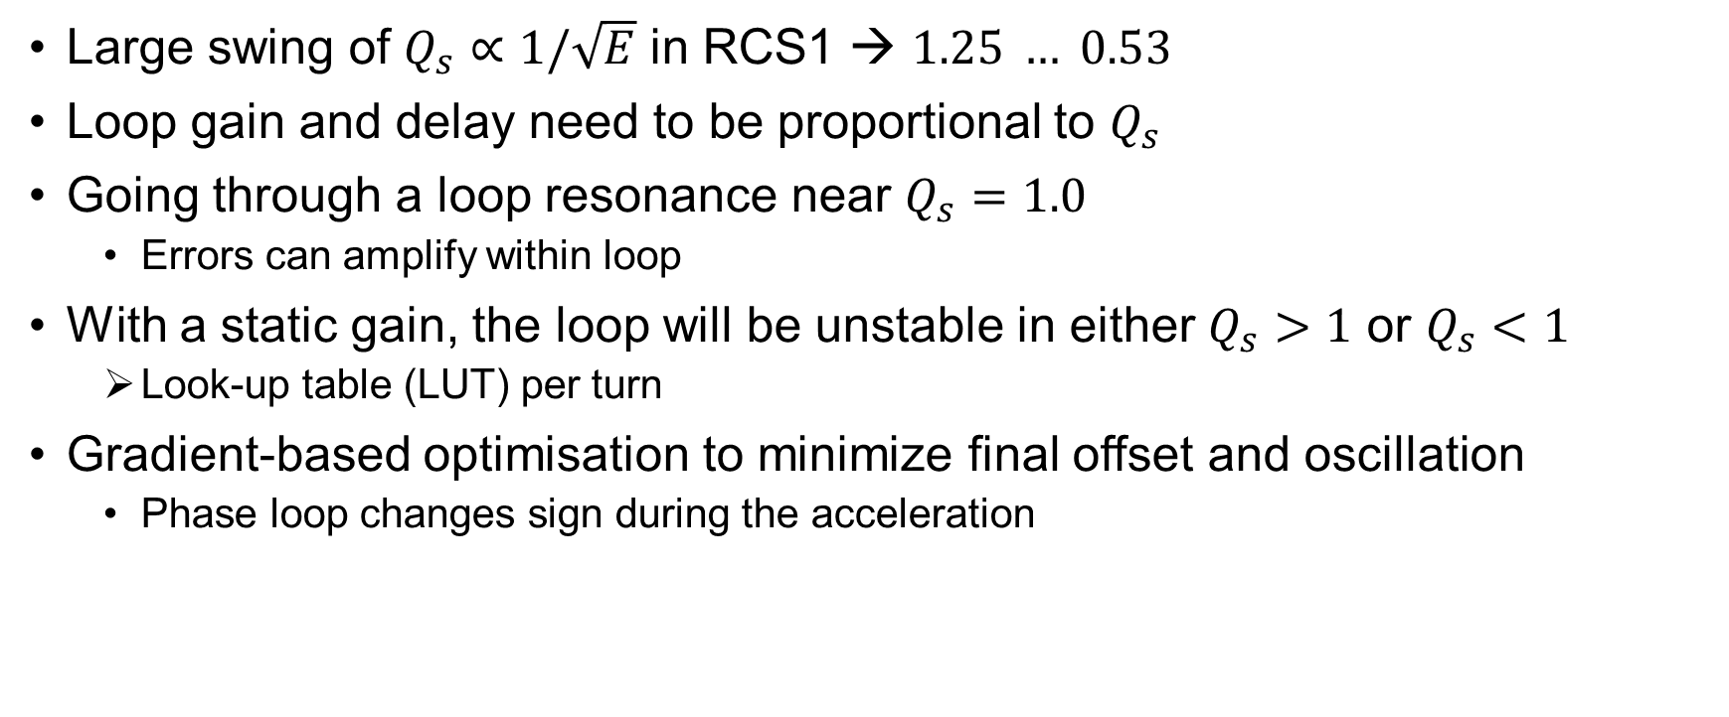
RCS1 specific challenges
Large swing of $Q_{s}∝1/\sqrt{E}$ in RCS1 → $1.25 … 0.53$
Loop gain and delay need to be proportional to $Q_{s}$
Going through a loop resonance near $Q_{s}=1.0$
  Errors can amplify within loop
With a static gain, the loop will be unstable in either $Q_{s}>1$ or $Q_{s}<1$
  Look-up table (LUT) per turn
Gradient-based optimisation to minimize final offset and oscillation
  Phase loop changes sign during the acceleration

Slide 39
RCS1 phase loop with static gain

Slide 40
RCS1 phase loop with lookup table

Slide 41
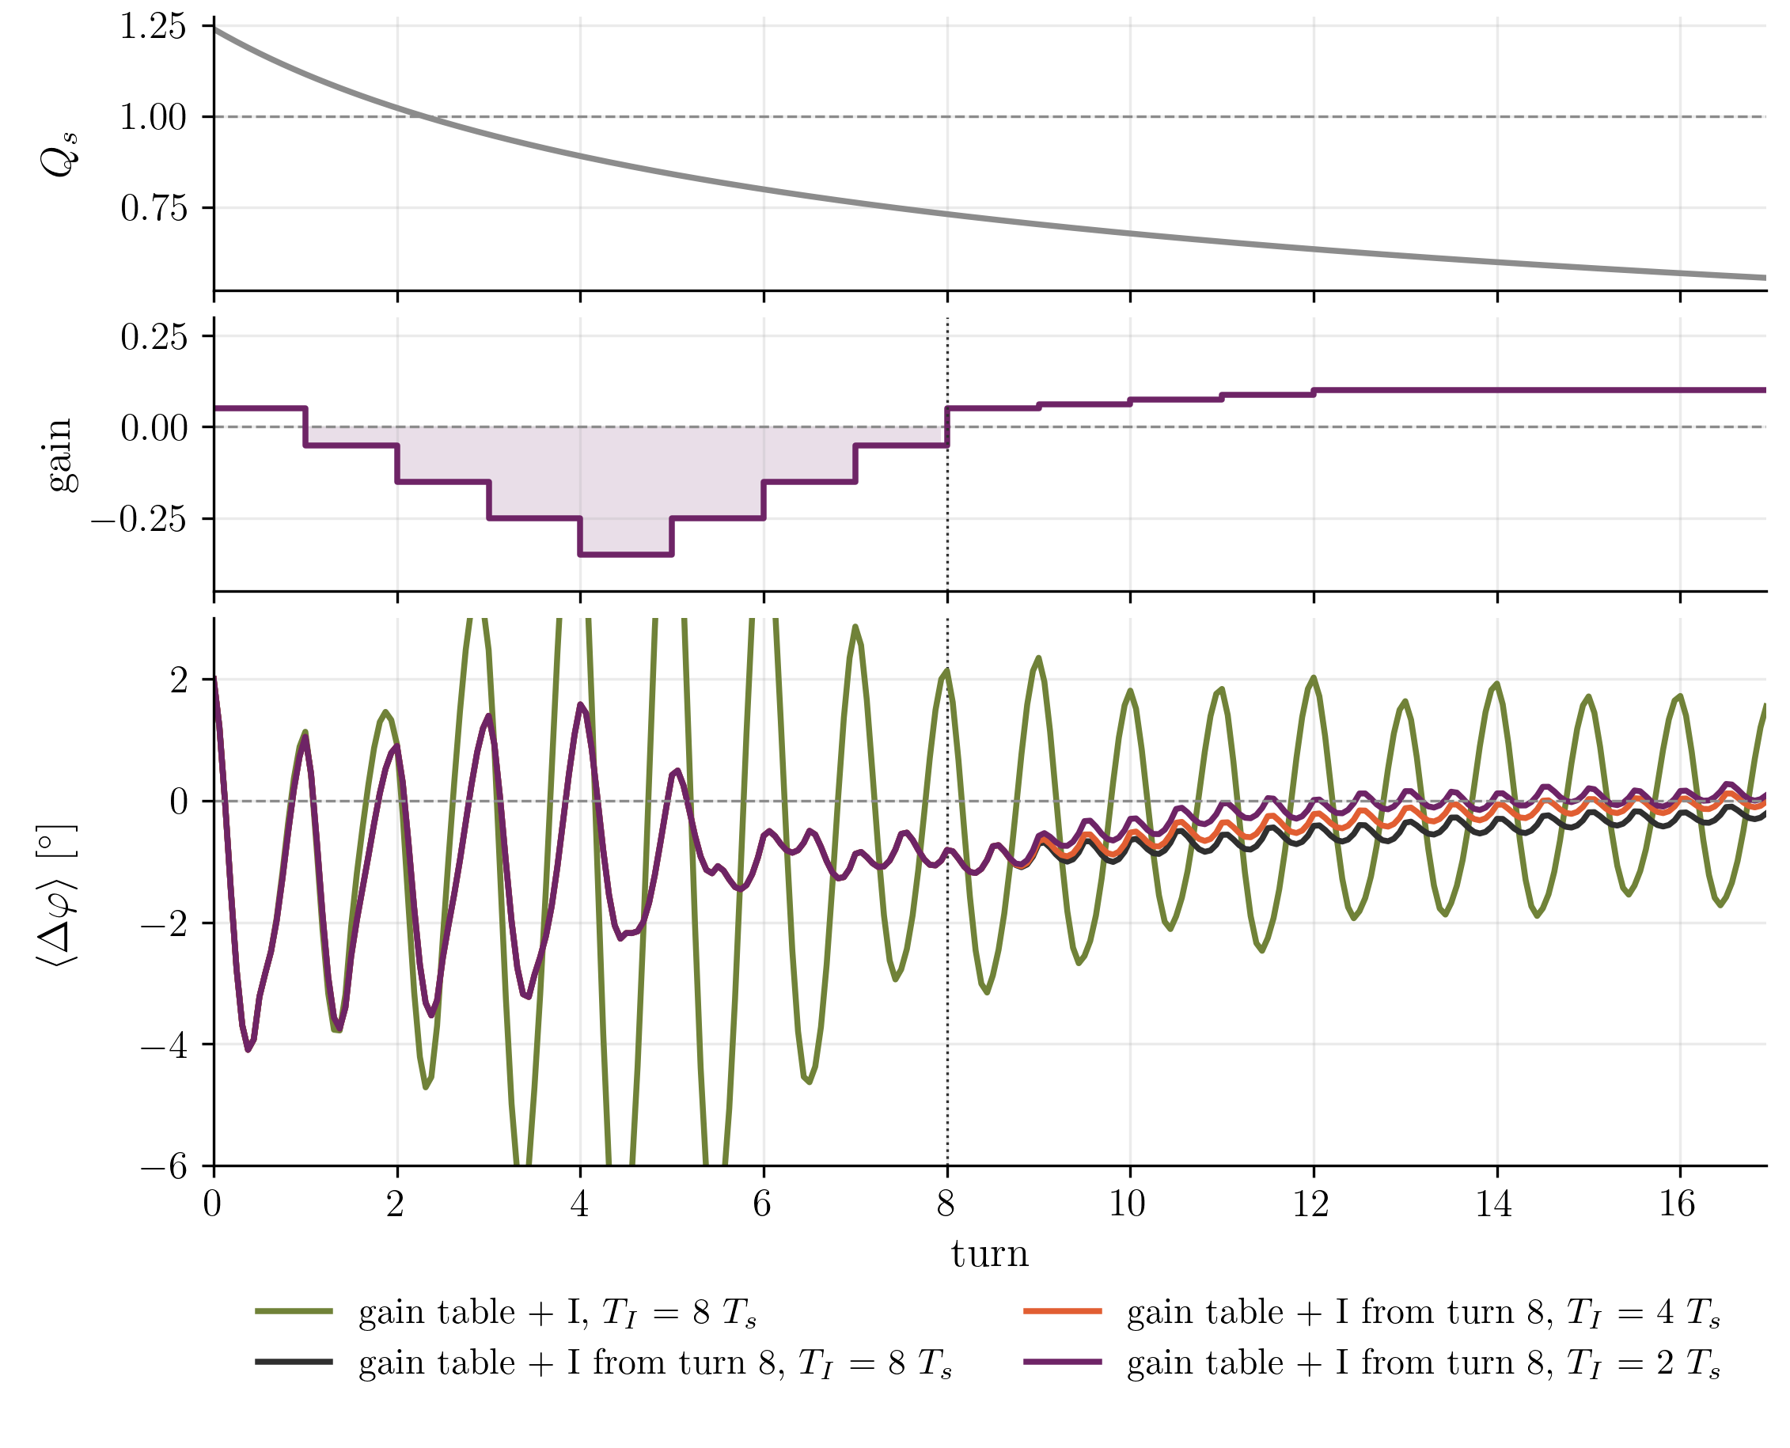
RCS1 phase loop with
LUT and integrator

Slide 42
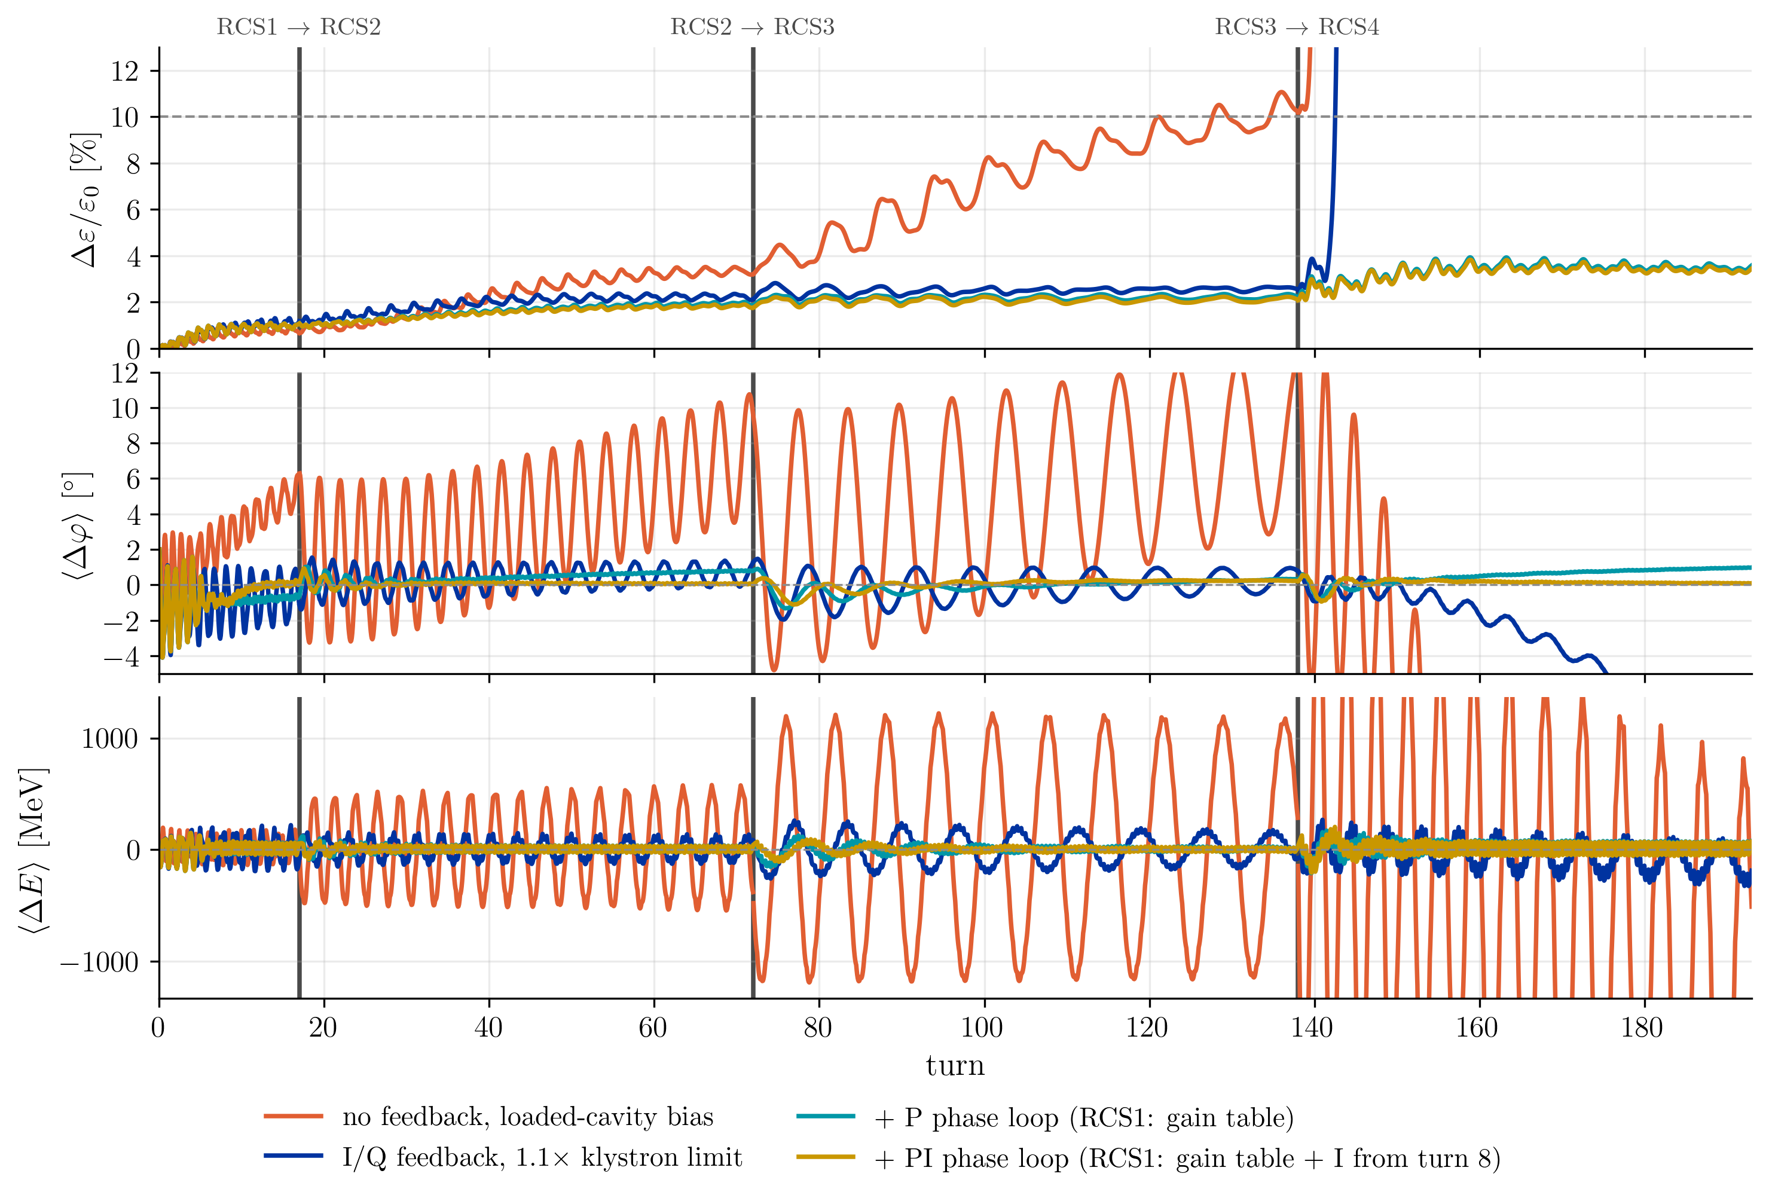
Chain overview

