Slide 1
Operational Experience with the Adaptive Feed-Forward at CERN Linac4
LLRF Topical Workshop on Advanced Feedback Control
Nova Gorica · 13 October 2026
Bartosz Bielawski · CERN SY-RF
Notes:
[18: 0:20 | 12: 0:20 | 8: 0:20]
Good evening – I am the last thing between you and the reception, so I'll keep it tight. The AFF has run in Linac4 since 2019, operationally with the PS Booster since 2021. This talk is about what that taught us.
Transition: first, why Linac4 needs it.

Slide 2
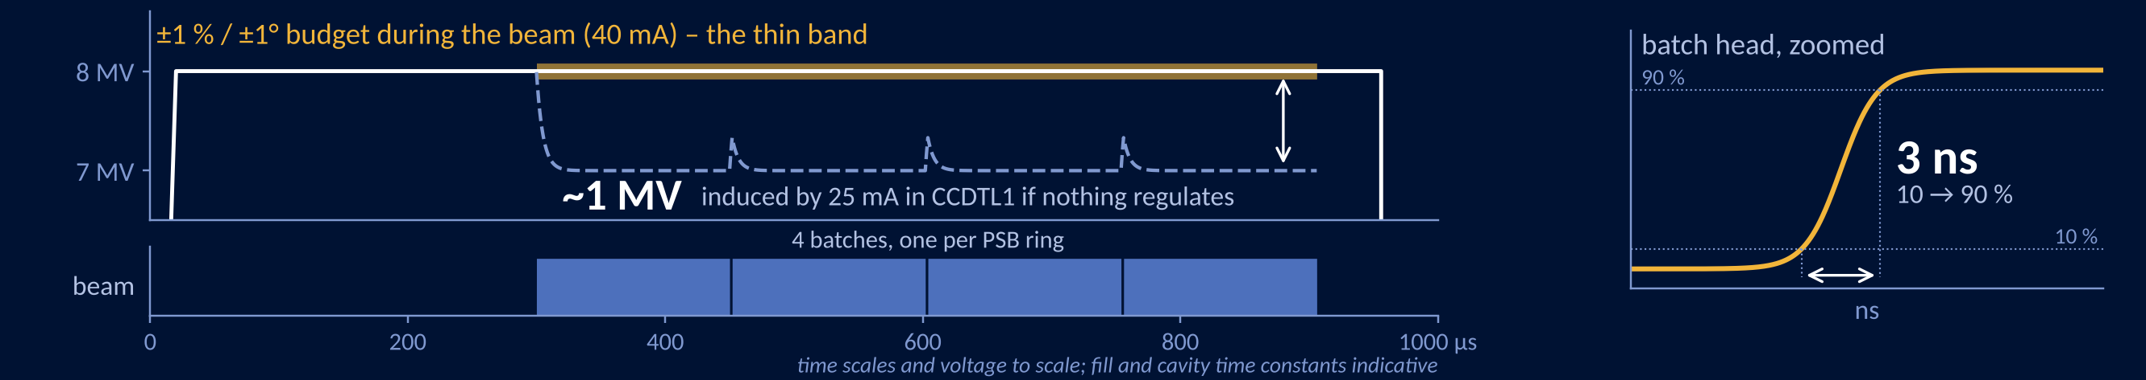
Beam loading is the largest perturbation in the Linac4 cavities
RFQ
Bunchers
DTL
CCDTL
PIMS
Debuncher
3 MV
3 × 100 kV
10 + 2 × 20 MV
7 × 5 MV
12 × 5 MV
750 kV
1
2
3
1
2
3
1
2
3
4
5-6
7
1-2
3-4
5-6
7-8
9-10
11-12
PSB
3 MeV
50 MeV
100 MeV
160 MeV
dump
LLRF crate with AFF (17 of 20)
chopper (3 MeV)
27 cavities on 20 LLRF crates
longitudinal painting
“…an RF feedback, a feed-forward and a one-repetition period feedback that keeps the accelerating voltage at the desired value in the presence of transient beam loading.” Linac4 TDR, 2006
Notes:
[18: 1:30 | 12: 1:45 | 8: 1:15]
H⁻ to 160 MeV, 352 MHz, up to four batches per pulse – one per PSB ring – every 1.2 s. 27 cavities on 20 LLRF crates; the AFF runs on 17 of them. The beam goes from zero to full in a few ns; in CCDTL1, 25 mA induces almost a megavolt on 8. At the design 40 mA that is 20 %. The design report already asked for a pulse-to-pulse correction in 2006 – it took until 2019 to build it.
12/8-min: add one sentence – feedback sees the beam only after ~2.5 µs of loop delay, so the batch head is always a surprise.

Slide 3
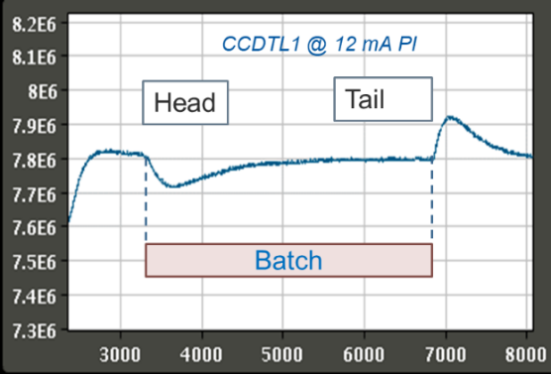
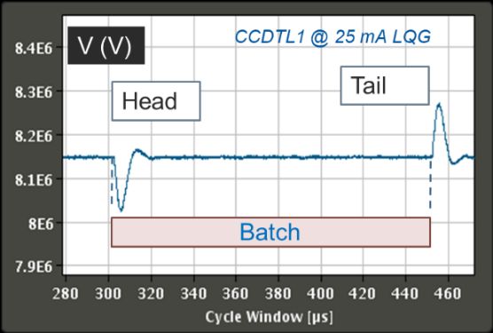
Feedback reacts too late for the batch head
PI · 2017 · 12 mA – transient over ~40 µs
LQG · 2019 · 25 mA – only the first ~5 µs
Loop delay ≈ 2.5 µs: the regulation sees the beam only after it has arrived.
Notes:
[18: 1:15 | 12: – | 8: –]
With a PI the loop delay limits the gain. The LQG – a Kalman predictor that estimates the cavity voltage without the delay, plus an LQR – shortened the transient from ~40 to ~5 µs. But causality wins: no feedback can act before the beam is seen.
Source: Linac'22 TH1AA06 Fig. 4.

Slide 4


The AFF learns the correction from previous pulses
FPGA · ADC 88 MHz · regulation and AFF at 22 MHz
beam
2
r
Σ
LQG
Σ
polar loop
klystron
cavity
3
−
+
antenna y
k | pulse number – of the same timing user
n | sample (45 ns); window opens 50 µs early: the LPF smears the step
eₖ[n] | field error recorded in pulse k, I and Q ①
bᵢ, M | low-pass FIR (software), by a script: window or step resp.; M ≤ 1024
L | look-ahead = loop delay, same script: 1.45–2.0 µs
εₖ[n] | filtered error ②
sₖ[n] | correction added to the drive in pulse k ④
β | memory: 0.97 on all lines; near steady state within ~10 pulses ③
G | gain: 20–100 per line → residual ε ∝ 1/G ③
error buffer eₖ[n]
1
AFF buffer sₖ[n]
4
next pulse of the same user
learning gates
filter b, L → εₖ
sₖ₊₁ = βsₖ + (1−β)Gεₖ
sₖ₊₁ stored per user
2
3
gates: timing · SIS · pulse statistics
reset: validity time · settings
FPGA: fast and simple, one buffer replayed · FEC: slow and smart, per user
Front-end software · between pulses (1.2 s)
Inspired by K. Fong, TRIUMF (LINAC'16 TUPLR009)
Notes:
[18: 2:15 | 12: 2:00 | 8: 1:45]
Beam loading repeats pulse to pulse, so learn it. The error is low-pass filtered – the filter is computed per line by a Python script: a fixed window, or on some lines the measured step response of the line turned back in time; the delay is measured by the same script in EXCITATION mode – and shifted by the loop delay – that is what lets the correction start before the beam. The filter is a long low-pass on purpose: the pre-driver amplifiers inject a component close to 1 MHz into the drive, and a short filter would let it through. The price is that the low-pass smears the sharp beam arrival, so the correction must start well before the beam – the AFF window opens 50 µs before the beam arrives and the amplifier is already ramped up when the batch head comes. A leaky integrator over pulses, β = 0.97, so it converges close to steady state within about 10 pulses; the per-pulse learning gain (1−β)G is 0.6–3. The FPGA only replays a buffer; everything smart is in the front-end software, between pulses. CERN timing is multiplexed: users are interleaved, so each user has its own history, kept in software – remember that, it comes back.
Credit: the idea comes from K. Fong, TRIUMF.
Sources: aff.cpp (exact), FEC persistent settings.

Slide 5
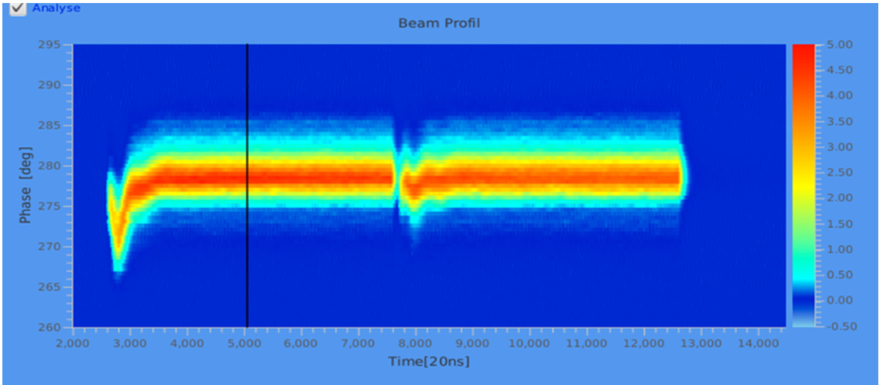
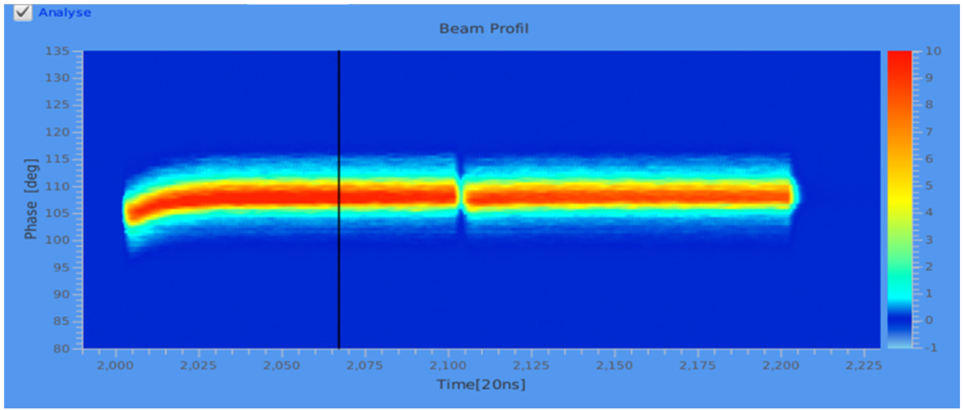
The batch-head error now uses half of the budget
Field deviation at the batch head · CCDTL1
1 % specification
0.375 %
30 kV pk-pk at 25 mA – about half of the budget, even scaled to 40 mA
Beam phase along the batch – before LQG & AFF
No power surge at the batch head
< 10 keV energy deviation at PSB injection
High Current Mode (2024, 2026): no AFF issues
Harder on the Thales-klystron lines
… and after LQG & AFF
Notes:
[18: 1:45 | 12: 1:30 | 8: 1:15]
Beam phase along the batch: the head transient is gone. In the cavity: 30 kV at the head, 0.375 % at 25 mA – within half of the budget, even scaled to 40 mA. Because the AFF anticipates, the klystron is no longer hit by a power spike at every batch head. Not every line is equally good – the lines with the Thales klystrons needed more tuning. And the High Current Mode runs (MDs and end of run in 2024, again this year) caused no AFF issues – part of the extra source current is lost in the RFQ and the chopper removes another fraction, so the accelerating cavities see a much smaller increase.
Sources: Linac'22 Figs 6–7; LLRF23 poster; IPAC'25 THPS029. Next slide: power, energy, availability.

Slide 6
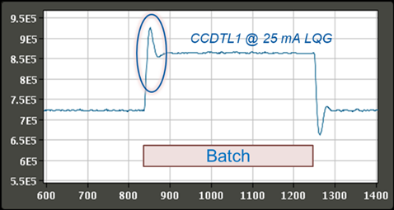
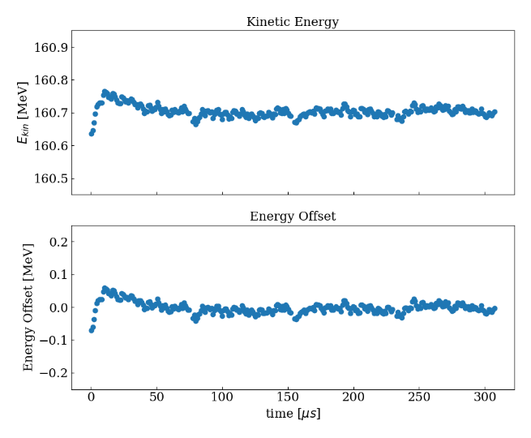
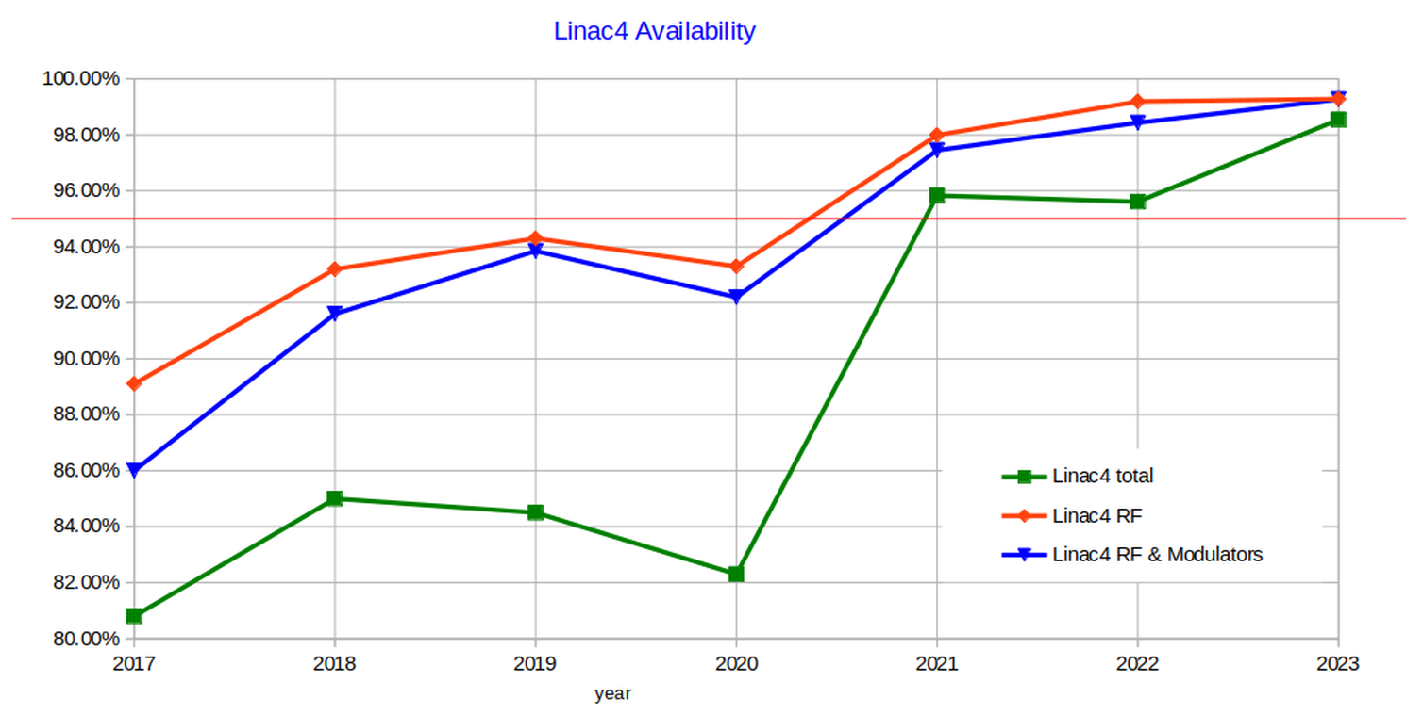
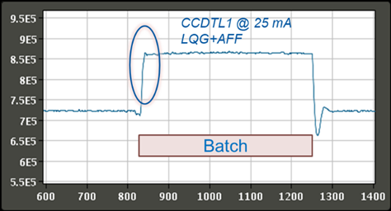
Flat power, flat energy – and the RF stays on
no surge
klystron power, CCDTL1 · 25 mA: LQG (top), LQG + AFF (bottom)
±50 keV
at the batch head, < 20 keV elsewhere · Linac4 output, 4 × 75 µs, 21 mA
99 %
RF availability 2022–23, from ~93 % in 2020 · whole RF system, the AFF is one part
Notes:
[18: 1:30 | 12: – | 8: –]
What the machine sees. Klystron power: with the LQG alone the klystron gets a spike at every batch head; with the AFF the power is already there when the beam arrives. Energy at the Linac4 output, four 75 µs batches at 21 mA: ±50 keV at the head, below 20 keV elsewhere. And availability: the RF went from about 93 % in 2020 to 99 % in 2022–23. That is the whole RF system – modulators, sequencer, protections – the AFF is one piece of it, but the gates on the next slides are a good part of why it no longer causes stops.
Sources: Linac'22 Figs 7 and 9 (energy courtesy P. Skowronski); Linac4 availability plot.

Slide 7
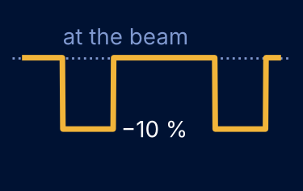
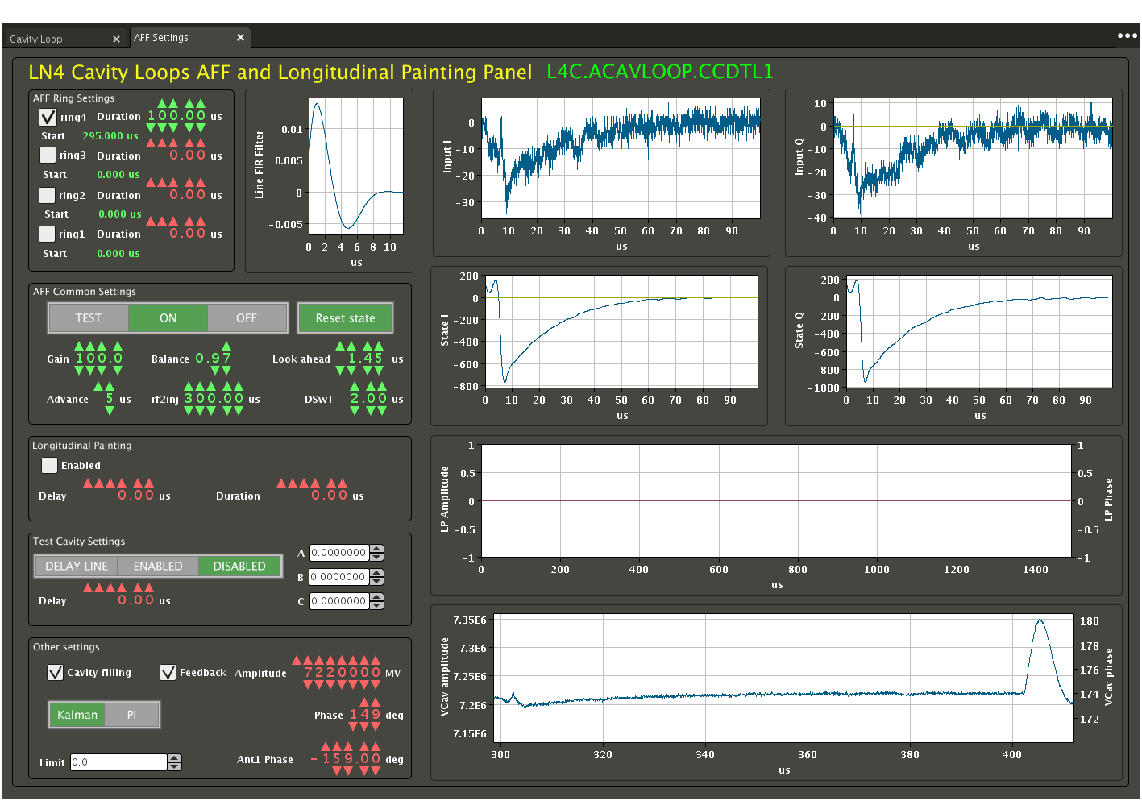
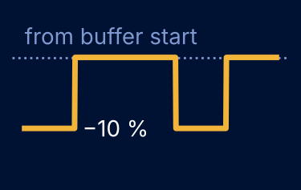

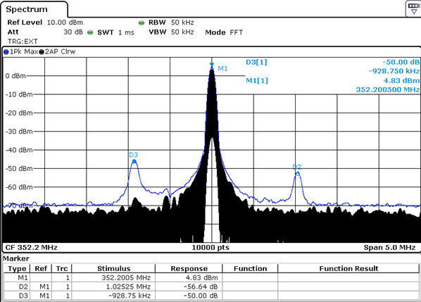
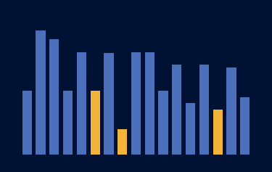
The AFF buffers double as a set-up and diagnostic tool
TEST Two fake beam-loading dips, −10 % of nominal, in the first and last quarter of the beam window – the AFF learns on them. Gain, filter and memory set up closed-loop, without beam.
EXCITATION The same dips from the start of the buffer, no learning. Delay of the line → look-ahead; step response → low-pass filter (some lines). Automatic: 16 pulses → fit → differentiate → half-Hanning → DC removed or kept → normalise.
NOTCH SET-UP Rectangular drive pulses from the same buffer reveal parasitic modes of multi-cell cavities → notch frequencies.
AFF panel: rings, gain, balance, look-ahead, modes
TUNING PER LINE β = 0.97 everywhere; G = 20–100 and filter shape per line. Gains lowered for robustness: CCDTL4 20, PIMS0910 35, CCDTL2 50.
CCDTL5: modes at −0.93 / +1.02 MHz
Notes:
[18: 2:00 | 12: 1:15 | 8: –]
The 2006 design report foresaw a baseband network analyser for step and frequency responses; in practice the AFF buffers cover part of it – not a full network analyser, but a very handy diagnostic and set-up tool. TEST gives the AFF a repeatable fake beam, so we set up a line before beam is in the machine. EXCITATION gives the delay of the line – that is the look-ahead – and the step response, from which one script computes the low-pass filter in a few minutes – on the other lines the script uses a fixed window. The same buffer plays rectangular pulses for the notch set-up – the Linac'22 paper shows the spectrum but does not say where the pulses come from: it is the AFF buffer. Parameters were then tuned per line for robustness.

Slide 8
A learning loop learns whatever it sees
5 years
2019–2023: one fix at a time
2019-10
2019-11
2020-07
2020-09
2020-12
2021-03
2021-03
2022-09
2023-01
2023-01
LQG & AFF
RF ON from PSB
single buffer, auto reset
AFF only with feedback
PSB connection
bad-pulse detection
beam destination
polar-loop reset
SIS learning inhibit
painting-aware check
Notes:
[18: 0:45 | 12: – | 8: –]
Each box is a case where the AFF learned something it should not have. The highlighted ones are on the next slides.

Slide 9
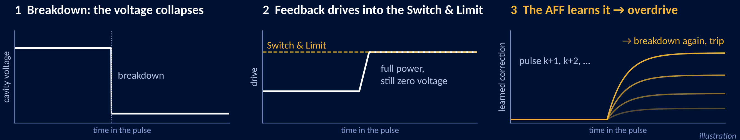
Breakdowns must never be learned
Now
Built-in pulse classifier: min · max · mean · std of the cavity voltage → no voltage · breakdown · unstable → not learned. The std catches oscillations that keep the same mean.
Mean-error threshold → not learned
Restart by the sequencer, AFF off until the end: open loop, tuners lock, set-point ramp → reset polar loop → close feedback → reset AFF history of all users → enable AFF from zero
Switch & Limit card caps the drive → protects the klystron
Notes:
[18: 1:45 | 12: 1:15 | 8: –]
A breakdown collapses the voltage within the pulse. The feedback drives harder and harder until the drive hits the Switch & Limit card – all the power the amplifier is allowed to give, and the field is still zero. The AFF sees an error the size of the voltage and learns a huge correction; the next pulses overdrive, break down again, until something trips. Now: a small pulse classifier is built in – min, max, mean and std of the cavity voltage over the pulse; std is there for oscillations that keep the same mean. A bad pulse is not learned; a mean-error threshold catches the rest. After a trip the sequencer restarts the line step by step: open loop, tuners lock, set-point ramp, then it resets the polar loop and closes the feedback. The AFF has been off since the RF-off sequence (and it cannot run without feedback anyway); only now its history is reset for all users and it is enabled, starting from zero – no stale correction is ever played into a cavity that is just coming back. A SAL veto check follows each step. The Switch & Limit card caps the drive and protects the klystron. The polar loop is reset because it has the same weakness, it learns a wrong gain from a breakdown pulse (reset since 2022).

Slide 10
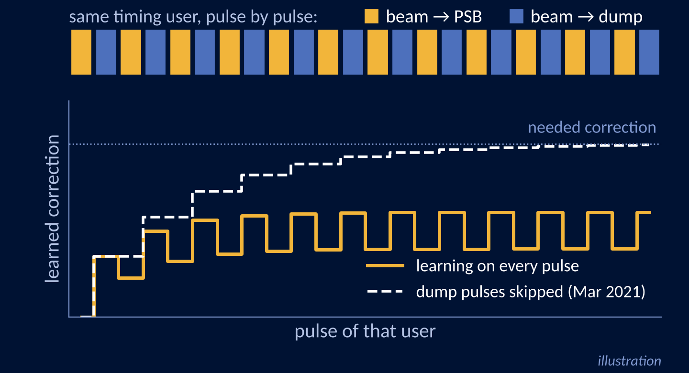
One user, two destinations – the AFF never settled
Debuncher, 2021
The AFF never reached a stable state.
Every second pulse of the same user went to the dump – the destination is decided pulse by pulse.
No beam in the debuncher → the AFF unlearned what the previous pulse taught it.
Surprise: the same user can have two destinations.
Fix: destination = dump → no learning, no playback.
Related gates
No ring played
known before the pulse → no learning, no playback
SIS inhibit (2023)
arrives after the pulse → played, not learned. Source or other line tripped, destination not ready
Notes:
[18: 2:00 | 12: 1:15 | 8: –]
The surprise: the debuncher's AFF would not settle. The same timing user had two destinations – every second pulse went to the dump, decided pulse by pulse. On a dump pulse the debuncher sees no beam, so the AFF unlearned what the previous pulse had taught it, and it oscillated around half the needed correction. Fix in March 2021 (Piotr spotted the dynamic destination): dump pulse – no learning and no playback. Same rule later for no ring played. SIS inhibit comes after the pulse – we only know after the beam has passed whether it was fine – so that pulse was already played with the correction, it is just not learned. It still saves us from learning malformed pulses: source tripped, another line tripped, destination not ready. Painting is the subtle one – next slide.

Slide 11
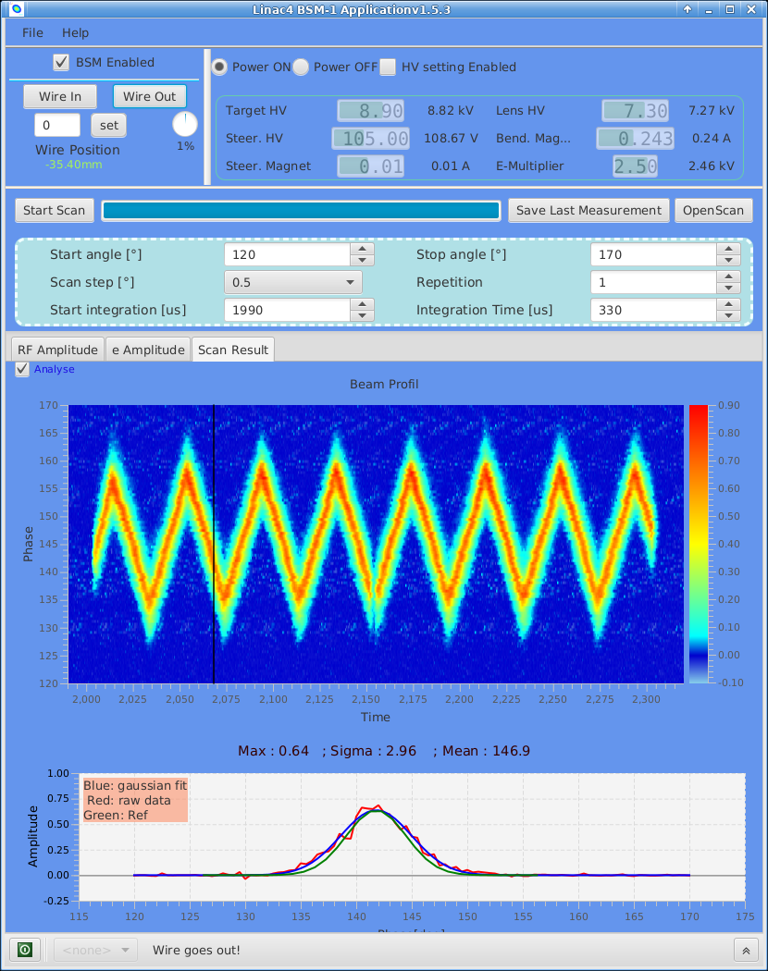
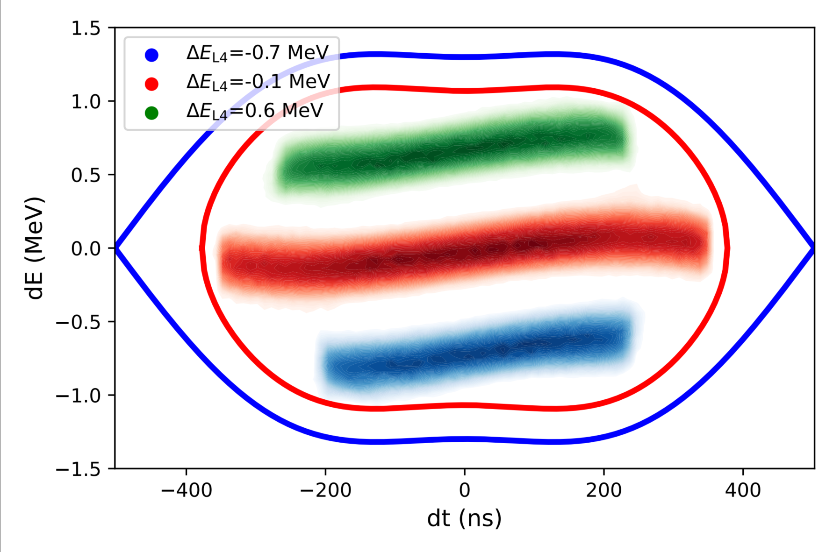
Painting: a modulated pulse can be a good pulse
PIMS11-12 swing the energy, the debuncher swings the phase – on purpose.
The pulse classifier called it unstable → the AFF stopped learning on exactly the painted users.
Jan 2023: the classifier knows the painting waveform – min · max · mean · std relative to it.
PSB longitudinal phase space with painting
BSM measurement during painting tests
courtesy J. Tan, SY-BI
Notes:
[18: 1:15 | 12: – | 8: –]
Longitudinal painting for the PSB: the last PIMS cavities swing the energy and the debuncher the phase, within the pulse. For the pulse classifier that looked like an unstable pulse, so on the painted users the AFF stopped learning – exactly where the beam is most demanding. Since January 2023 the classifier evaluates min, max, mean and std relative to the painting waveform, so painted pulses are learned again.
Sources: LLRF23 poster, thbp38, vcav.cpp.

Slide 12
Every failure mode now has an automatic answer
Condition | Detected by | Action
Feedback off | mode check | AFF off entirely
Beam to dump (debuncher) | timing: dynamic destination | no learning, no playback
No ring played | timing: PSB ring mask | no learning, no playback
Source / other line tripped, destination not ready | SIS learning inhibit (after the pulse) | skip learning
Breakdown / no voltage / unstable | pulse classifier: min · max · mean · std | skip learning
Painted pulse (modulated on purpose) | pulse classifier, relative to the painting waveform | learn as normal
Abnormal error | mean-error threshold | skip learning
User not played, or re-mapped | validity time per user | reset
Ring lengths or chopping changed | PSB Cruise Control writes ring settings | reset
Lesson 0: it works too well. In 2020 a line ran on the AFF alone, with the feedback off – and held the voltage. Since then the AFF switches itself off without feedback.
Notes:
[18: 2:10 | 12: 1:55 | 8: 2:00]
All of this lives in the front-end software, none of it needs an operator – and that, not the algorithm, is what made the AFF operational. Simple fast loop in the FPGA, judgement in software. Resets: a user is only a slot in the supercycle – after OP re-maps it, the 'same' user may be a different beam, so an old history is discarded, not trusted (validity time, ring-settings write, sequencer ON). Lesson 0: in 2020 we found a line running on the AFF alone with the feedback off – it held the voltage. Since SVN r93050 (29 Sep 2020) the AFF switches itself off without feedback.
Emergency exit: this slide alone carries the message.

Slide 13
Outlook and thanks
Next – the AFF is stable today, but
Tell the AFF the pulse current → a computed, not learned, correction from the first pulse
The other way round: estimate the beam current from the learned correction
High Current Mode: no problem so far, but at higher current the learning may become unstable
Thanks
Core team
P. Baudrenghien, R. Borner, B. Bielawski
Inspiration
K. Fong (TRIUMF)
Operations
P. Skowronski, G.P. Di Giovanni, B. Mikulec
High-power RF
R. Wegner
… and many colleagues in SY-RF, BE-OP and ABP
Notes:
[18: 1:00 | 12: 0:45 | 8: 0:30]
The feature is stable today; ideas: pre-inform the AFF about the pulse current and generate a computed, not learned, correction – and the inverse, use the learned correction to estimate the beam current. High Current Mode has not been a problem so far, but at higher current the learning loop may become unstable.

Slide 14
Thank you
Questions?
bartosz.bielawski@cern.ch
Notes:
Leave on screen during questions. Sources, references and backup slides B1–B7 follow.

Slide 15
Sources and image credits
Slide | Figure / content | Source
2 | Linac4 layout · TDR quote | drawn for this talk · Linac4 Technical Design Report, CERN-AB-2006-084
3 | Cavity voltage, PI vs LQG | P. Baudrenghien, B. Bielawski, R. Borner, LINAC'22 TH1AA06, Fig. 4
4 | AFF principle | inspired by K. Fong (TRIUMF), LINAC'16 TUPLR009 · equations from the ALLL4CavityLoop FESA class
5 | Beam phase along the batch (BSM) | R. Wegner, 2019 · LLRF'23 poster, B. Bielawski
6 | Klystron power · energy at the Linac4 output | LINAC'22 TH1AA06, Figs 7 and 9 · energy: P. Skowronski
6 | Linac4 availability | LLRF'23 poster, B. Bielawski
7 | AFF panel · CCDTL5 spectrum | AFF application, B. Bielawski · LINAC'22 TH1AA06, Fig. 8
10 | Two destinations | simulation for this talk (illustration)
11 | PSB phase space with painting | S. Albright et al., HB'23 THBP38, Fig. 1
11 | Phase sweep along the pulse | J. Tan, CERN SY-BI – BSM measurement during painting tests
5–6 | Operation, High Current Mode | P.K. Skowronski et al., IPAC'25 THPS029
Code: ALLL4CavityLoop FESA class (aff.cpp, vcav.cpp) · ln4_rf_sequencer (aff_filter.py, turn_on.py) · FEC settings · CavityLoops firmware model
Notes:
Not presented – after Thank you, for the PDF on Indico.

Slide 16
References
[1] P. Baudrenghien, B. Bielawski, R. Borner, “Low Level RF Control Algorithms for the CERN Proton Linac4”, in Proc. LINAC'22, Liverpool, UK, 2022, paper TH1AA06.
[2] M.P. Laverty, K. Fong, “An Iterative Learning Feedforward Controller for the TRIUMF e-linac”, in Proc. LINAC'16, East Lansing, MI, USA, 2016, paper TUPLR009, doi:10.18429/JACoW-LINAC2016-TUPLR009.
[3] B. Bielawski, R. Borner, P. Baudrenghien, “Insights and Conclusions from Operating the CERN Linac4 LLRF System”, poster, 11th LLRF Workshop (LLRF2023), Gyeongju, Korea, Oct. 2023.
[4] S. Albright, F. Asvesta, C. Bracco, B. Bielawski, R. Wegner, P. Skowronski, “Two-Dimensional Longitudinal Painting at Injection into the CERN PS Booster”, in Proc. HB'23, Geneva, Switzerland, 2023, paper THBP38, doi:10.18429/JACoW-HB2023-THBP38.
[5] P.K. Skowronski et al., “Experience with the CERN Linac4 and its Performance during the First Four Years of Operation”, in Proc. IPAC'25, Taipei, Taiwan, 2025, paper THPS029, doi:10.18429/JACoW-IPAC2025-THPS029.
[6] L. Arnaudon et al., “Linac4 Technical Design Report”, CERN-AB-2006-084, CERN, Geneva, 2006.
Unpublished CERN sources: ALLL4CavityLoop FESA class (aff.cpp, vcav.cpp) · ln4_rf_sequencer (aff_filter.py, turn_on.py) · CavityLoops firmware model · FEC settings · SY-RF e-mail and SVN history 2018–2023
Notes:
Not presented – for the PDF on Indico.

Slide 17

Backup · LQG regulator, traced from the firmware
Per I and Q · traced from LQG_combined.slx (System Generator, 2022) · D = KalmanDelaySelect (22–46 samples) · r_f: setpoint low-pass, τ ≈ 18 µs · K sign to confirm
Kalman predictor with the loop delay (one sample per stage, P register of a DSP48)
antenna y
u_m
a·x̂ + c·u + L·e
z⁻¹ + L₁e
z⁻¹ + L₂e
z⁻¹ + L_De
ŷ
Σ
e
…
x̂ → LQR
innovation e = y − ŷ corrects every stage (L₀…L₄₆, sfKalmanL)
Notes:
Backup. Equations from aff-equations.md §1; figures Linac'22 Figs 2–3.

Slide 18
Backup · AFF filter design (aff_filter.py)
A low-pass FIR filter, computed per line by the script: a fixed window (Hanning, exponential, rectangular) or, on some lines, the measured step response of the line – with or without DC. Long on purpose: the pre-driver amplifiers put a component close to 1 MHz into the drive:
AFF in EXCITATION mode, 4 rings × 150 µs, RF→injection temporarily 250 µs; average 16 pulses of the error
Delay: first sample where the median-filtered (25) derivative exceeds a threshold → look-ahead
Fit a polynomial (degree 21) to the step response
Differentiate → impulse response of the closed loop
Window with the falling half of a Hanning window
Optionally remove the DC component (“AC-coupled”, used since Sep 2020; --no-dc keeps it)
Normalise to Σ|b| = 1; write filter and look-ahead to the FESA class
Notes:
Backup. Source: sequencer aff_filter.py (--filter LINE | HANNING | EXP | RECT | SINE; EXP is Philippe's exponential decay).

Slide 19
Backup · Learning gates in code order
Mode OFF / EXCITATION, or ON with feedback off → no learning, no playback
Debuncher: DYN_LINAC_DEST = DUMP → no learning, no playback [INHIBIT_DEST]
PSB ring mask ∧ AFF rings = 0 → no learning, no playback [INHIBIT_NO_BEAM]
SIS learn inhibit (arrives after the pulse, one cycle) → that pulse is not learned; it was already played [INHIBIT_SIS]
Cavity-voltage pulse status ≠ NORMAL → no learning [INHIBIT_BAD_PULSE]
Mean |error| > threshold → no learning [INHIBIT_BAD_PULSE]
Otherwise: s ← β·s + (1−β)·G·ε, clipped, saturation flagged
Notes:
Backup. Source: ALLL4CavityLoop aff.cpp processAFF / writeAFFSettings.

Slide 20
Backup · AFF modes
Mode | Learning | Playback | Excitation | Use
OFF | no | no | no | –
ON | yes (feedback on, gates pass) | yes | no | operation
TEST | yes, also without beam | yes | fake beam-loading step | set-up without beam
EXCITATION | no | no | step from buffer start | delay → look-ahead, filter
INHIBIT_* / NOT_NEEDED | status only |  |  | why the last pulse was not learned
Notes:
Backup. Source: affMode enum and aff.cpp.

Slide 21
Backup · Timing: putting the window on the beam
Window start = RF_ON→injection delay − advance; length = advance + Σ(ring length + distributor gap) + advance. Advance = 50 µs: the long low-pass smears the sharp beam arrival, so the correction must start early and the amplifier is ramped up when the beam arrives
Before Linac4 became operational, small timing shifts caused jitter → since Nov 2019 RF_ON is chained to the PSB (L4X.RFON), the same way as the chopper; the beam position in the pulse follows the PSB
Aug 2020: beam arrived 243 µs after RF_ON while the default assumed 300 µs – the AFF missed the batch head; now computed from the master RF_ON
Ring lengths and the chopping pattern come from PSB Cruise Control; writing them resets the AFF
Notes:
Backup. Sources: emails Jun 2020, Aug 2020; aff.cpp writeAFFSettings.

Slide 22
Backup · AFF settings per line (FEC data)
Line | G | β | look-ahead
BU3 | 50 | 0.97 | 1.59 µs
DTL1 / 2 / 3 | 97 / 90 / 50 | 0.97 | 1.75 / 1.77 / 1.59
CCDTL1 / 2 | 80 / 50 | 0.97 | 1.86 / 1.91
CCDTL3 / 4 | 79 / 20 | 0.97 | 1.95 / 1.86
CCDTL0506 / 7 | 80 / 80 | 0.97 | 1.45 / 1.59
PIMS0102 / 0304 | 50 / 70 | 0.97 | 1.65 / 1.54
PIMS0506 / 0708 | 40 / 70 | 0.97 | 1.64 / 1.55
PIMS0910 / 1112 | 35 / 68 | 0.97 | 1.59 / 1.59
Debuncher | 45 | 0.97 | 2.00
Bunchers 1–2: tested, never activated. RFQ: no AFF.
Notes:
Backup. Source: FEC persistent data, 05-procedures-data/aff-settings-fec/summary.md.

Slide 23
Backup · A wrong correction can be stable – Buncher 3, 2021
Sunday 7 – Monday 8 March 2021
no trip – poor transmission for half a day
11:50
Tuner filter lets a bad sample through → cavity detuned, the AFF compensates
12:15
The AFF settles in a wrong but stable state
20:52
Supercycle change: users not played > 60 s are cleared – not the one still playing
05:07
All cycles removed → cleared
Now
Stricter tuner filtering · error threshold · validity time per user · reset on setting changes · sequencer “ON” resets all users
A user is only a slot in the supercycle: after re-mapping, the “same” user may be a different beam – so an old history is discarded, not trusted.
Notes:
Backup. The dangerous failures are the quiet ones. A tuner glitch detuned Buncher 3, the AFF compensated into a wrong but stable state, nothing tripped, and transmission was poor for half a day. Why a reset on time at all? The system is multiplexed: users are interleaved, the FPGA has one buffer, the history of each user lives in software. A user is only a slot – after OP re-maps it, the 'same' user may be a different beam. In 2019 OP asked us to store corrections in LSA because they re-map several times a day; that is exactly when a stored correction is wrong.

