Slide 1

LLRF Topical Workshop on Advanced Feedback Control
Analysis and Suppression of Ponderomotive
Instabilities in SRF Cavities
Jiayi PENG, Feng QIU
Institute of Modern Physics, Chinese Academy of Sciences
13 October 2026 · Nova Gorica, Slovenia
J. Peng, Ponderomotive Instabilities in SRF Cavities, TWoAFC 2026, Nova Gorica, 13 October 2026
1

Slide 2
01
Introduction
02
Electromechanical Modeling
CONTENTS
03
Experiments & Suppression
04
Summary
J. Peng, Ponderomotive Instabilities in SRF Cavities, TWoAFC 2026, Nova Gorica, 13 October 2026
2

Slide 3
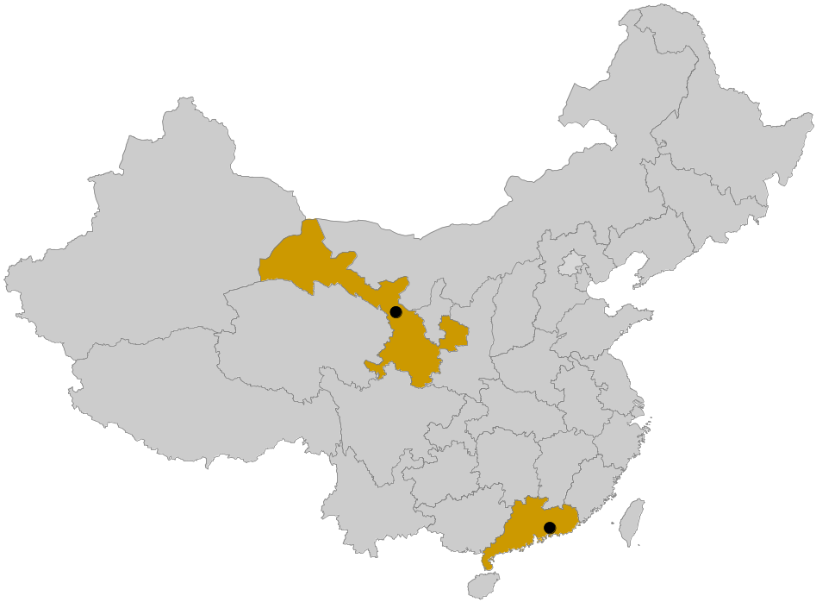
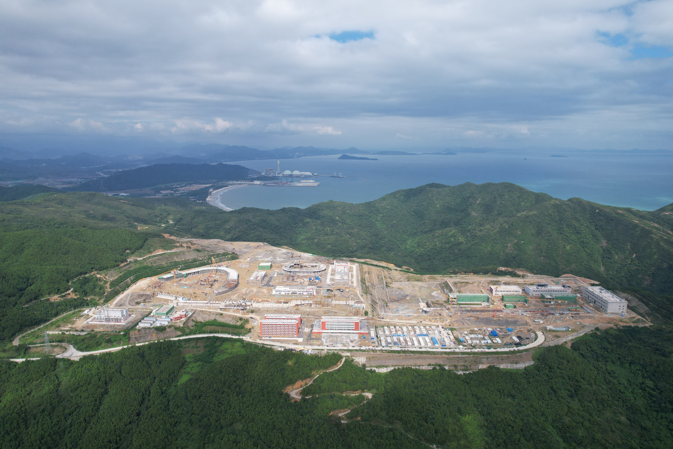
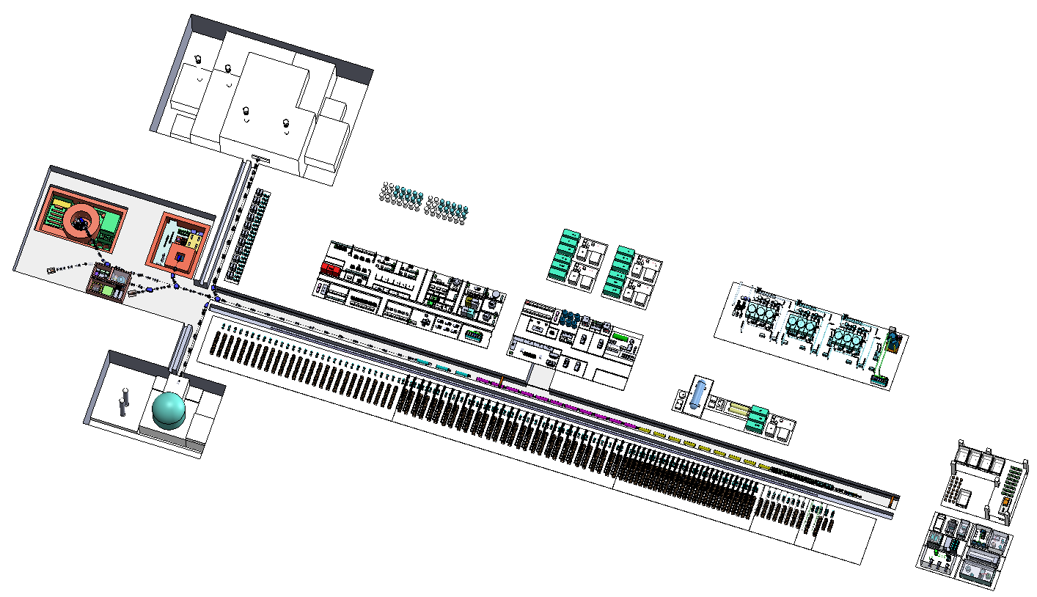
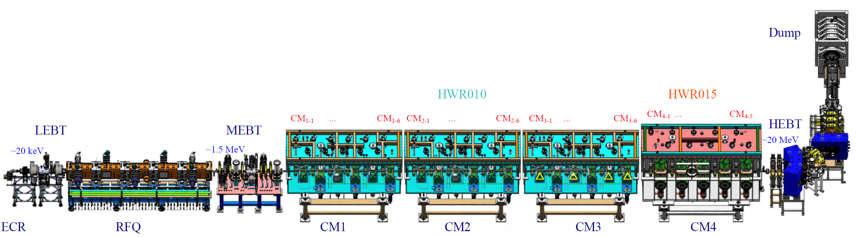
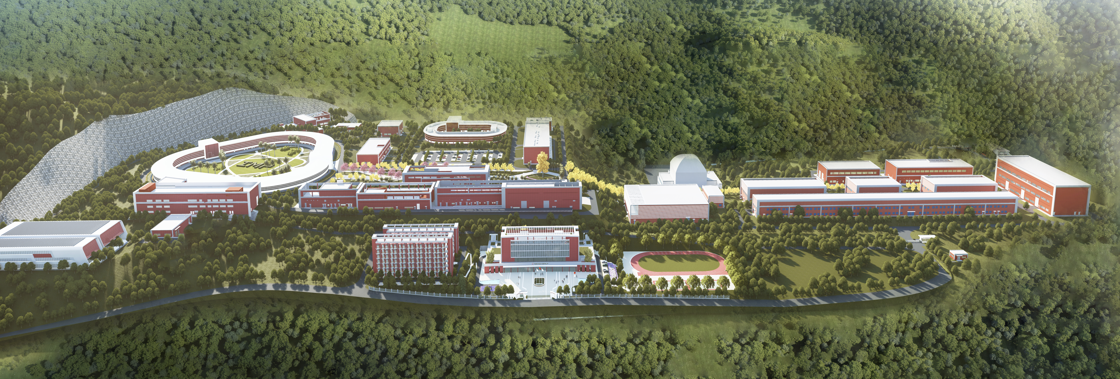
SRF Cavities
CAFe：China ADS Front-end (SRF facility, in CW mode)
  Demonstrate the feasibility of the 10-mA high-power CW proton beam for the China-initiative ADS (CiADS) project
Sep. 2023
CiADS
Linac Prototype
CAFe (Lanzhou)
Aerial View
SRF
Architectural Rendering
CiADS (Huizhou)
HIAF (High Intensity heavy-ion Accl. Facility)
CAFe (China ADS Front-end demo linac) @ IMP
Four cryomodule，23 SRF cavities，cavity bandwidth：80 Hz~200 Hz，HWR₀₁₀+HWR₀₁₅）
J. Peng, Ponderomotive Instabilities in SRF Cavities, TWoAFC 2026, Nova Gorica, 13 October 2026
3

Slide 4
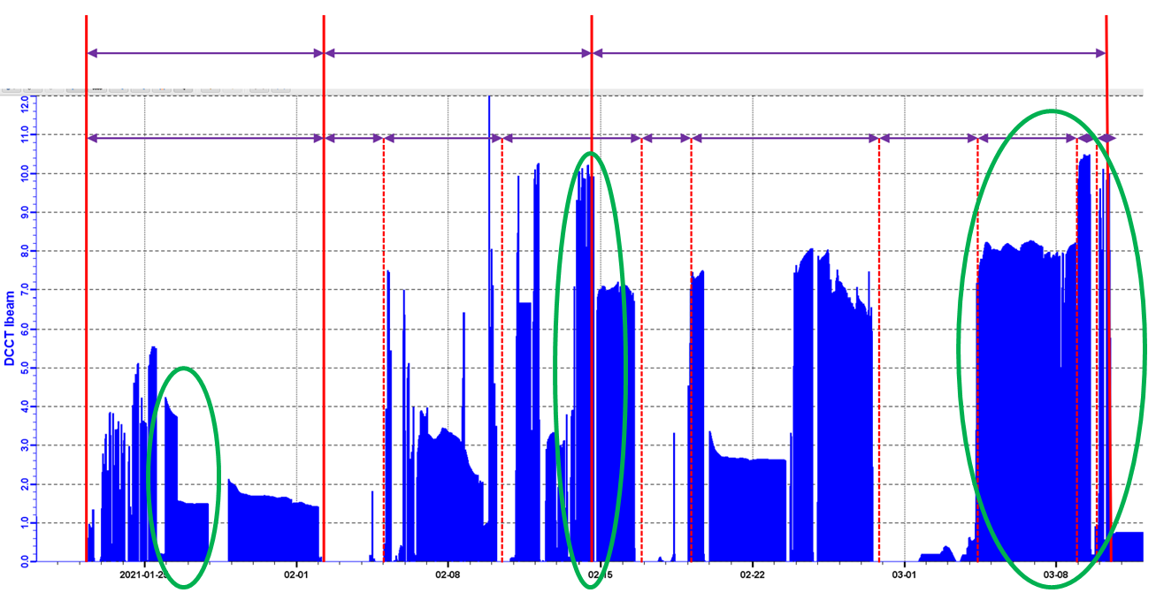
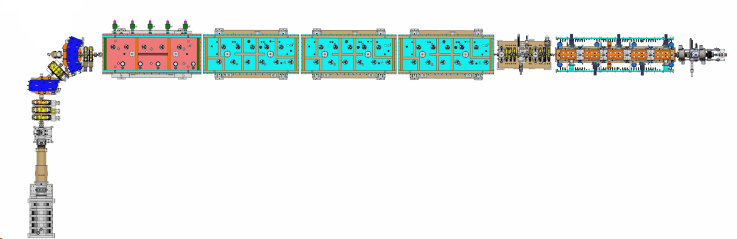
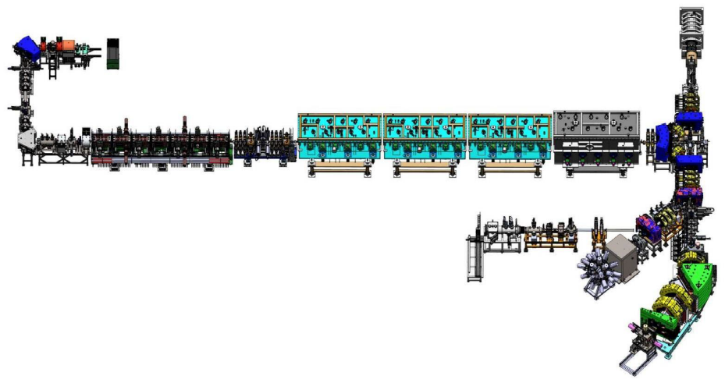
SRF Cavities
CAFe beam commissioning
Success long-term operation of 8-10 mA CW for 100 hrs
2021.03, stable operation of 10 mA proton beam
8~10 mA
~7 mA
CAFe: 10 mA proton beam
2~4 mA
Heavy Ion Source
China Accelerator Facility for super-heavy new elements (CAFe2)
CAFe2: 0.1 mA Ion beam
Target：
Highest beam current accelerator for superheavy elements synthesis
Engaging in research on the synthesis of the 119th and 120th element
Spectrometer for Heavy Atoms and
Nuclear Structure
2022.02, first beam.
2022.03 ~ present, user experiments
J. Peng, Ponderomotive Instabilities in SRF Cavities, TWoAFC 2026, Nova Gorica, 13 October 2026
4

Slide 5
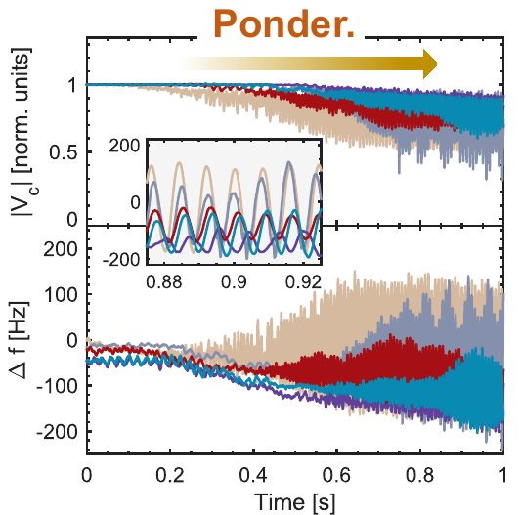
Operational Impact
Growing field and detuning oscillations
Electromechanical coupling can drive self-excited oscillations during CW operation.
The disturbance can involve several cavities and interrupt accelerator operation.
A stability threshold is needed under
actual LLRF feedback settings
J. Peng, Ponderomotive Instabilities in SRF Cavities, TWoAFC 2026, Nova Gorica, 13 October 2026
6

Slide 6
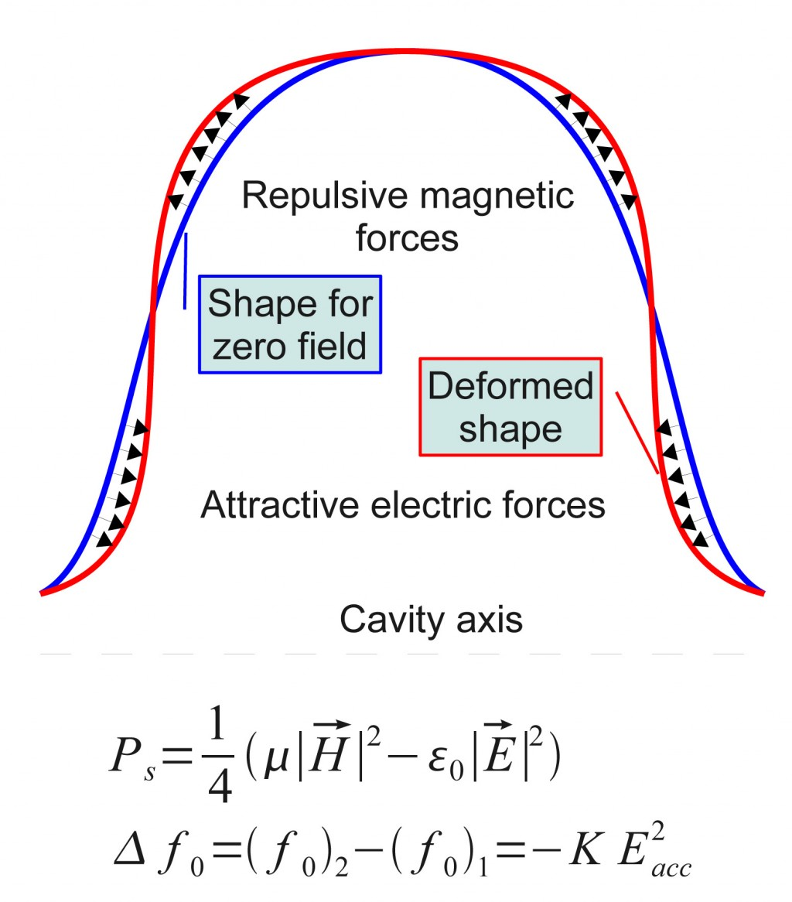
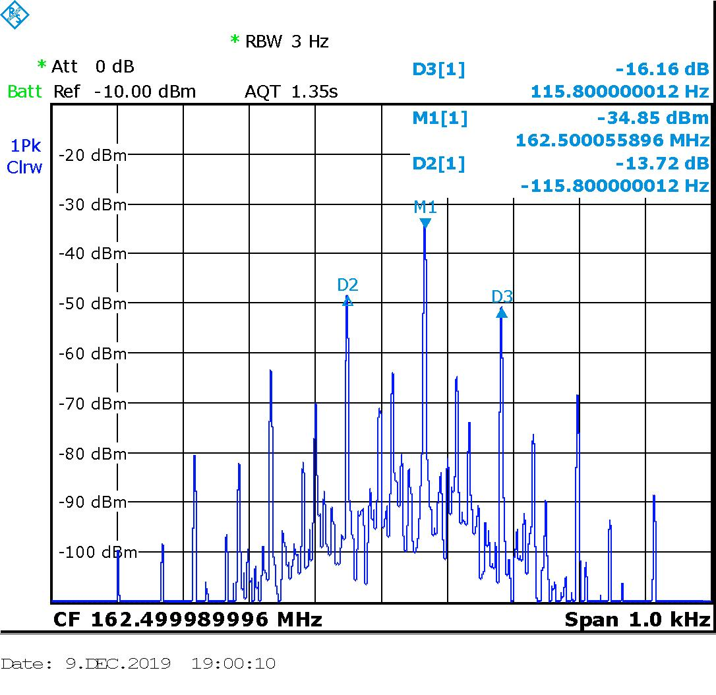
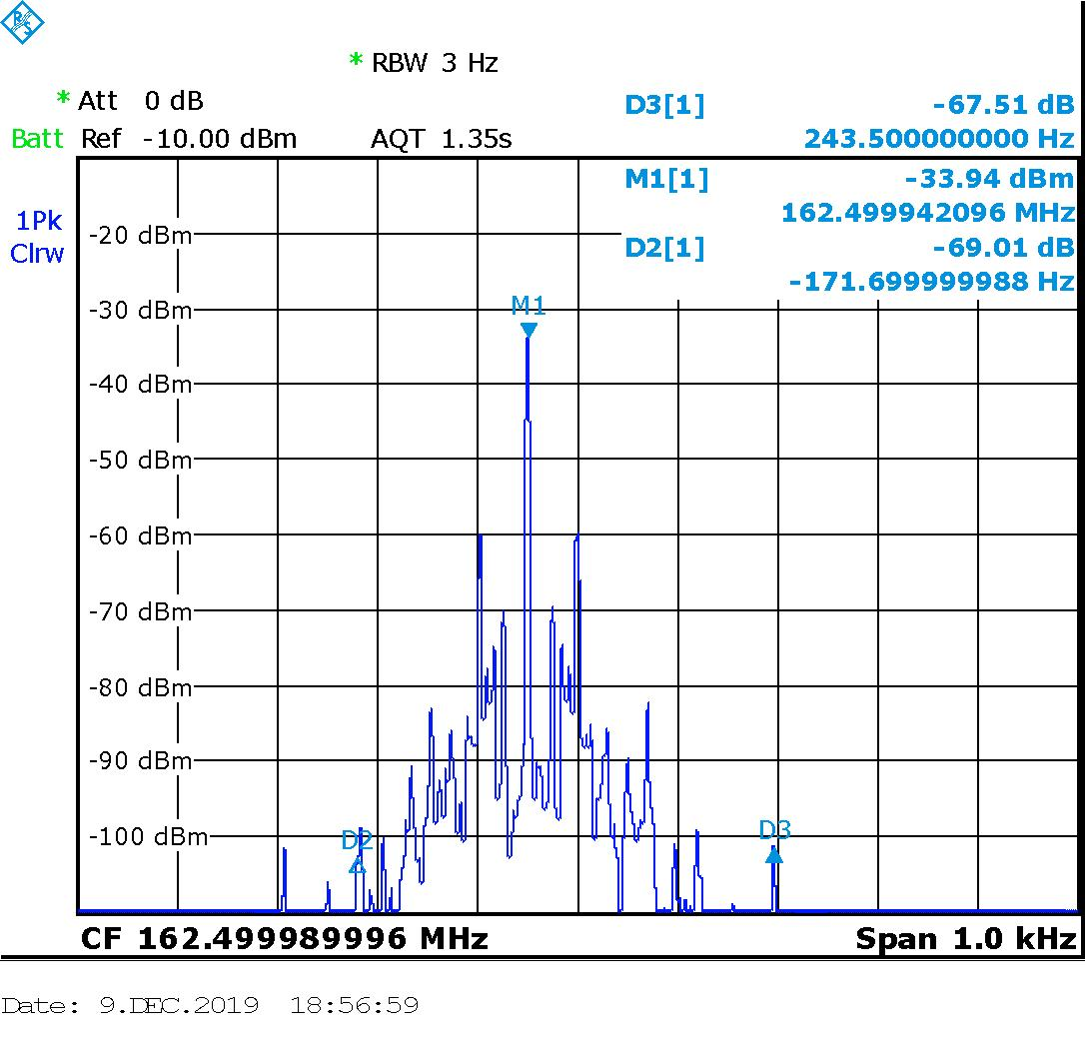
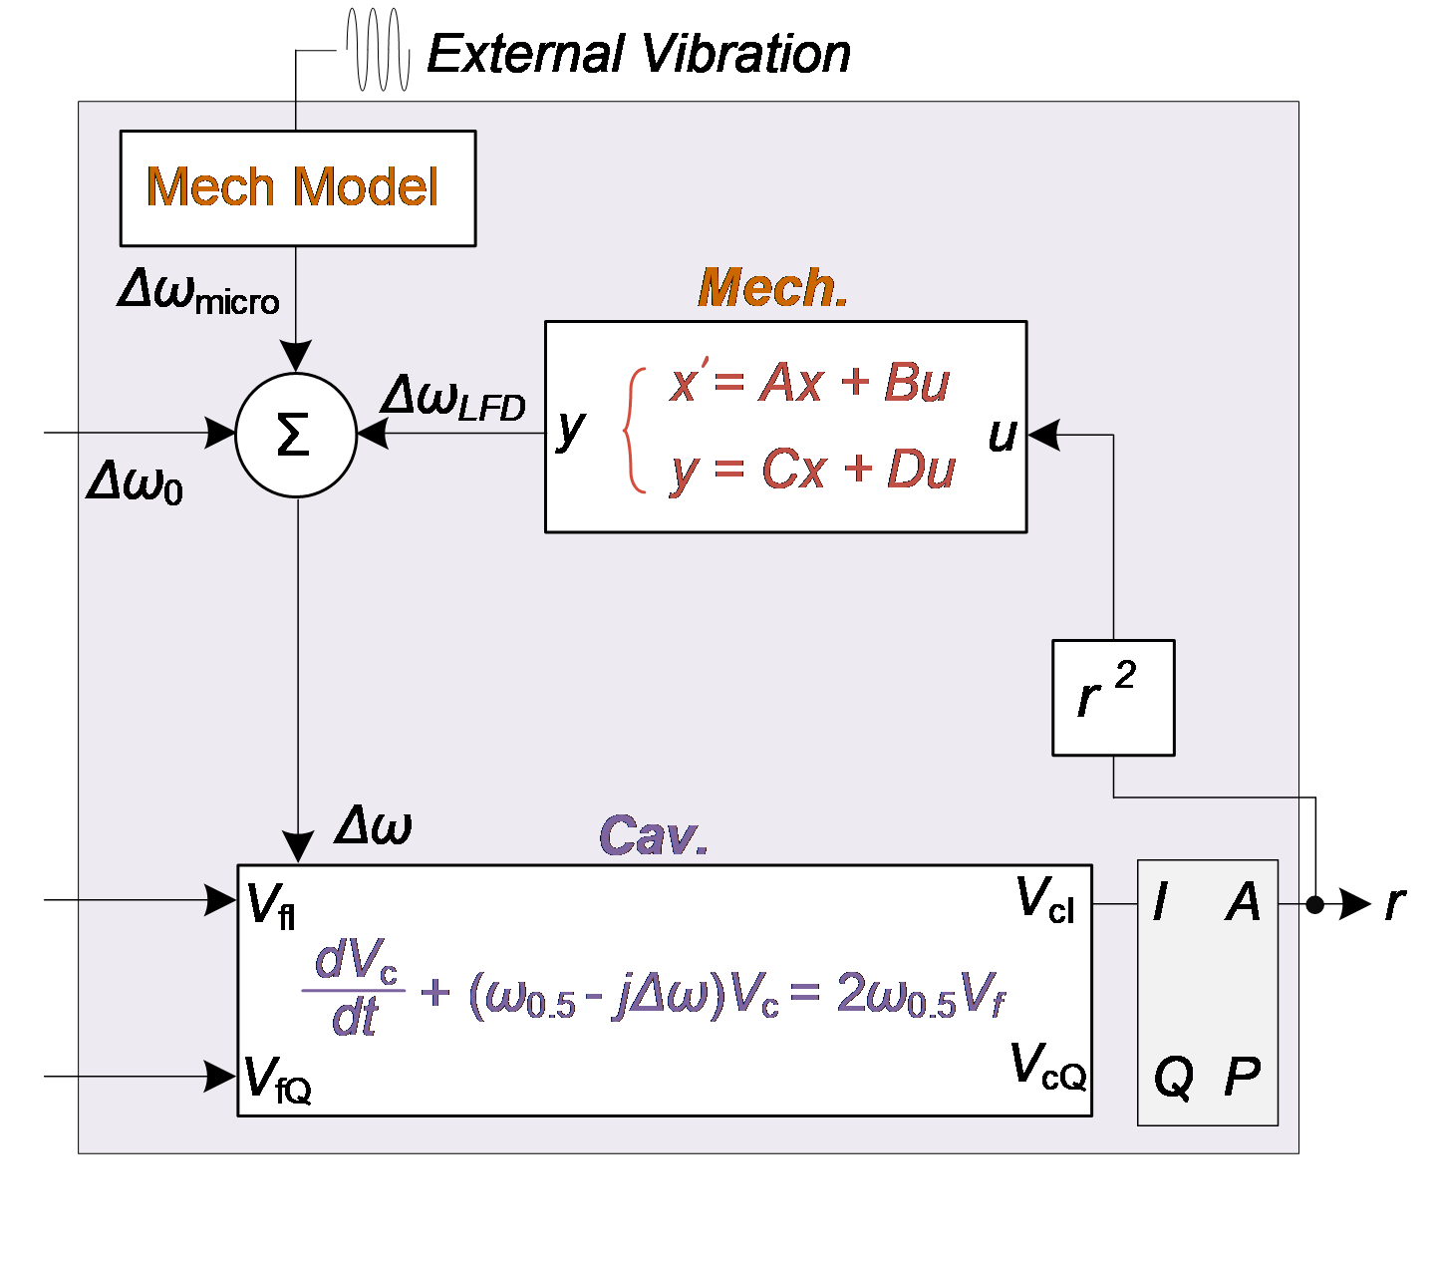
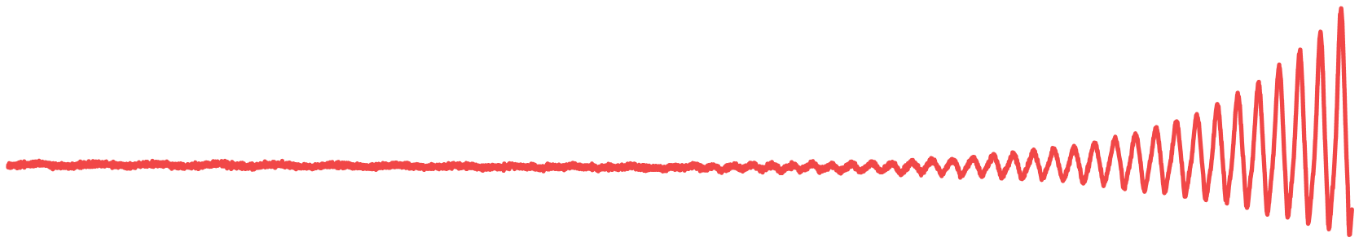
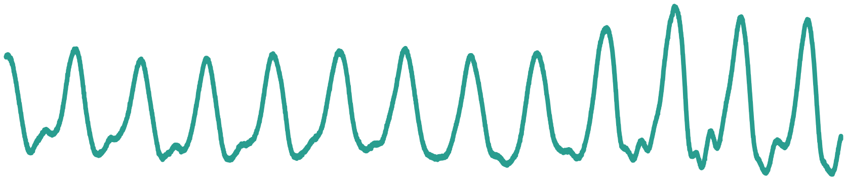
Ponderomotive Effects and Microphonics
Ponderomotive instability: internal electromechanical feedback causes growing oscillations.
Microphonics: external vibration changes the cavity resonance frequency.
Simplified LFD transfer function
Ponderomotive Effects
Microphonics
~120 Hz
~120 Hz
0~50 Hz
Divergent Oscillation
Vibration (w/o divergency)
J. Peng, Ponderomotive Instabilities in SRF Cavities, TWoAFC 2026, Nova Gorica, 13 October 2026
7

Slide 7
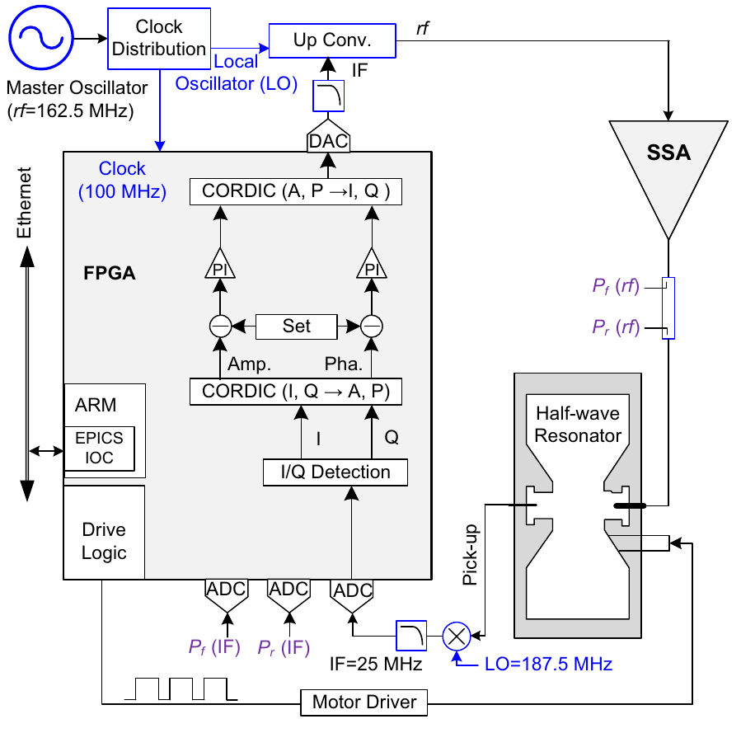
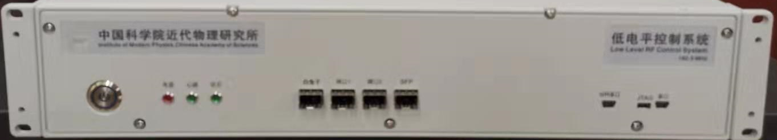
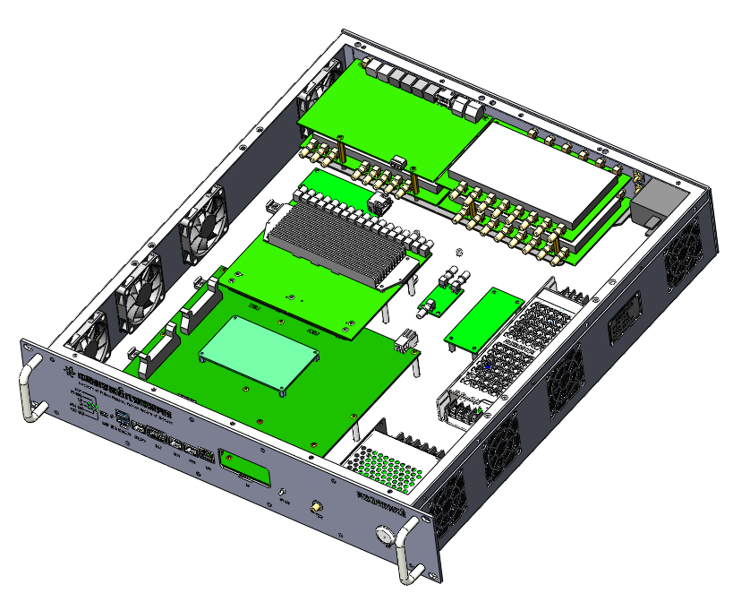
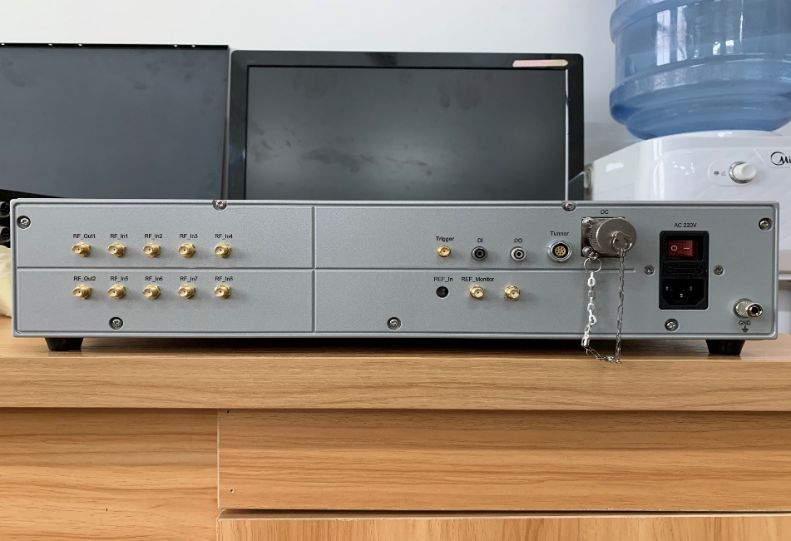
LLRF Control at CAFE2
Amplitude / phase feedback
Digital PI controllers regulate
the cavity amplitude and phase.
Resonance control
The frequency loop sets the detuning
for the stability measurements.
Both loops remain closed during
the threshold scan.
J. Peng, Ponderomotive Instabilities in SRF Cavities, TWoAFC 2026, Nova Gorica, 13 October 2026
8

Slide 8
01
Introduction
02
Electromechanical Modeling
CONTENTS
03
Experiments & Suppression
04
Summary
J. Peng, Ponderomotive Instabilities in SRF Cavities, TWoAFC 2026, Nova Gorica, 13 October 2026
9

Slide 9
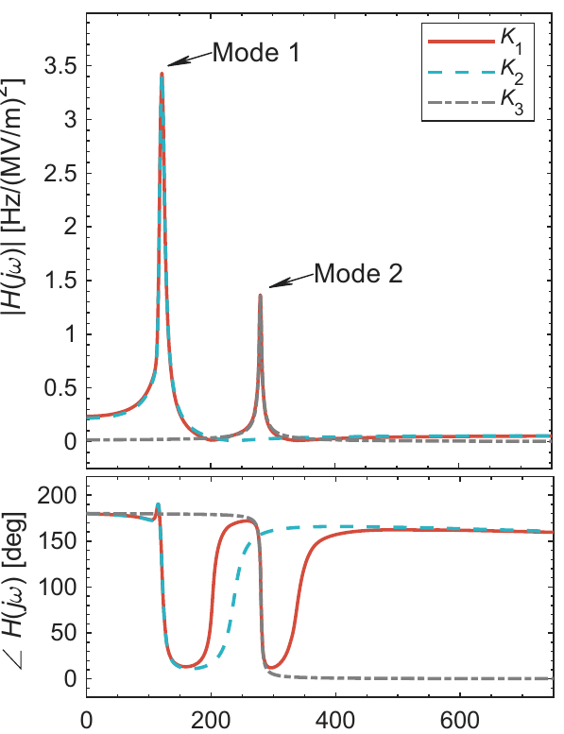
Mechanical System Identification
Grey-box fit to measured detuning
A baseline term plus two resonant modes
reproduces the electromechanical response.
Parameter | Mode 1 | Mode 2
Frequency [Hz] | 118 | 280
Mechanical Q | 15 | 78
Mode strength Gₘ | −3.4 | −1.55
H(s) = H_{base}(s) + H₁(s) + H₂(s)
Frequency [Hz]
J. Peng, Ponderomotive Instabilities in SRF Cavities, TWoAFC 2026, Nova Gorica, 13 October 2026
10

Slide 10
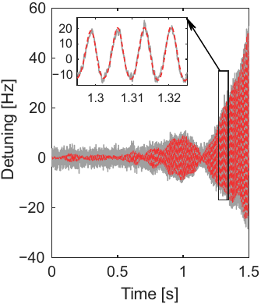
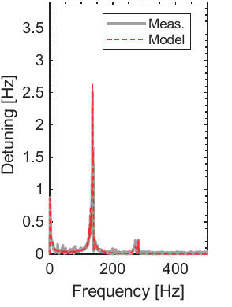
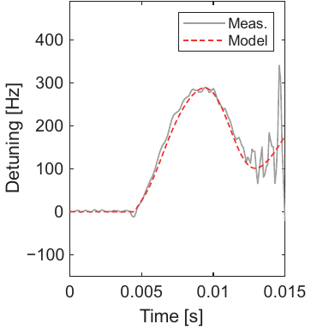
Measured and Modeled Detuning
RF turn-off transient
Self-excited oscillation
Oscillation spectrum
The identified model reproduces both transient and oscillatory detuning.
J. Peng, Ponderomotive Instabilities in SRF Cavities, TWoAFC 2026, Nova Gorica, 13 October 2026
11

Slide 11
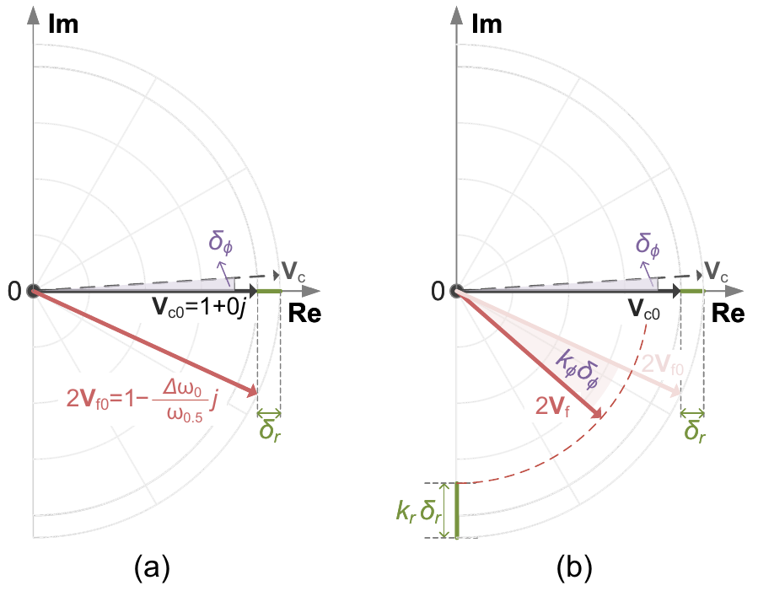
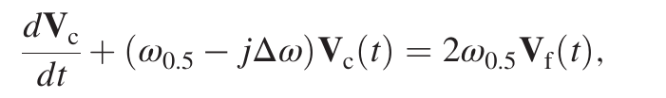
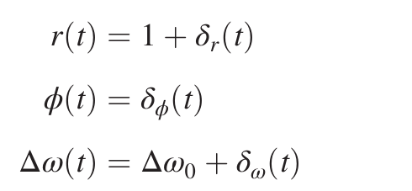
Small-signal Model
Cavity electromagnetic dynamics
Perturbations at the operating point
Linearization about the operating point
links field perturbations to detuning.
Normalized variables; negligible beam loading; strongly overcoupled cavity.
J. Peng, Ponderomotive Instabilities in SRF Cavities, TWoAFC 2026, Nova Gorica, 13 October 2026
12

Slide 12
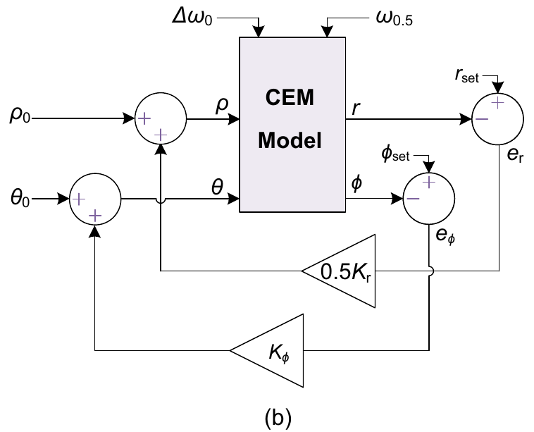


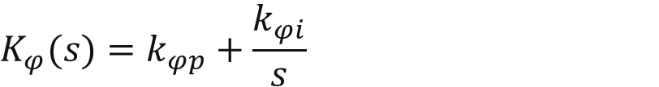
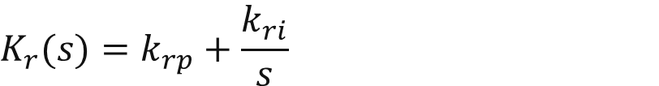

Closed-loop Stability Criterion
Separate A/P PI controllers
$$K_{r}(s)=k_{rp}+\frac{k_{ri}}{s}$$
$$K_{φ}(s)=k_{φp}+\frac{k_{φi}}{s}$$
Characteristic equation
$$D_{\text{cl}}(s)=[s+ω_{0.5}(1+K_{r}\text{cos}{Δθ_{0}})]$$
$$×[s+ω_{0.5}(1+K_{φ})]$$
$$+Δω_{0}(1+K_{φ})$$
$$×[Δω_{0}+ω_{0.5}K_{r}\text{sin}{Δθ_{0}}+2H(s)]=0$$
Stable: Re(s) < 0 for every characteristic root. Boundary: max Re(s) = 0.
J. Peng, Ponderomotive Instabilities in SRF Cavities, TWoAFC 2026, Nova Gorica, 13 October 2026
13

Slide 13
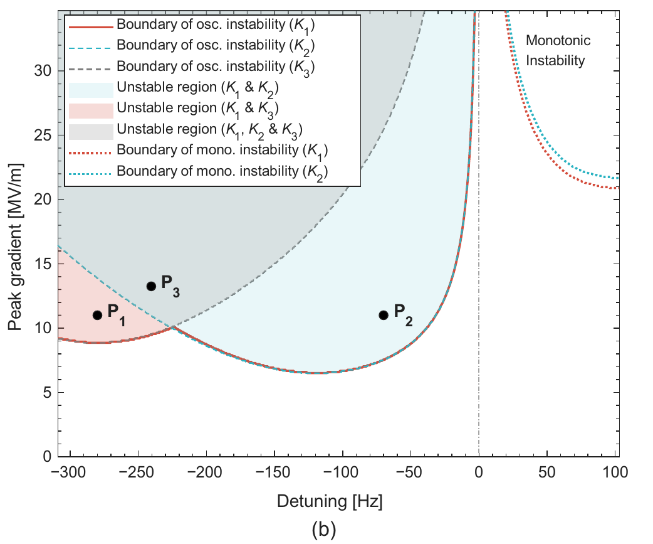
Instability Boundaries
Mechanical model variants
K₁: baseline + 118 + 280 Hz
K₂: baseline + 118 Hz
K₃: 280 Hz
Selected operating points
P₁: 280 Hz mode
P₂: 118 Hz mode
P₃: two-mode beating
The excited mechanical mode depends on the operating point.
J. Peng, Ponderomotive Instabilities in SRF Cavities, TWoAFC 2026, Nova Gorica, 13 October 2026
14

Slide 14
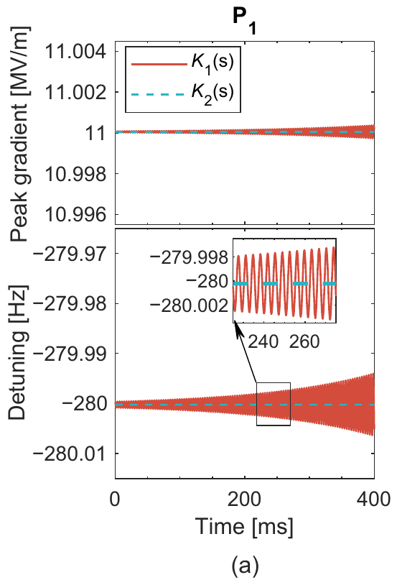
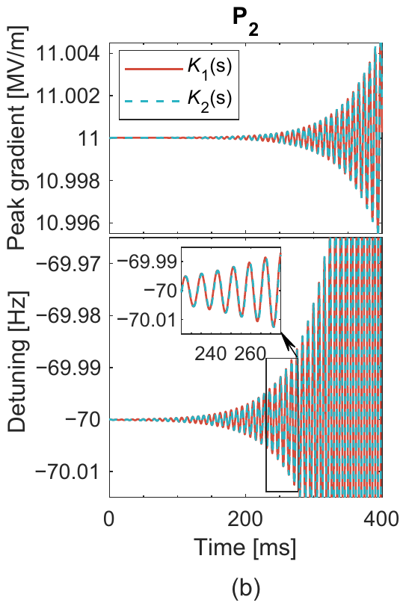
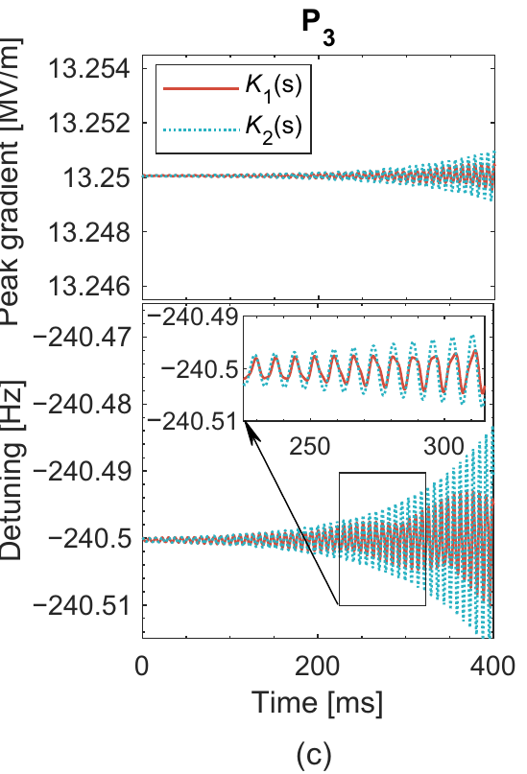
Time-domain Verification
P₁: 280 Hz
P₂: 118 Hz
P₃: two-mode beating
Time traces confirm the mode dependence of the analytical boundaries.
J. Peng, Ponderomotive Instabilities in SRF Cavities, TWoAFC 2026, Nova Gorica, 13 October 2026
15

Slide 15
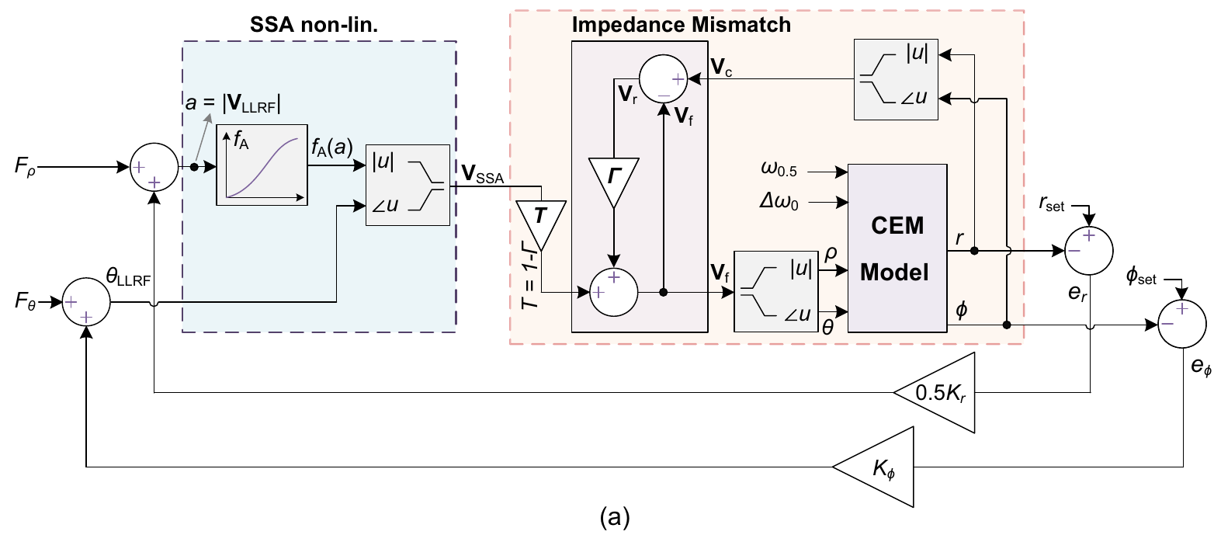
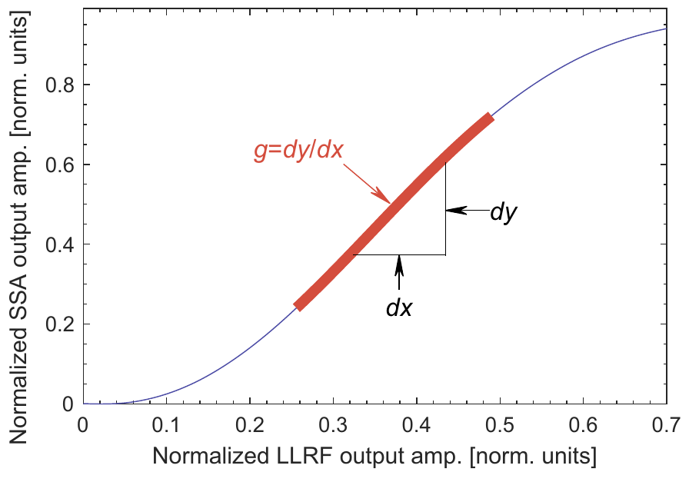
Hardware Effects in the Model
Operating-point-dependent loop gain
SSA gain and impedance mismatch enter
the effective cavity and controller parameters.
These corrections connect the ideal model to the measured RF system.
J. Peng, Ponderomotive Instabilities in SRF Cavities, TWoAFC 2026, Nova Gorica, 13 October 2026
16

Slide 16
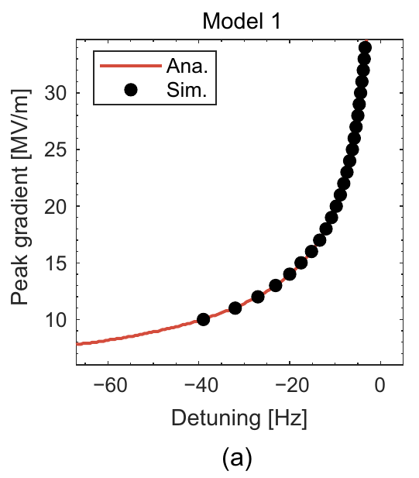
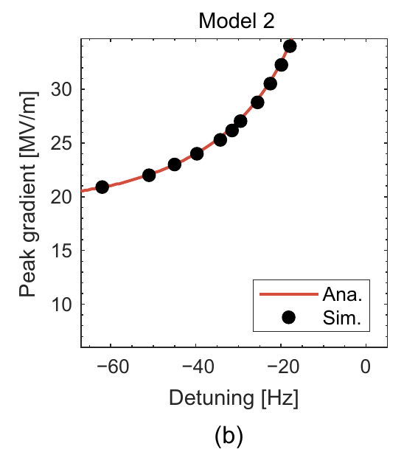
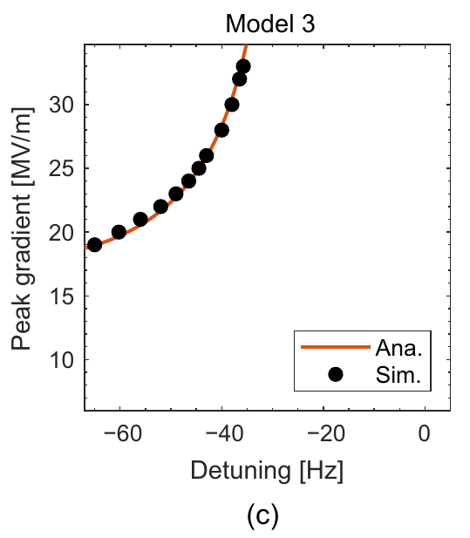
Analytical and Simulated Thresholds
Open loop
A/P feedback
Hardware corrections
Characteristic-root analysis and time-domain simulation give consistent onset boundaries.
J. Peng, Ponderomotive Instabilities in SRF Cavities, TWoAFC 2026, Nova Gorica, 13 October 2026
17

Slide 17
01
Introduction
02
Electromechanical Modeling
CONTENTS
03
Experiments & Suppression
04
Summary
J. Peng, Ponderomotive Instabilities in SRF Cavities, TWoAFC 2026, Nova Gorica, 13 October 2026
18

Slide 18
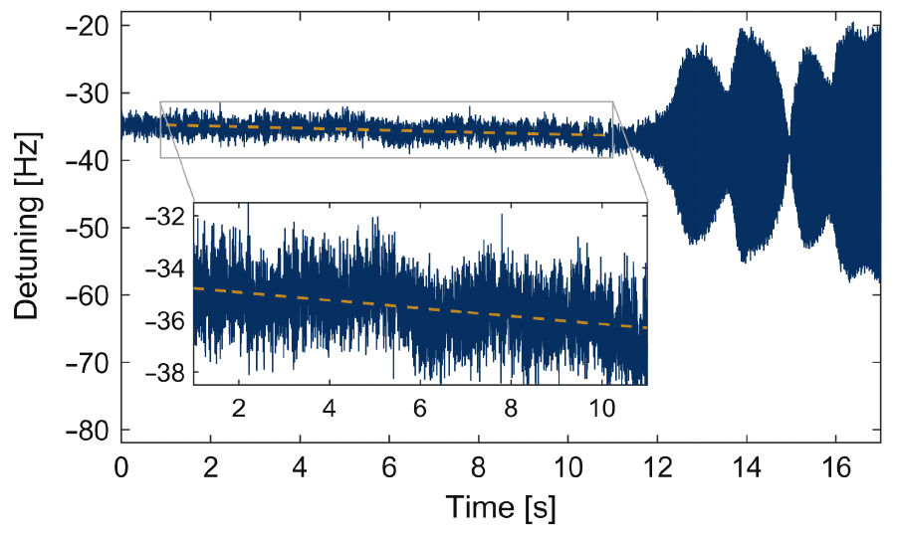
Threshold Measurement Procedure
Measurement sequence
Detuning scan near the threshold
1. Set the cavity gradient and PI gains.
2. Sweep toward negative detuning.
3. Slow the scan near the boundary.
4. Fit detuning just before oscillation onset.
Near onset: 0.1–0.15 Hz/s
The threshold is the pre-onset detuning at a fixed cavity gradient.
J. Peng, Ponderomotive Instabilities in SRF Cavities, TWoAFC 2026, Nova Gorica, 13 October 2026
19

Slide 19
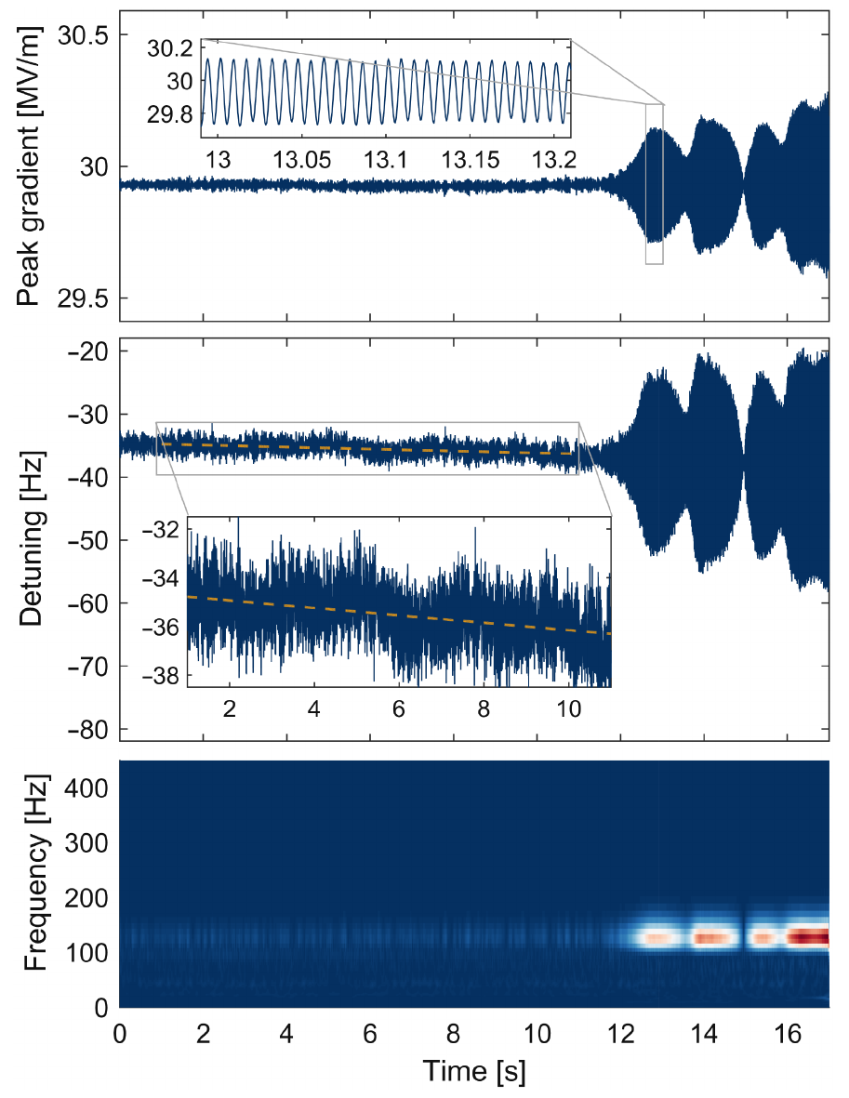
Observed Oscillation Onset
CM4-1
29.8 MV/m
Peak electric field
≈ −37 Hz
Detuning at onset
118 Hz
Dominant mechanical mode
J. Peng, Ponderomotive Instabilities in SRF Cavities, TWoAFC 2026, Nova Gorica, 13 October 2026
20

Slide 20
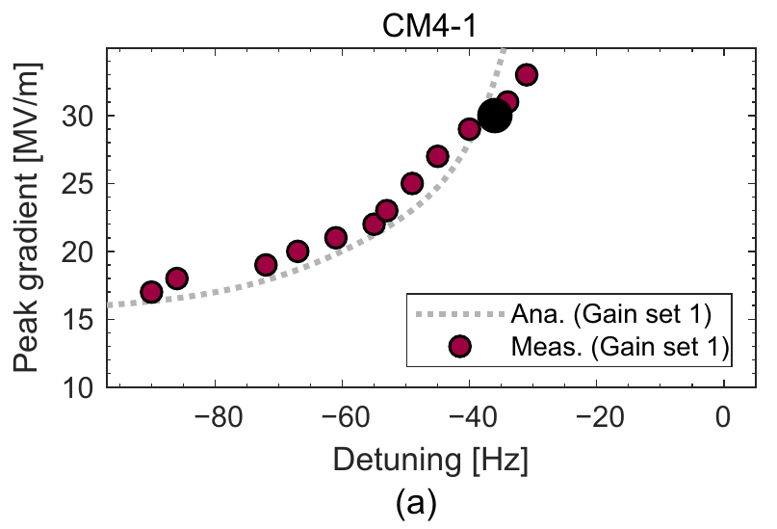
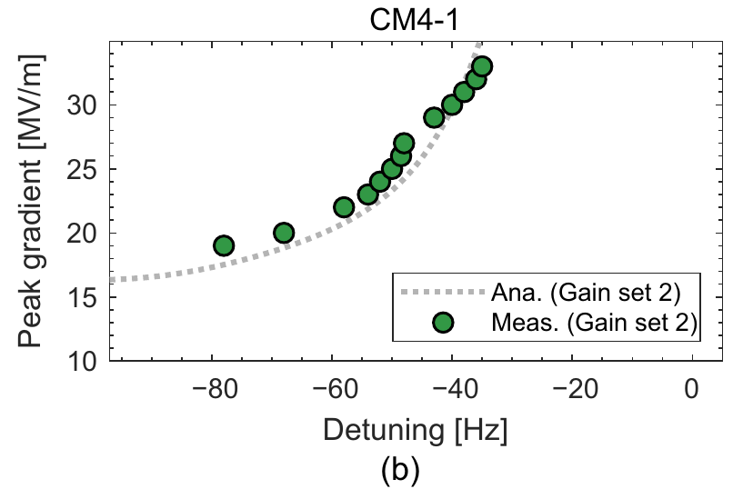
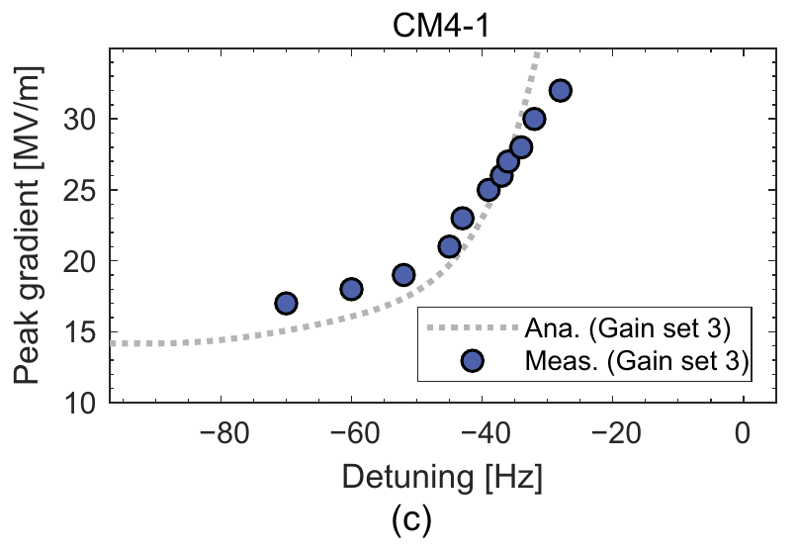
Thresholds under Different PI Gains
Gain set 1
Gain set 2
Gain set 3
A: (1, 150)
P: (20, 2000)
A: (1.4, 200)
P: (10, 1000)
A: (0.7, 150)
P: (20, 2000)
A/P entries give (proportional, integral) gains.
Measured thresholds follow the predicted dependence on the PI gains.
J. Peng, Ponderomotive Instabilities in SRF Cavities, TWoAFC 2026, Nova Gorica, 13 October 2026
21

Slide 21
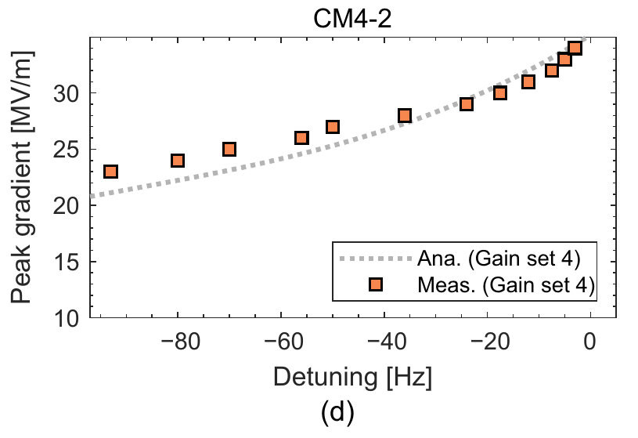
Verification on a Second Cavity
Two cavities, four gain settings
 | CM4-1 | CM4-2
Half-bandwidth | ≈ 103 Hz | ≈ 113 Hz
Gain sets | 1, 2, 3 | 4
CM4-2: gain set 4
Amplitude PI: (1, 250)
Phase PI: (20, 2000)
The agreement extends to a second cavity and a different RF operating condition.
J. Peng, Ponderomotive Instabilities in SRF Cavities, TWoAFC 2026, Nova Gorica, 13 October 2026
22

Slide 22
Diagnosis and Controller Retuning
Cause
An attenuation change altered the effective loop gain
without a corresponding controller recalibration.
Diagnosis
The operating point approached the predicted
oscillatory-instability boundary.
Correction
The model guided controller gain adjustment
to recover stable operation.
RF-chain changes require a check of the effective loop gains and stability margin.
J. Peng, Ponderomotive Instabilities in SRF Cavities, TWoAFC 2026, Nova Gorica, 13 October 2026
23

Slide 23
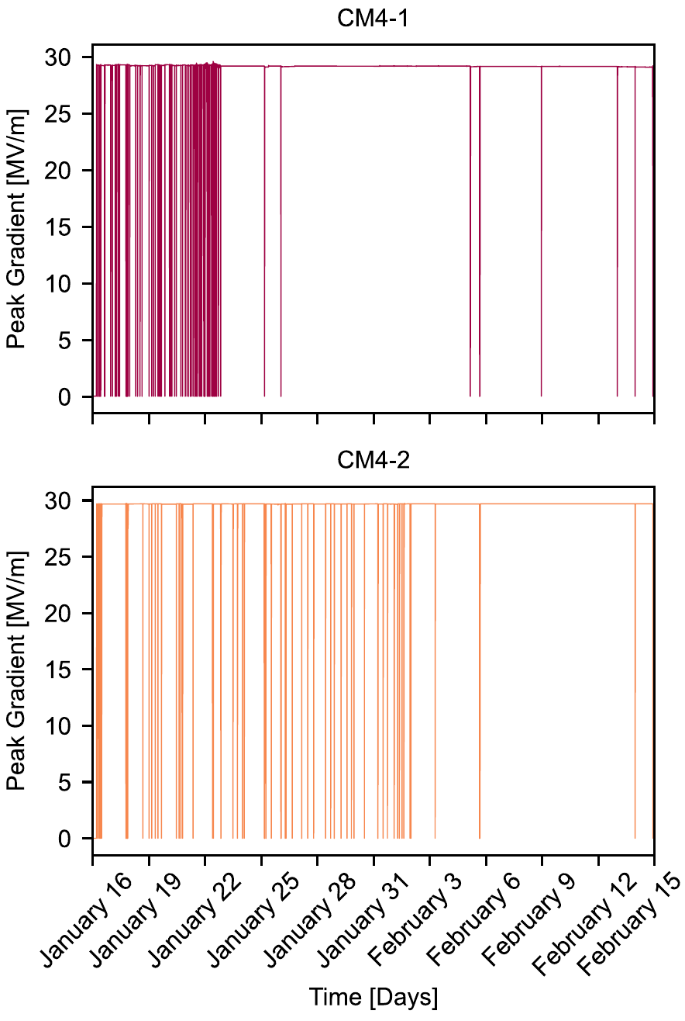
Suppression in Routine Operation
CM4-1
~17 to < 0.4 faults/day
Gain correction: 23 January 2024
CM4-2
~5 to < 0.4 faults/day
Gain correction: 1 February 2024
J. Peng, Ponderomotive Instabilities in SRF Cavities, TWoAFC 2026, Nova Gorica, 13 October 2026
24

Slide 24
01
Introduction
02
Electromechanical Modeling
CONTENTS
03
Experiments & Suppression
04
Summary
J. Peng, Ponderomotive Instabilities in SRF Cavities, TWoAFC 2026, Nova Gorica, 13 October 2026
25

Slide 25
Summary
Mechanical response
The identified modes near 118 and 280 Hz reproduce
measured cavity detuning dynamics.
Stability prediction
The closed-loop characteristic equation connects
PI gains and RF hardware to instability thresholds.
Verification
Two cavities and four gain settings confirm
the predicted dependence of the thresholds.
Suppression
Controller retuning reduced the daily fault rates
from about 17 and 5 to below 0.4.
Stability modeling provides a quantitative basis for reliable LLRF operation.
J. Peng, Ponderomotive Instabilities in SRF Cavities, TWoAFC 2026, Nova Gorica, 13 October 2026
26

Slide 26
Thanks for your attention
Acknowledgments to the IMP SRF and LLRF teams and collaborators
E-mail: pengjiayi@impcas.ac.cn
J. Peng, Ponderomotive Instabilities in SRF Cavities, TWoAFC 2026, Nova Gorica, 13 October 2026
27

Slide 27
Backup: Cavity and Mechanical Parameters
HWR015 cavities in CM4
Identified mechanical modes
Parameter | Value
RF frequency | 162.5 MHz
Loaded Q | 6 × 10⁵–8 × 10⁵
Half-bandwidth | 100–135 Hz
Peak electric field | ≈ 30 MV/m
R/Q | 382 Ω
V꜀ / Epeak | 0.066 m
Static LFD coefficient | ≈ −0.2 Hz/(MV/m)²
Parameter | Mode 1 | Mode 2
fₘ [Hz] | 118 | 280
Qₘ | 15 | 78
Gₘ | −3.4 | −1.55
Epeak denotes peak electric field
throughout this presentation.
J. Peng, Ponderomotive Instabilities in SRF Cavities, TWoAFC 2026, Nova Gorica, 13 October 2026
28

Slide 28
Backup: Characteristic Equations
Open-loop characteristic equation
$$D_{\text{ol}}(s)=(s+ω_{0.5})^{2}+Δω_{0}^{2}+2Δω_{0}H(s)=0$$
Closed-loop A/P characteristic equation
$$D_{\text{cl}}(s)=[s+ω_{0.5}(1+K_{r}\text{cos}{Δθ_{0}})][s+ω_{0.5}(1+K_{φ})]$$
$$+Δω_{0}(1+K_{φ})[Δω_{0}+ω_{0.5}K_{r}\text{sin}{Δθ_{0}}+2H(s)]=0$$
The oscillatory boundary corresponds to a root pair at s = ±jΩ.
J. Peng, Ponderomotive Instabilities in SRF Cavities, TWoAFC 2026, Nova Gorica, 13 October 2026
29

Slide 29
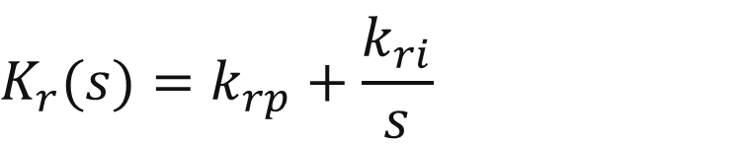
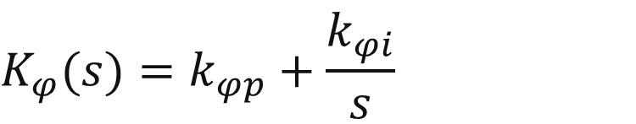
Backup: PI Gain Settings
Set | Cavity | Amplitude (kₚ, kᵢ) | Phase (kₚ, kᵢ)
1 | CM4-1 | (1, 150) | (20, 2000)
2 | CM4-1 | (1.4, 200) | (10, 1000)
3 | CM4-1 | (0.7, 150) | (20, 2000)
4 | CM4-2 | (1, 250) | (20, 2000)
PI controller definitions
$$K_{r}(s)=k_{rp}+\frac{k_{ri}}{s}$$
$$K_{φ}(s)=k_{φp}+\frac{k_{φi}}{s}$$
J. Peng, Ponderomotive Instabilities in SRF Cavities, TWoAFC 2026, Nova Gorica, 13 October 2026
30

Slide 30
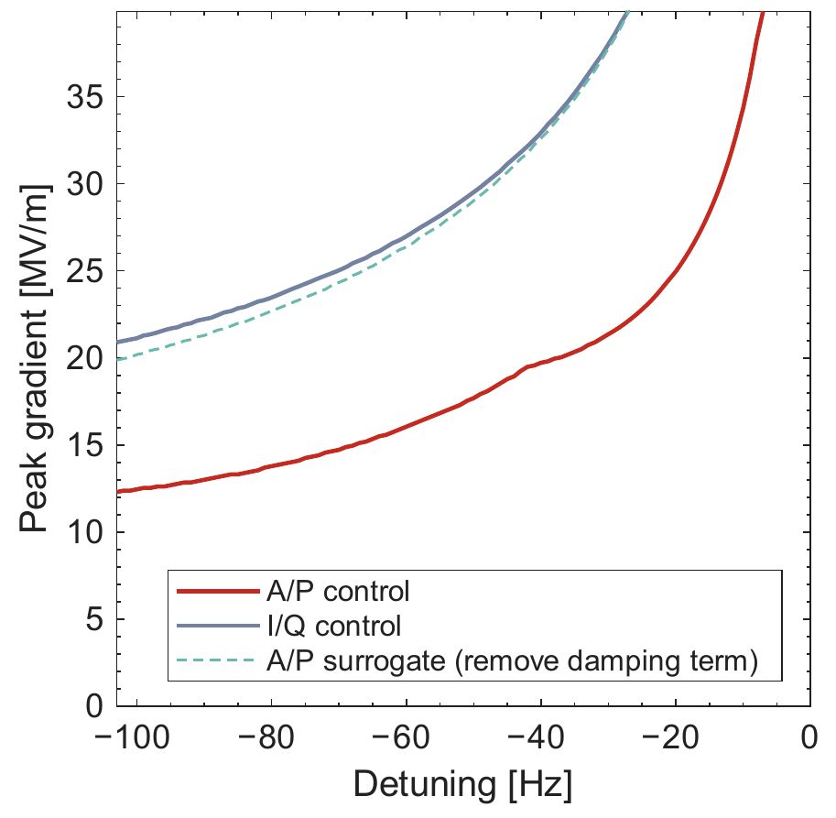
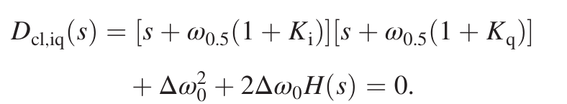
Backup: A/P and I/Q Control
I/Q characteristic equation
The two controller representations
lead to different coupling terms.
Comparison applies to the stated
model and gain settings.
J. Peng, Ponderomotive Instabilities in SRF Cavities, TWoAFC 2026, Nova Gorica, 13 October 2026
31

Slide 31
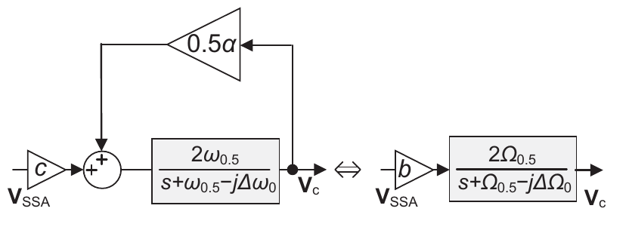

Backup: Impedance Mismatch
Effective cavity parameters
Characteristic equation with hardware corrections
Example for CM4-1: Γ ≈ 0.15 exp(j70°)
J. Peng, Ponderomotive Instabilities in SRF Cavities, TWoAFC 2026, Nova Gorica, 13 October 2026
32

