Slide 1
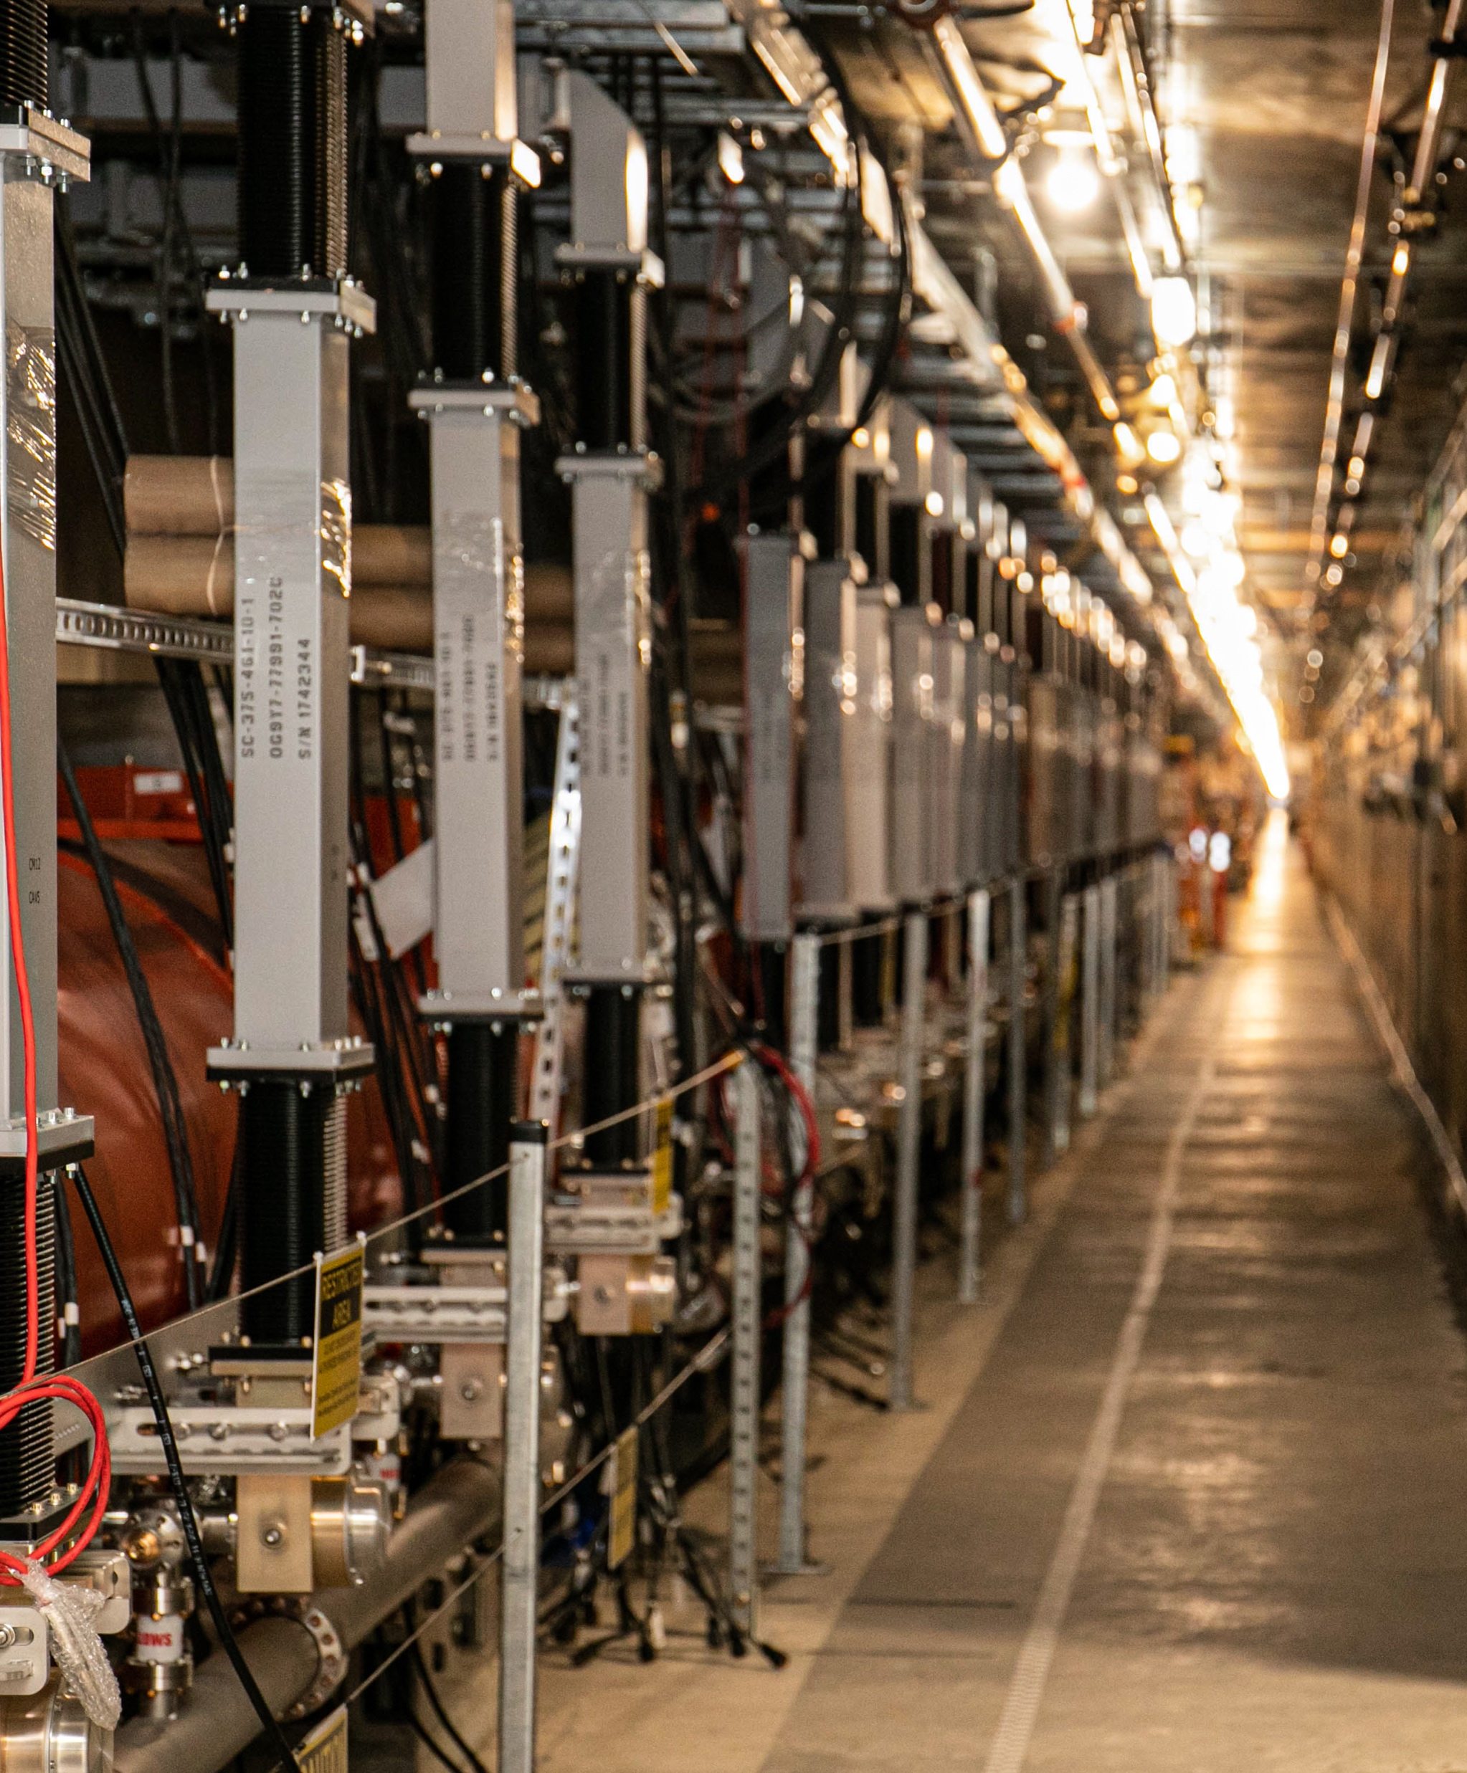
Active Noise Cancellation Measurements on
LCLS-II SRF Cavities
Operational experience with Narrowband Active Noise Cancellation (NANC)
Andy Benwell, SLAC on behalf of many contributors
10/14/26 - LLRF Topical Workshop on Advanced Feedback Control

Slide 2
Content
  Motivation
  Microphonics in LCLS-II
  LCLS-II LLRF System
    LCLS-II LLRF System
    LCLS-II LLRF SEL Regulation and "clipping"
    LCLS-II Resonance Control System
  Narrowband Active Noise Cancellation (NANC)
    Theory
    User Interface
    Test results... Proof of Concept
    Test results.. Improved Gradient
    Test results. Full Cryomodule
  Summary and Conclusion

Slide 3
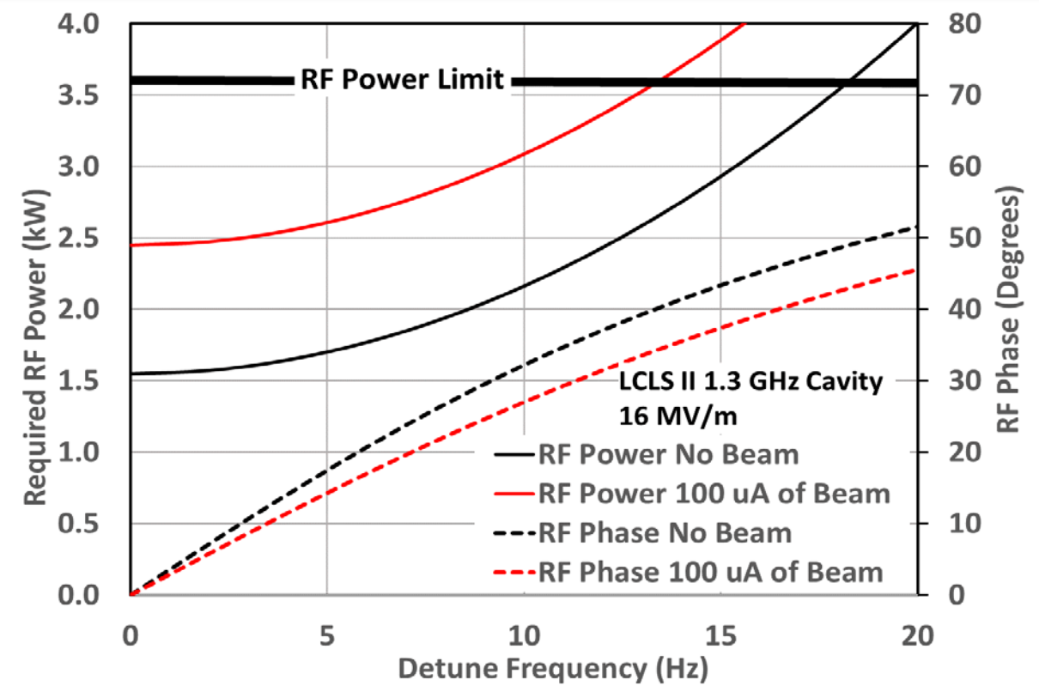
Motivation
Microphonics are the main motivation!
  Microphonics induced detuning can adversely affect high-Q SRF cavities
  The LCLS-II peak detuning limits are < 10 Hz
    Yet we regularly observe that SRF cavities can have detuning of tens of Hertz
  The assumption that we have full SSA power to compensate detuning, is not quite valid (I'll explain why Iater)
  To mitigate severe detuning, various forms of active resonance control (ARC) have been implemented with successful, yet varied, results.
  To operate within its RF Power limits, LCLS-II and its High Energy upgrade, will benefit from a proven and mature ARC system.

Slide 4
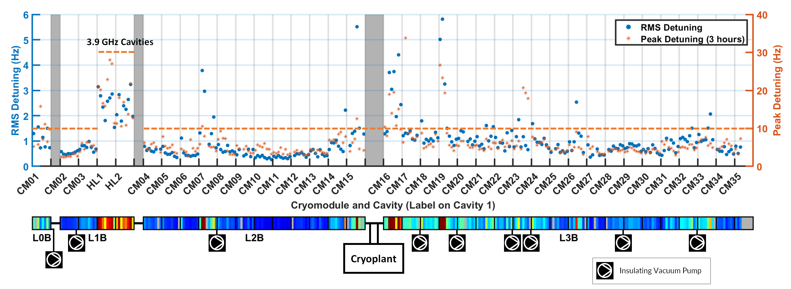
Microphonics in LCLS-II
  Some cavities in LCLS-II are gradient-limited due to microphonics.
    The main source of microphonics are liquid helium valves, vacuum pumps, and cool-down valve leaks.
  Similar effects can be expected in LCLS-II-HE
    Yet even higher gradient operation will be expected from those cavities.

Slide 5
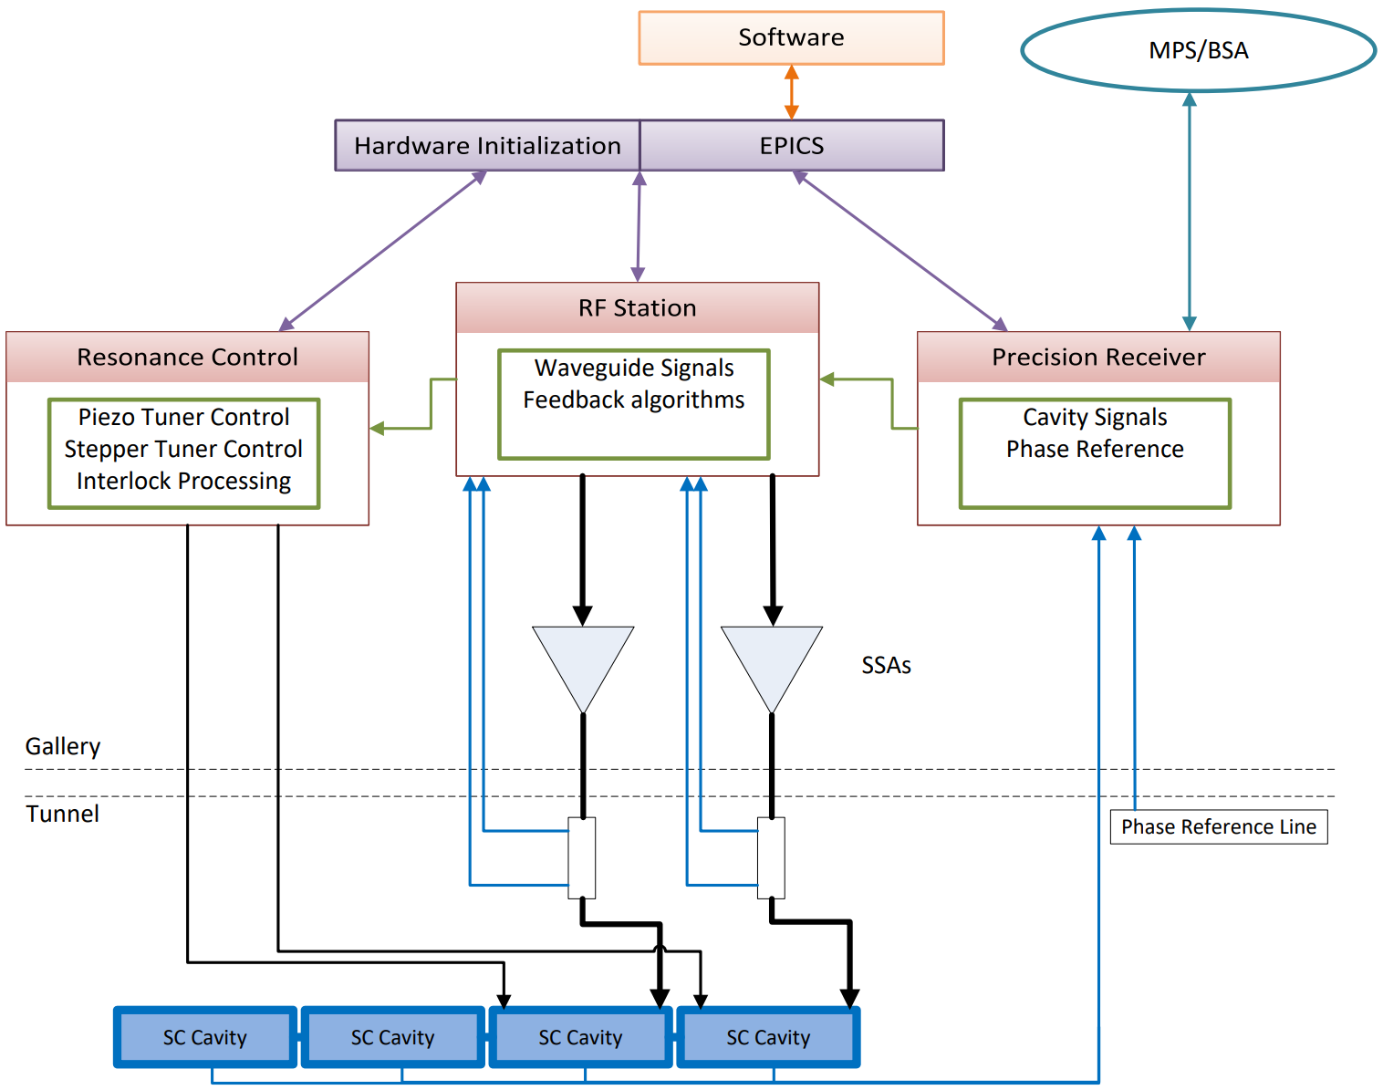
LCLS-II LLRF System Details
Hardware/Firmware
Precision Receiver Chassis (PRC)
  Exclusively for cavity signals
  Fiber communication for high Isolation necessary for 0.01°/0.01%
RF Station (RFS)
  Generates independent RF signal for 2 cavities
  Forward, Reverse and SSA Drive signals
  Detune frequency calculation, PI loop control
Resonance Control
  Piezo Tuner Control
  Stepper Motor Control
  Temperature Monitoring
  Interlock processing
Software
  Automated Scripting
    Cavity and SSA characterization
    Piezo transfer-functions
  Smooth transition between modes
  Channel Access
EPICS
  All control displays and waveform readouts
  Cavity control interface
  Modes of Operation
  Hardware health

Slide 6
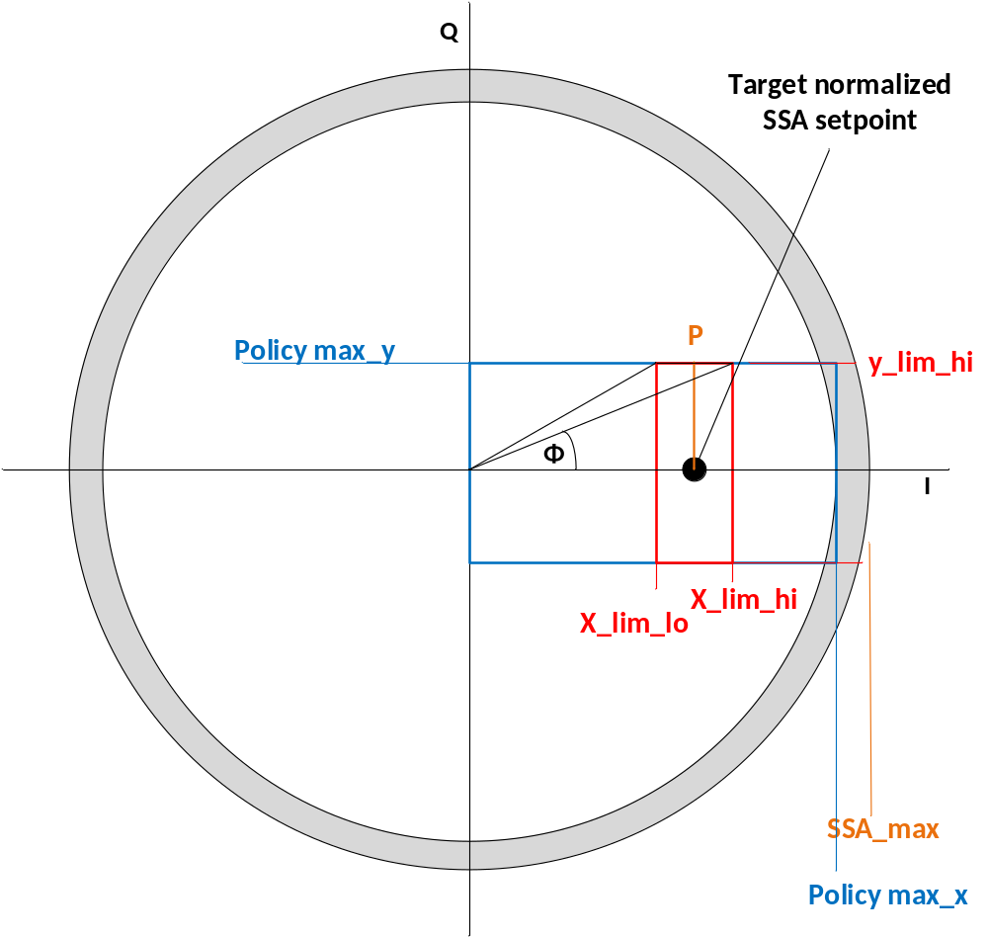
LLRF System Clipping
For SELAP operation a series of limits are applied to the available RF amplitude to prevent oscillations and instabilities from high gain feedback
The gradient "Target” is calculated from the desired amplitude and is based on cavity and system scaling parameters.
The RF "Target" is the nominal setpoint for the RF FWD Power
Policy maximum X and maximum Y are estimated to form the basic frame for total drive and I & Q in SEL mode
X and Y limits (lo and hi) form the upper and lower bounds for SELAP operation …. the “clip limits” for SELAP operation
  Note that x_lim_hi is NOT the same as the SSA_max!!
If the cavity goes beyond the y limits, it will exit SELAP and enter SELA in order to preserve cavity amplitude and prevent Lorentz force induced faults.
  We refer to this effect as "Clipping"

Slide 7
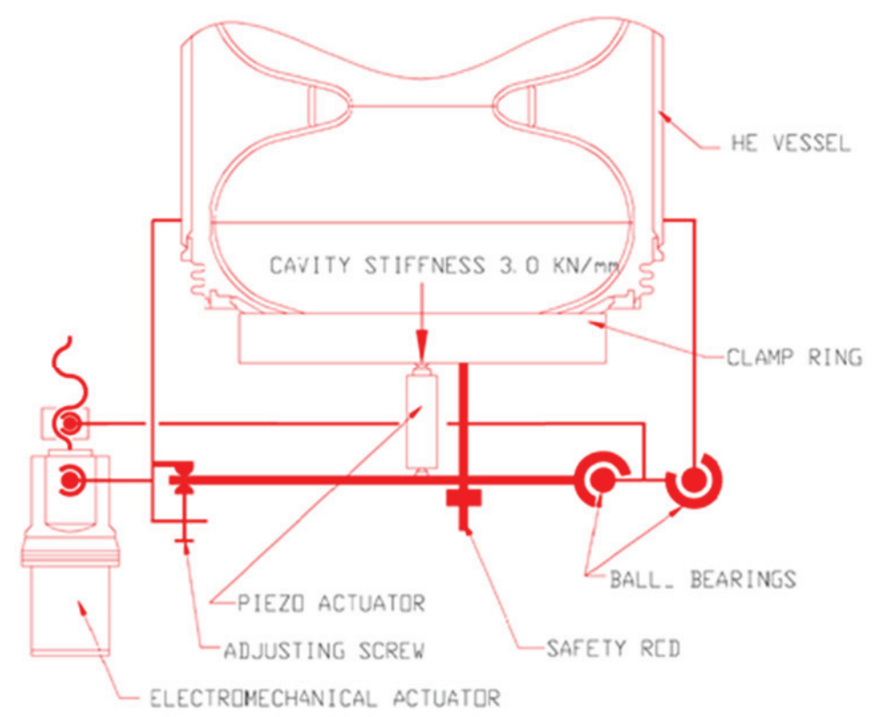
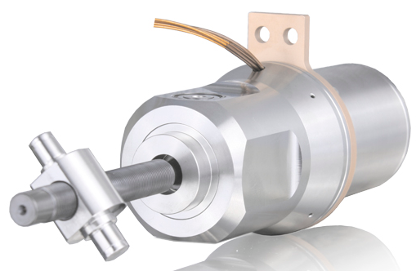
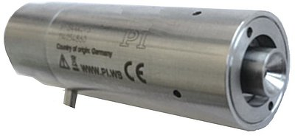
LCLS-II Resonance Control System
The LCLS-II LLRF system makes use of two mechanical tuners for cavity control
Coarse tuning over hundreds of kHz is performed by a stepper motor tuner: Phytron LVA-52
  Manual tuning mode only
  Turned off with no holding current when the cavity is tuned
Fine tuning is performed by a piezoelectric tuner assembly: Physik Instrumente P-844K075
  Nominally runs with low bandwidth feedback enabled (<5Hz)
  Higher frequency feedback modes are avoided to prevent driving mechanical eigenmodes leading to instabilities

Slide 8
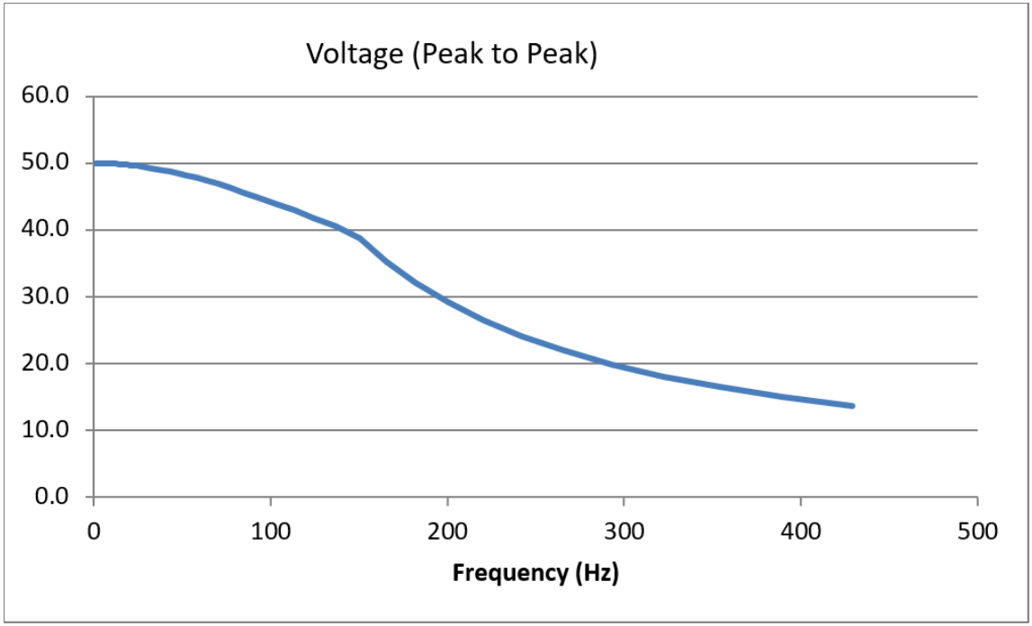
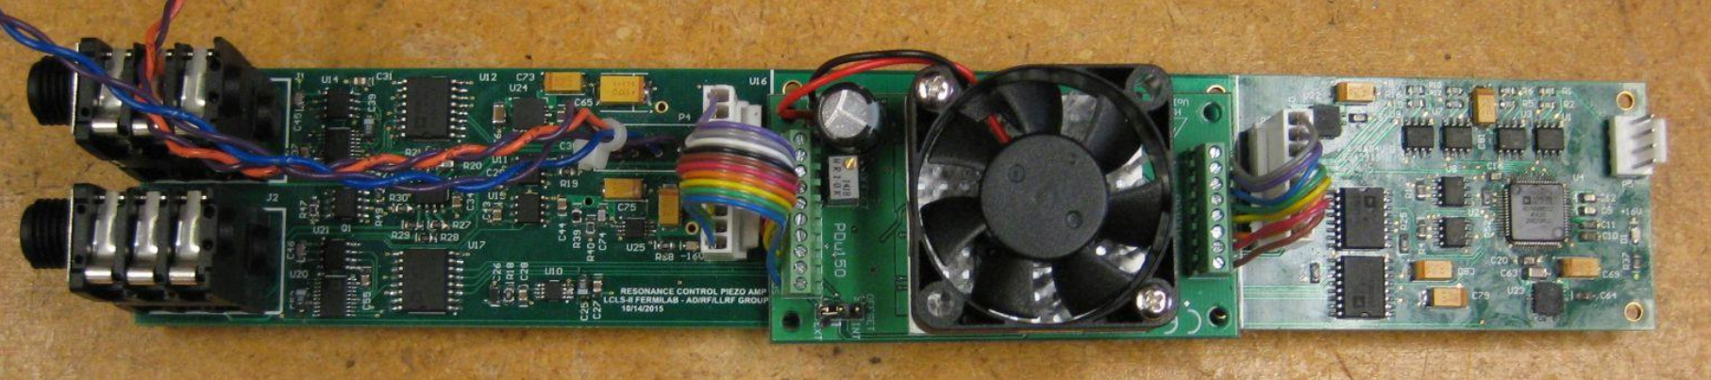
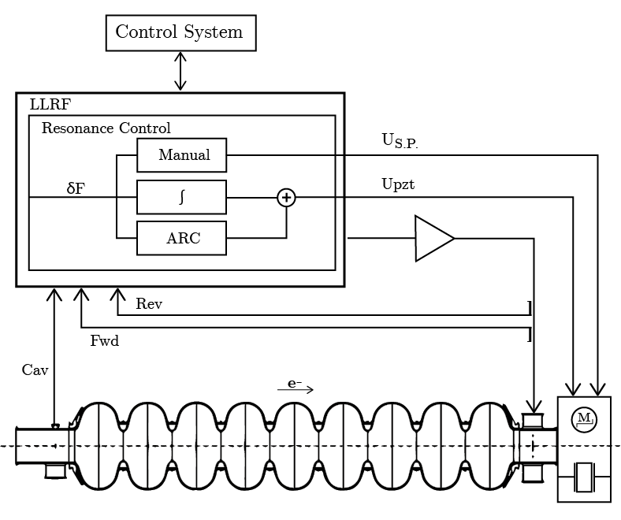
LCLS-II Piezo Tuner System
The piezo tuner system provides continuous fine control of the cavity natural frequency
The tuner is driven by a PDU150 amplifier with output voltage limits set at 50 Vpp
Two modes of operation are normally used
Manual, including a DC bias to center the useable range of the piezo controller
Integrator feedback for low frequency detuning correction
Both "normal" modes of operation can take advantage of the full piezo tuner range​
In LCLS-II firmware Active Resonance Control is control is summed with the standard integrator feedback mode compensates for detuning in at higher frequencies, up to 200 Hz​
Of concern, some power bandwidth limitations exist in the PDU150, but not too much over frequencies of interest for detuning​

Slide 9
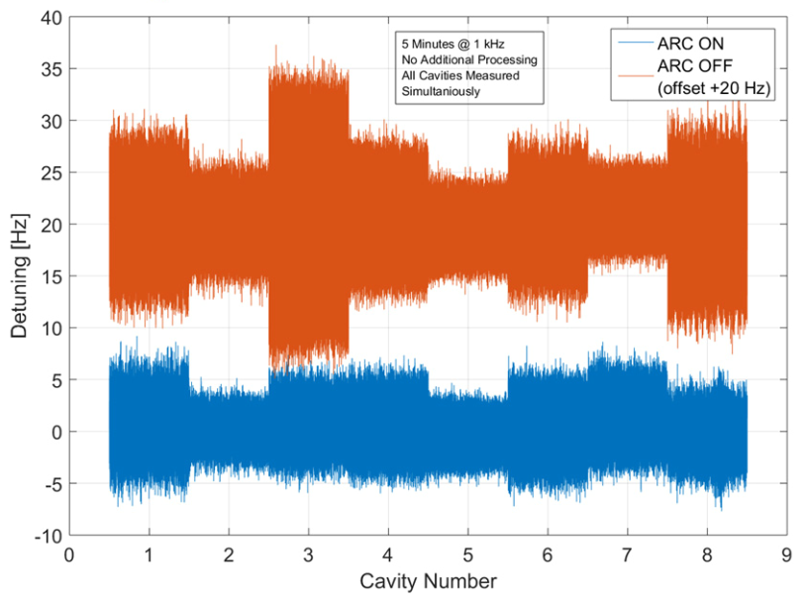
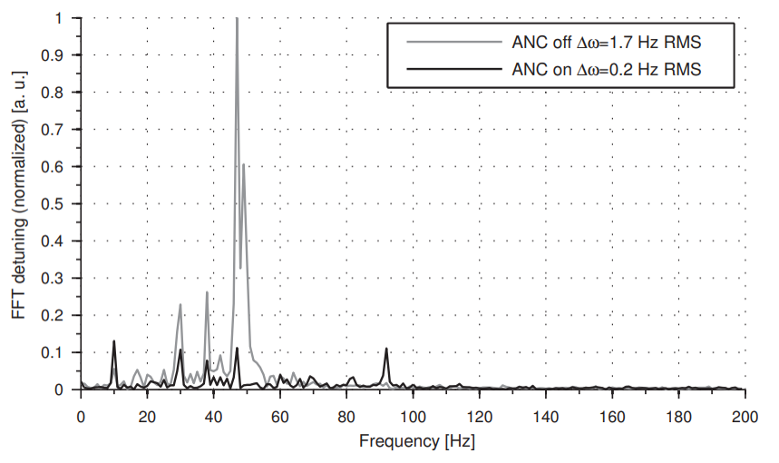
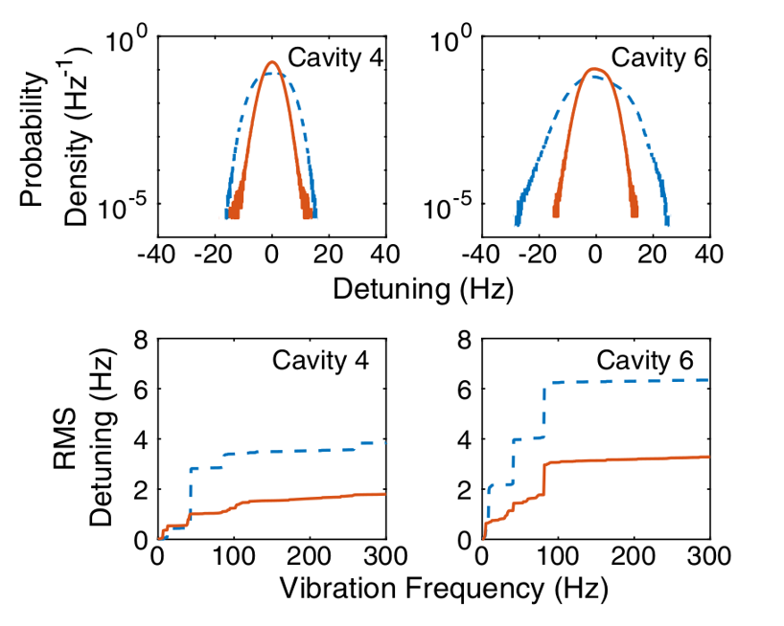
Narrowband Active Noise Cancellation (NANC)
  Over the years, and external to LCLS-II, Active Resonance Control efforts have yielded positive outcomes
  FNAL effort reduced detuning by x2 with a comb filter
  DESY / Cornell reduced detuning by as much as 20 dB with a NANC style approach
  In 2020, SLAC used the DESY approach with the direct help of Andrea Bellandi, and began development of a real time adaptable - Narrowband Active Noise Cancellation algorithm
  In 2025, the system was generalized for the LCLS-II LLRF platform with open-source code
  Our ongoing goal has been to adapt this proven system for LCLS-II LLRF and make it widely deployable for use in LCLS-II operations and for LCLS-II HE commissioning
FNAL
DESY
Cornell

Slide 10
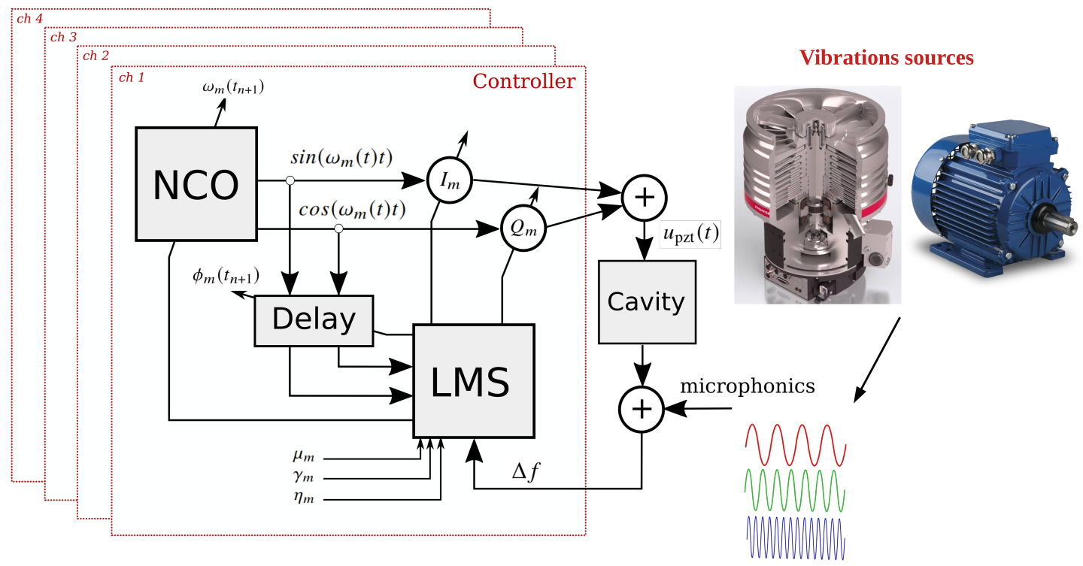
Theory – Noise Cancellation
NANC focuses on canceling specific narrow band detuning oscillations that can shift in frequency (and amplitude)
External microphonic disturbances are assumed to be sources of superimposed sinusoidal signals of unknown phase, amplitude and frequency
A Numerically Controlled Oscillator (NCO) in the piezo tuner controller is used to generate a sinusoidal signal.
The signal is modulated by an I&Q vector to change frequency, phase and amplitude.
To match (or cancel) the detuning disturbance, a Least Mean Square (LMS) algorithm adapts the I&Q.
To estimate the I&Q correctly, the actuator delay has to be calculated as well
Shown here: 4 parallel noise cancelling signals being generated by the NANC controller, each minimizing a microphonic frequency peak of concern

Slide 11
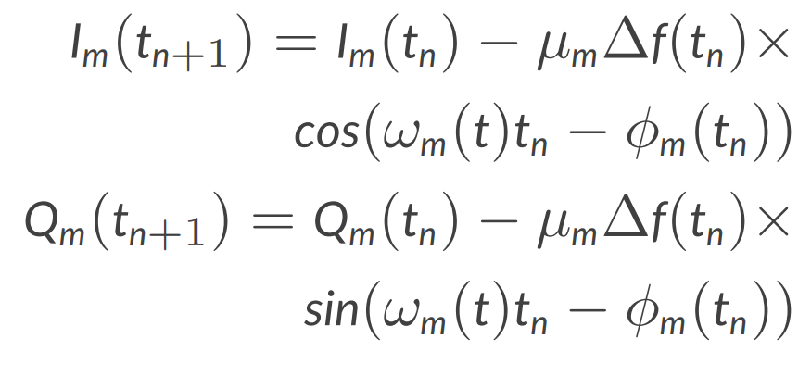
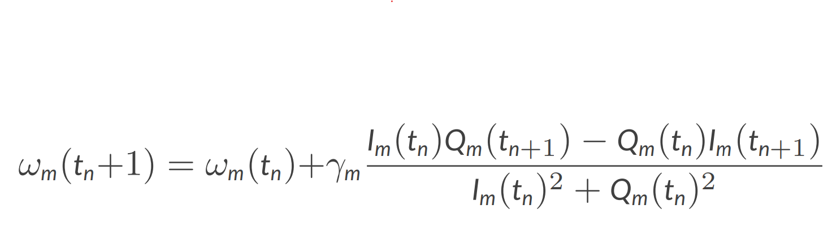
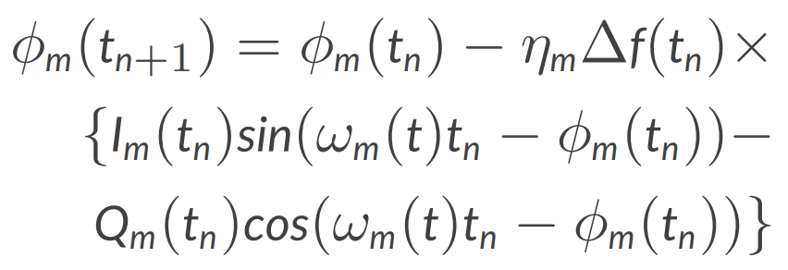


Theory - Adaptation
I&Q Adaptation
Frequency Adaptation
Chain Delay Adaptation
We found no need to use delay adaption rate in this system.
It is folded into I&Q adaptation

Slide 12
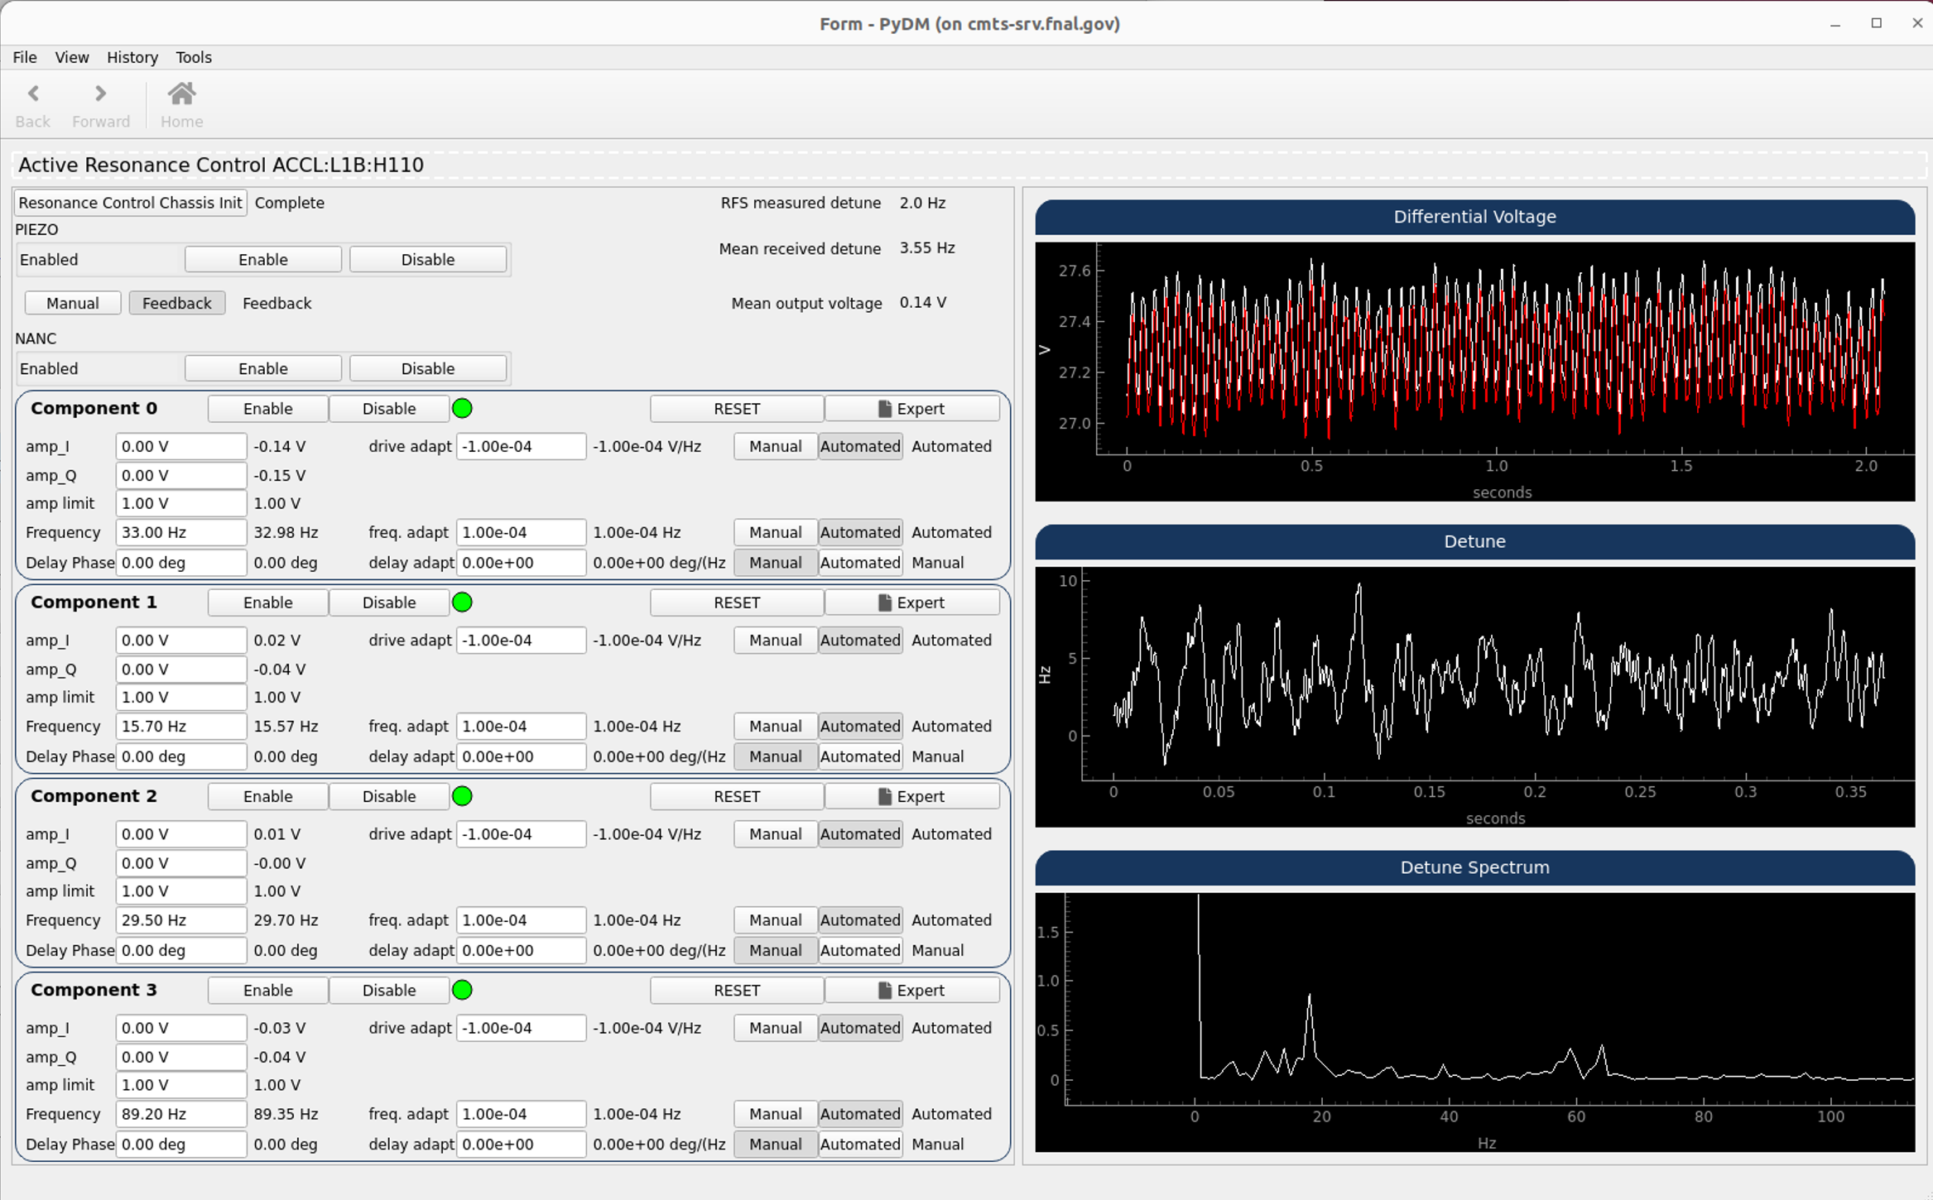
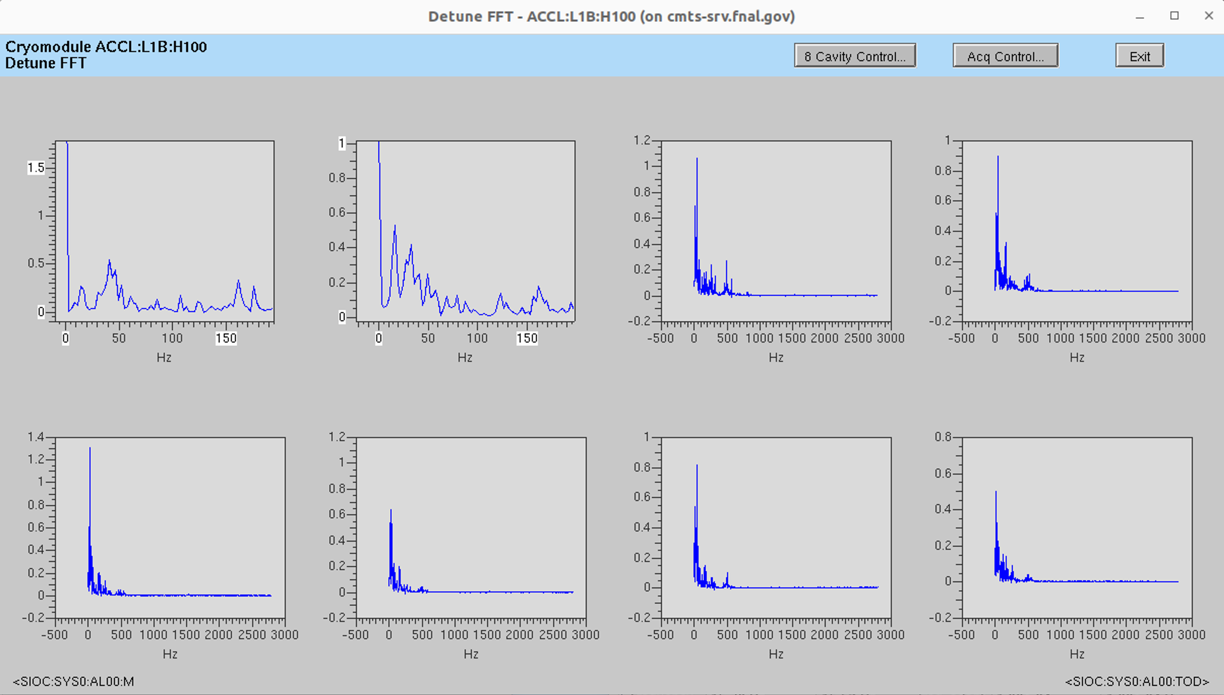
User Interface for Individual Cavities
The expert level User Interface enables individual control of every cavity while observing detuning of all cavities
Up to 4 frequencies per cavity can be acted upon by NANC (32 "components" for the entire 8 cavity cryomodule)
Each component has independently settable attributes
Enable/disable
Amplitude limits
Amplitude adaptation speed
Frequency search range
Frequency adaptation speed
Manual / Automatic
Delay phase
Delay adaptation rate

Slide 13
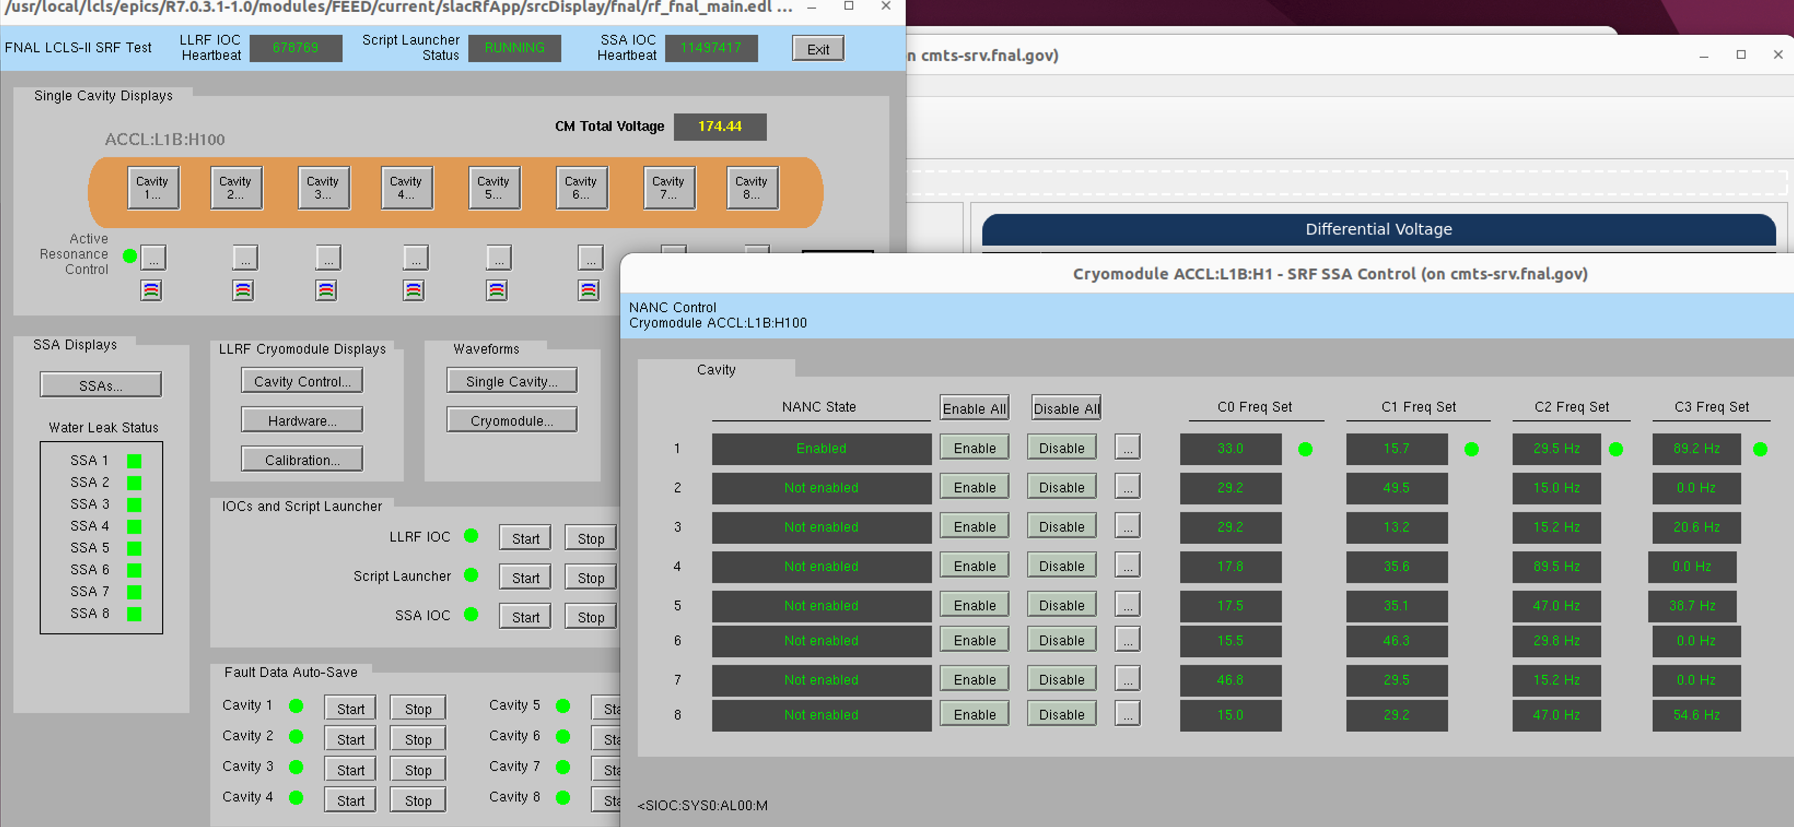
User Interface for Full CryoModule
Global control of NANC for a full crymodule is being developed to simplify use at scale.
Enable/Disable full CM control
Enable/Disable full cavity control
Enable/Disable individual components

Slide 14
Testing so far
SRF tests on the NANC system have occurred over several rounds as opportunities
2020 @ LCLS-II proof of concept with a single frequency and single cavity operation
2020 @ LCLS-II proof of concept with multiple frequencies on a single cavity
2025 @ LCLS-II over several hours while observing a cyclical pressure driven disturbance
2025 @ LCLS-II increasing gradient to beyond microphonics limited operation
2026 @ FNAL HE Cryomodule Test Facility (CMTF) controlling multiple frequencies and multiple cavities
2026 @ FNAL HE CMTF with artificially induced sources of detuning
2026 @ FNAL HE CMTF during an 8-hour full Cryomodule unit test

Slide 15
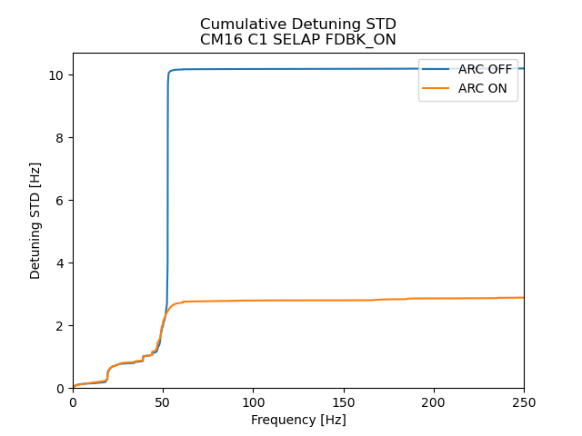
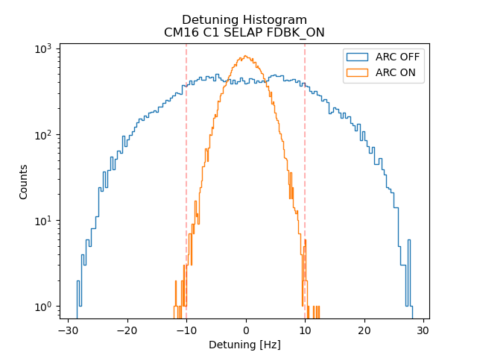
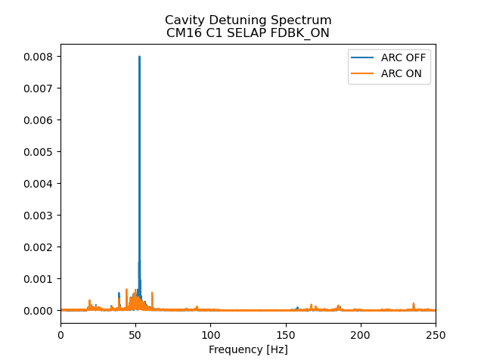
Single Cavity, Single Frequency
Performed during a proof of concept test on a single particularly noise cavity
Other cavities in the cryomodule were off
Gradient was set to a low value due to microphonics

Slide 16
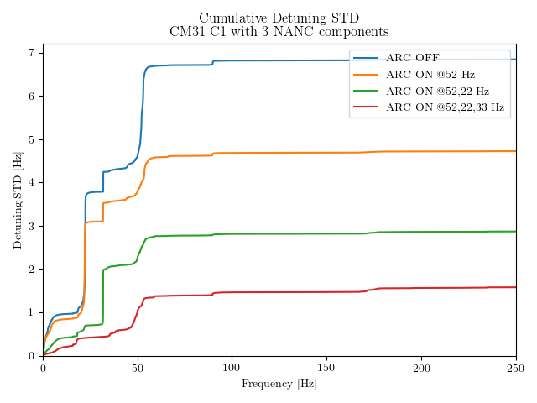
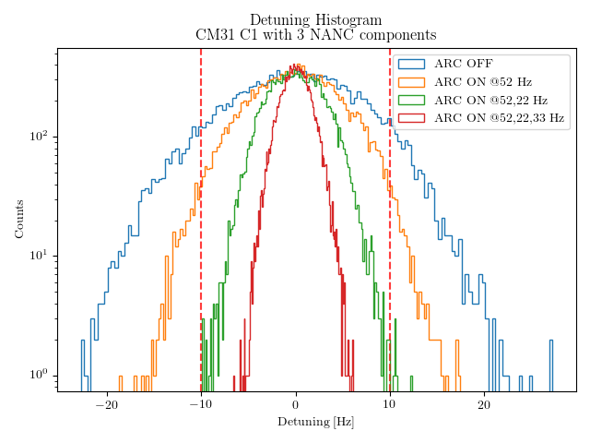
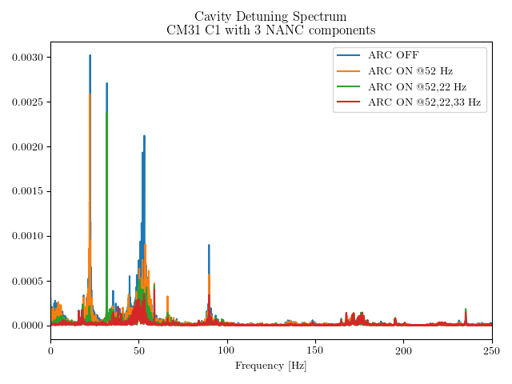
Single Cavity, Multiple Frequencies
Compensation for 3 sources of detuning
Other cavities in the cryomodule were off
Gradient was set to a low value due to microphonics

Slide 17
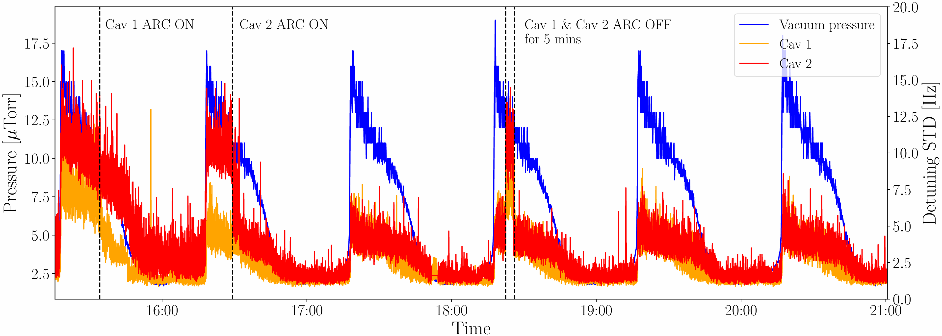
Adapting to changing conditions
First test for improving a true, well understood source of instability in the LCLS-II Linac
A small cryogenic distribution leak during the LCLS-II initial run resulted in periodic vacuum spikes with correlated microphonic disturbances in the downstream linac cavities
This condition encouraged us to test NANC under changing conditions to observe the effect of system adaptability
Under NANC, cavities were within the LCLS-II detune specifications at the target gradient

Slide 18
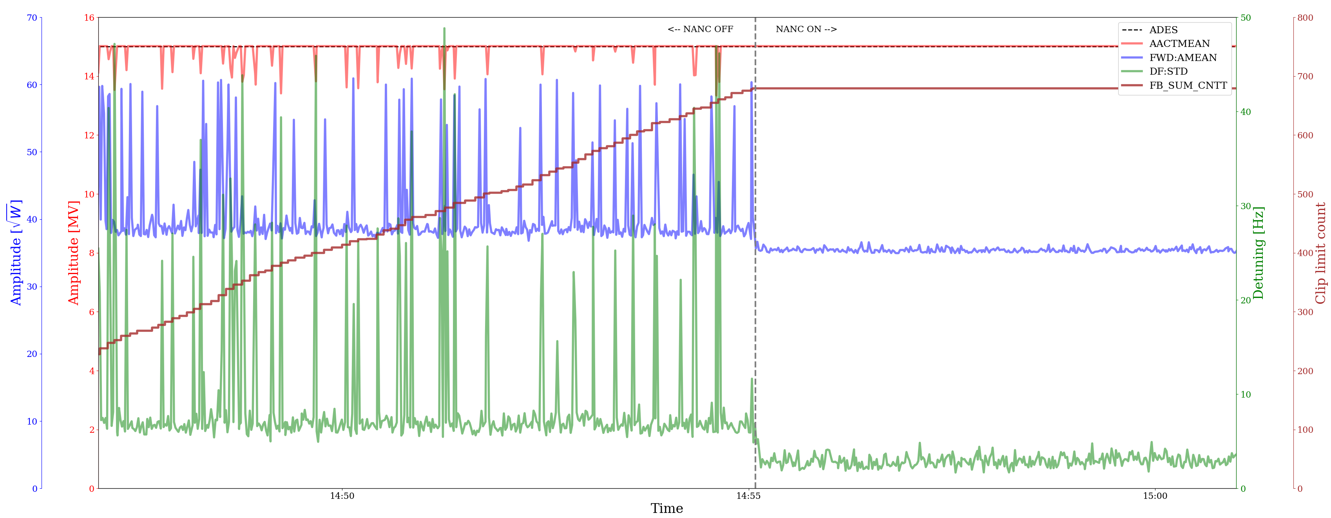
Improving High Gradient Stability
Gradient of CM19 Cavity 2 normally limited to 9MV due to microphonics induced instability
At 15 MV operation the cavity exhibits frequent clipping
With NANC enabled, cavity gradient was stable at 15MV for the duration of the test

Slide 19
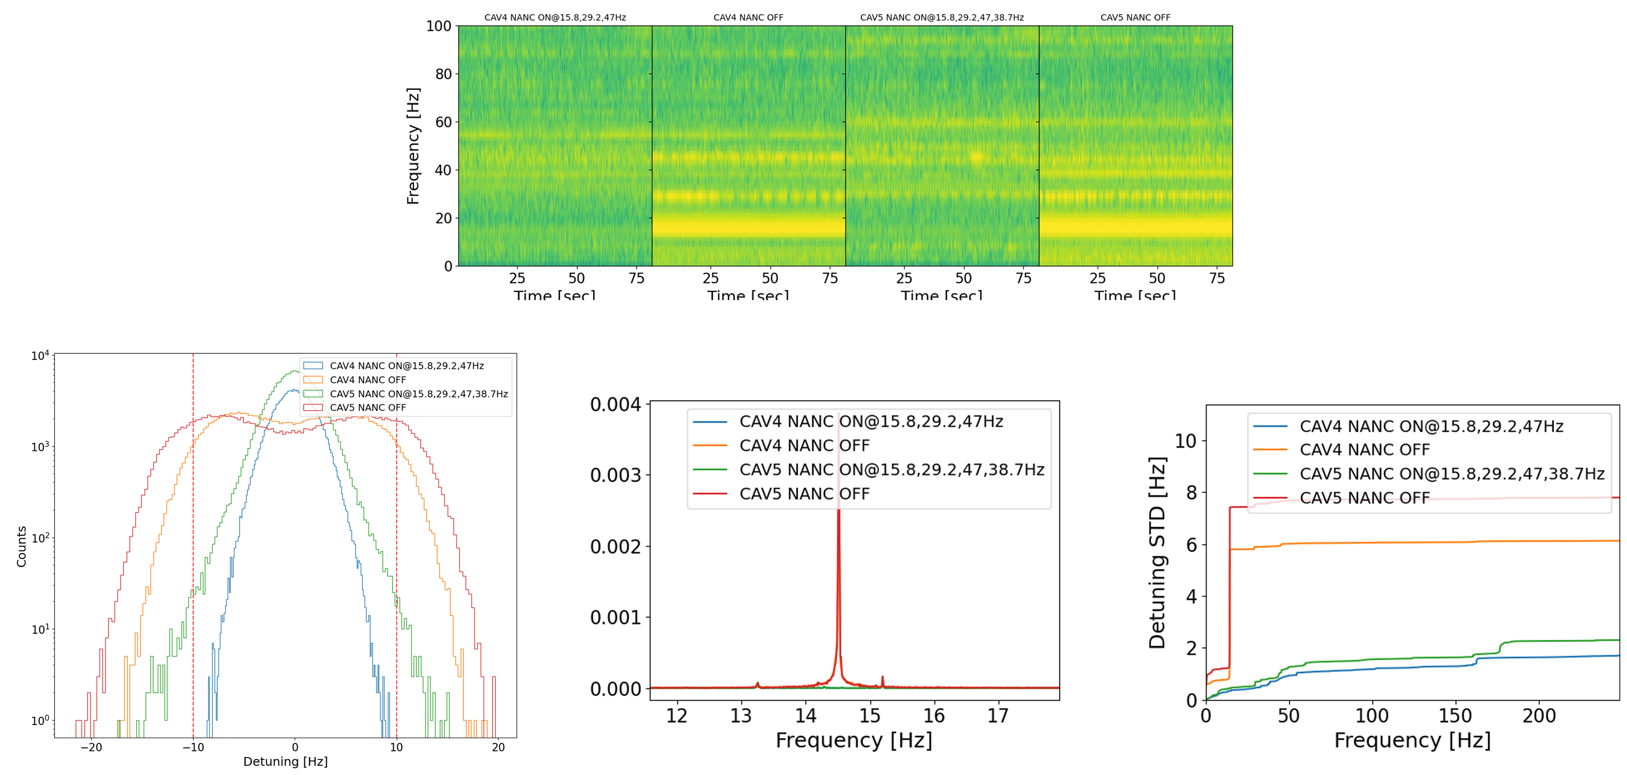
Multiple Cavities Simultaneously Controlled
Two neighboring cavities, simultaneously configured for multiple frequencies
Cavity 4
Cavity 5
NANC On
NANC Off
NANC On
NANC Off

Slide 20
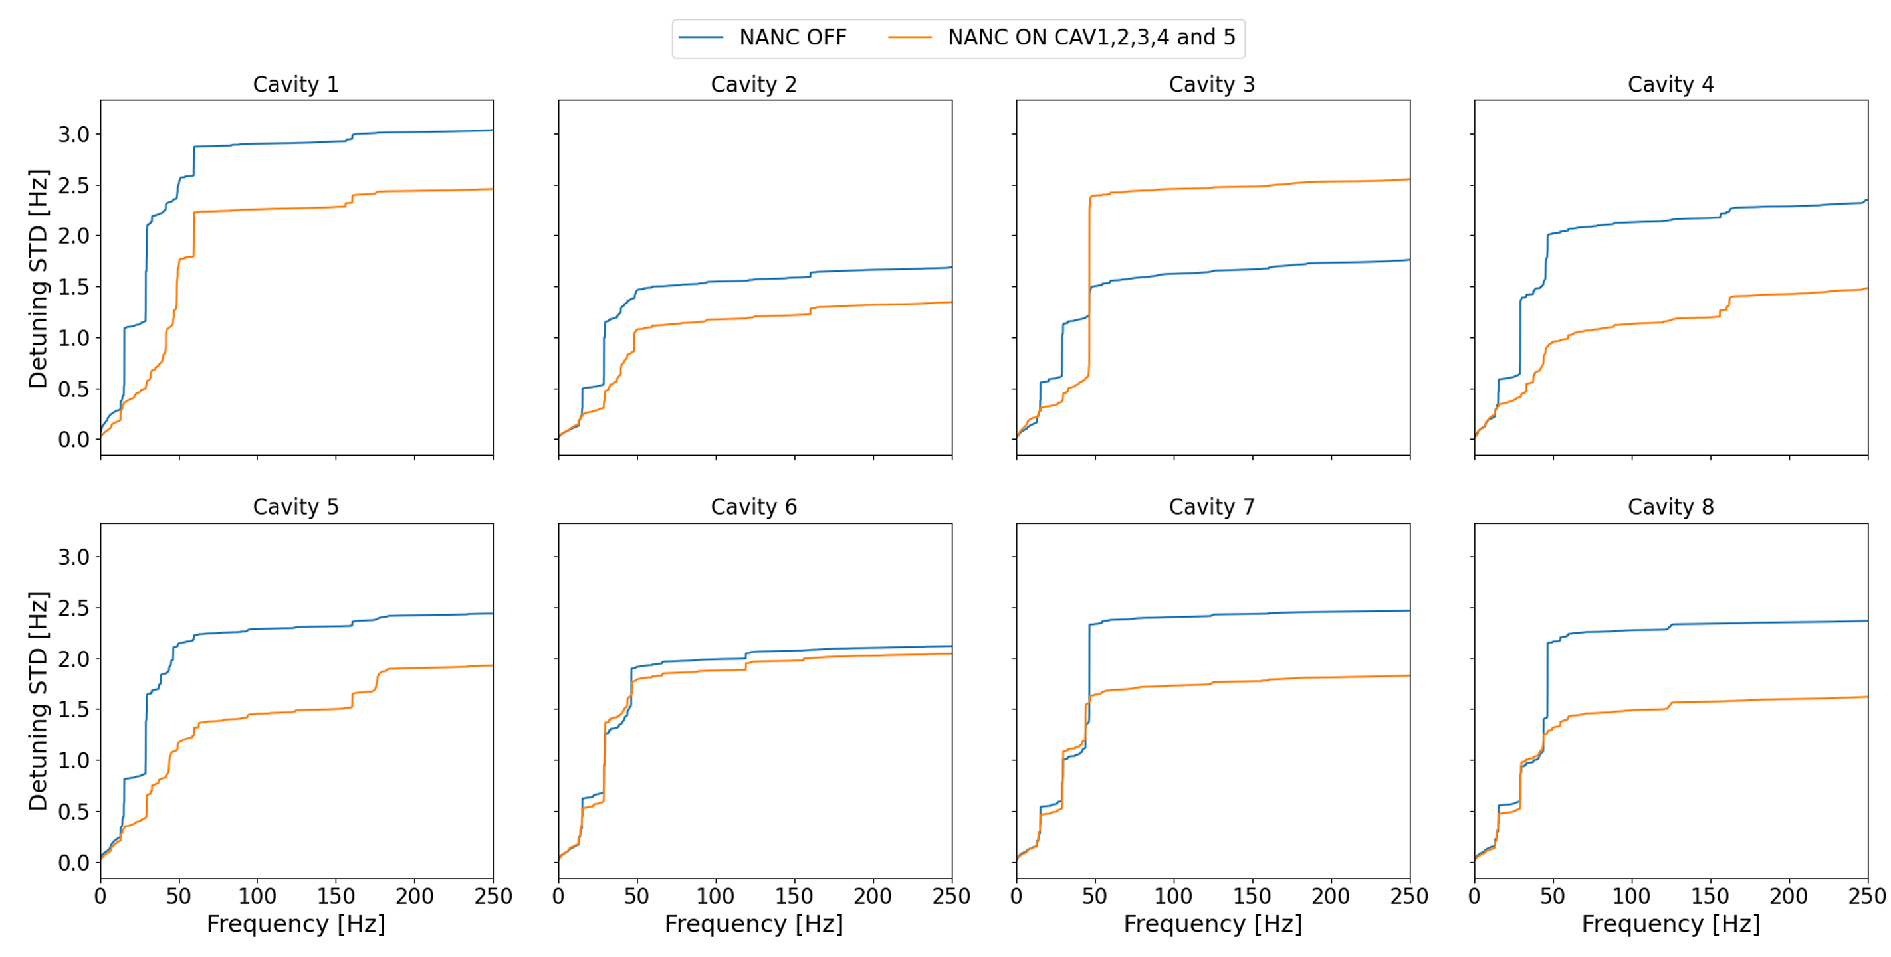
NANC exciting modes other cavities
When 5 of 8 cavities were controlled for multiple frequencies, we noticed some instances of mechanical "crosstalk"
Cavity 3 exhibited greater detuning when certain frequencies from cavity 4 were dampened

Slide 21
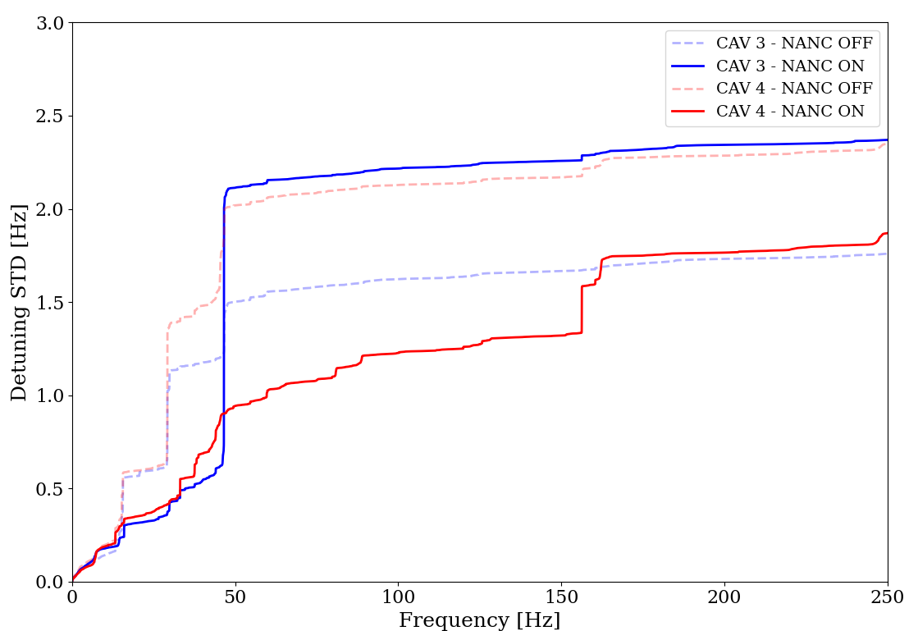
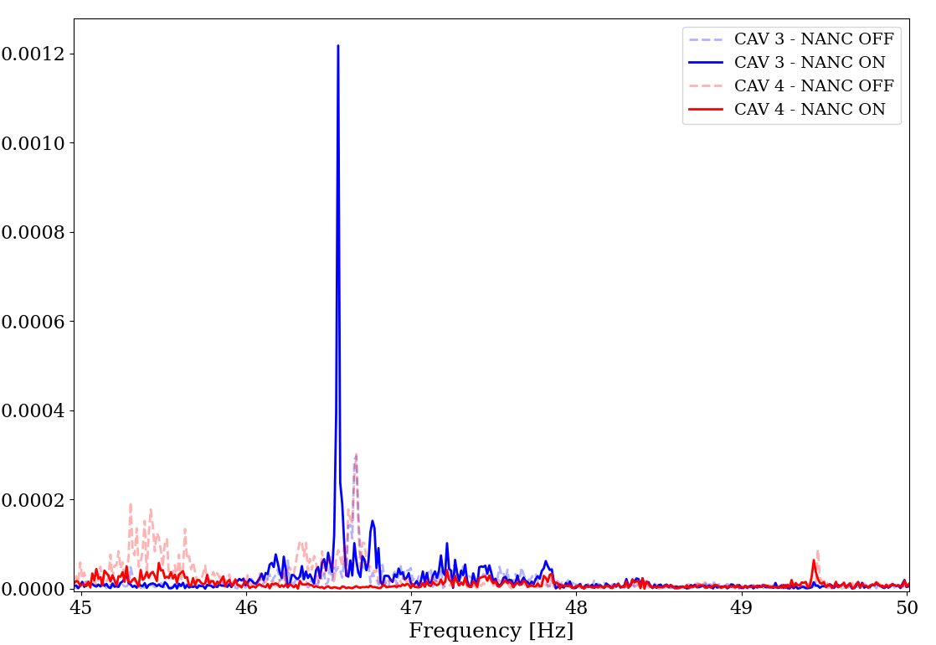
Mechanical Eigenmodes
A natural mechanical mode of cavity 3 was excited when a cavity 4 microphonic source was being dampened
This became more apparent when trying to operate cavity 3 with NANC enabled to suppress the eigenmode
Clearly some frequencies must be avoided by NANC to prevent exciting them which results in severe detuning
And in some cases, NANC can excite mechanical modes in neighboring cavities
These modes should be measured and catalogued prior to broad deployment of NANC

Slide 22
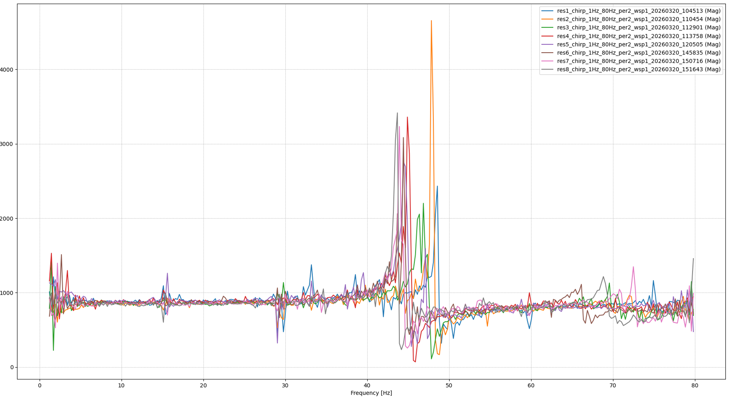
Measuring and Cataloging Eigenmodes
Performing piezo tuner "chirps" enable the characterization of mechanical eigenmodes
Piezo tuners are driven with a small sinusoidal wave at low frequency with RF enabled
Natural cavity modes are observed in the transfer function waveform
These modes are then catalogued so that they can be avoided by the NANC controller
These modes were already known and well understood by the cryomodule experts we tested with!
NANC will not dampen out natural modes of the cavity and they should be avoided.
Cavity | 1 | 2 | 3 | 4 | 5 | 6 | 7 | 8
Dominant Mode (Hz) | 47.5 | 47 | 45.5-46 | 45 | 44.5 | 44.5 | 44 | 43.5

Slide 23
Summing up
NANC has become a powerful tool for suppressing external sources of mechanical detuning of SRF cavities.
Even though its promise was apparent from early testing, system maturity took many years of incremental development.
Integration into the LCLS-II and LCLS-II HE control system is now under way.
  The LCLS-II HE commissioning effort may benefit immediately with the use of NANC to mitigate any currently unknown sources of microphonic instability.
  The system is ready to drop in "as needed" for mitigating local microphonic problems and help prevent hasty repairs,
  Or the system could simply be broadly used to minimize cavity detuning.
While NANC is ready for use, there are some improvements already underway
  The NANC system is implemented with an open-source RISC-V softcore processor on an FPGA
    Adaptation toward a pure firmware-based approach will increase the bandwidth of the system, and possibly reduce FPGA resource consumption
  Other broadband approaches are being considered and tested by team members at LBNL, SLAC and FNAL – please take the time to look up their efforts if you are interested in this work

Slide 24
A Long-Term Team Effort
  Development of this system from concept and through several rounds of development to its current mature form has been a long-term effort
  This work has been a true team effort. THANK YOU:
    to DESY and Andrea Bellandi for kicking off the effort at SLAC in 2000
    to Sebastian Aderhold, Lauren Alsberg, and the entire SRF team at SLAC for providing occasional opportunities to test NANC on LCLS-II, and support for travel to CMTS
    to Jorge Diaz and Sonya Hoobler for the many rounds of incremental improvement in the system
    to Bozo Richter (again at DESY) for adapting the system to an open-source platform enabling it to be broadly supported by the LCLS-II LLRF system
    to the Shree Murthy and Du Qiang and the entire LBNL LLRF team for assisting firmware development and all the tools and scripts for making this system work properly
    to our partners at FNAL, particularly the team at the Cryomodule Test Facility led by Andrew Cravatta for the many hours of SRF testing time, and for your expertise and suggestions

