Slide 1

Deterministic RF Parameters Transmision over White Rabbit Network
LLRF Workshop 2026
13-10-2026
Juan Fernández
juan.fernandez@nav-timing.safrangroup.com
Javier Carmona
javier.carmona@nav-timing.safrangroup.com
Guillermo Albacete
javier.carmona@nav-timing.safrangroup.com

Slide 2
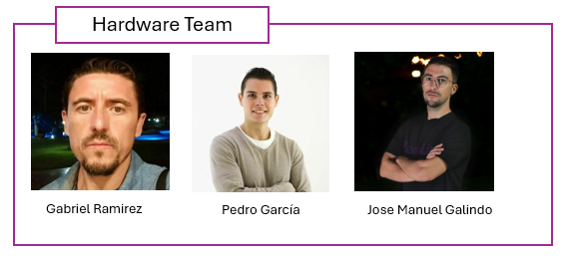
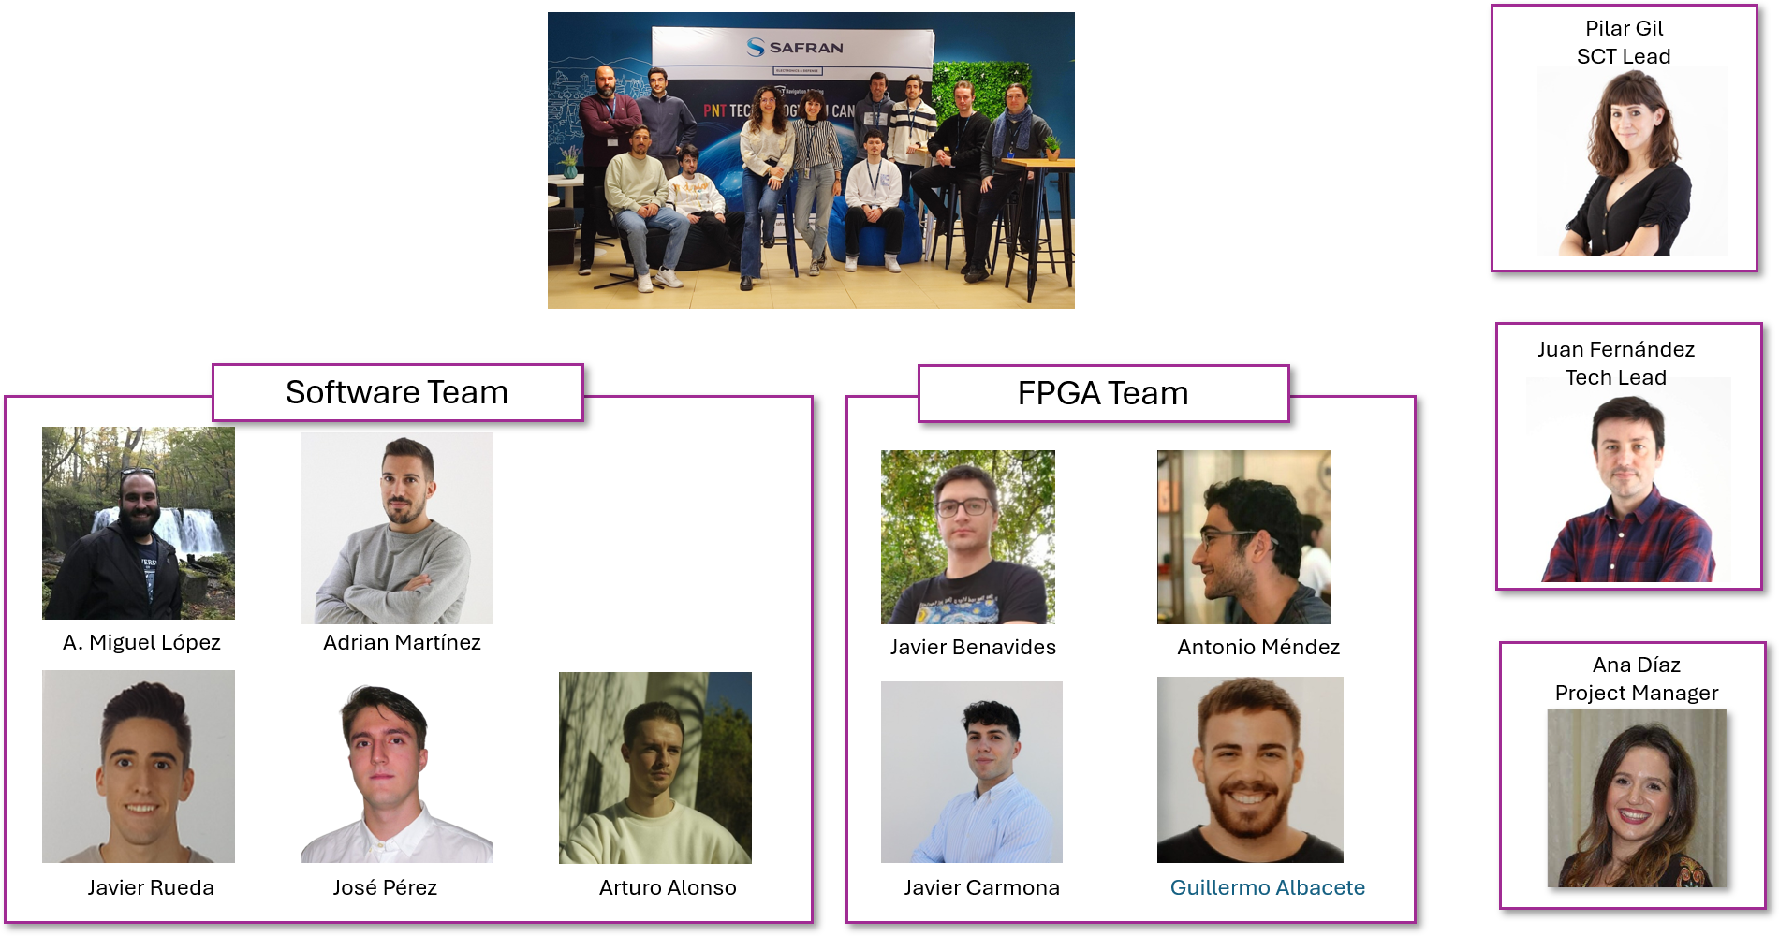
01 – Safran Spain – SCT department
SCT Team

Slide 3





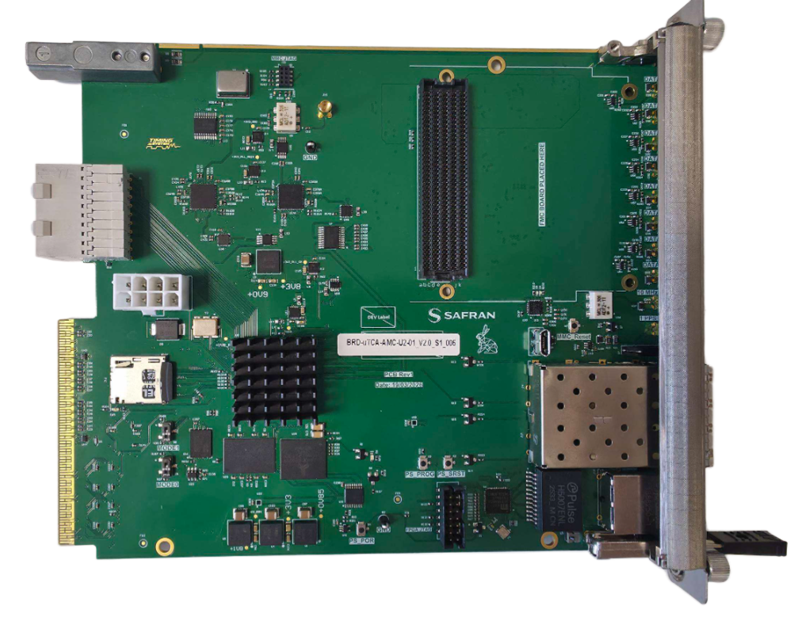
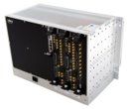
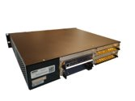
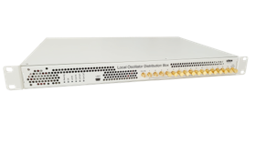

01 – Safran Spain – SCT department
Team areas of expertise:
Ultra-stable low-noise RF electronics
Customized or standard crates (Compact PCI-e Serial, uTCA or standalone solutions).
Real-time embedded system based on the latest FPGAs and SoCs.
Individualized Control system Solutions based on EPICS frameworks (EPICS, TANGO).
RF distribution.
High reliable and real-time diagnosis and post-mortem analysis.
Fast data acquisition systems.
Adaptive Fast-control systems.
Products & servicies:
RF generation and distribution
LLRF – Precise Low Level RF generators
BPMs – Beam Position Monitors
MPS – Machine Protection System
Timing systems – Precise triggers generation
Software & Services
LLRF Workshop 2026

Slide 4
02 – Experiment
An old idea: Recreating RF in a distributed and synchronized way.
T. Włostowski, J. Serrano, G. Daniluk, M. Lipiński, and F. Vaga, “Trigger and RF Distribution Using White Rabbit,” Proc. ICALEPCS 2015, Melbourne, Australia, paper WEC3O01, pp. 619–622, 2015.
Why?
Offer a uTCA alternative.
Test the suitability in distributed control with Master-Slave scenarios.
LLRF Workshop 2026

Slide 5
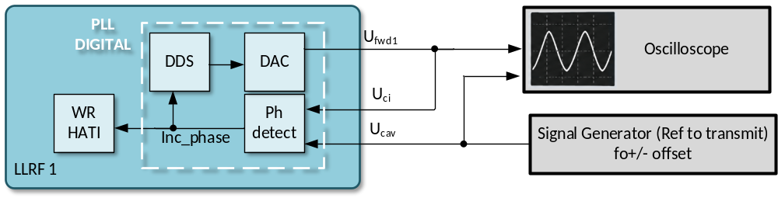
03 – Introduction
Safran LLRF
Digital PLL to estimate resonant cavity frequency.
LLRF Workshop 2026

Slide 6
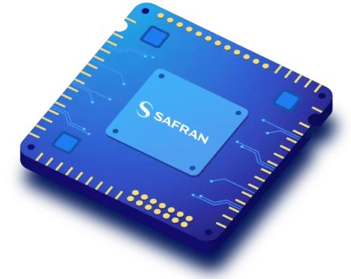
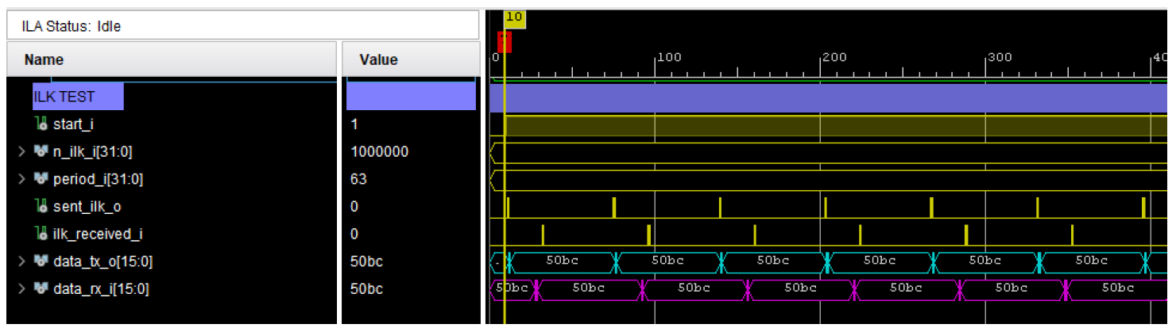

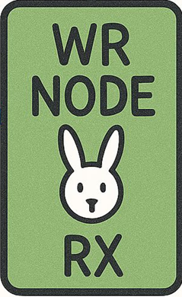

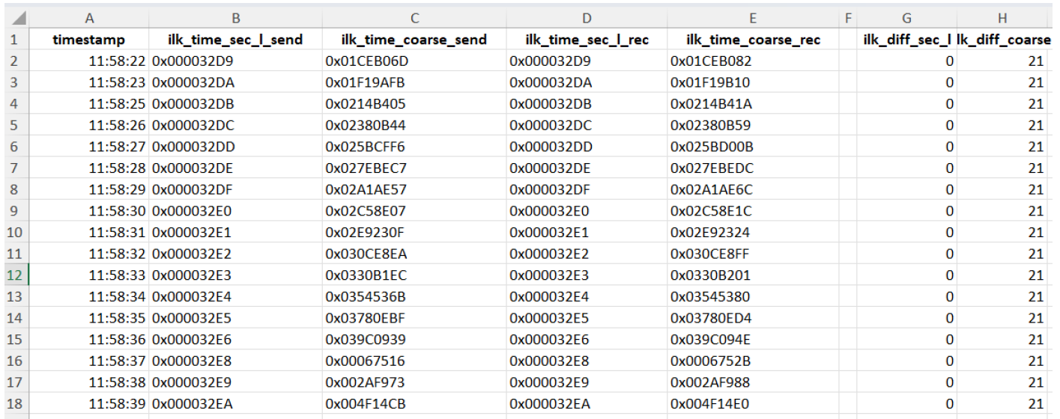
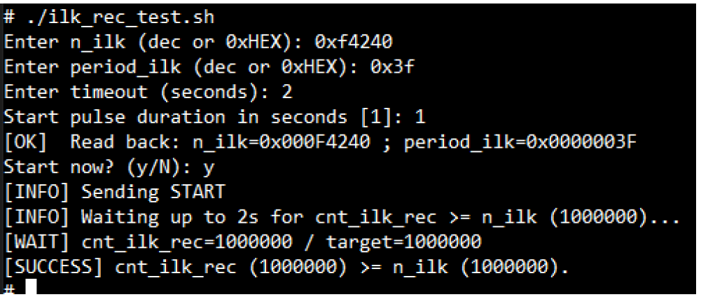
03 – Introduction
HATI IP core
Long term test
Intensive sending of packets

Slide 7
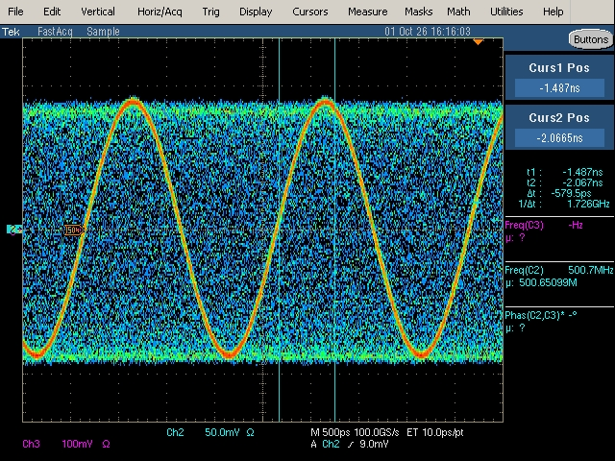
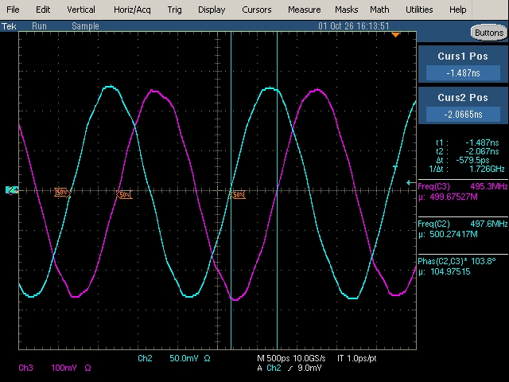
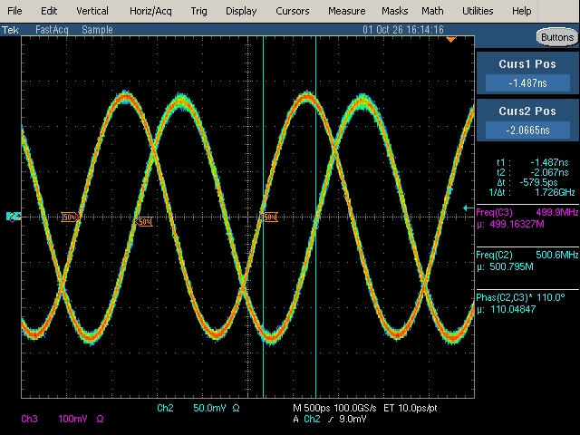
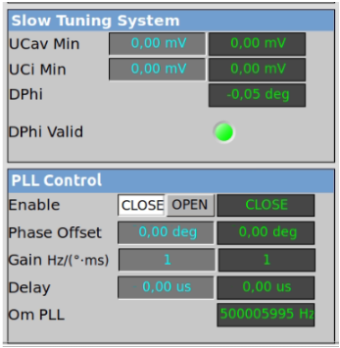
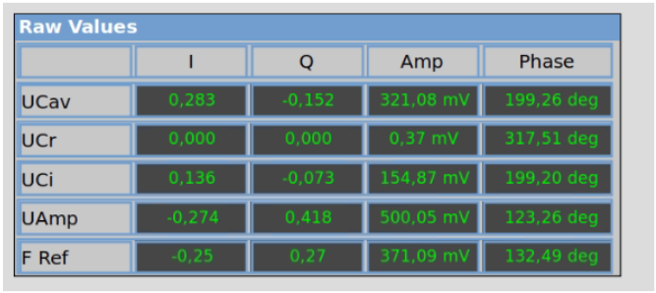
04 – LLRF digital PLL
PLL open
PLL closed
PLL closed (fast acquisition)
Phase offset not corrected
LLRF Workshop 2026

Slide 8

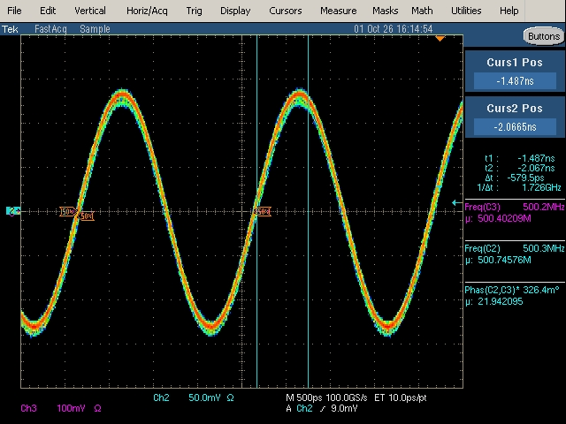
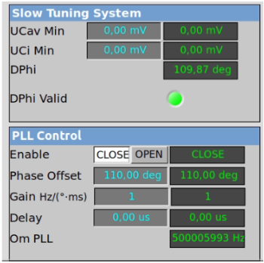
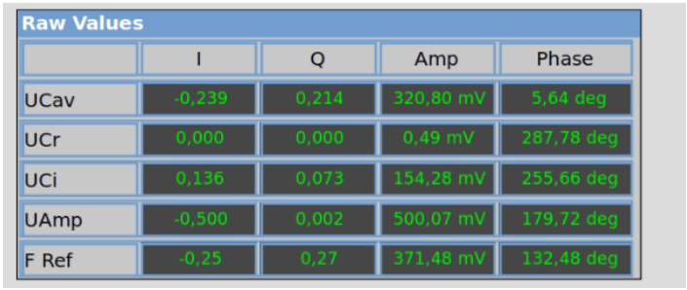
04 – LLRF digital PLL
PLL open
PLL closed
PLL closed (fast acquisition)
Phase offset corrected
LLRF Workshop 2026

Slide 9
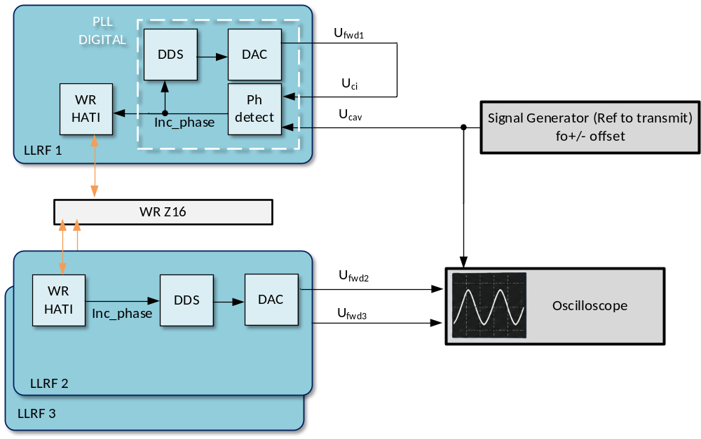
05 – Distributed PLL
LLRF Workshop 2026

Slide 10
06 – Measurements
Oscilloscope Measurements
Phase difference between the Signal Generator and the Master LLRF over 1 minute (mean and standard deviation).
Phase difference between the Signal Generator and the Slave LLRF over 1 minute (mean and standard deviation).
Phase Noise Analyzer
Signal Generator phase noise.
Master LLRF phase noise.
Slave LLRF phase noise with DDS updates every 1 ms (visible phase drift on the oscilloscope).
Slave LLRF phase noise with DDS updates every 100 µs.
Slave LLRF phase noise with DDS updates every 10 µs.

Slide 11
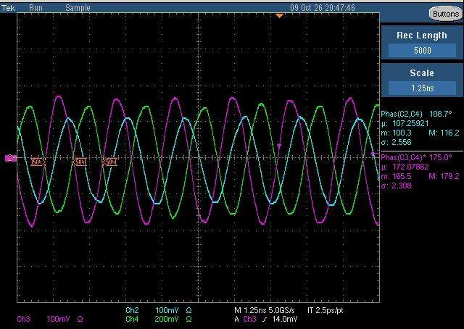
07 – Results
CH4 : Reference
CH2 : LLR slave
CH3 : LLRF master
 | mean | std | Equivalent Jitter RMS
CH2 – CH4 (slave to reference) | 108,7° | 2,556° | 14,20 ps
CH3 – CH4 (master to reference) | 175,0° | 2,308° | 12,82 ps

Slide 12
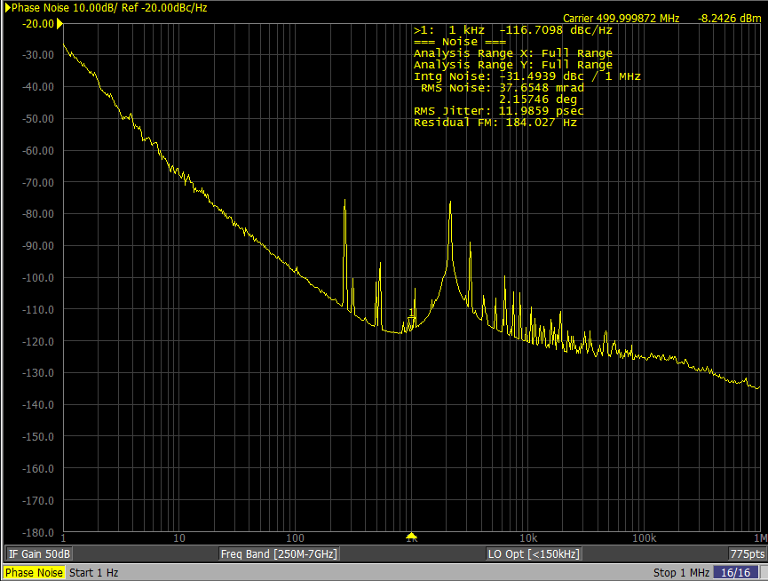
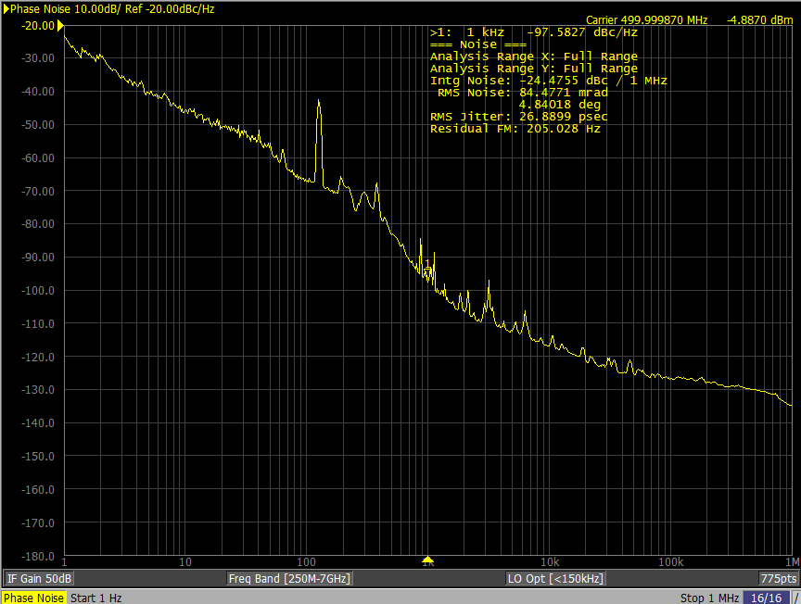
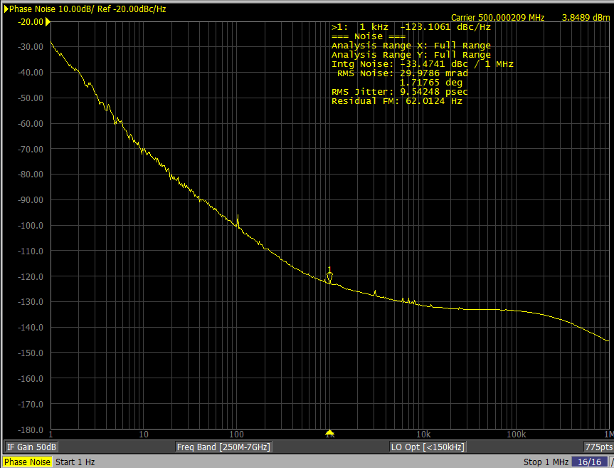
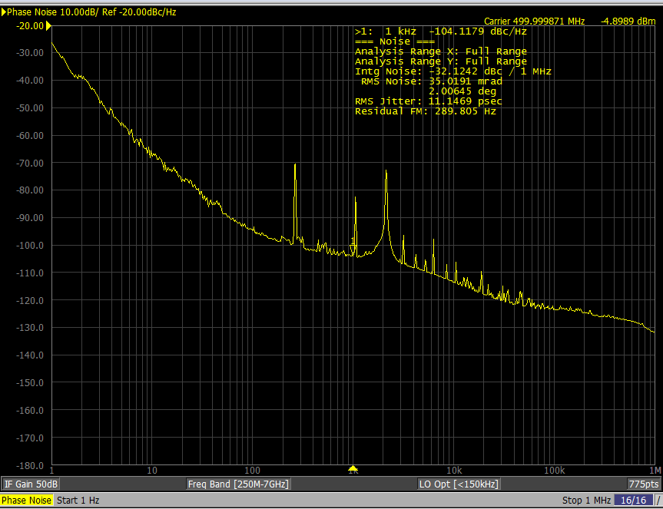
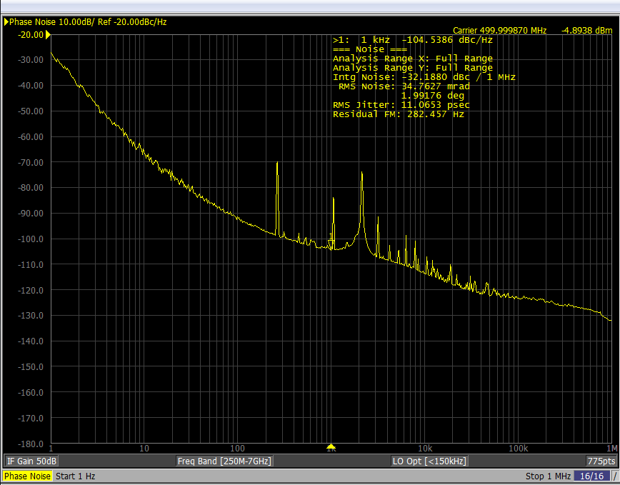
07 – Results
LLRF master
LLRF slave, update rate 1ms
REF
LLRF slave, update rate 10us
LLRF slave, update rate 100us
Notes:
“The oscilloscope measurements show approximately 2–2.6° RMS relative phase fluctuations at 500 MHz, equivalent to 11–14 ps RMS time fluctuations. These values are of the same order as the 11–12 ps RMS jitter obtained from absolute phase-noise measurements integrated from 1 Hz to 1 MHz, although the two measurements are not directly equivalent.”

Slide 13
08 – Next Steps
Cleaner RF Reference: Test a lower phase-noise 500 MHz signal generator to evaluate potential jitter improvements in both master and slave LLRFs.
PLL Optimization: Fine-tune the PI controller parameters (K_p and K_i) to reduce phase noise, suppress spurious components, and optimize loop stability.
Long-Term Phase Stability: Measure relative phase drift and jitter over extended periods to assess synchronization performance.
Scalability: Extend the setup to multiple slave LLRFs connected to the White Rabbit network and evaluate synchronization performance as the number of nodes increases.
Deterministic RF Generation: Implement scheduled RF generation using the common White Rabbit timebase, enabling multiple LLRFs to start RF generation simultaneously at predefined timestamps.
Phase Coherence: Investigate deterministic phase alignment between distributed LLRFs to enable coherent RF generation across multiple nodes.

Slide 14
09 – Applications
Distributed RF Reference Generation: Distribution of frequency information over White Rabbit networks, enabling multiple LLRF stations to generate frequency-coherent RF signals without requiring dedicated analog RF reference distribution to every node.
Multi-Cavity LLRF Synchronization: Coordinated frequency tracking across multiple RF cavities using a common master reference, while allowing each LLRF to independently regulate its cavity amplitude and phase.
Deterministic RF Pulse Generation: Synchronized RF generation at predefined timestamps using the common White Rabbit timebase, enabling multiple LLRF systems to execute precisely timed RF sequences independently of network communication delays.
Synchrotron RF Frequency Tracking: Distribution of dynamically changing RF frequency references during accelerator ramping cycles, allowing multiple RF stations to follow the same frequency profile while maintaining controlled relative phase stability.

Slide 15

Juan Fernández
juan.fernandez@nav-timing.safrangroup.com
Javier Carmona
javier.carmona@nav-timing.safrangroup.com
Guillermo Albacete
javier.carmona@nav-timing.safrangroup.com

