Slide 1
Pulse to Pulse stability
Kévin Pepitone
LLRF Topical Workshop on Advanced Feedback Control
13-15 October 2026, Nova Gorica, Slovenia

Slide 2
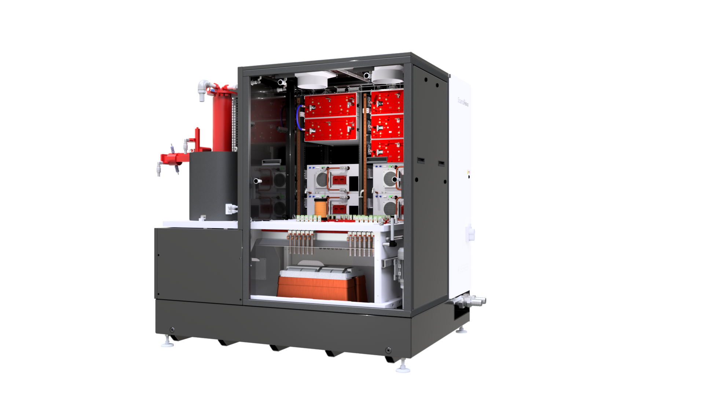
K-series
Table of content
What is the pulse-to-pulse stability?
Integrated Klystron and Solenoid
Parallel Switching™
Switch Units
Pulse to Pulse Control™
CCPS
What is the impact?
Splitcore™
Pulse Transformer
ScandiCAT™
Control Systems
How to measure it?
K300 RF Unit

Slide 3
Definition
Pulse to pulse stability
Pulse to Pulse Stability: Consistency of energy or particle pulses from one pulse to the next.
Why Does It Matter for Accelerators & LLRF?
RF Phase & Amplitude Jitter: High-voltage fluctuations directly translate into phase jitter at the klystron output.
Beam Synchronization & Emittance: In modern linacs and FELs, phase errors degrade arrival-time stability, bunch compression, and longitudinal emittance.

Slide 4
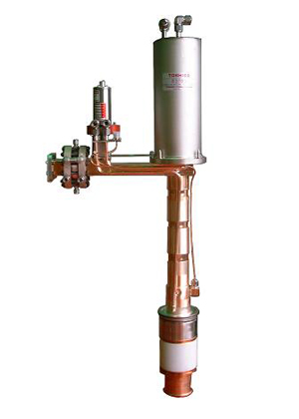
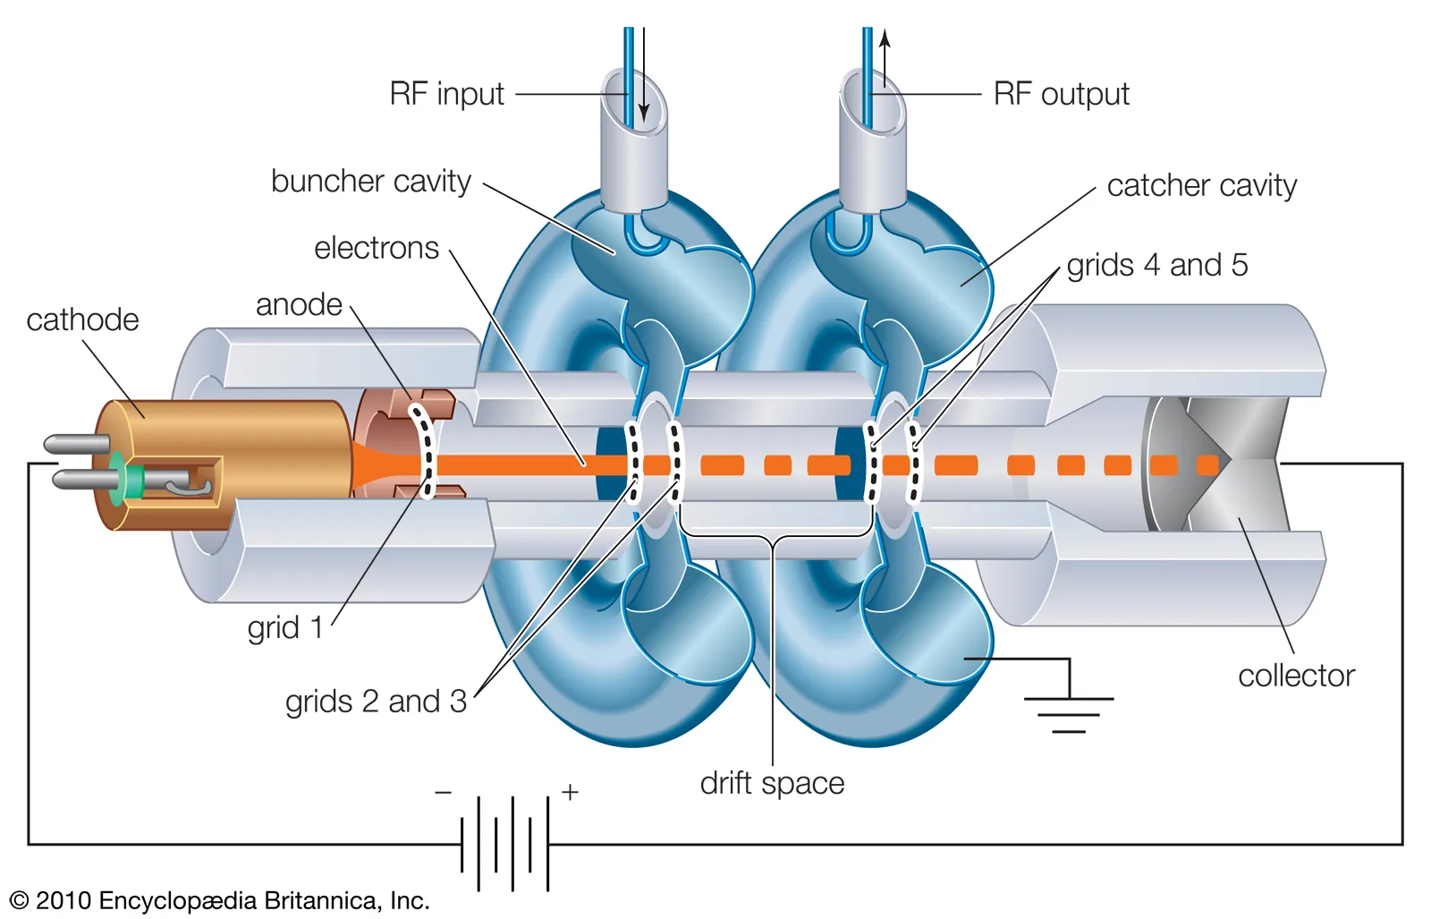
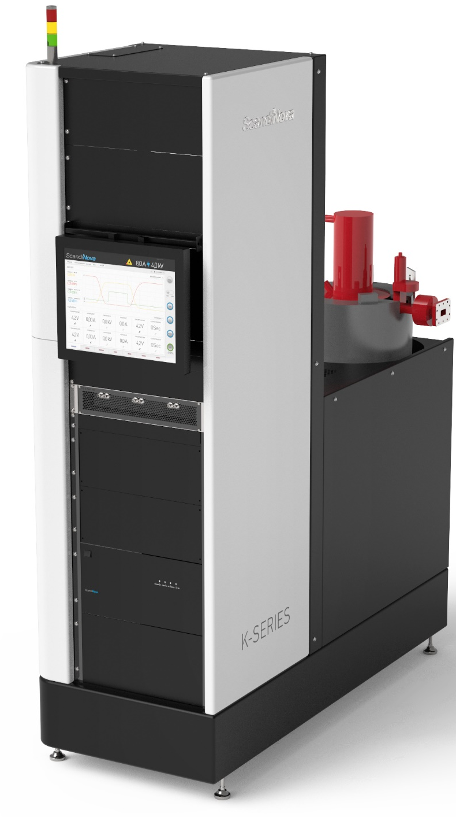
Phase stability of the pulse modulator
Definition of a klystron
A klystron is an electron source in which electron are produced, accelerated and dumped in a very short distance
The modulator produces the electric field to accelerate the electrons between the anode and the cathode
The klystron consists of a cylindrical vacuum chamber containing a series of electrodes that accelerate and decelerate the electron beam, creating oscillations at a desired frequency

Slide 5
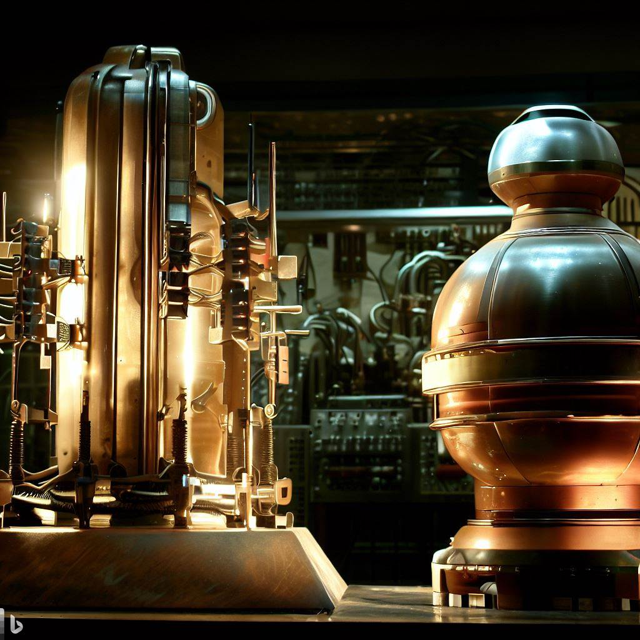
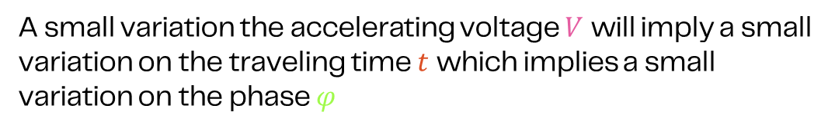

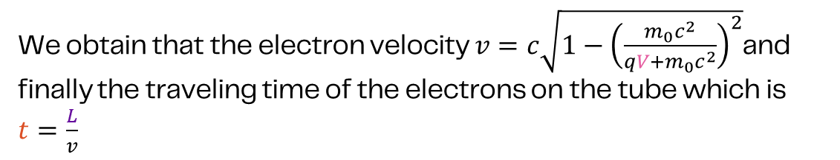


Phase stability of the pulse modulator
Theory
$$E_{tot}=qV+m_{0}c^{2}$$
where $V$ is the accelerating voltage, $q$ is the electron charge and $m_{0}c^{2}$ is the rest energy
$$E_{tot}=γm_{0}c^{2}$$
where $γ$ is the Lorentz factor which is $\frac{1}{\sqrt{1−\frac{v^{2}}{c^{2}}}}$
We obtain that the electron velocity $v=c\sqrt{1−{\left(\frac{m_{0}c^{2}}{qV+m_{0}c^{2}}\right)}^{2}}$and finally the traveling time of the electrons on the tube which is $t=\frac{L}{v}$
The phase depends on the traveling time by $∆φ=360°×f×∆t$
A small variation the accelerating voltage $V$ will imply a small variation on the traveling time $t$ which implies a small variation on the phase $φ$

Slide 6
Phase stability of the pulse modulator
From Pulse to pulse to Phase stability
Let’s consider a driving voltage $V$ = 155 kV, which has a traveling tube of $L$ = 0.5 m and operates at a constant temperature and at $f$ = 3 GHz
By computing the previous equations, we obtain that
  The traveling time is $t=$2.60057 ns
Now let’s consider variation of the driving voltage
Pulse to pulse stability (ppm) | Voltage difference (V) | Traveling time (ns) | Traveling time difference (ps) | Phase stability (°)
1000 | 155.00 | 2.59971 | 0.8655 | 0.9348
500 | 77.50 | 2.60014 | 0.4330 | 0.4676
200 | 31.00 | 2.60040 | 0.1732 | 0.1871
100 | 15.50 | 2.60049 | 0.0866 | 0.0936
70 | 10.85 | 2.60051 | 0.0606 | 0.0655
10 | 1.55 | 2.60056 | 0.0087 | 0.0094
8 | 1.24 | 2.60057 | 0.0069 | 0.0075

Slide 7
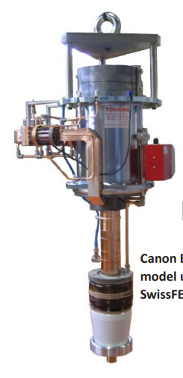
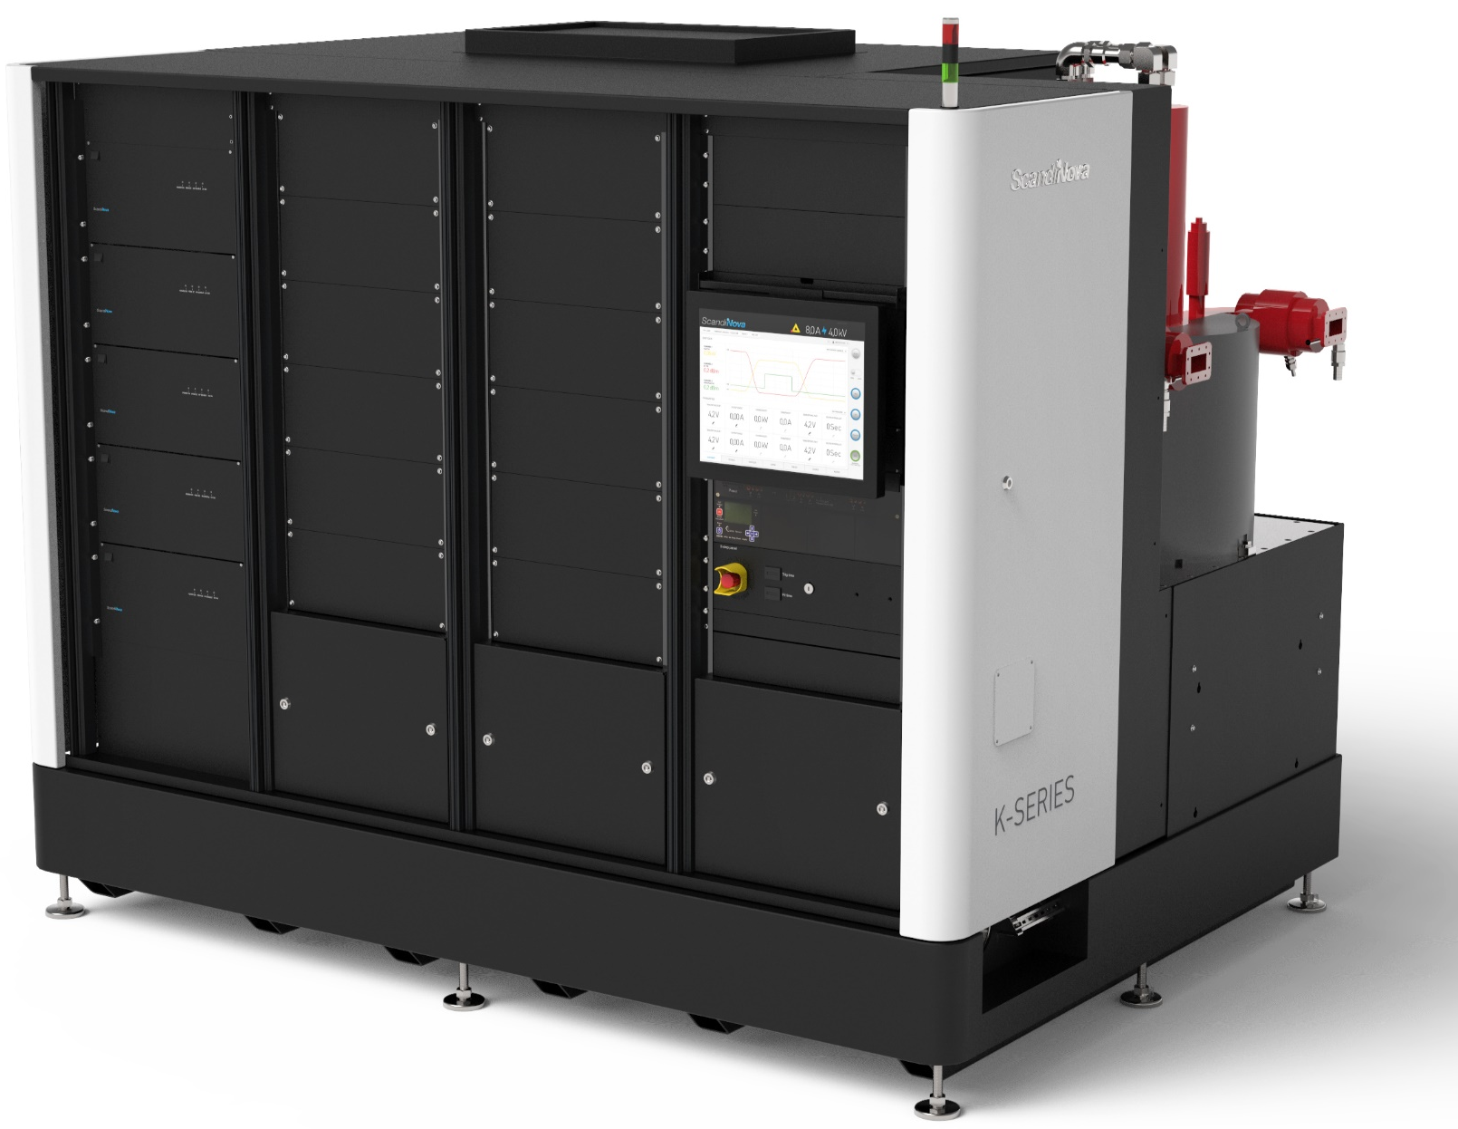
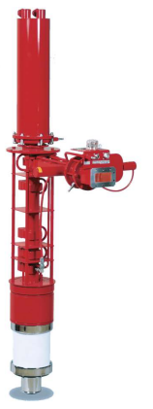
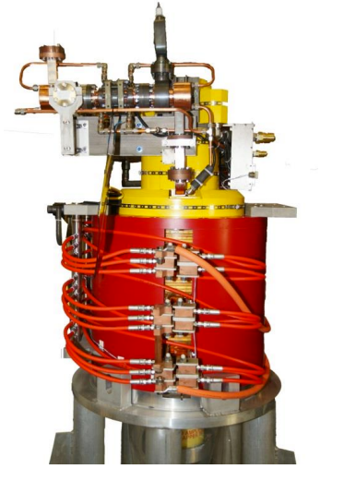
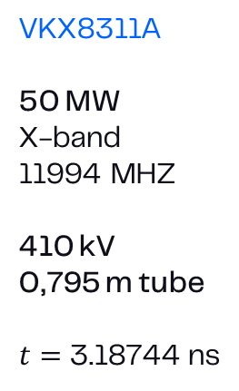
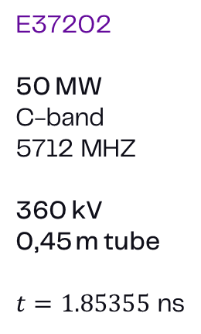
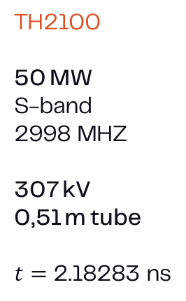
Phase stability of the pulse modulator
Comparison of 3 klystrons
TH2100
50 MW
S-band
2998 MHZ
307 kV
0,51 m tube
$t=$2.18283 ns
E37202
50 MW
C-band
5712 MHZ
360 kV
0,45 m tube
$t=1.85355$ ns
VKX8311A
50 MW
X-band
11994 MHZ
410 kV
0,795 m tube
$t=$3.18744 ns
K400
RF peak power: 30 – 60 MW
Pulse voltage: 280 – 450 kV
Pulse current: 230 – 450 A
Modulator peak: 160 MW
Modulator avg.: 125 kW
Klystron | Pulse to pulse stability (ppm) | Voltage difference (V) | Traveling time (ns) | Traveling time difference (ps) | Phase stability (°)
TH2100 | 50 | 15.35 | 2.18281 | 0.0262 | 0.028
E37202 | 50 | 18.00 | 1.85353 | 0.0201 | 0.041
VKX8311A | 50 | 20.50 | 3.18741 | 0.0316 | 0.136

Slide 8
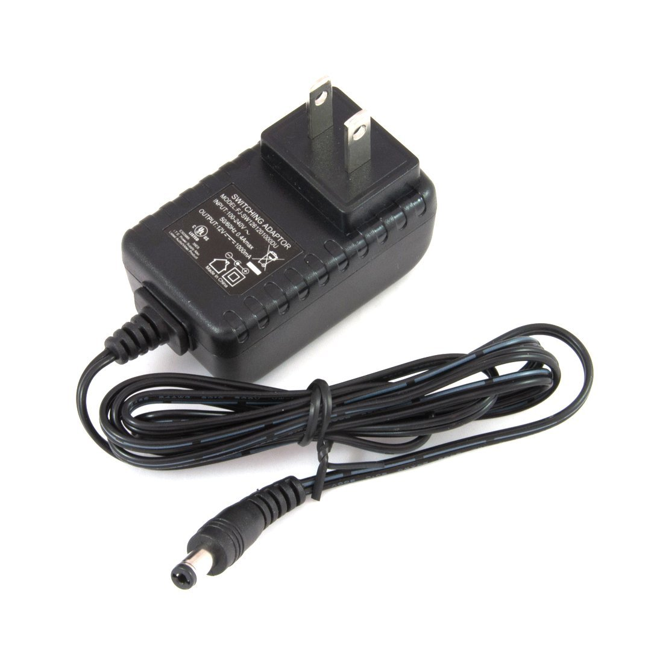
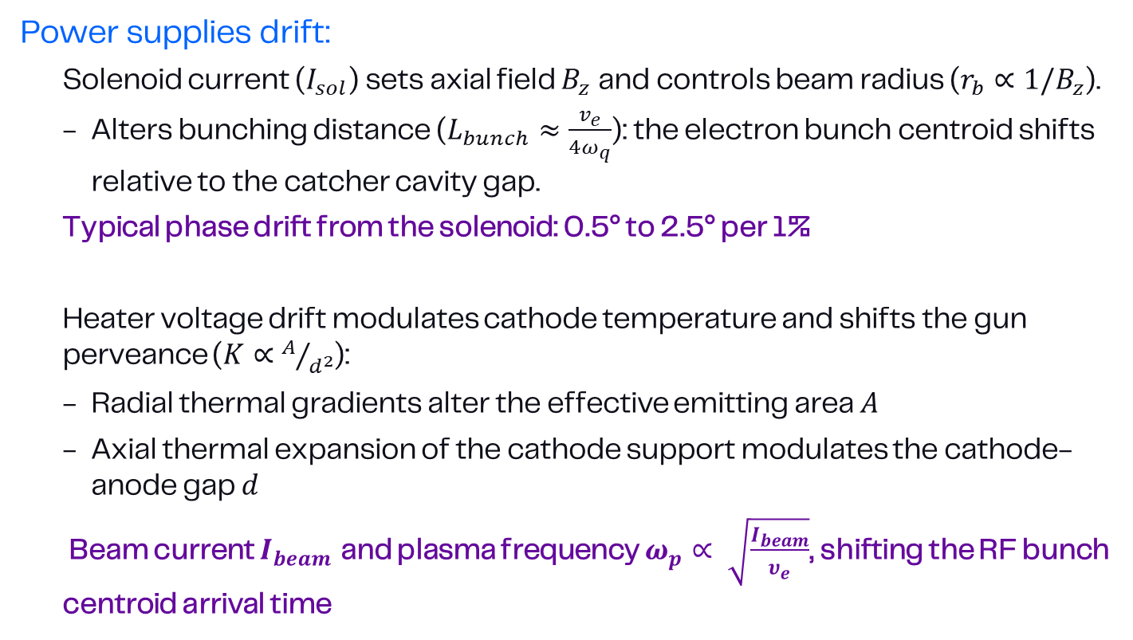
Beyond High Voltage
What Else Impacts Klystron Phase?
Power supplies drift:
  Solenoid current ($I_{sol}$) sets axial field $B_{z}$and controls beam radius ($r_{b}∝1/B_{z}$).
  Alters bunching distance ($L_{bunch}≈\frac{v_{e}}{4ω_{q}}$): the electron bunch centroid shifts relative to the catcher cavity gap.
  Typical phase drift from the solenoid: 0.5° to 2.5° per 1%
  Heater voltage drift modulates cathode temperature and shifts the gun perveance ($K∝A/{d^{2}}$):
  Radial thermal gradients alter the effective emitting area $A$
  Axial thermal expansion of the cathode support modulates the cathode-anode gap $d$
  Beam current $I_{beam}$ and plasma frequency $ω_{p}∝ \sqrt{\frac{I_{beam}}{υ_{e}}}$, shifting the RF bunch centroid arrival time

Slide 9
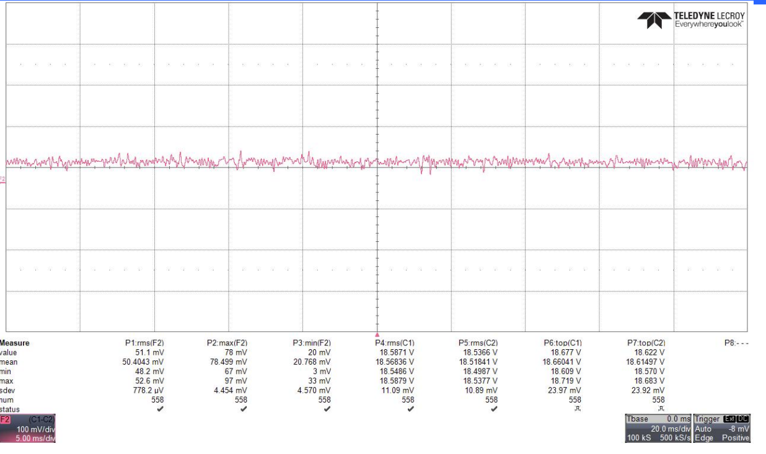
Beyond High Voltage
Measurements
Power supplies were measured over a shunt.
The stability is given as the sdev of the drop voltage over the shunt normalized by the mean coil voltage (this is shunt dependent)
Device | Typical stability (ppm) | Estimated phase contribution (°)
Solenoids | 10-50 ppm | 0.0005 – 0.0125
Heater | 10-20 ppm | -

Slide 10
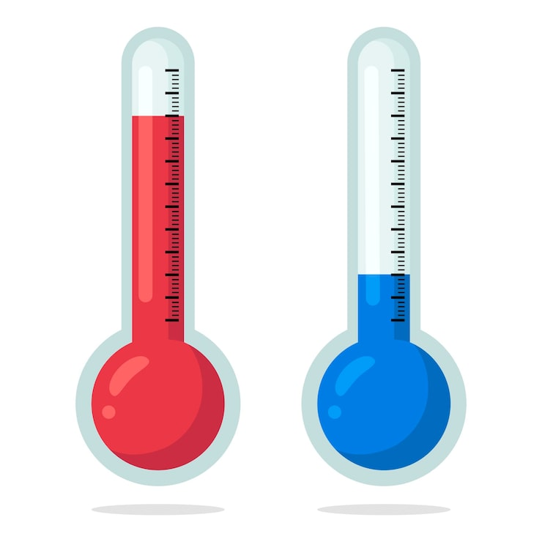
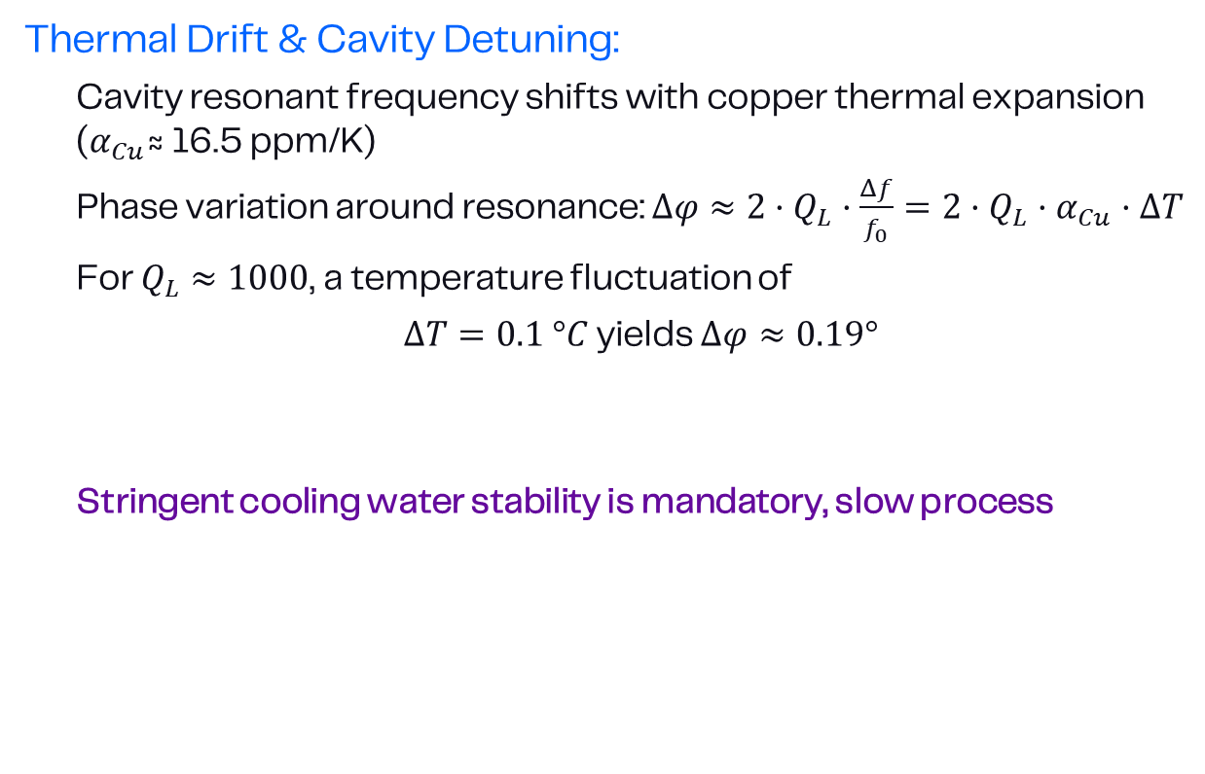
Beyond High Voltage
What Else Impacts Klystron Phase?
Thermal Drift & Cavity Detuning:
  Cavity resonant frequency shifts with copper thermal expansion ($α_{Cu}$≈ 16.5 ppm/K)
  Phase variation around resonance: $Δφ≈2·Q_{L}·\frac{Δf}{f_{0}}=2·Q_{L}·α_{Cu}·ΔT$
  For $Q_{L}≈1000$, a temperature fluctuation of
  $ΔT=0.1 °C$ yields $Δφ≈0.19°$
  Stringent cooling water stability is mandatory, slow process

Slide 11
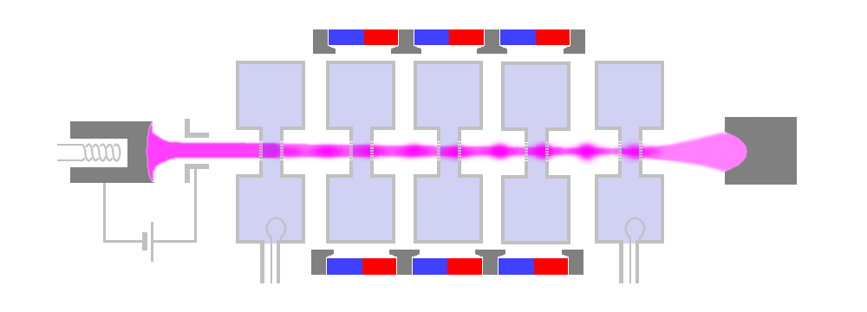
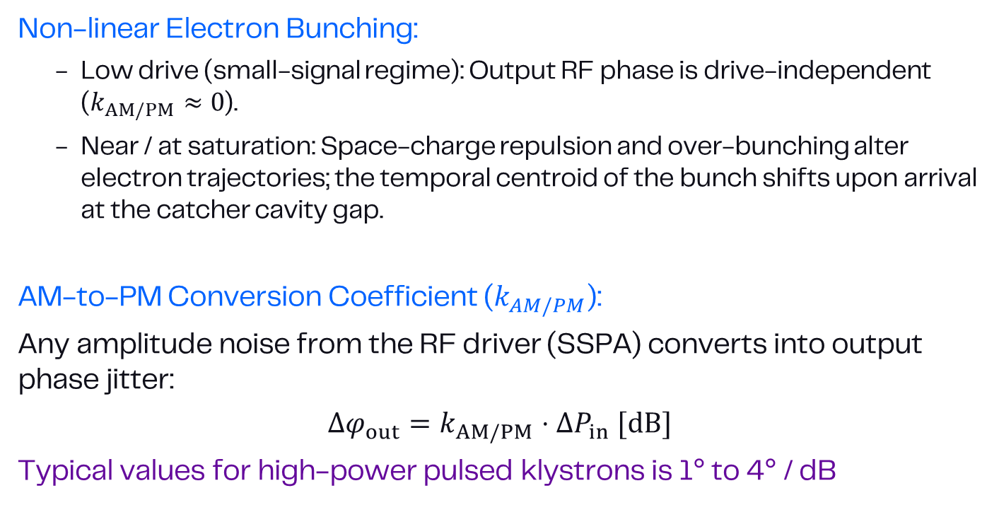
Klystron Saturation
AM/PM Conversion
Non-linear Electron Bunching:
  Low drive (small-signal regime): Output RF phase is drive-independent ($k_{AM/PM}≈0$).
  Near / at saturation: Space-charge repulsion and over-bunching alter electron trajectories; the temporal centroid of the bunch shifts upon arrival at the catcher cavity gap.
AM-to-PM Conversion Coefficient ($k_{AM/PM}$):
Any amplitude noise from the RF driver (SSPA) converts into output phase jitter:
$$Δφ_{out}=k_{AM/PM}⋅ΔP_{in} [dB]$$
Typical values for high-power pulsed klystrons is 1° to 4° / dB

Slide 12
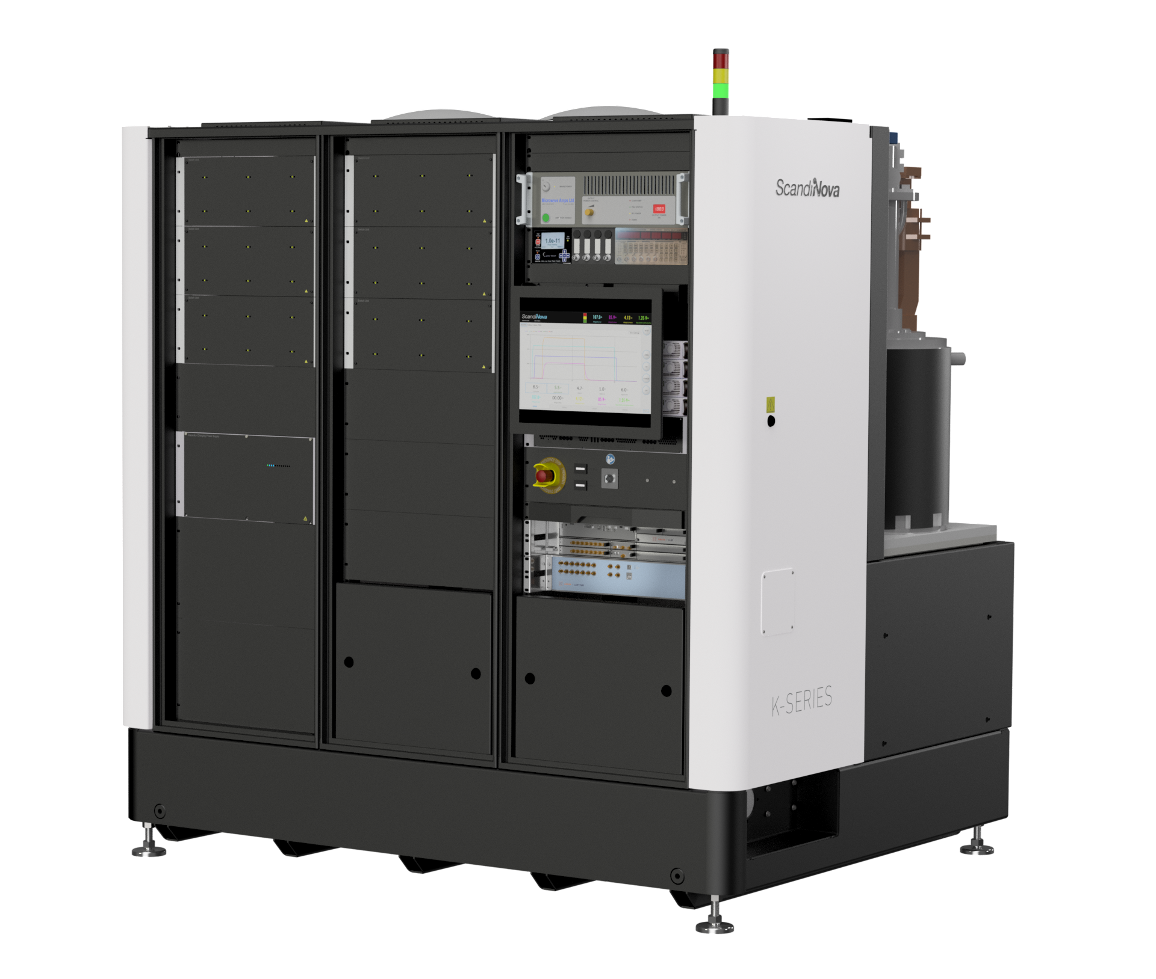
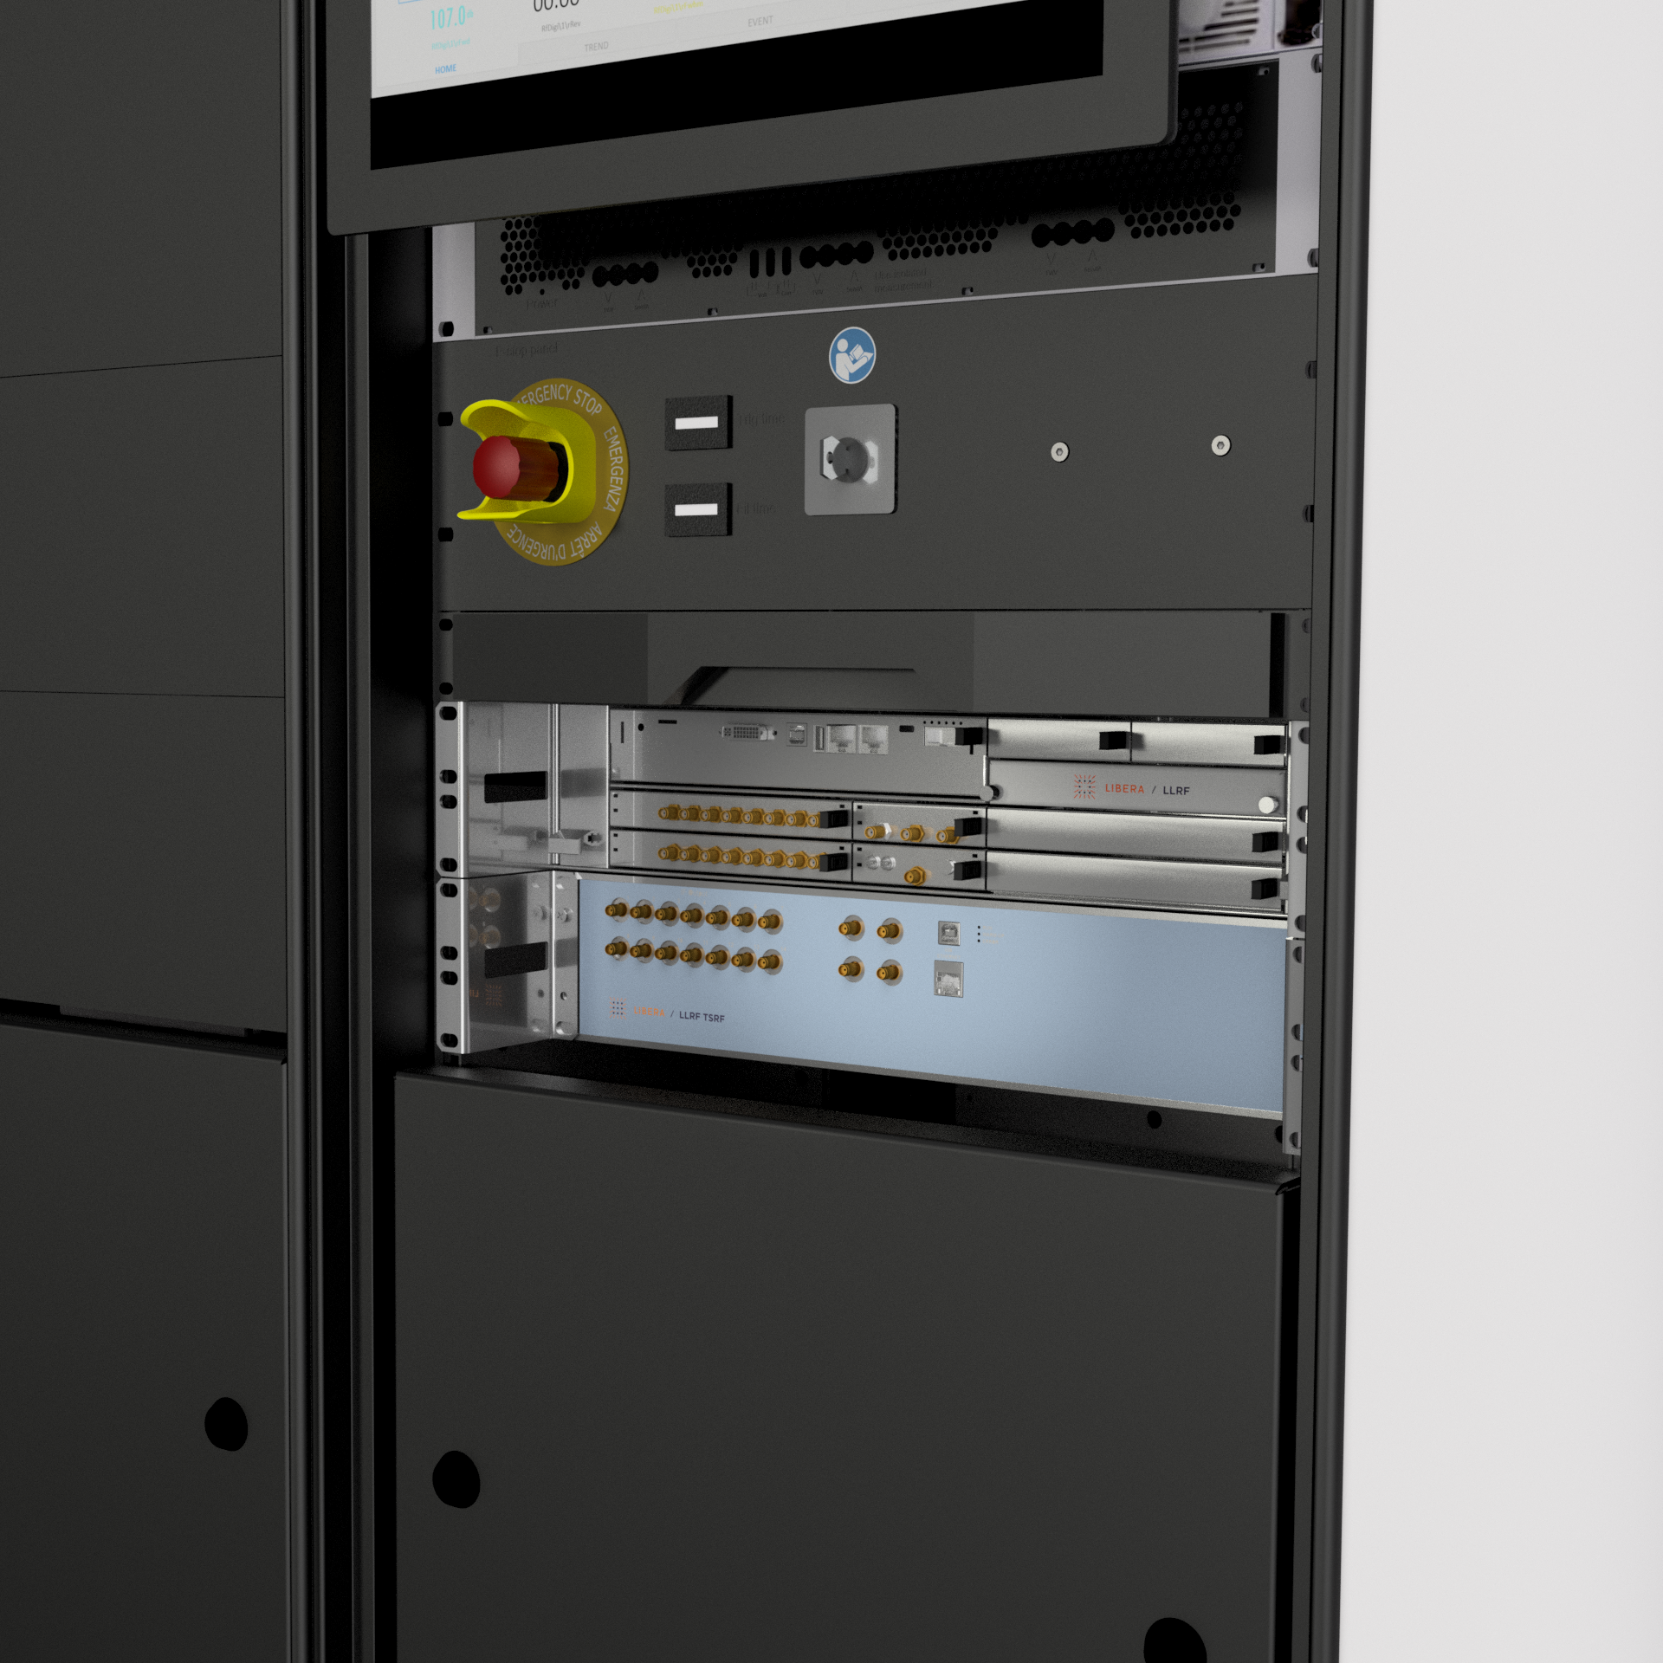


LLRF as an Ultra-Fast High-Voltage Diagnostic Tool
Closed-Loop Turnkey RF Unit
Collaboration

Slide 13
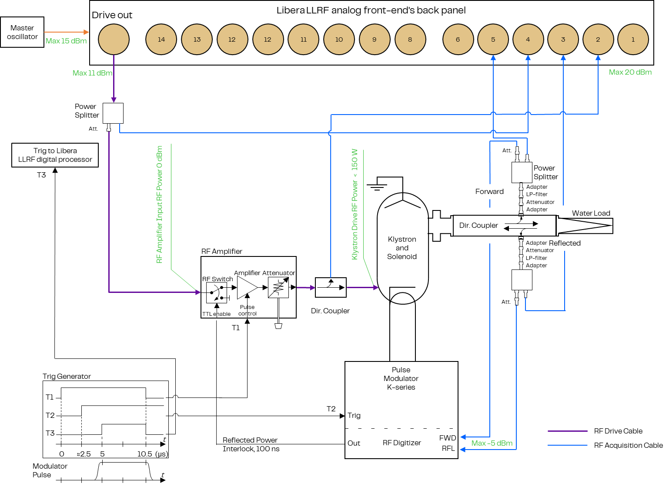
RF layout
Closed loop

Slide 14
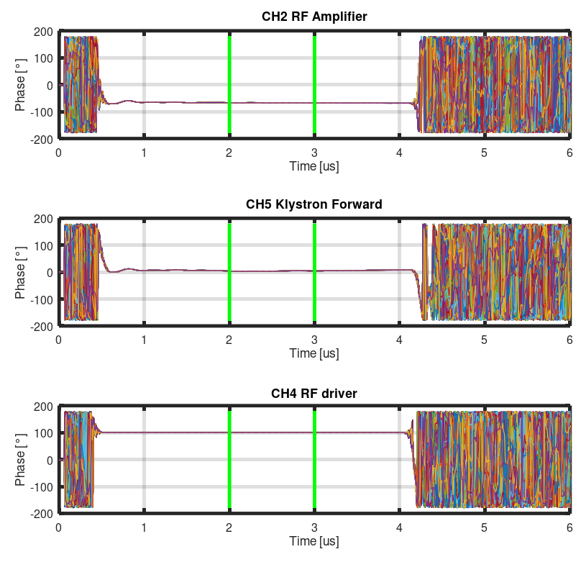
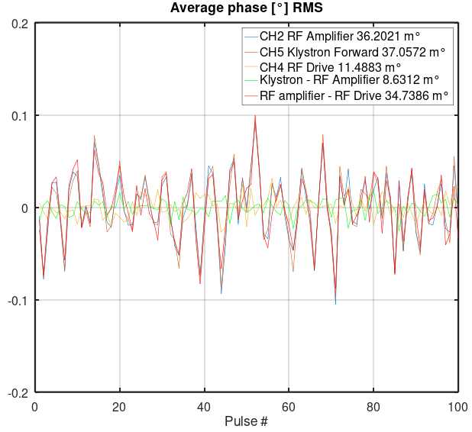

Advantages
Experimental measurements
100 pulses at 3.1 MW, 3.5 μs and 50 Hz measured over 1 μs
The modulator contributes up to
8.6 m$°$ RMS on the phase stability

Slide 15
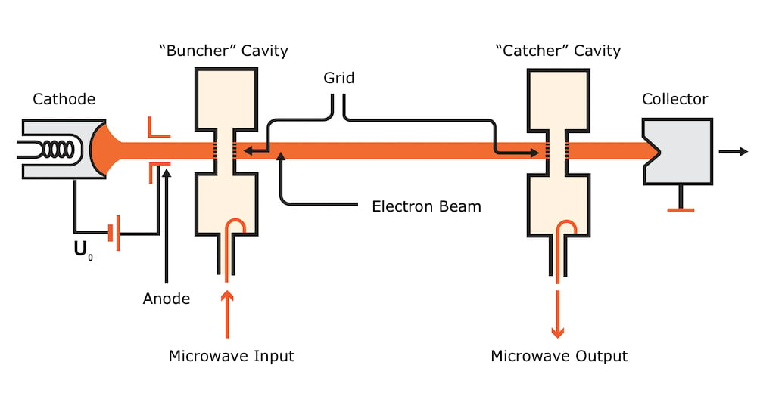
Klystrons theory
Application
If we consider the klystron having $L=0.45$m and a modulator voltage of $V=106$kV
A phase variation of 8.6 m$°$(8.0 fs) will correspond to a pulse-to-pulse
stability of 8.0 ppm

Slide 16
Takeaways
Conclusions
Direct HV-to-Phase Link:
Modulator stability sets the RF phase noise floor — modern solid-state modulators (ScandiNova K-series) reach approx 0.01° in S-band.
Frequency Scaling Matters:
The same HV stability yields 4× more phase jitter at X-band than at S-band — higher frequencies demand tighter HV control.
Modulator & LLRF Synergy:
A stable modulator frees the LLRF loop to focus on cavity/beam-loading regulation instead of correcting HV imperfections.

Slide 17
Thanks for your attention!

