Slide 1
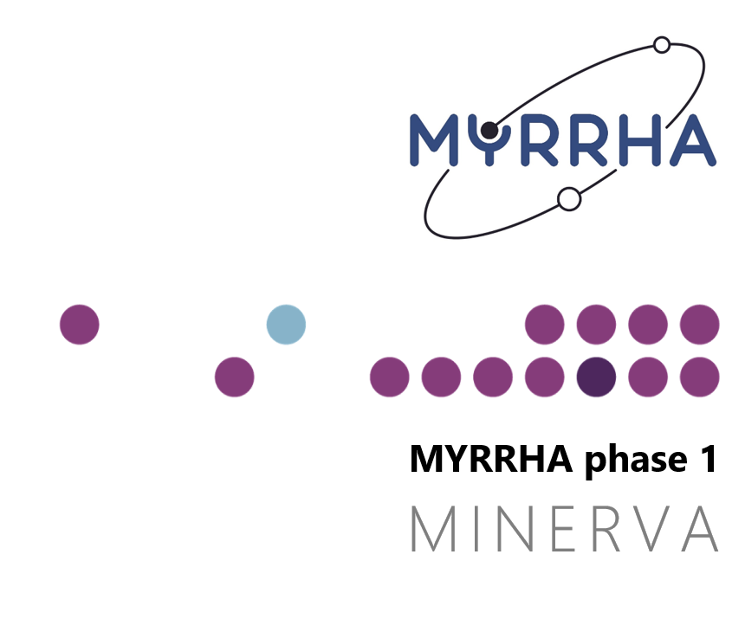

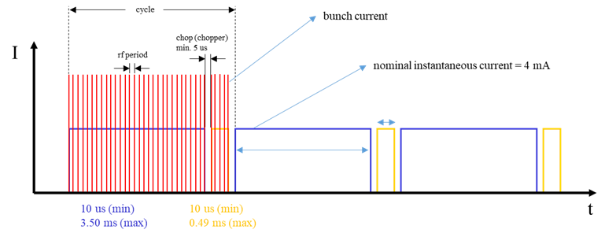
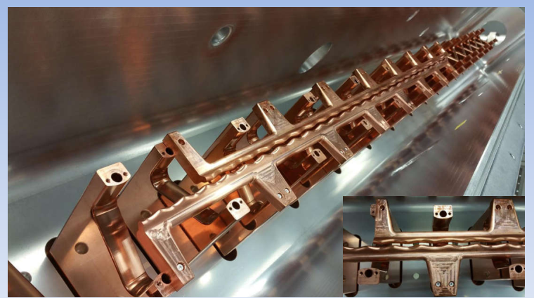
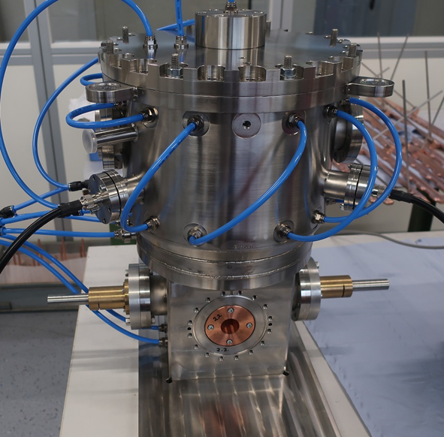
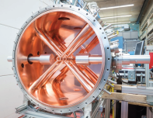
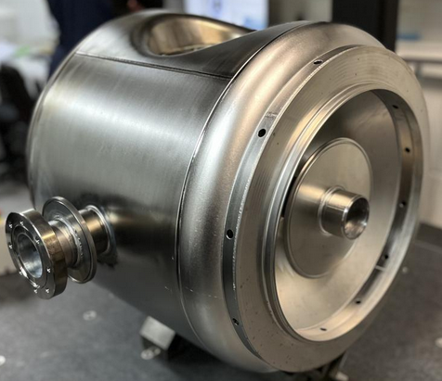
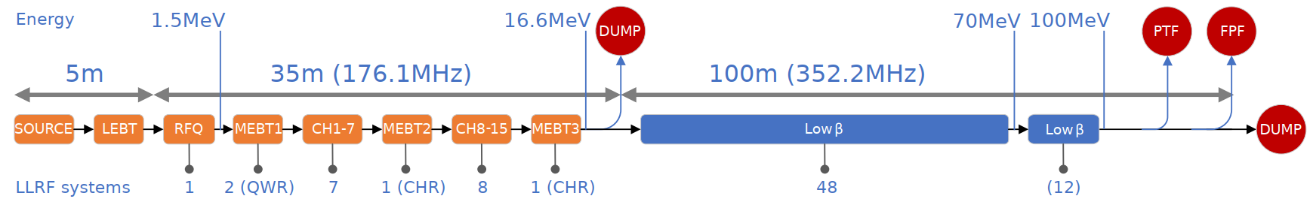
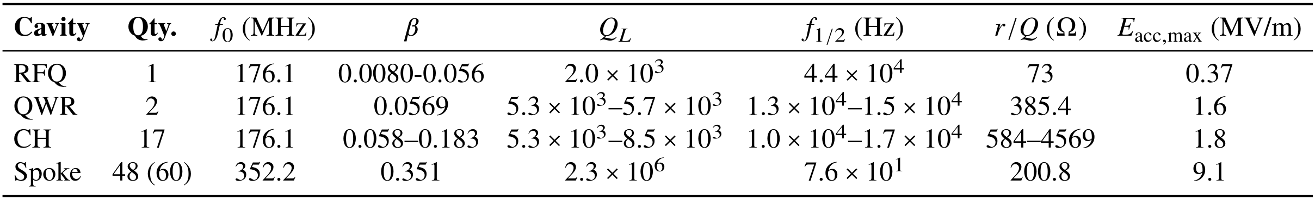
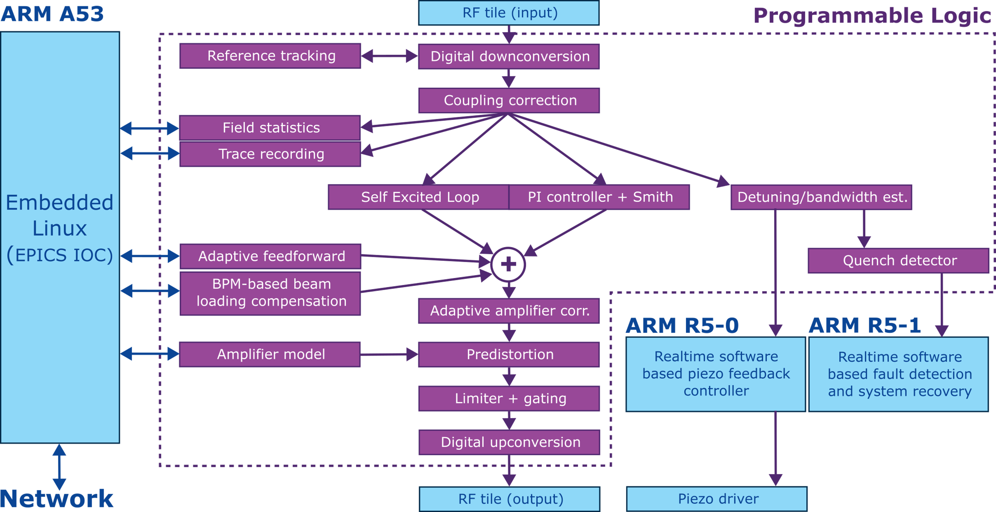
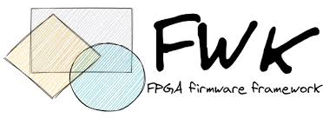





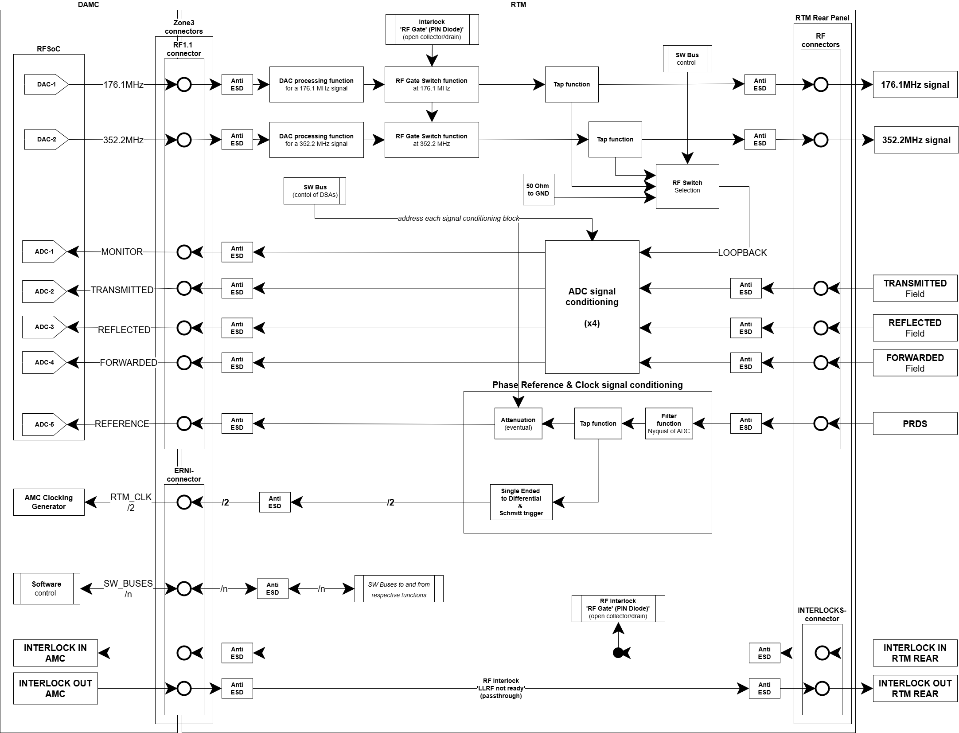
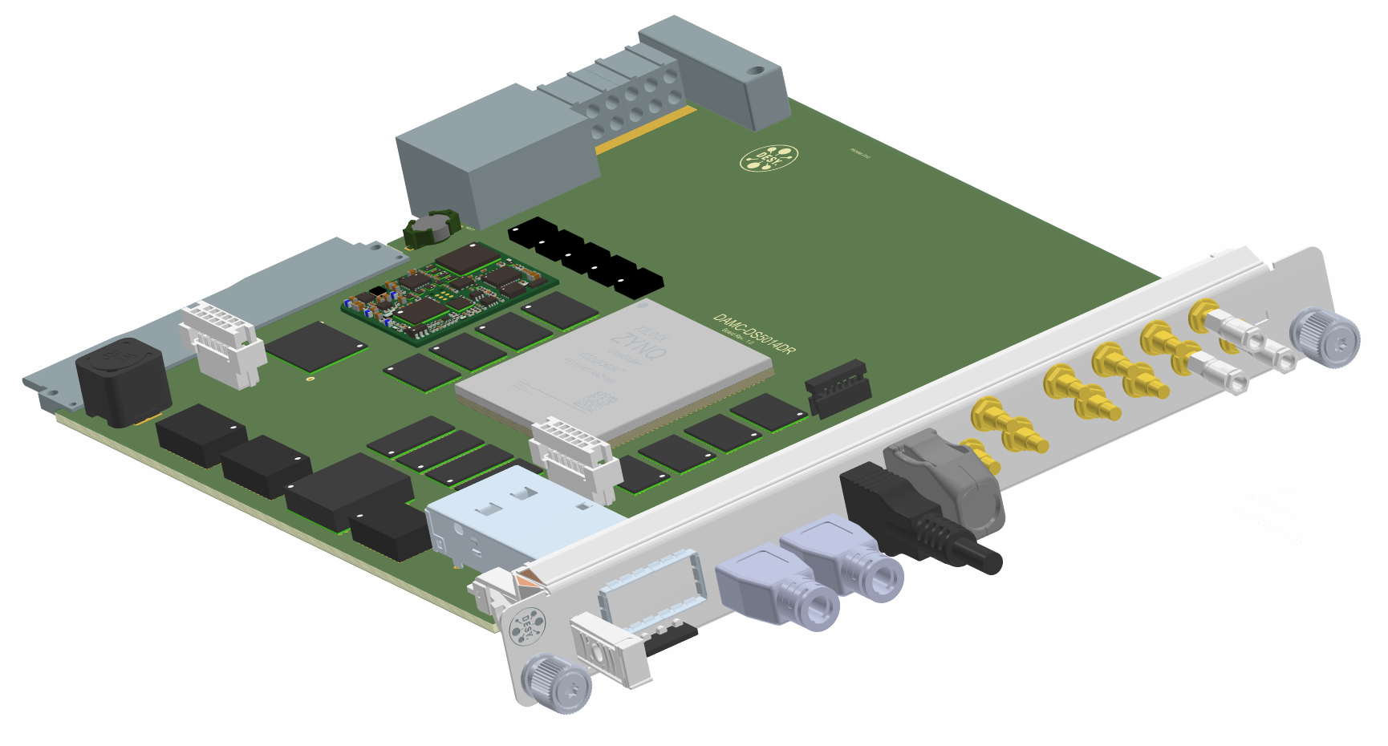
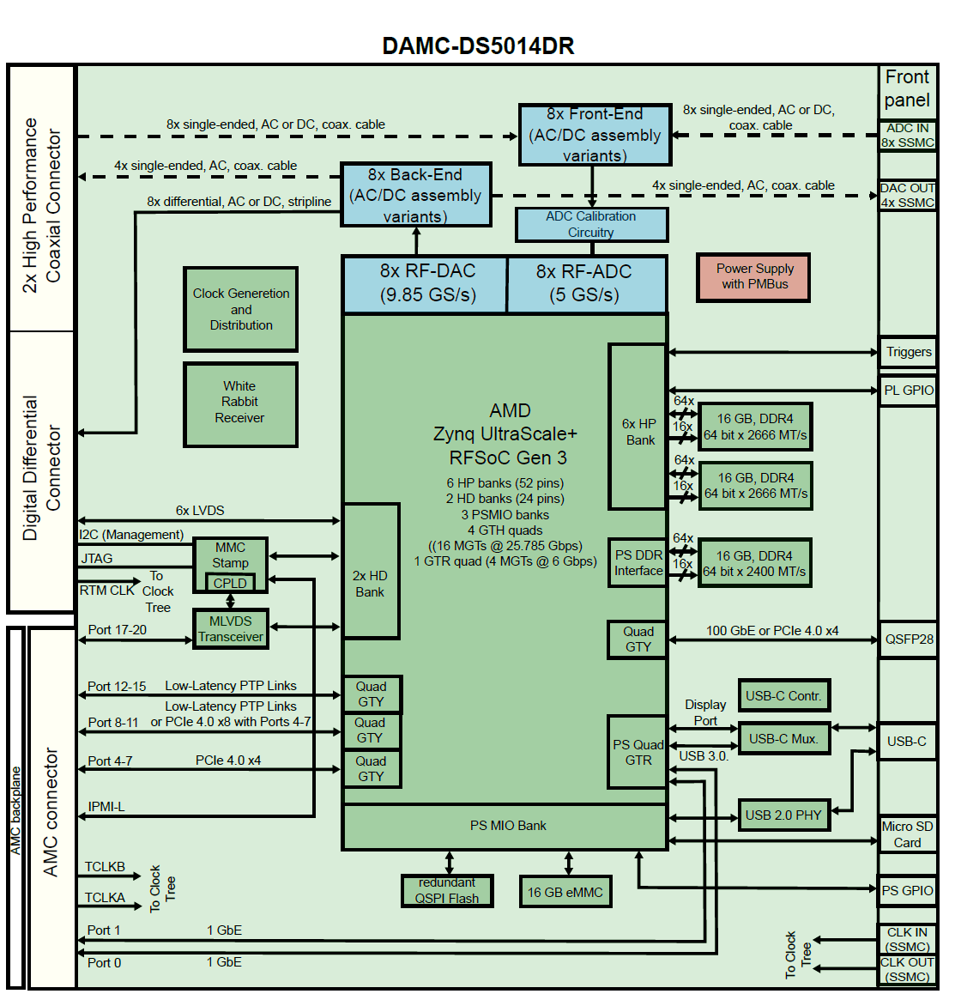
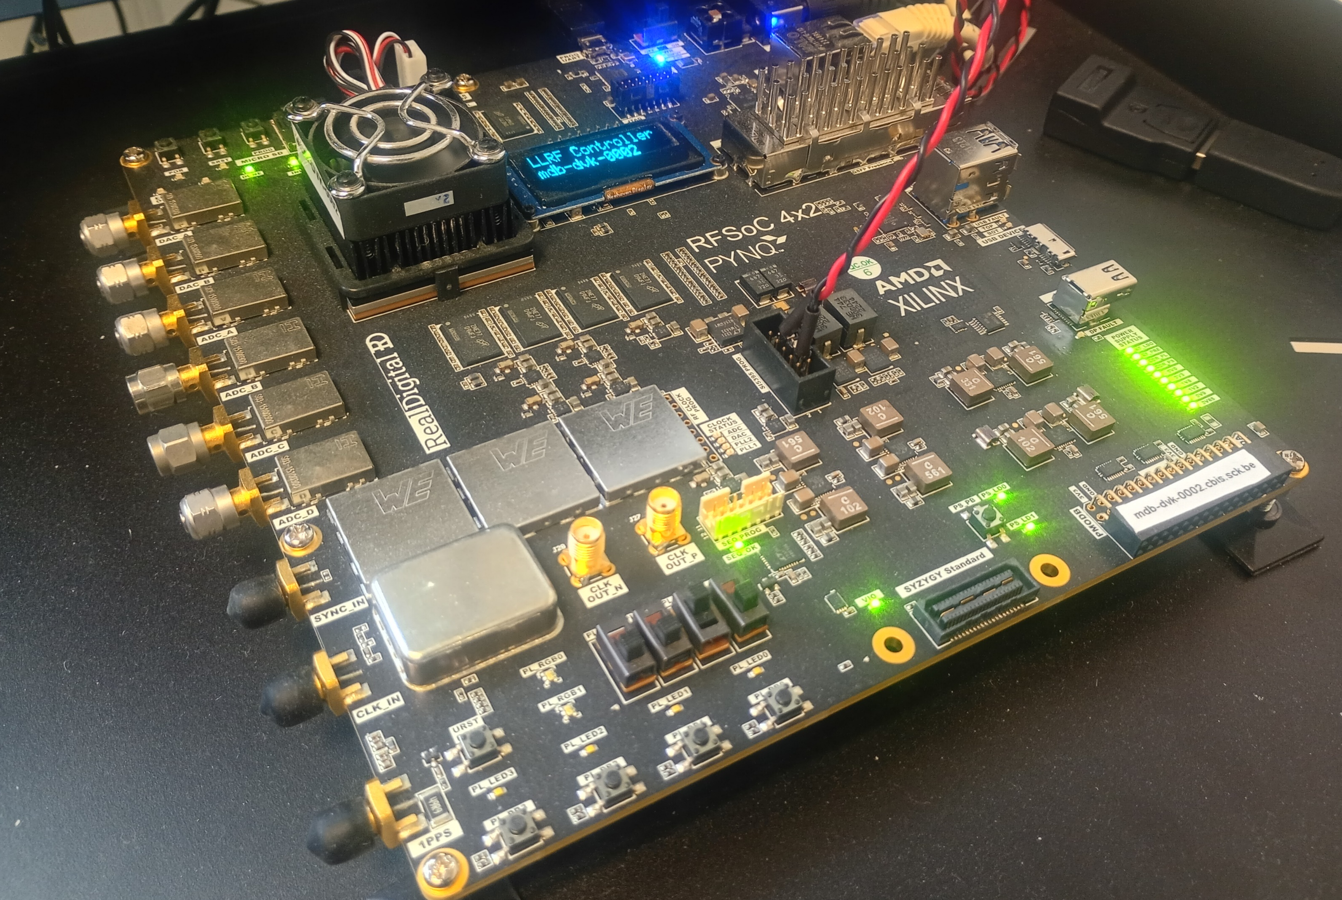

The MYRRHA Phase 1 MTCA.4-Based LLRF System
A. Bellandi¹, W. De Cock, F. Frank, J. Geerts, K. Geerts, E. Verhagen
¹Belgian Nuclear Research Centre, SCK CEN, Mol, Belgium
¹E-mail: andrea.bellandi@sckcen.be
Abstract
The first 100 MeV stage of the MYRRHA superconducting RF linear accelerator is under construction in Mol, Belgium. The machine will produce an instantaneous proton beam current of 4 mA and represents the first step toward the construction of the MYRRHA Accelerator-Driven System (ADS). Such a machine presents several technical challenges for the control of its RF cavities.
First, the required field stability is ≤ 0.1% in amplitude and ≤ 0.1° in phase to avoid excessive beam losses. The high loaded quality factor (𝑄_{𝐿} = 2.3 × 10⁶) and the need to modulate the beam at 250 Hz require sophisticated field- and detuning-control techniques to keep RF power consumption and stability within specifications.
Finally, since the maximum allowed beam-trip duration is less than 3 s, real-time fault detection and recovery techniques must be implemented in the Low-Level RF (LLRF) controller. To meet these stringent requirements, the MTCA.4 RFSoC-based DAMC-DS5014DR direct-sampling AMC board, currently being developed by DESY, is taken as the performance baseline for the project, for the upcoming tenders.
In this proceeding, the LLRF control strategy foreseen for MYRRHA Phase 1 will be presented. The status of the firmware, software, and analog front-end will also be discussed
The Accelerator
Beam Pattern
High current 4mA/100MeV CW superconducting proton LINAC
Normal conducting 16.6 MeV injector operating at 176.1 MHz
Superconducting low-beta section operating at 352.2 MHz
Key milestone to demonstrate ADS technology readiness
Unique facility for nuclear, material and medical research
RFQ
QWR
CH
SRF Spoke
LLRF Challenges
Precision: operating the accelerator for 40 years at 4 mA requires high field stability to minimize cryogenic losses and component activation
Efficiency: driving SSAs at maximum efficiency requires compensating nonlinearities. Superconducting cavities have an high Q_{L} and are affected by microphonics
Flexibility: time-varying beam patterns requires novel compensation strategies
Reliability: industrial grade reliability. Maximum allowed fault duration of 3s
Courtesy of F. Marhauser
For further information about MYRRHA, look at:
WEP6154, TPH4014, THP4056, THP4057
FPGA modules
Reference tracking
  environmental drifts in transmission lines and ADCs
Coupling correction
  compensates crosstalk in forward and reflected RF channels
  Required for accurate detuning and bandwidth estimations
Closed loop control
  SEL for testing and characterization
  GDR for beam operation
Predistorter
  linearizes SSA AM/PM modulation
Beam loading control
  compensates beam current effects
  uses timing- and BPM-data
Detuning and bandwidth estimation
  required for resonance control and quench detection
Block scheme of the LLRF system
Realtime CPU modules
Resonance control
  microphonics and drift compensation
  mechanical instabilities stabilization
Tuner health check
  current and voltage monitoring
  piezo capacity and heat estimation
Fault detection
  RF parameters monitoring
  automatic detuning upon cavity fault
Fault recovery
  automatic reconfiguration to a new operating point
  hard real-time requirements
LLRF MTCA.4 AMC
RFSoC-based
  direct sampling architecture
  5 GS/s ADCs and DACs
  digital up/down-conversion
High speed DSP
  123 MHz clock
  12.3 MS/s DSP data rate
Onboard Linux system
  communicates with FPGA logic
  quad 1.5 GHz ARM A53
  16GB DDR, GbE, PCIe 4.0, SATA
Realtime cores
  dual 500 MHZ ARM Cortex-R5
  DSP, control and supervision tasks
  full access to FPGA registers
Low noise PLL
  generates board clocks
  uses the high-quality reference signal at 176.1/352.2 MHz
Developed by the accelerator community
  design by DESY
  performance baseline for future tenders
Hardware
RTM block scheme
LLRF MTCA.4 RTM
Low noise design
  crosstalk isolation of 70+ dB
  low noise amplifiers
  minimization of digital components
Supports of multiple frequencies
  analog bandwidth of 1.5 GHz
  supports 176.1, 352.2 and future 704.4 MHz operation
Wide range of operation
  digitally controlled attenuators and amplifiers
  full scale ADC input between +10 dBm and -20 dBm
Coaxial zone 3 connectors
  minimize signal crosstalk and reflections
High speed gating
  interlock-latched for failsafe operation
Courtesy of M. Fenner, DESY
AMC block scheme
Prototype board RFSoC4x2 from RealDigital
Jablonski, Szymon, et al. "High-speed ADC and high-speed DAC MicroTCA. 4 AMC-RTM pair for a multiple of diagnostics and feedback implementations." IBIC2024, Beijing, China (2024).
www.sckcen.be

